Slide 1

Making Better Decisions:
Operational Research
Subtitle
Venue
DD Month YYYY
Notes:
History, changes, info about volunteering

Slide 2
Introduction
What is Operational Research (OR)?
How is it used solve real-life, everyday problems?
It’s an interesting, varied and fun career using maths!

Slide 3

Operational Research
OR is the application of mathematical methods and advanced analysis to improve decision-making
Or:
“The science of better decision-making”
Notes:
Ask the students if they have heard of operational research. Often not many people have. (Text appears on click/moving forward).
The answer on the slide can also be stated as “OR involves using maths to solve problems or make better decisions”. It is a broad, slightly vague answer – that’s because OR has lots of practical applications!
OR is used today by many businesses – shops, airlines, architects, hospitals, local government and central government (think Ministry of Defence, HMRC etc.)
There are some in depth examples of OR on the following slides. Feel free to include your own.

Slide 4
My Job in OR
Presenter can add own notes about personal OR experience...
Include slides and information on who they work for/what they do/how they go there etc.
Notes:
Use lots of images / videos / details to highlight why your job is great and what you do!

Slide 5
Origins of OR
Video
Notes:
Play the 3 ½ minutes long youtube video
https://www.youtube.com/watch?v=ILWbaWrjgU4&t=5s
Operational researchers used statistics to analyse the results of past battles and found that it wasn’t actually the size of the convoy that mattered, but how many warships there were in each one.
As a result, the Navy switched to using a few large convoys rather than lots of little ones, saving lives and helping to win the war.
Operational researchers today still work within all branches of the military, but businesses and governments have also realised the benefits of using mathematical and scientific thinking to solve problems.

Slide 6

OR in detail - Supermarkets
  Understanding people’s buying patterns
  Determining the number of staff needed on checkout and when
  Calculating order quantities and delivery times
Notes:
Please feel free to paraphrase the below:
Supermarkets use teams of OR professionals to solve problems and make decisions, such as understanding consumer buying patterns, deciding how many staff they should allocate to a shift, and calculating the optimal quantity and delivery times of their products.
Supermarket loyalty cards, like a Tesco’s Clubcard, are a great example of OR in action. Loyalty cards let supermarkets track what their customers are buying, creating huge amounts of data for operational researchers to work with. They can use statistics to search for patterns in the data, attempting to predict how customers will behave in the future.
For example, the data might show that people buy lots of milk on a Saturday, in which case the supermarket would know to stock up on Friday evening. It might also show that lots of people shop at certain times, or on a particular day, so the store managers would know to have more staff members working at that time.
Most supermarkets also incorporate weather forecasting data, obtained from weather stations near each of their stores to optimise this further, for example, by making sure they have extra BBQ food in towns that are expecting sunny weekends.
It’s easy to see what a big impact OR has on making the right decisions for supermarkets – helping them keep customers happy and make profits!

Slide 7

OR in detail - Airlines
  Forecasting where people want to go, and when
  Setting the ticket prices
  Simulating boarding the plane
Notes:
Please feel free to paraphrase the below:
Operational Researchers at places like British Airways are involved in a lot of decision making.
When you book a holiday, OR has been used to decide where an airline will fly to, and how much they charge you for your ticket, using customer buying patterns and forecasting to predict future demand.
When you arrive at the airport, OR has been used to minimise queueing times, and simulations are used to model the flow of passengers through the terminal to ensure staff members and equipment are in the right places at the right time.
When you board the plane, OR has helped choose a boarding strategy and ensure your plane leaves on time. OR is even used to forecast how many passengers are likely to cancel their holiday!
Just like supermarkets, airlines rely heavily on OR to make better, more informed decisions that result in better outcomes for their business.

Slide 8
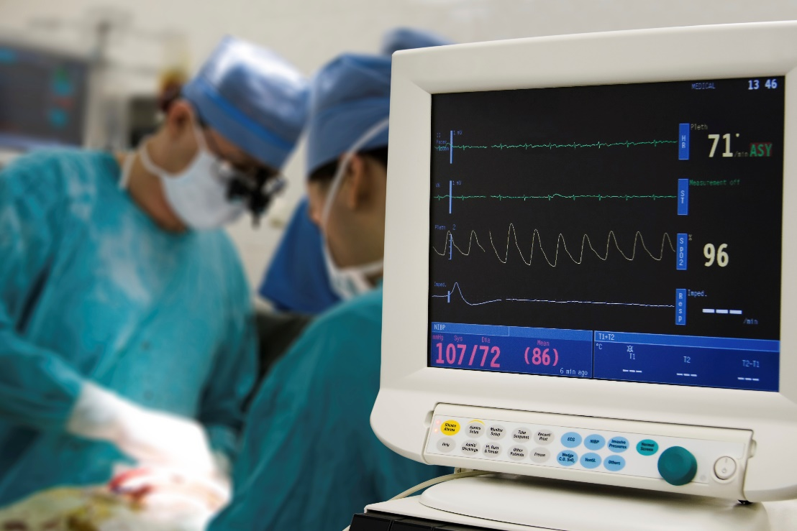
OR in detail - Healthcare
  Moving people through waiting lists as quickly as possible
  Using hospital resources as efficiently as possible
  Increasing the number of transplant operations
Notes:
Please feel free to paraphrase the below:
Some hospitals have dedicated OR teams to help with resource allocation – especially if they have multiple specialities. The OR staff allocate patients, equipment and surgical teams to operating theatres based on the urgency and specific requirements of each patient – some operations need specialist equipment and others do not, and it’s not very efficient to have a ‘general’ patient in a ‘specialist’ surgery.
The OR team have to try and set a schedule, which is made complicated by the fact that how long an operation takes can be hard to predict, and an emergency patient might need immediate attention and throw off the rest of the rota!
OR researchers designed an algorithm to optimise kidney transplant surgery – imagine somebody needs a kidney transplant, and their family member is willing to be a donor, but is incompatible. The algorithm identifies patients in this situation and matches them up so they can swap donors, and both patients receive the kidney that they need.
The surgery has to take place simultaneously to prevent anybody from backing out at the last minute, so the algorithm also has to take into account the nearest hospital with enough resources (theatres and surgical teams) to carry out the transplant when matching patients.

Slide 9
When is OR used?
When a decision is complex or it’s unclear what the main problem is
When you don’t know how well things are working or think they could work better
Notes:
Decision-making and problem-solving in business can be complicated and messy.
It may not be clear what the main problem is, what the outcome of different actions may be, or how well things are currently working, and there may be lots of different factors to consider.
For example, when businesses make big changes, if things don’t go well they might upset customers or slow down production, or staff may need extra training. Any of these could have a negative impact on the business. OR can help to reduce the chances of this happening.

Slide 10
What OR techniques are used?
Simulation is used to try different solutions and answers the “What if…?” question.
Optimisation uses problem solving to achieve the best outcome.
Notes:
Some commonly used OR techniques include:
Optimisation – depending on what variable is most important (manufacturing something quickly, or maximising profit?), optimisation will find the best use of limited resources.
Simulation – this modelling tool is fantastic when there are a lot of different ways to solve a problem as you can try lots of different solutions until you find the best one. It also allows something to be tested in a safe way, for example, organisations like the NHS have to be careful when making changes as lives could be at risk!
Also many more techniques – including algorithms!

Slide 11
















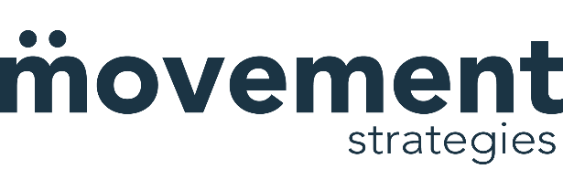











Where can OR take you?
Notes:
Non-exhaustive list of businesses that use OR. Please note they are not endorsed by the OR Society but are designed to show the variety of careers in OR. Feel free to use your own examples if relevant.

Slide 12
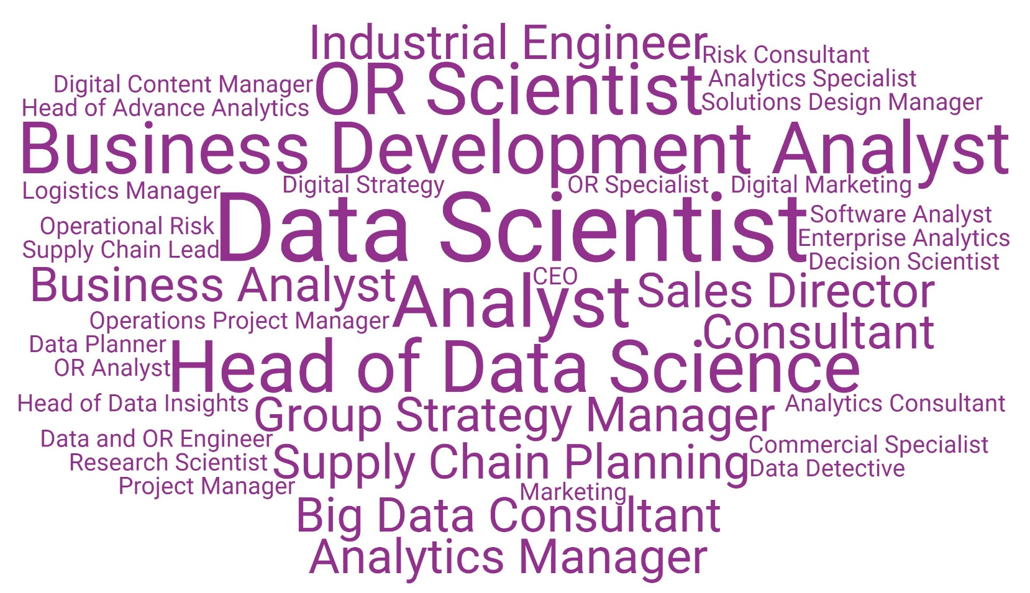
OR Jobs
Notes:
This is a random sample of job titles taken from the OR Society LinkedIn group members. The bigger the job title, the more commonly it appeared. This slide may be helpful in illustrating that a) OR jobs can sometimes be a bit tricky to spot and b) OR jobs are found in all sorts of places.

Slide 13

The OR Society
Student membership is fully subsidised
Thinking of further study?
Apply for our £10,000 master’s scholarship
Thinking of looking for a job?
Attend our Careers Open Day
Notes:
Students can join the OR Society by visiting our website and clicking the ‘join’ button in the top left corner, next to our logo.
Your Student Membership is full subsidised by the OR Society. ( impt. the word free is not used)
Tailored Resources: Access to resources curated for students passionate about OR and analytics. From industry insights to academic support, we've got your back.
Exclusive Opportunities: Gain a competitive edge with exclusive career opportunities and events designed to kickstart your career in OR.
Community and Belonging: Connect with like-minded students who share your enthusiasm for OR and analytics.
Professional Development: Elevate your skills and stay ahead of the curve. Prepare for a successful career in the dynamic field of OR and analytics.
Networking Events: Build a network that lasts a lifetime. -attend exclusive networking events, both virtual and in-person, where you can engage with industry professionals & graduate recruiters.
Our master’s scholarship is worth up to £10,000 and will be awarded to a student starting a masters in OR or a related subject in September 2021.
The Careers Open Day is the only careers fair in the UK with a focus on OR and analytics roles.

Slide 14

Questions

Slide 15
Find out more
www.theORsociety.com
Email: education@theorsociety.com
@ORinEducation @TheORSociety
Notes:
Careers information, OR news and information on free student membership (available for people aged 16+) can be found on our website.

