Slide 1
The Royal Air Force and the Grey Zone: Challenges and Insights
Mr Mike Sinha
Air & Space Warfare Centre UK Joint Force Air Component Senior Operational Analyst

Slide 2
Role & Background
Air & Space Warfare Centre (ASWC) Senior Operational Analyst
Attached to the UK Joint Force Air Component Headquarters (UK JFAC) based at RAF High Wycombe
UK JFAC is a part of 11 Gp (Multi-Domain Operations Group)
Responsibilities include:
Leading UK JFAC Operational Assessment
In Air Warfighting: Systems Analysis focussed and data-driven
Modelling and Simulation support to RAF Operational Decision-Making
Red Teaming/Critical Thinking support to planning
Qualified Air Battle Staff
10 years in post
Computer Science background
Previous Modelling and Simulation role in Dstl

Slide 3
Aims
Outline the issues involved in the (very real) ‘Grey Zone’
Add depth to the theoretical foundations with:
Practical examples
Real-world challenges
Outline potential ways forward
Discuss implications for OR
Caveat: Intentionally avoiding discussing Deterrence as far as practicable
Notes:
Deterrence is an important part of Grey Zone activity, but tends to dominate the conversation and thinking. Behavioural effects in reality are about much more than deterrence.
Questions on deterrence can be taken at the end.
Note that a key insight is that there is one specific circumstance where measuring deterrence is straightforward: When it has happened to us.

Slide 4
UK JFAC Overview
2003 to present: UK JFAC established to provide deployable Operational-level Air Command and Control headquarters
Led by 1*/2* Joint Force Air Component Commander (JFACC)
Warfighting focus
Rotational role as the NATO Response Force Air Component Headquarters
Support to numerous operations
2018: 11 Gp (Multi-Domain Operations Group) established, UK JFAC transferred to 11 Gp
2020-present: UK JFAC supporting Global Routine Operations while maintaining Warfighting capability
“The nature of warfare is evolving constantly and Air Command must adapt and be able to conduct operations across multiple environments or domains, particularly Air, Space and Cyber. The huge amount of data that we collect must be applied with a focused and integrated approach, where intelligence and information activity is incorporated into the planning and execution of operations across the domains.”
Notes:
Quote from https://www.raf.mod.uk/our-organisation/groups/no-11-group/

Slide 5
The Problem Space
Complex world
Global competition
Rapid social, political and economic change
War in Europe
Continual attempts to expand the scope of military activity
Comprehensive Approach, Full Spectrum Effects, Multi-Domain Integration…
Multiple previous attempts without fully gaining traction

Slide 6
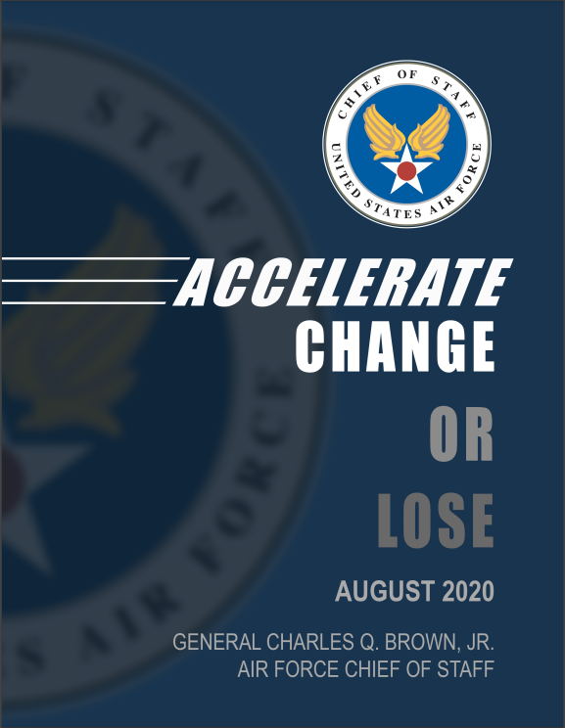
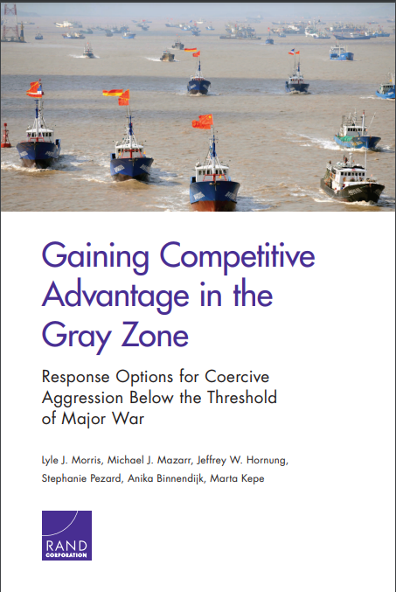
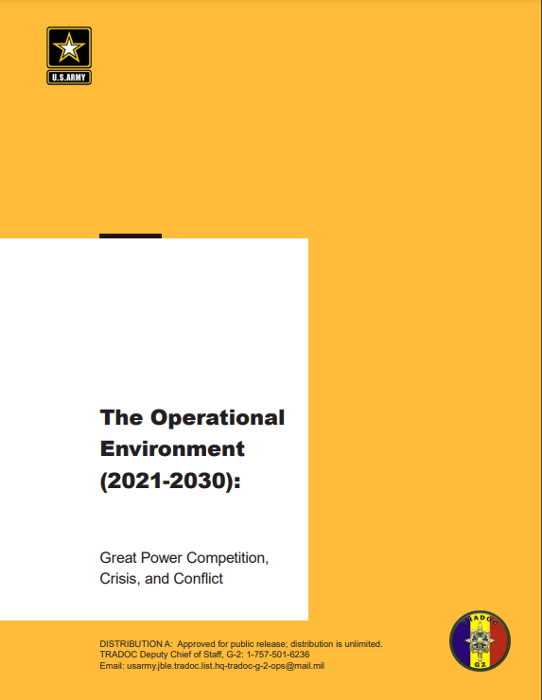
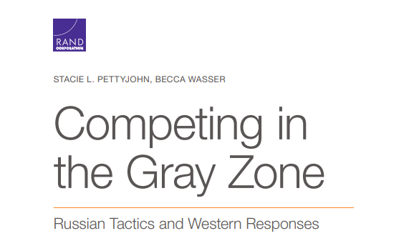
Where are we now? The Theory
Notes:
Growing body of literature – mostly theoretical, directives, frameworks dictating the necessity to adapt to competition and describing the operating environment
Limited literature on how to do competition.
IOpC: https://assets.publishing.service.gov.uk/government/uploads/system/uploads/attachment_data/file/1014659/Integrated_Operating_Concept_2025.pdf
Integrated Review: https://assets.publishing.service.gov.uk/government/uploads/system/uploads/attachment_data/file/975077/Global_Britain_in_a_Competitive_Age-_the_Integrated_Review_of_Security__Defence__Development_and_Foreign_Policy.pdf
TRADOC Operational Environment 2021-2030: https://oe.tradoc.army.mil/2021/10/04/the-operational-environment-2021-2030-great-power-competition-crisis-and-conflict-2/
CSAF Accelerate Change or Lose: https://www.af.mil/Portals/1/documents/2020SAF/ACOL_booklet_FINAL_13_Nov_1006_WEB.pdf
RAND Papers:
Competing in the Gray Zone: https://www.rand.org/content/dam/rand/pubs/research_reports/RR2700/RR2791/RAND_RR2791.pdf
Gaining Competitive Advantage in the Gray Zone: https://www.rand.org/content/dam/rand/pubs/research_reports/RR2900/RR2942/RAND_RR2942.pdf
RAND papers, levels of activity (unit of currency)
Nascent acknowledgement of the reality, while actively participating in it

Slide 7
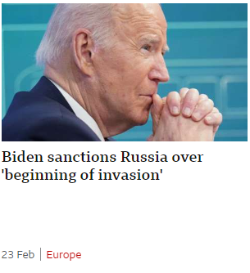
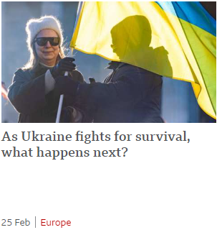
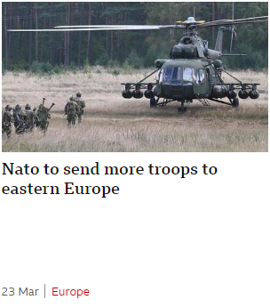
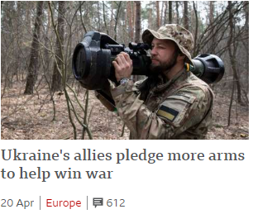
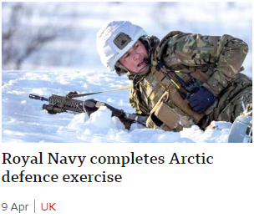
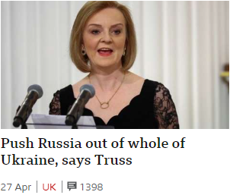
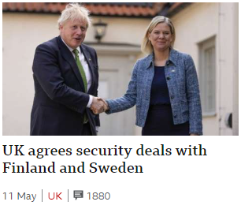
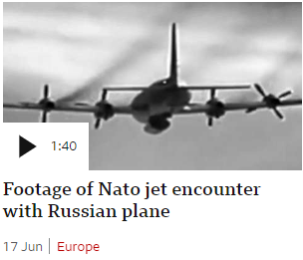
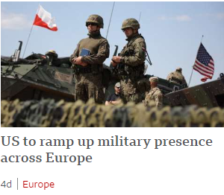
Where are we now? The Reality
Notes:
All snippets copyright BBC.
Examples spanning the full range of Diplomatic, Information, Military, and Economic levers, most examples span multiple levers.
The current reality maps well with the theoretical descriptions. We have a good set of widely agreed and robust descriptions of the operating environment.

Slide 8
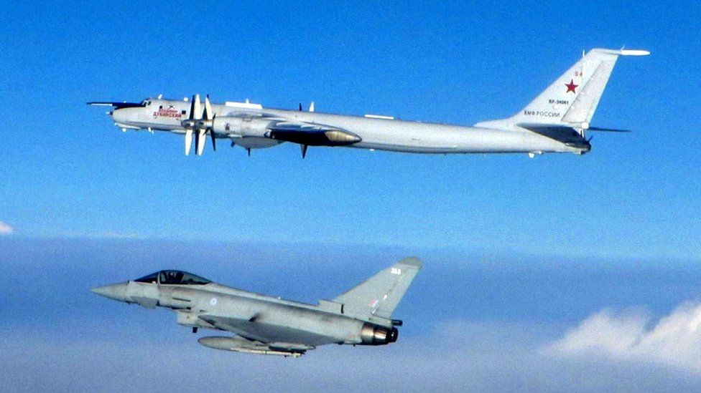
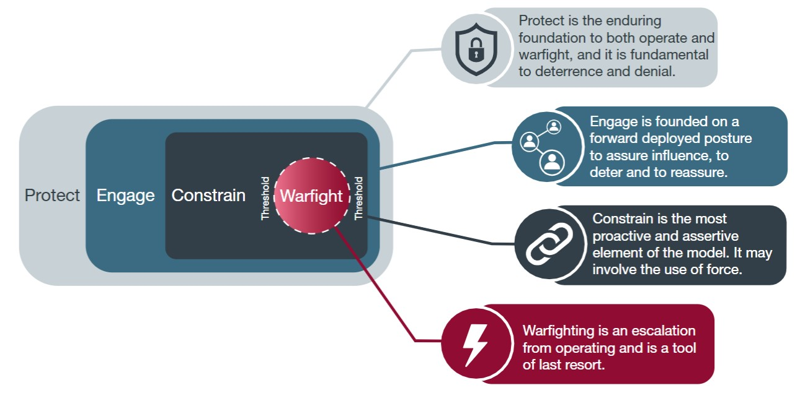
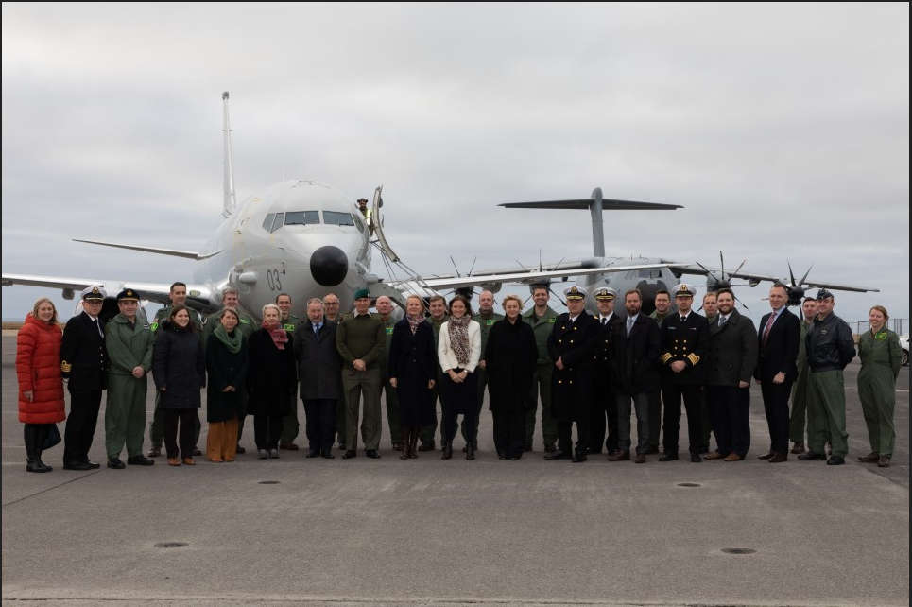
The Integrated Operating Framework
Notes:
Source: https://assets.publishing.service.gov.uk/government/uploads/system/uploads/attachment_data/file/1014659/Integrated_Operating_Concept_2025.pdf
The Integrated Operating Framework is part of the Integrated Operating Concept and describes the types of operations that will be conducted within a sub-threshold environment.
Examples:
Protect – ongoing use of Quick Reaction Alert aircraft to protect UK airspace
Engage – Deployment of P-8 aircraft to Iceland in Autumn 2021
Constrain – Deliveries of weaponry to Ukraine prior to its invasion in Feb 2022
As with the previous slide, these are a useful and valid set of descriptions in reality.

Slide 9
Some Definitions
Systemic Competition
“The intensification of competition between states and with non-state actors… and the testing of the boundary between war and peace, as states use a growing range of instruments to undermine and coerce others” - Integrated Review
Encompasses “Strategic Competition” and “Constant Competition”, describes the strategic environment
The Grey Zone
“[operations that] remain below the threshold of an attack which could have a legitimate conventional military response” – Wikipedia
Describes the military operating environment
Competitive Operations
A term used in to describe operations within the Protect, Engage and Constrain spectrum described in the Integrated Operations Framework
Working term to describe military activity within a Grey Zone/sub-threshold environment
Used to avoid confusion with ‘operate’ in IOpC
Notes:
Competitive Operations vs Sub-threshold operations – sub-threshold carries an implication of being adversary-facing
The verb ‘operate’ is very commonly used in other contexts!

Slide 10
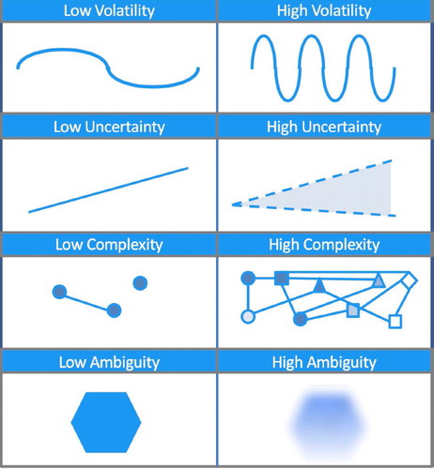
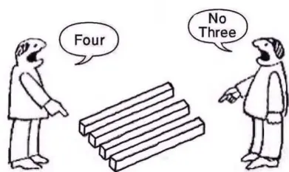
Volatility, Uncertainty, Complexity and Ambiguity
Volatility – how quickly are things going to change?
Uncertainty – how confident can we be in what the future looks like?
Complexity – how difficult is it to understand the totality of the problem?
Ambiguity – how differently can/do people interpret observations of the same issues?
VUCA exists in Warfighting but exists to a much higher degree in Competition
Notes:
Diagram from https://www.tandfonline.com/doi/full/10.1080/2058802X.2021.1894793
Derived from https://www.forbes.com/sites/jeroenkraaijenbrink/2018/12/19/what-does-vuca-really-mean/?sh=6c89585c17d6
Comic from https://lynxthoughts.com/2016/09/06/philosophy-tuesday-102/, original credit unknown

Slide 11
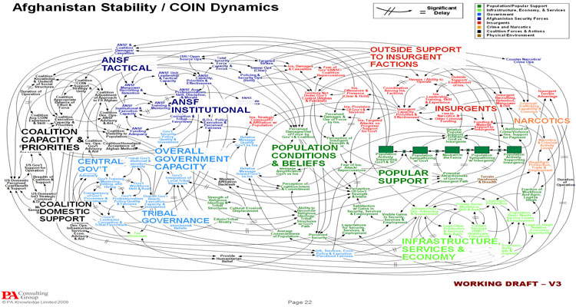
The Challenge of Scope
Building on ideas from Prof Anthony King, KCL:
20th Century warfare primarily a challenge of scale
Scale of forces
Scale of capability
Decisions focused on defeating a force by leveraging scale effectively
Well-defined system boundaries for military tasks
21st Century warfare primarily a challenge of scope
Scope of conflict
Scope of roles inside and outside of conflict
Military Aid to Civilian Authorities, Humanitarian and Disaster Relief, Competition
Decisions often focused on achieving very broad objectives
Poorly defined system boundaries for military tasks
Notes:
https://defenceindepth.co/2018/06/20/the-twenty-first-century-general-from-individual-to-collective-command/
The “McChrystal Spaghetti” (pictured) drew a large amount of criticism in the media, however it illustrates the sheer scope of activity and systems within the operating environment in Afghanistan.

Slide 12
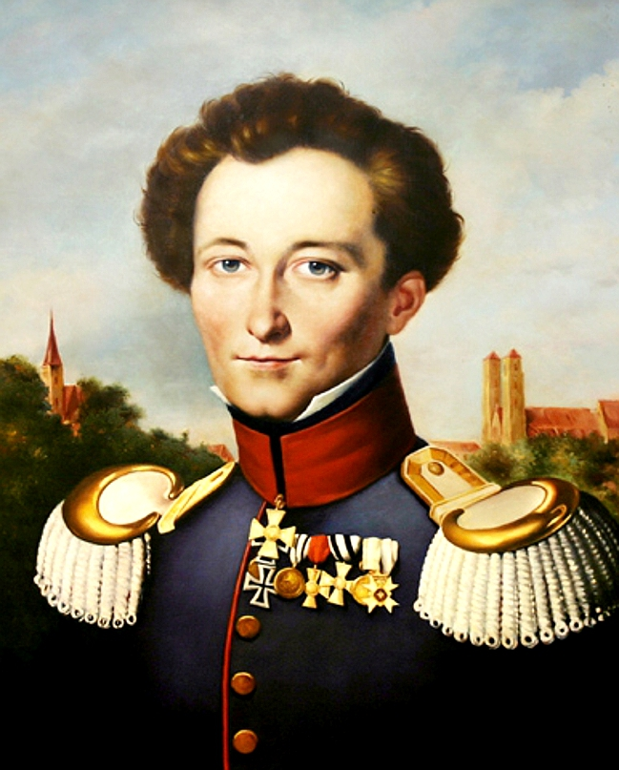
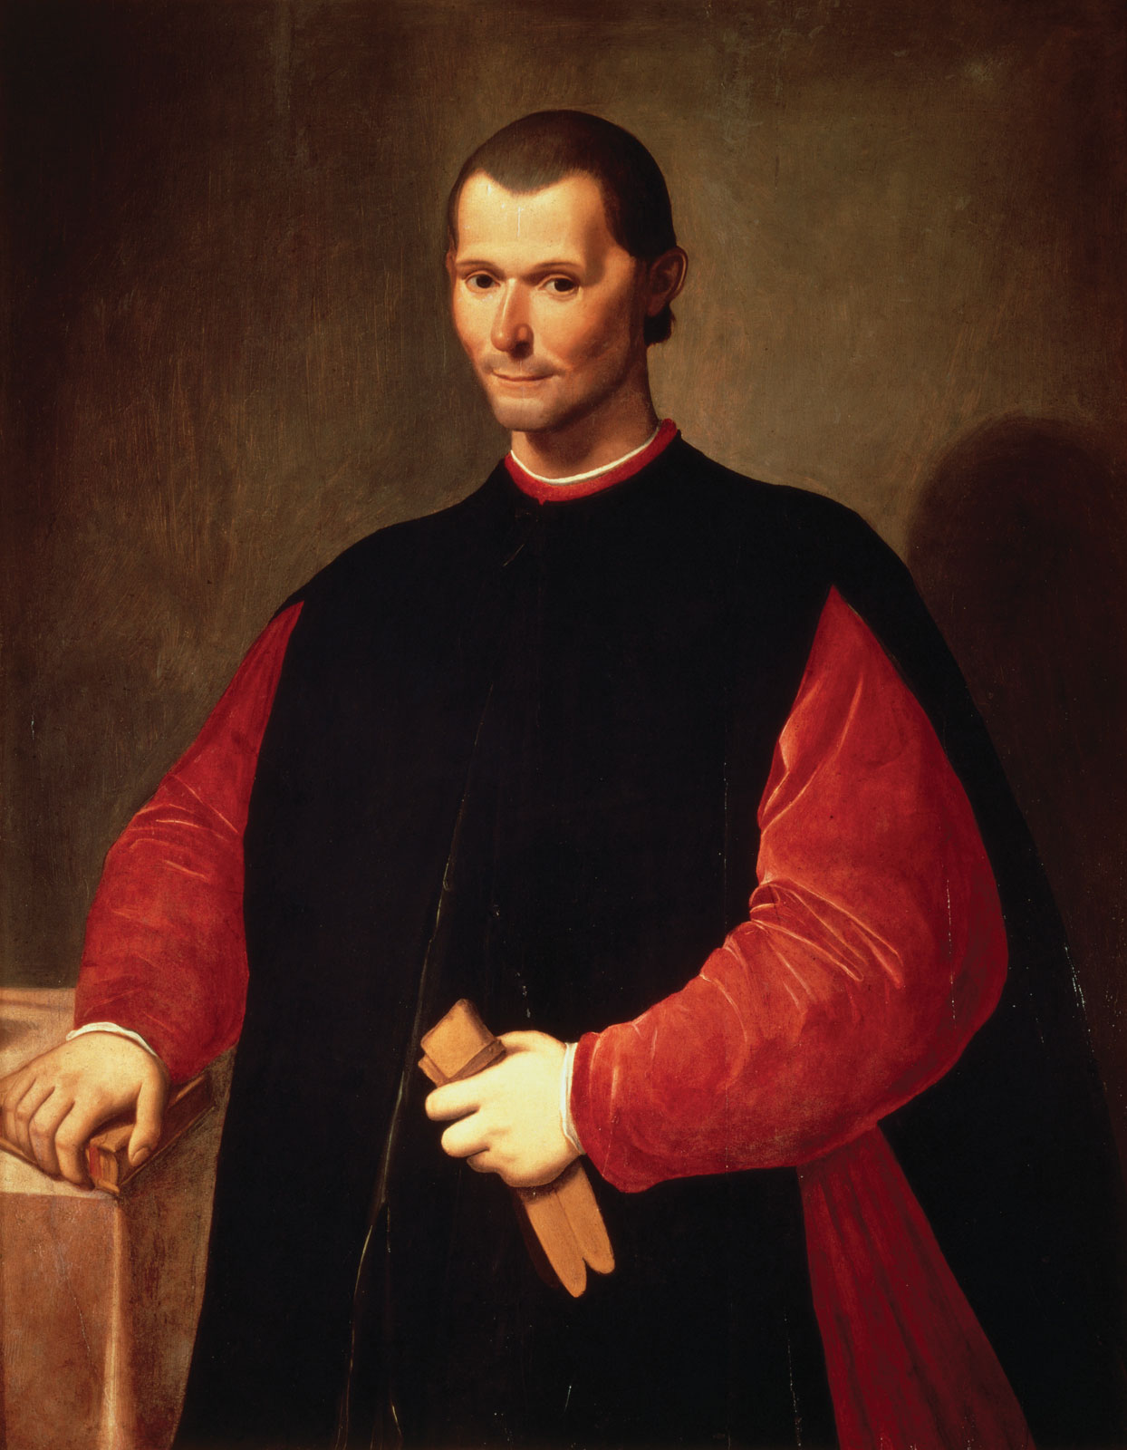
A Difficult Transition: Differing Ends and Ways
“War is thus an act of force to compel our enemy to do our will."
“To achieve victory we must mass our forces at the hub of all power and movement. The enemy’s ‘centre of gravity’”
“Never attempt to win by force what can be won by deception."
“…it is desirable to be both loved and feared; but it is difficult to achieve both and, if one of them has to be lacking, it is much safer to be feared than loved.”
Clausewitz: Perspectives on Warfighting, early Systems Analysis, Statecraft as a superset of war
Machiavelli: Perspectives on Statecraft, political realism, Warfighting as a subset of politics
Not mutually exclusive – both in agreement that war is an extension of politics
Notes:
Image sources: https://en.wikipedia.org/wiki/File:Clausewitz.jpg
https://upload.wikimedia.org/wikipedia/commons/e/e2/Portrait_of_Niccol%C3%B2_Machiavelli_by_Santi_di_Tito.jpg
Note that both “Engage” and “Constrain” indicate a desire to be both “loved” and “feared”

Slide 13
A Dilemma of Means: Swords or Ploughshares?
Tension between Warfighting and Statecraft
Defence’s primary purpose is Warfighting
‘Big ticket’ capabilities, training, equipment currently focussed around Warfighting
Ongoing purpose as a deterrent, very occasional (ideally no) direct use
Defence is very good at this
Defence’s day-to-day is now Statecraft as well as operational delivery and force generation for Warfighting
DIME – Diplomatic, Information, Military and Economic levers
How do we make best use of the ‘big ticket’ capabilities for Statecraft?
What other capabilities do we need to supplement them for Statecraft?
Army Spec Ops Brigade STTTs – equivalents for other domains?
What capabilities provide a high payoff to both Warfighting and Statecraft?
How can we ensure forces can efficiently and rapidly adapt to both?

Slide 14
Effects-Based Operations (EBO) and Competition
“Effects-based operations (EBO) are defined … as operations conceived and planned in a systems framework that considers the full range of direct, indirect, and cascading effects—effects that may, with different degrees of probability, be achieved by the application of military, diplomatic, psychological, and economic instruments” – Paul K Davis, EBO: A Grand Challenge for the Analytical Community
Banned by Gen James Mattis in 2008
“All operating environments are dynamic with an infinite number of variables; therefore, it is not scientifically possible to accurately predict the outcome of an action.”
Personal view:
Disagree with Gen Mattis’ statements as universal
EBO applies and works very well specifically in an Air warfighting context
Highly technologically-driven form of warfare
Capability focused, with greater predictability and reliability
Agree with Gen Mattis in all other cases I can think of
The more a given effect relies on or affects human thought and behaviour, the less predictable and reliable it is
‘Agency problem’ in next slide
Notes:
First definition is more specific than other definitions available
RAND/Paul K Davis paper: https://www.rand.org/content/dam/rand/pubs/monograph_reports/2006/MR1477.pdf
Gen Mattis paper on EBO: https://apps.dtic.mil/sti/citations/ADA490619 or https://smallwarsjournal.com/documents/usjfcomebomemo.pdf

Slide 15
Problem Statements
An attempt to ‘diagnose’ issues arising from Competitive Ops, spanning inherent conceptual challenges to environmental constraints
Aspects of VUCA contribute to these problems (usually more than one)
List below is not exhaustive
Contribution Problem
Many disparate actors working towards a goal
How do you know what to adjust if you can’t ascertain your contribution?
Decidability Problem
EBO and the presumption of certainty - capability vs capability
EBO and well-defined system boundaries and states vs Competition with poorly-defined system boundaries and states
Countability Problem
Subjective information dominates – sensitive to interpretation, context and bias
Analysis Paralysis Problem
Difficulty in structuring non-linear complexity with linear Warfighting approaches
Feedback Delay Problem
Audience impacts can take time to observe, how do you use feedback to support upcoming activities?
Initiative Problem
Under the Rules Based International System (RBIS), we will tend to be reactive by default, while most military activity is proactive by default
Escalation Problem
Defaulting to risk-aversion when activity could be perceived as escalatory
Agency Problem
Adversary’s vote
Notes:
Contribution Problem – e.g. NATO expansion with Sweden and Finland
Overlap with the concept of ‘gestalt’ in Psychology
Feedback Delay Problem – may contradict previous activity
Escalation Problem – Responses will tend to be sub-optimal when the ‘red lines’ for escalation are unknown
Agency problem – The ability to resist a kinetic effect is contingent on the capability to do so, the ability to resist an information effect can be based on conscious choices

Slide 16
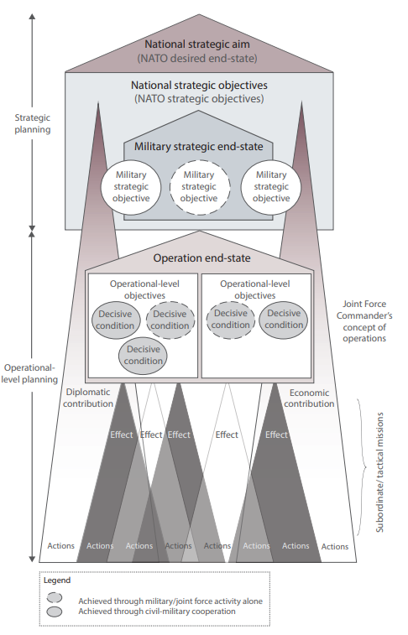
Current Lessons and Approaches
Accepting, acknowledging and working with uncertainty
Soft OR methods (Scenario development, Soft Systems Methodology…)
Greater use of abductive logic in Assessment
Target Audience Analysis (TAA) in lieu of EBO
“Defined Problems” as an intermediary between TAA and activity
EBO is favoured because of the clear logic from high-level strategy to tactical activity
Current approaches with TAA do not have the same level of natural logic
Characterising activity as Persistent, Moderate, Assertive
Rethinking the planning lexicon
End-States to Desired Narratives
Decisive Conditions to Desirable Conditions

Slide 17
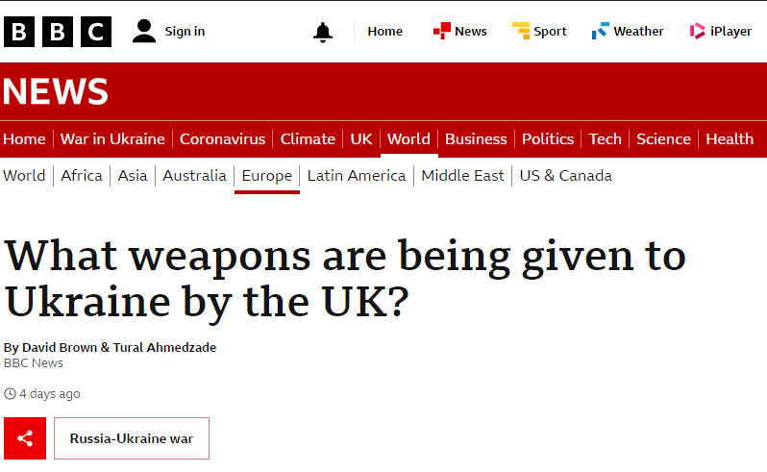
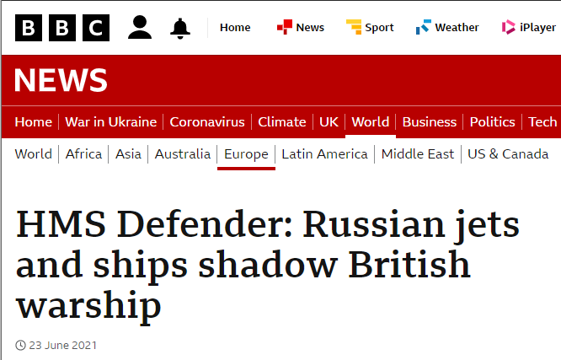
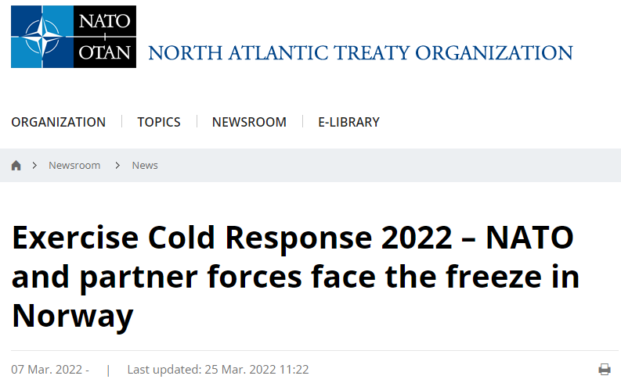
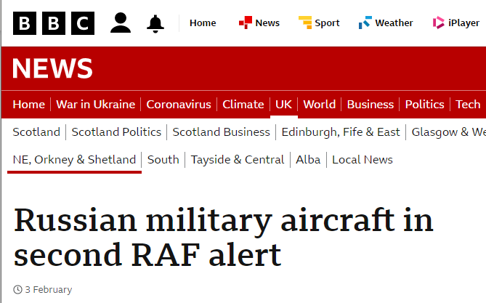
Example Insight: Currency of Competition – Levels of Activity
Level | Characteristics | Examples | PECF Focus
Assertive | Significant direct actions intended to achieve specific adversary-focused effects. | Delivery of anti-tank weapons to Ukraine prior to its invasion by Russia in early 2022. NATO Enhanced Vigilance Activities in response to the Ukraine Crisis. | Constrain
Moderate | Direct, focused actions intended to reinforce or deliver specific messages or achieve specific effects. | Freedom of Navigation activity conducted by HMS Defender in the vicinity of Crimea in Summer 2021. Large, pre-planned multi-domain Allied exercises such as Ex COLD RESPONSE. | Engage, Constrain
Persistent | Low-level routine actions to reinforce standing strategic messages, or to contribute to sustained Shaping operations. Routine defence of the UK, its Overseas Territories, and NATO. | UK involvement in US Bomber Task Force exercises in the UK and Europe. The contribution of UK Quick Reaction Alert (QRA) to Op CONSTANT EFFORT and other NATO Air Policing missions. | Protect, Engage
Notes:
News snippets copyright BBC and NATO
Levels of activity represent a spectrum rather than distinct categories.
Builds on the RAND Grey Zone paper, acknowledging that our activity can also be categorised.
Supplements Protect, Engage, Constrain with an additional dimension of assertiveness.
Provides a useful guideline for planning and describing activity.

Slide 18
Where Should We Be?
Develop Defence’s understanding of Competitive Ops to the same level as Warfighting
Pan-DLOD Capabilities
Doctrine
Planning tools
Training & education
Understanding Allies and Partners to the same level as our adversaries
Maintain a Warfighting capability while delivering against Competition
Both specialised and generalised – an appropriate mix
Notes:
Note that UK JFAC’s current position is a microcosm of the wider problem faced by Defence

Slide 19
Recommendations for Defence
Acknowledge and explore the similarities and differences between Warfighting and Competitive Ops
Training and education to develop a Competition mindset
While maintaining linear systems analysis understanding for Warfighting
Long-lead development and experimentation with:
Conceptual planning (low risk)
Operational activity (higher risk)

Slide 20
So-What for OR?
Competitive Operations highlight new challenges and opportunities for both Defence and OR
The increased demand for Soft OR is there, but will take time to be truly understood within Defence
The relevance of Systems Analysis expertise has increased in Competitive Ops
The relevance of Hard OR is currently decreased in Competitive Ops
The relevance of Hard OR for Warfighting remains extant
The relevance of Hard OR may increase as the understanding of Competitive Ops matures
Abstract “sense-making” is critical to Competitive Ops – processing large volumes of subjective information
Many opportunities for Problem Structuring Methods due to disparate, novel and complex problems
Identifying, articulating and mapping complexity via OR approaches can mesh well with military approaches

Slide 21
Any Questions?
“How we live is so different from how we ought to live that he who studies what ought to be done rather than what is done will learn the way to his downfall rather than to his preservation.”
“The enemy of a good plan is the dream of a perfect plan.”

