Slide 1
Soft OR in NATO Concept Development
Achieving Analytical Rigour and Political Consensus
Nick Rose
HQ SACT CAPDEV / REQS / OA Branch
Overall Classification: NATO UNCLASSIFIED RELEASABLE TO FINLAND & SWEDEN

Slide 2
Summary
Who am I?
NATO & concept development
What an analyst does
Soft OR supporting the Concept Development process

Slide 3
Who am I?
Business cases & approvals management
Studies: modelling & simulation, soft OR
Risk analysis & management
Cost estimation & analysis
Producing & delivering training courses
Notes:
OR / OA consultant for 10 years
BAE Systems
Dstl
NATO Communications & Information Agency
DE&S
NATO ACT

Slide 4
NATO
Defensive political-military alliance of 30 (soon 32) Nations
Formed in 1949
Organization(s) to facilitate & deliver political & military direction
Deterrence & defence
Crisis prevention & management
Collective defence & security
Notes:
What is NATO
Collection of 30 (32?) nations
The organizations that facilitates & delivers the shared political / military direction
Political
Military / Operational
Military / Futures
Strategic concept: deterrence & defence, crisis prevention & management, collective defence & security

Slide 5
NATO Concept Development
A NATO concept is an “agreed notion or idea (…) that provides guidance for different working domains and which may lead to the development of a policy”¹
Protection of Civilians Concept
Concept for Counter Terrorism
Framework Nations Concept
NATO Security Force Assistance Concept
Future Mission Network Concept
Enabling Coherent Deterrence Concept
1 – AAP-6; 2 – MC 0583;
Notes:
Definition: or “solution-oriented transformational idea that addresses a capability shortfall or gap”
[Narrative] Purpose is to change how the Alliance and military force structures deliver our core tasks.
Strategic Concepts contain political or high-level politico-military assessments, objectives, and guidance. They outline NATO’s purpose, nature, and fundamental security tasks and identify central features of the security environment and provide guidelines for the adaptation of its military forces10. A strategic level concept will typically influence force development and employment, provide a broad description of military activities across significant portions of the spectrum of operations, and describe what is required to meet strategic objectives.

Slide 6
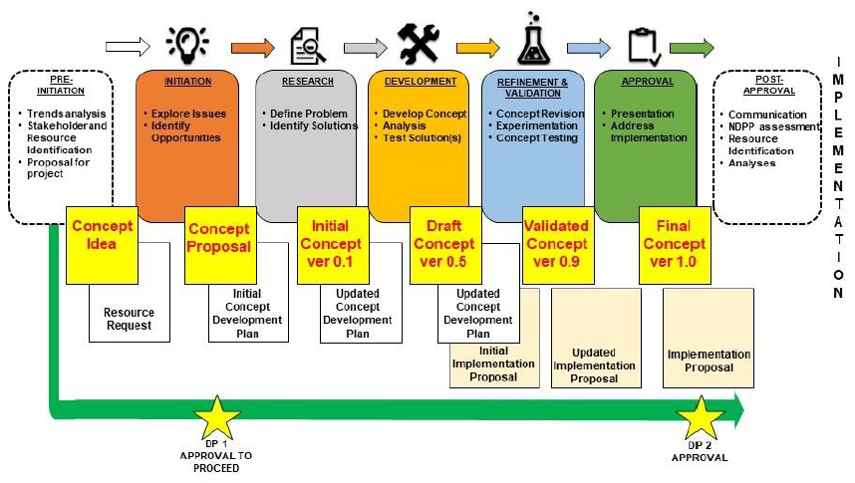
NATO Concept Development

Slide 7
Concept Development Challenges
Clarity
Strength of buzzwords over clear vision
Politics
Everyone has an opinion, and almost anyone can cause problems
Where does the concept stop?
Some people, organizations, Nations have clear(er) visions
The right answer vs the acceptable answer
Notes:
Strength of buzzwords over clear vision
Where does the concept stop?
Clarity that this is about the scope
Everyone has an opinion, and almost anyone can cause problems
MC approval, however will take National direction (sovereignty of National decisions)
Current centers of power
Making change in NATO is a more small-p-political problem than hierarchical
Some people, organizations, Nations have clear visions
These inevitably don’t align
The right answer vs the acceptable answer

Slide 8
Analytical Support
Planning & execution
Knowledge gathering, synthesis, exploitation
Supporting the political process
Notes:
A large part of NATO concept development is stakeholder engagement
Gaining knowledge of problem & solutions
Understanding the (small-p) political environment
Preparing the battlespace

Slide 9
Example Soft OR Techniques
 | Starbursting | DLoD Gap Brainstorm | 6 Thinking Hats | SWOT Brainstorming | Debate | MoSCoW
Description | Generate questions | Identify changes needed | Consider different perspectives | Assessment of options | The classic: for & against the motion | Prioritization: Must, Should, Could, Won’t
Analytical benefit | Divergence Success criteria! | Divergence Solution options Bottom-up assessment | Divergence Reducing groupthink | Divergent-convergent Refining analysis | Convergence Structured logical arguments | Convergence Lists of priorities
Human benefit | Expose worries | Build enthusiasm for tangible change | Appreciating others’ POVs Permission to be negative | Appreciating others’ POVs Require objectivity | Appreciating others’ POVs Explore true vs convincing | Compare & contrast Basis for compromise

Slide 10
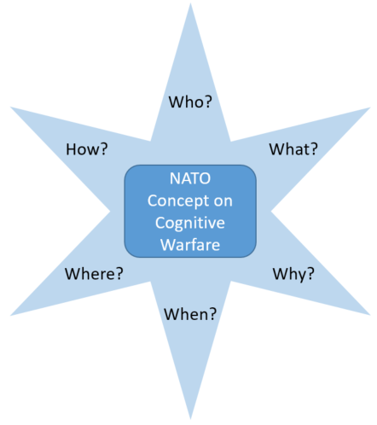
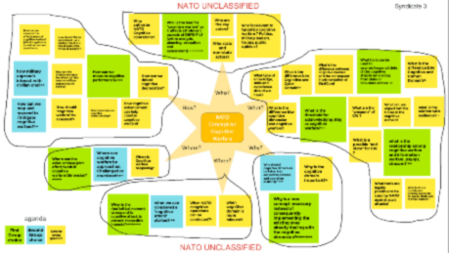
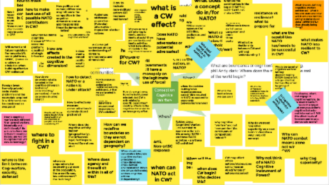
Starbursting
I Keep six honest serving-men:
(They taught me all I knew)
Their names are What and Where and When
And How and Why and Who.
Rudyard Kipling, The Elephant’s Child, 1902

Slide 11
6 Thinking Hats
Consider the problem from different perspectives:
factual, emotional,
creative, controlling,
optimistic, judgmental.
Permission to be negative
“They are wrong and I have to tell them” – adversarial
“They are wrong, and want my help to change” – collegial
De Bono, E. (1985). Six Thinking Hats. London: Penguin Books.
Notes:
Facial feedback & affective experience

Slide 12
MoSCoW
Prioritize requirements for a specified task:
Must
Should
Could
Won’t
Everyone sees & understands each others’ priorities
Clarity & transparency
Sincerity
Setting expectations
By U.S. Department of State - Russia, Public Domain, https://commons.wikimedia.org/w/index.php?curid=105454511

Slide 13
The Analyst
One of the team
SME advisor
Mentor & guide
Facilitator
Notes:
Guide: like a safari guide – eat those berries, but not these. The animals you want to see are usually over here (similarly: not always there, but often).
Facilitator: event group facilitator, but also more like a “fixer” – someone who can get stuff done. Military Engineer: when you arrive at a gorge, we look at the gorge, evaluate whether it is crossable (in time to meet the CO’s objectives), and set up the bridge. Run out of water – we find a way to get new, clean water.

Slide 14
Conclusions
Outcomes, not outputs
Be political (when appropriate)
Use named ‘techniques’
Balance analytical rigour & managing persuasion

Slide 15
Soft OR Resources in NATO
SAS-087 Code of Best Practice Judgement-Based OA in Defence Decision Making
COBP for analysts
Guide for clients / users
NATO Alternative Analysis (AltA)
21 ‘soft’ OA / OR techniques with detailed guidance
Openly available (online) handbook
Training courses for NATO MIL / CIV at NATO School Oberammergau

Slide 16
Questions?

Slide 17
Backup Slides

Slide 18
Vignette Assessment
What
When
“I know it when I see it” – Justice Potter Stewart, 1964
Problem is intuitively known, but hard to describe
Why
Outcome
Stakeholder priorities
Understand red lines
Outsource analysis
Anger, bargaining, acceptance
Discussions: similarities, differences, why
Notes:
Remember the battle of buzzwords vs. clear vision?
Well, what is “Cognitive Warfare”? Can we say, specifically what it is, and is not?
Initially: annoyed! “It depends!” Cool, what does it depend on?
Later: compare & contrast – valuable discussion through different views?

Slide 19
Starbursting
What
When
I Keep six honest serving-men:
(They taught me all I knew)
Their names are What and Where and When
And How and Why and Who.
Rudyard Kipling, The Elephant’s Child, 1902
Early problem scoping
Why
Outcome
Understanding stakeholder concerns
Non-judgemental space
Success criteria!
Lists of questions
Themes

Slide 20
DLoD Gap Brainstorm
What
When
Assess DLoDs (TEPIDOIL / DOTMLPFI)
Brainstorm necessary changes to achieve desired end state / vision
Early in process: solution-focused thinking
With “tame” stakeholders who understand current system
Why
Outcome
Revealed preferences
Some people favour theory, others practical specifics
Many tactical change proposals
Themes: current constraints & changes needed
Notes:
Solution-focused thinking: diving into detail and then raising back up to strategic level

Slide 21
6 Thinking Hats
What
When
Consider the problem from different perspectives: factual, emotional, creative, controlling, optimistic, judgemental
When group-think is likely OR very divergent stakeholders
Highly emotional views
Why
Outcome
Give permission to have feelings
Consider opposing POVs
Problem considerations
Changed group dynamic

Slide 22
SWOT Comparisons
What
When
Consider Strengths, Weaknesses, Opportunities & Threats
[+ action plan for exploitation / mitigation]
Stakeholders understand the problem and potential solutions
Why
Outcome
Outsource detailed analysis
Structured space for expertise & deep knowledge
Integrate multiple POVs
Multiple prioritized requirements

Slide 23
Structured Debate
What
When
Debate club!
For & against motion: time to prepare, speak & rebut
Judge / panel
Common language
Stakeholders have a good understanding of the problem
Two strong camps who cannot compromise
Why
Outcome
Give time & space to prepare logical, evidenced arguments
Entertainment & managing energy
Prepare for external challenges
Logical, evidenced arguments

Slide 24
MoSCoW
What
When
Must
Should
Could
Won’t
Prioritize requirements for a specified task
Problem & potential solutions are well-understood
Well-bounded question
Why
Outcome
Stakeholder priorities
Understand red lines
Outsource analysis
Set(s) of prioritized requirements

