Slide 1

Updating the Helmbold
Land Battle Database
Paul R. Syms, Dstl Platform Systems Division
39th International Symposium on Military Operational Research
DSTL/CP142393
Notes:
Abstract
The Helmbold Battle Database, last revised in 1991, is the still the standard open resource for analysing high-intensity land combat. It is used to address questions of attrition and advance rates, and to understand the drivers of success in battle. The database was implemented in Excel, and describes 660 battles from 1600 to 1982. It used 205 data fields per battle, many of which were partially populated, or unpopulated. However, while its shortcomings have been known for many years, it has not recently been cleaned or updated. The author has started the process of checking the data against published sources, filling in the missing data fields where possible, exploiting new historical research published since 1991. Best estimates have been provided where no information was found. New data points have been added to balance the database, to increase the representation of under-represented nations and wars, and particularly, to add more post-Second World War conflicts. The revised database describes 770 battles from 1600 to 1999, and the structure has been simplified to 83 data fields per battle. It is the author's intention that the revised battle database will be updated periodically, and that it will be made openly available through the ISMOR website.

Slide 2
Topics
Background to the Helmbold Database
Project aims
Data sources
Data additions and deletions
Revised database characteristics
References

Slide 3
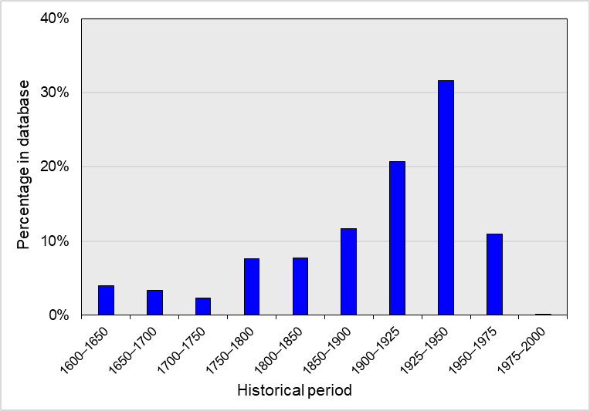
The Helmbold Land Battles Database
A database of high-intensity land (later land-air) battles for analysis
  which side wins, and why?
Compiled by T.N. Dupuy’s HERO (now TDI) for US CAA, 1980s
Included forces, environments, driving factors, durations, and outcomes
  losses on each side, distances advanced
660 battles from 1600 to 1982
  up to 205 fields describing each battle
    many optional, and partially populated
  dominated by WW1 and WW2
Last version CDB91G released in 1991
WW2
WW1

Slide 4
Background to the updating project
Parallel UK and US HA in 1990s, used different battle data sets
  David Rowland’s DOAE data
  Goodman & Young (1996) CORDA database
Dstl received Helmbold CDB91G in 2007
First aware of Helmbold problems from Rotte and Schmidt (2003)
  shortcomings described by Biddle (2008) and Syms (2009)
Helmbold and CORDA data used together in a 2013 Dstl study
  post-WW1 data points combined to analyse effects of force ratios
  many lines deleted because of incomplete or inaccurate data
Similar data sets requested on many occasions since

Slide 5
Project aims
Making the data more relevant to HA in the 2020s
  following recent Dstl project experience
Improving confidence in the data
Completing the data with estimates, to avoid wholesale deletions
Adding data fields where needed
  following recent experience of where we needed more data
Improving data transparency
  recording assumptions and data sources
Improving formats and readability
  spreadsheets have improved since 1991!

Slide 6
The aims in practice
Simplifying the data structure
  focusing on the most useful data fields, discarding some others
Adding detail on casualties and losses
Adding some new data points where needed
  improving historical ‘balance’, e.g. on Russia, and post-1945 conflicts
  adding some post-1982 battles
Cleaning the existing data
  filling data gaps, revising data, removing duplicates, correcting typos
Exploiting data sources published since 1991

Slide 7
Data sources
Much pre-1900 data was from Bodart (1908)
  a book of data cataloguing statistics for ≈1400 battles, 1619–1905
  now available online at gutenberg.org
Purchased Clodfelter’s (2002) ‘Warfare and Armed Conflicts’
  a monumental data compilation from 1500–2000
  also Smith (1998) on the Revolutionary and Napoleonic Wars
Post-1991 research in Russian archives
  e.g. David Glantz et al., and Soviet losses data book by Krivosheev (1997)
More official histories published, in paper and online

Slide 8
New data fields
Terrain split into relief (ground form) and ground cover
  climate types clarified using the Köppen-Geiger system
Battles flagged as either ‘Full’ or ‘Part’
  where a ‘Part’ battle is a component of another ‘Full’ battle
An ‘echelon’ field added for attacker’s and defender’s command level
  allowing (for example) divisional attacks to be selected for analysis
Losses split into KiA, WiA, and PoWs
  insufficient data for a separate MiA category
  MiAs added to KiAs or PoWs using best estimates

Slide 9
Other data fields simplified
Start date and duration replaces Helmbold’s start and end dates
  greatly simplifies analysis and data cleaning
    Helmbold’s end dates had the most errors of all fields
All conditional data fields have been removed
  near-impossible to use for analysis
  participant numbers now always the maximum present on each side
Battles phases have been removed
  were never used for analysis, as far as is known

Slide 10
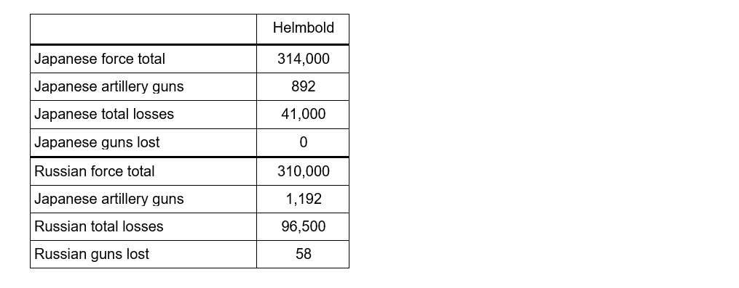
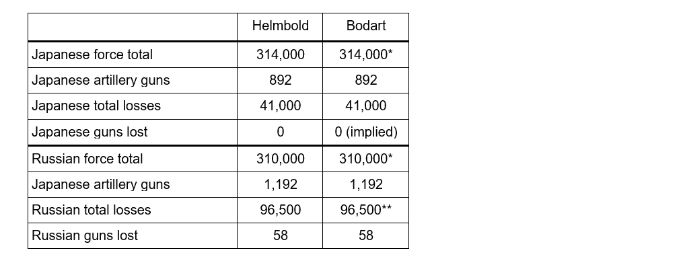
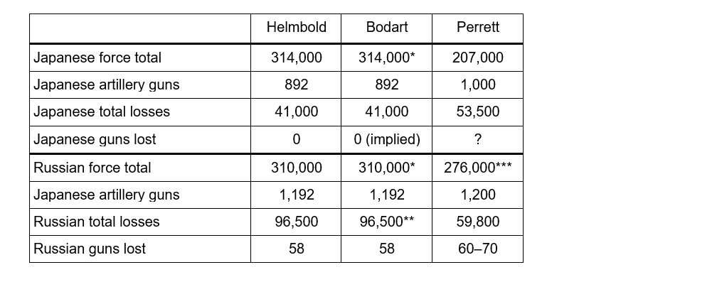
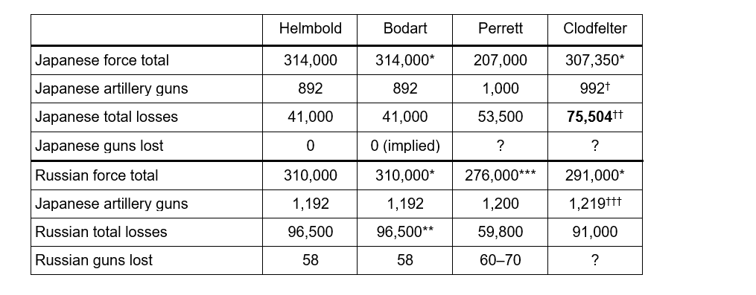
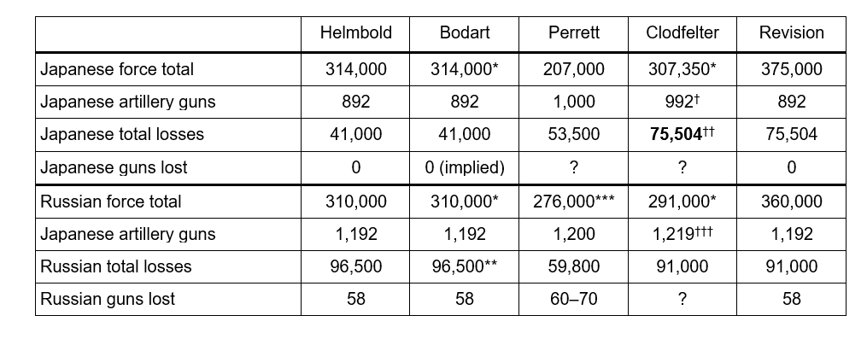
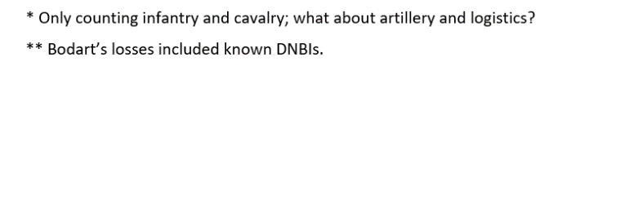
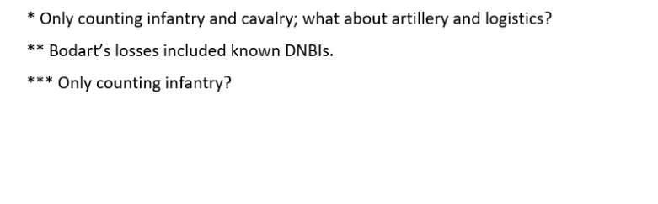
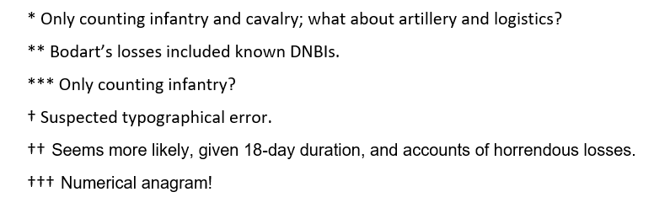
Numbers and battle losses example
Battle of Mukden (now Shenyang; 1905), Japanese attacked Russians

Slide 11
Some new battles added
More battles involving Russia through the ages
7 more from the Second Boer War, 1899–1902
  a good ‘anchoring point’ for modern battle studies
Early WW2 battles, to balance the preponderance of 1944–45
Korean War increased from 11 to 24 data points
  many were ‘quick wins’ from Dstl’s Cirsium data provision for HQ ARRC
Vietnam War increased from 1 to 16 data points
21 new data points from 1975 to 1999
  Falklands, 1982; Grenada, 1983; Panama, 1989; Gulf War, 1990–91; etc.

Slide 12
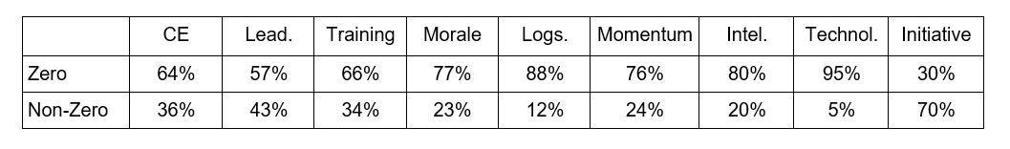
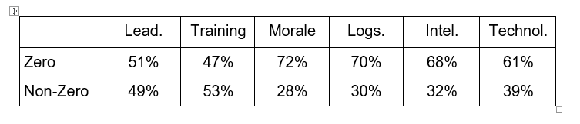
Revising the qualitative data fields
Nine data fields described qualitative factors affecting battles
  only populated for 95% of battles, of which …
Six qualitative data fields remain in revised database
û
û
û

Slide 13
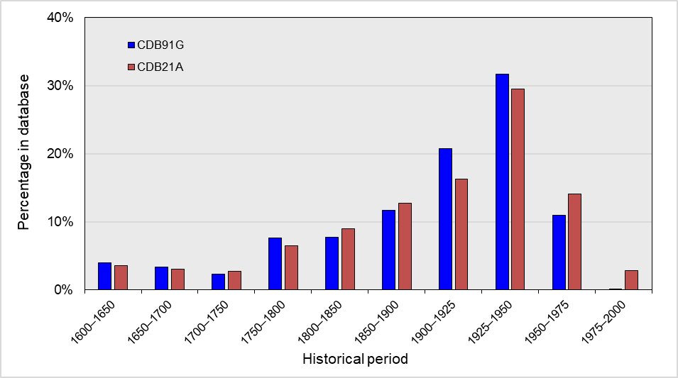
Revised database characteristics (1)
Now contains 770 battles from 1600 to 1999

Slide 14
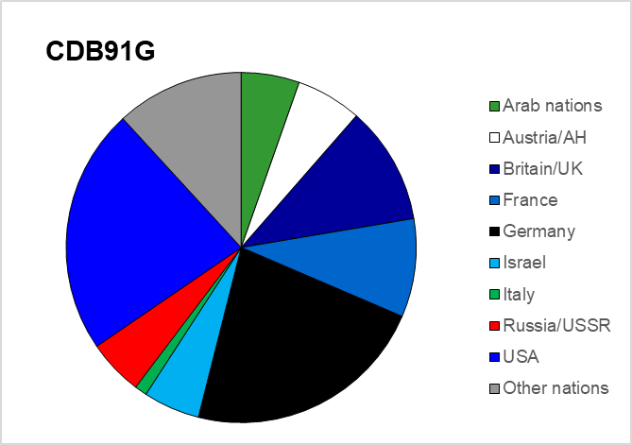
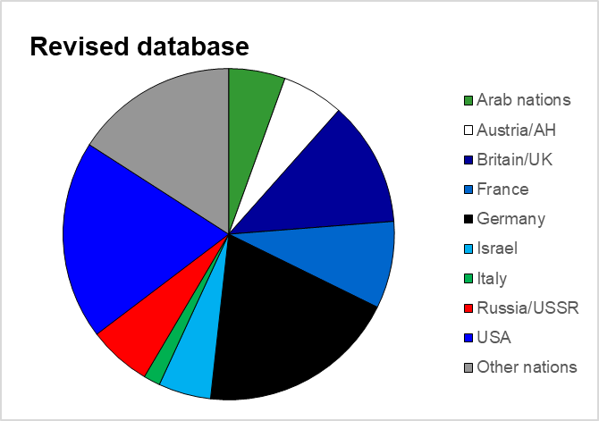
Revised database characteristics (2)
Shifts in representation of different nations, from all periods
Others
+4.1%
USA
–3.3%
Germany
–3.0%
Russia
+1.0%

Slide 15
Conclusions
Increased confidence in data quality
Improved balance, and representation of post-WW2 conflict
  the period of greatest interest to MoD
Already used in three HA studies
  casualty rates and battle durations at different echelons
  effects of artillery support on battle outcome
Intention to make database available for academic study
  e.g. researching the drivers of ground conflict outcome
May the new analysis of battle begin!

Slide 16
References
BIDDLE S.D. (2004) ‘Military Power: Explaining Victory and Defeat in Modern Battle’ Princeton University Press, Princeton, NJ: 337 pp.
BODART G. (1908) ‘Militär-historisches Kriegs-Lexikon (1618–1905)’ C.W. Stern, Vienna and Leipzig: 956 pp.
CLODFELTER M. (2002) ‘Warfare and Armed Conflicts: A Statistical Encyclopedia of Casualty and Other Figures, 1500–2000’ 2nd. Ed., MacFarlane & Co. Inc., Jefferson, NC: 840 pp.
KRIVOSHEEV G.F. (ed., 1997) ‘Soviet Casualties and Combat Losses in the Twentieth Century’ Translated by C. Barnard, Greenhill Books, London: 290 pp.
PERRETT B. (1992) ‘The Battle Book: Crucial Conflicts in History from 1469 BC to the present’ Arms and Armour Press, London: 349 pp.
ROTTE R. & SCHMIDT C.M. (2003) ‘On the production of victory: empirical determinants of battlefield success in modern war’ Defence and Peace Economics 14(3): 175–192
SMITH D.G. (1998) ‘The Greenhill Napoleonic Wars Data Book’ Greenhill Books/Lionel Leventhal Ltd., London: 582 pp.
SYMS P.R. (2009) ‘A critical evaluation of the Helmbold battle database’ Presentation to the Historical and Operational Data and Analysis Symposium, Farnborough, 22 April 2009 (U)

Slide 17
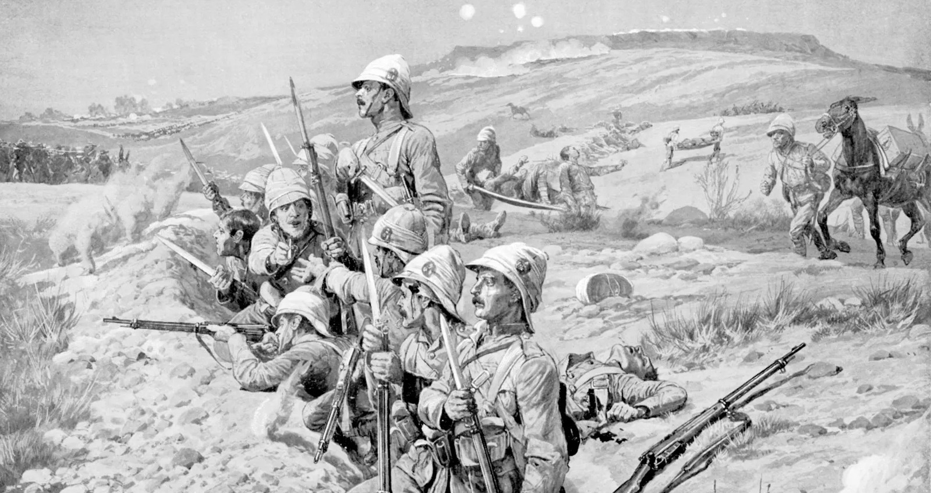
Questions?

