Slide 1
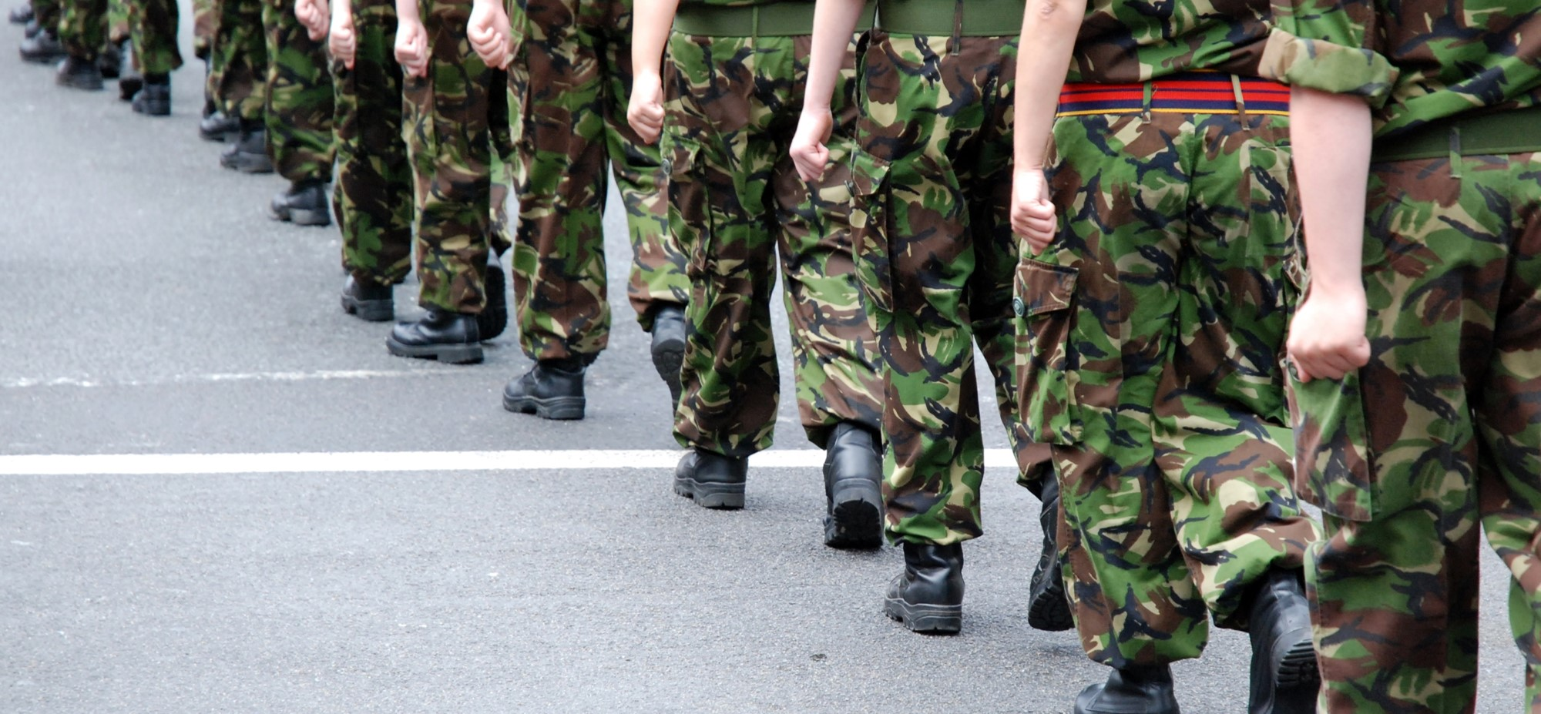
Analysing and exploiting data from Wargaming: Supporting Force Optimisation and Warfare Development Priorities
Jason Potter
Senior Consultant, CORDA, BAE Systems

Slide 2
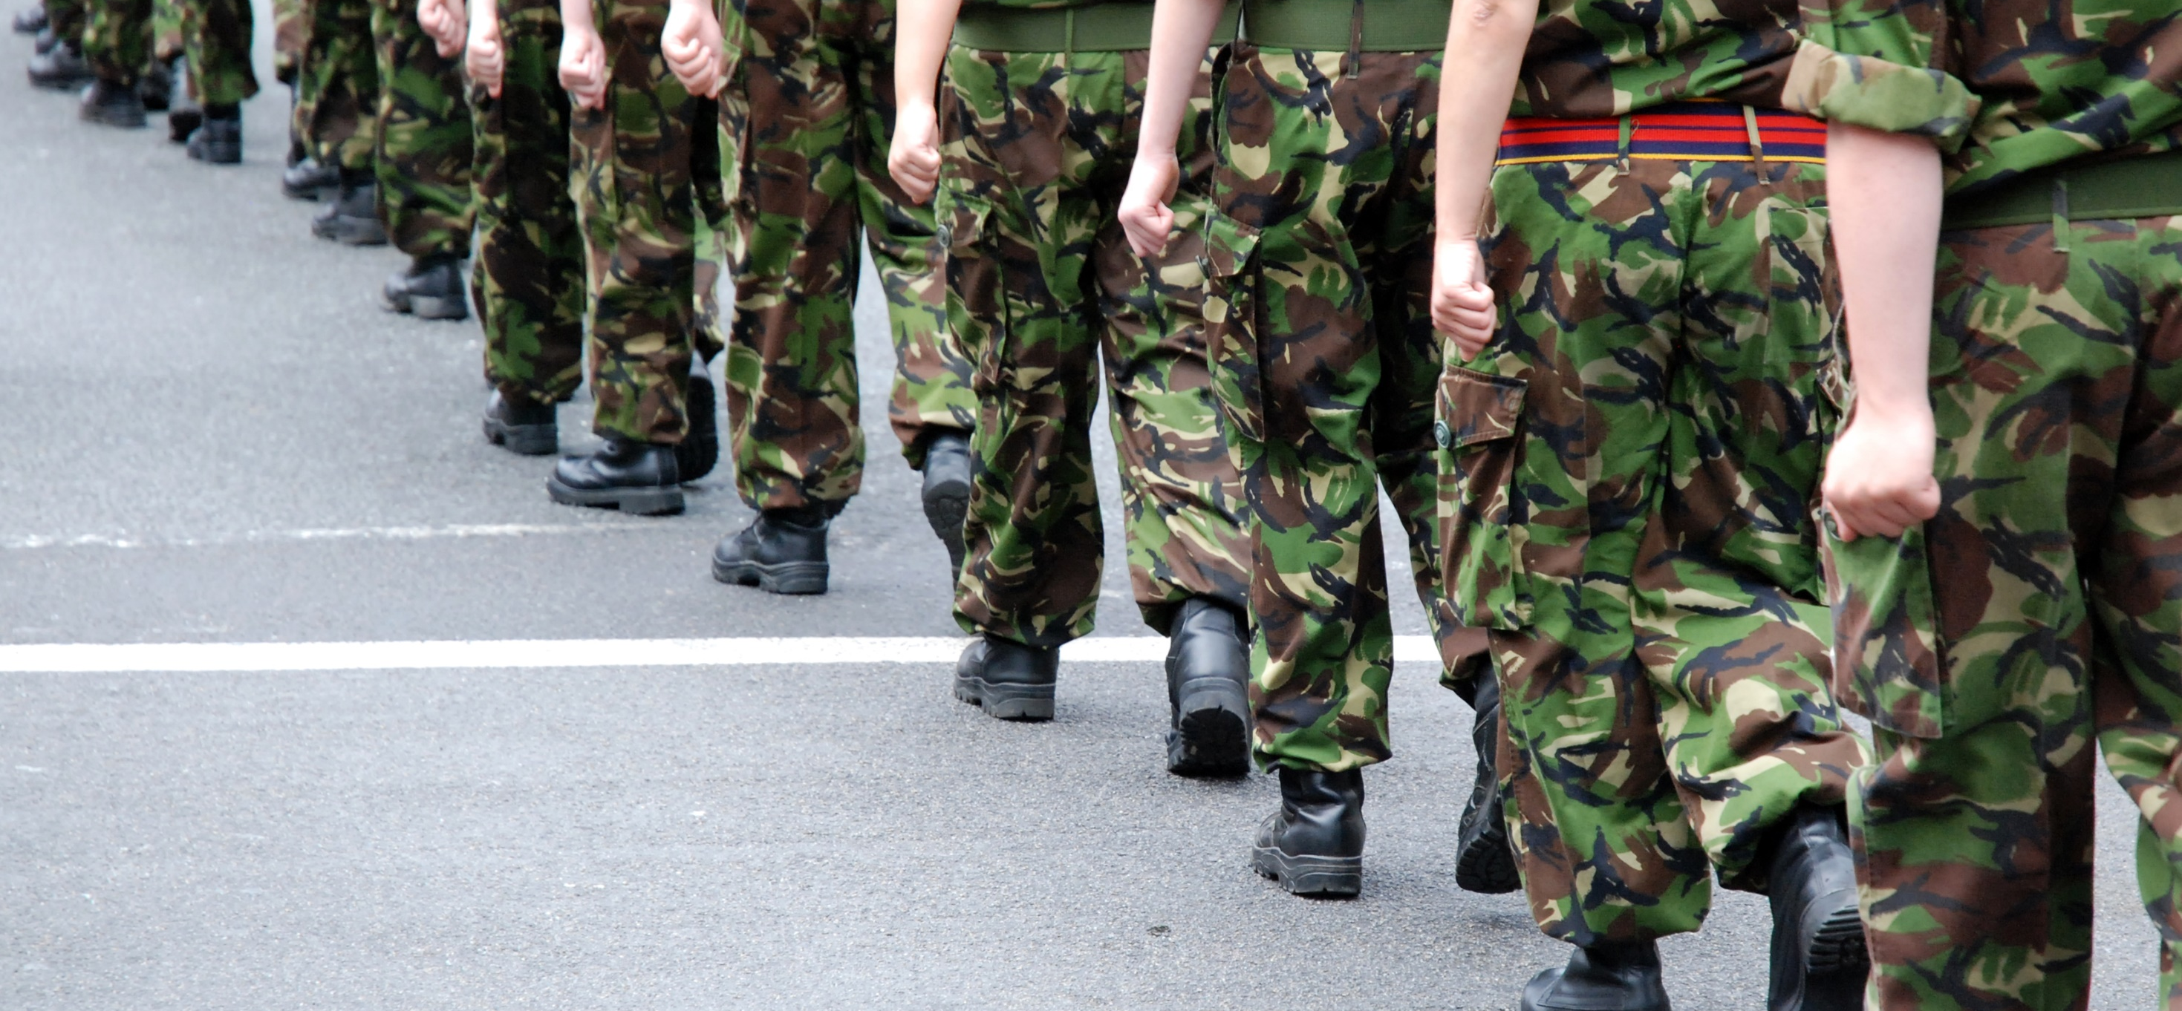
Analysing and exploiting data from Wargaming: Supporting Force Optimisation and Warfare Development Priorities
Jason Potter
Senior Consultant, CORDA BAE

Slide 3


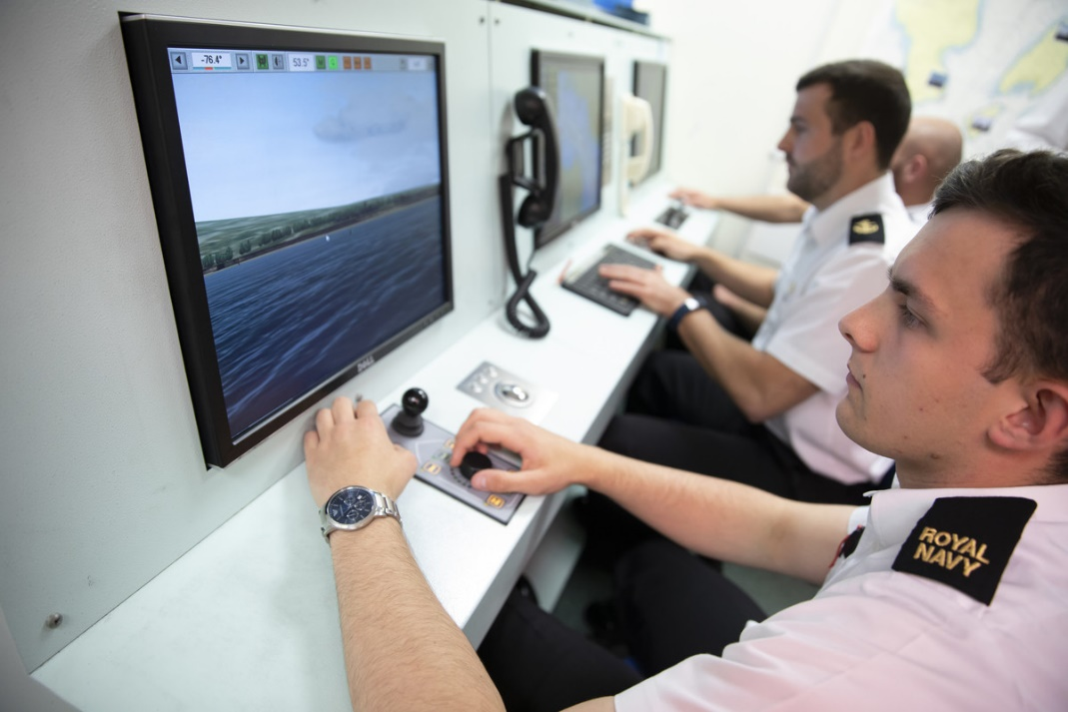
What is wargaming?
‘A simulation, by whatever means, of a military operation involving two or more opposing forces, using rules, data, and procedures designed to depict an actual or assumed real life situation.’

Slide 4
Force optimisation and warfare development
Force Optimisation
Optimizing for a task - how are we using our resources?
What do our forces need to perform at their highest capacity?
Warfare Development
Managing Change in organizations, approaches…
Preparing for Future Combat Environments

Slide 5


Example scenario
Customer: The Empire
Wargaming Programme: Storm Trooper Forces and Capability
Work Package: Assess the effectiveness of completing routine and contingent tasks for the 68th Legion
Vignette 1 : “Business as usual”
Vignette 2 : Some Rebel Activity - localised
Vignette 3 : Some Rebel Activity – localised + Introduce the new Light Saber V2.0
Scenario
Tatooine (Desert Planet)
Desert Terrain
Peacetime
Local Hub 5 Light Years away – Death Star
V2.0

Slide 6
Choosing the wargame type
Facilitated Study
Exploring a new or novel idea by undertaking an evidence/literature review, facilitating a structured workshop, or exploring the modelling/analysis of the idea.
Intention is to better understanding of the area around the idea and pave the way for further exploration.
Table Top Exercise (TTX)
Assess a capability area by using a scenario context to play test different UK ‘Blue’ Force Optimisation options against an adversary red force.
Allows participants to formulate master questions and challenge current capabilities in a realistic context.
Wargame (The Full Deal)
Purpose is to gain a detail understanding of a capability area by using a “Scenario-based warfare model in which the outcome and sequence of events affect, and are affected by, the decisions made by the players” – DCDC, Red Teaming guide 2013.
Able to test and explore a problem space in full, utilizing data to understand outcomes with an inclusive set of rules.

Slide 7
Who attends?
Forces
Representatives from capability team
SMEs / Industry experts
Representatives from other relevant capability teams
Representatives from further afield (Navy, NATO, US…)
Facilitators
Scenario Designer
Sponsor / Command
Analysts / Scribes

Slide 8
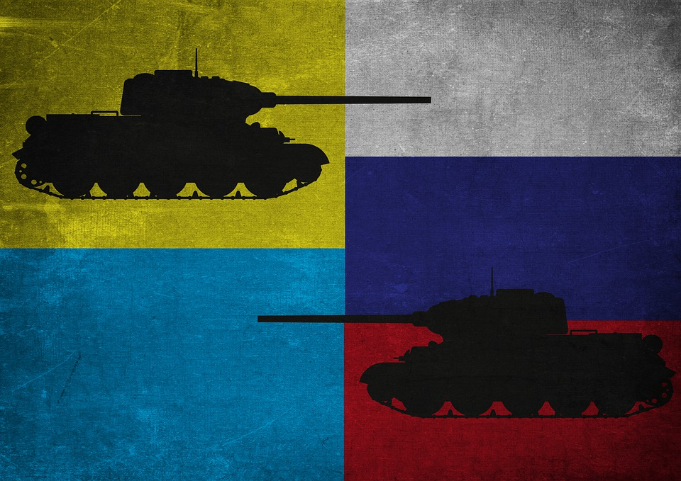
Remaining agile in our approach
TTX
TTX
TTX
Study
TTX
Wargame
TTX
TTX
Wargame

Slide 9

Key research questions (themes) for analysis
RQ1 – Command. What part should commanders based in the Death Star have in relation to the deployed land forces activity?
RQ2 – Inform. How should commanders, staffs and force elements the 68th Legion access relevant and timely information and intelligence to ensure plans and activity are effective?
RQ3 – Prepare. How should the 68th Legion generate force assets?
RQ4 – Project. How are the 68th Legion deploying their assets?
RQ5 – Operate. What should be the Death Stars’ role in planning and executing operations?
RQ6 – Protect. What should be Death Stars’ role in force protection?
RQ7 – Sustain. What should be Death Stars’ role in sustaining deployed forces?

Slide 10
The CORDA IAECP
Integrated Analysis and Experimentation Campaign Plan
The IAECP will set
The CORDA overview approach for ensuring an efficient and insight driven Wargame Programme.
Making the programme efficient: Ensures an Integrated and Coordinated set of Wargaming Activities – defining any linkages, dependencies, shared areas of interest.
Cost effectiveness: develops an understanding of which Force Optimisation themed activities are related and potentially sharing information, design material.
Value: at the programme level – What does this actually mean?

Slide 11

Conclusion of the wargame
Light Saber v2.0 – Game changer
Following the IAECP:
Where else could this be applied, do we need to adapt our programme or further challenge this conclusion?
What have we learnt about this capability, which information needs to be shared to support other work packages?
How does this influence our programme’s goals? How do we best deliver this finding in our output’s and deliverables in order to have an impact?

Slide 12
Thank you for listening, any questions?

