Slide 1
Air Defence: Finding a needle in a Hungarian haystack
(or why Air Defence doesn’t have to be exhausting)
Will Jones
Andy Nye

Slide 2
Initial problem
ADCIT - Air Defence Capability Investigation Tool
High level exploratory model to show analysts where to focus
Permutations of shooters, threats, waves, concurrent scenarios
Exhaustive search (we think!)
Long run time – impossible to analyse new policy

Slide 3
Basic problem – Supply and Demand

Slide 4
Basic problem – Supply and Demand
6
7
5
Cost = £18

Slide 5
Basic problem – Supply and Demand
6
8
12
4
7
8
7
2
5
Cost = £16

Slide 6
Hungarian algorithm
Combinatorial optimization algorithm
It was developed and published in 1955 by Harold Kuhn (based off original work of two Hungarian mathematicians: Dénes Kőnig and Jenő Egerváry).
Polynomial O(n^3)

Slide 7
Hungarian algorithm (example)
Step 1: Subtract row minima
Step 2: Subtract column minima
45 | 66 | 69 | 75
20 | 88 | 30 | 4
17 | 49 | 50 | 34
23 | 66 | 47 | 1
Step 3: Cover 0s in fewest lines. If line count n < matrix size N go to Step 4, else go to Step 5
Σ=114
Step 4: Subtract smallest uncovered element from all uncovered elements and add smallest uncovered element to all double covered elements. Go to Step 3.
N=4
Step 5: Identify set of Zeros (one per row and one per column). Replace with original values.
-45
0 | 21 | 24 | 30
16 | 84 | 26 | 0
0 | 32 | 33 | 17
22 | 65 | 46 | 0
0 | 0 | 0 | 30
16 | 63 | 2 | 0
0 | 11 | 9 | 17
22 | 44 | 22 | 0
+2
0 | 0 | 0 | 32
14 | 61 | 0 | 0
0 | 11 | 9 | 19
20 | 42 | 20 | 0
-4
-2
-2
-2
-17
+2
-1
-2
-2
-2
-21
-24
n=3
n=4
Notes:
Hungarian Algorithm:
Subtract row minima
Subtract column minima
Cover 0s in fewest lines. If line count n < matrix size N go to Step 4, else go to Step 5
Subtract smallest uncovered element from all uncovered elements and add smallest uncovered element to all double covered elements. Go to Step 3.
Identify set of Zeros (one per row and one per column). Replace with original values.

Slide 8
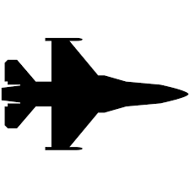
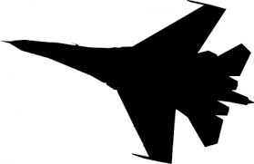
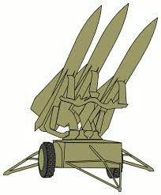
Initial Air defence problem

Slide 9
Multiple shooters at same threat
What if it is a wave of 4 fast jets?
1 SAM unit can engage 1, but what about the rest?
Partial coverage of the threat
Coordination between defensive units
Similar units
Dissimilar units

Slide 10
Problem
If Shooter A engages first then…
But if Shooter B engages first then…
Solution
Create Child tasks

Slide 11
Approach
For each wave decide what the optimal first engagements are

Slide 12
Approach
Then create child tasks, dependent on first engagements

Slide 13
Approach
Delete the engagement chains that have changed and start again

Slide 14
Infinite loops
In complex scenarios when deleting old engagement chains and creating new ones it is possible to get into an infinite loop
Stop the routine and take the highest score within the loop

Slide 15
Results
2,675 time faster
…and that was only because the original code couldn’t run more complex concurrency sets
Usually same result
Occasionally slightly worse, infinite loops, rounding errors
…but in some cases better – so what was the original code doing?

