Slide 1
Operator in the Loop Simulation for Experimentation
Presented by Joshua Ellington & Harvey Williams
Contribution from William Brown & Adrien Sellar
Notes:
MBDA have an OITL Facility called FOX Combat Flight Simulator.
It has a long history particularly for Air-to-Air Combat modelling
Much of this presentation is based on learnings from using FOX for Experimentation

Slide 2
Contents
Definitions:
OA & Experimentation
OITL Simulation
Planning
Delivery
Analysis
Summary

Slide 3
What is Operational Analysis at MBDA?
“PRE-CONCEPT”
CONCEPT
…
ASSESSMENT
DEMO
IN SERVICE
Future Environment
Operational Views
System
Trade-offs
Mid-life Development
Capability Needs
CONEMP
Survivability
Target Set
Vignettes
Weapon
Mix
Export
System Definition
System
Evaluation
Battlespace Integration
Notes:
Operational Analysis activities tend to be weighted towards the front end of the CADMID cycle
Many of our activities happen in a “Pre-concept” phase – an exploratory phase that tends to precede a formal Concept Phase
Many of these activities are then repeated with new context for mid-life development, spiral upgrades or export opportunities.
The purple boxes represent activities we typically use experimentation to assist with

Slide 4
What is Experimentation?
Structured Interaction with the User
5 Principles for Experimentation:
Mutual Benefit
Customer Focus
Challenge Culture
Efficiency / Agile
Integrated Approach
Notes:
In this context, we have 5 principles to experimentation within MBDA, but I feel these can be summarised in just three words:
Structured
Must be designed in such a way to illicit a particular outcome
User
Must involve a two-way exchange of information and learning with the User/customer and designers
Interaction
Requires an engaging, interactive element to ‘bring the problem to life’ and foster creativity and new thinking

Slide 5
What is an Operator-In-The-Loop (OITL) Simulator ?
A model or simulation which is coupled to human input.
Necessary when
(1) Behaviour cannot be simply determined in advance.
(2) Interaction of humans & model is most important ‘learning’ outcome.
(3) Reactions of the modelled system to human decisions is a key.
(4) Development of, or, Training humans with high-risk technology.
Challenges
How to accurately represent the problem; how to interpret results.
Notes:
there are some problems where we simply don’t know the best tactics to code into non- OITL model. Air air is a very complex space. Trade between repeatability and dynamic exploration of tactics and interaction of complex systems of systems.

Slide 6
OITL Simulator Use
PLANNING
DELIVERY
ANALYSIS
Technical
Objective
Live Analysis
Technical
Outcome
Operator Training
Fit For Purpose ?
Operator In The Loop Simulator
Data
Extraction
Build &
Config
Operator Behaviours
Data
Analysis
Validate & Verify
Notes:
Operator Simulator can be described in 3 distinct phases
Planning and preparation for the events, including both an event itself and the people, software, facilities, data that is required
Delivery of the event itself, including appropriate review and validation
Analysis post-event and the mechanisms to extract value from an event

Slide 7
OITL Simulator Use
PLANNING
DELIVERY
ANALYSIS
Technical
Objective
Live Analysis
Technical
Outcome
Operator Training
Fit For Purpose ?
Operator In The Loop Simulator
Data
Extraction
Build &
Config
Operator Behaviours
Data
Analysis
Validate & Verify
Notes:
Operator Simulator can be described in 3 distinct phases
Planning and preparation for the events, including both an event itself and the people, software, facilities, data that is required
Delivery of the event itself, including appropriate review and validation
Analysis post-event and the mechanisms to extract value from an event

Slide 8
Planning – Technical Objectives & People
Experienced Operators
Data Analysts
OITL Community
Analyst Operators
Model & Data Providers
Trial Coordinators
Developers
Stakeholders
Team and Roles
Aims and Objectives
Experiment Design
Build & Document
Deliver
Fit For Purpose Review
Notes:
People
People are at the heart of experimentation and involving the right people is key to successfully deriving value from an activity
Perhaps the most obvious is people involved in the event itself (flying virtual cockpits) and the analysts scoping the activity
However, there are many additional stakeholders and data providers to be considered
Who is validating your assumptions?
Where are your models and input data coming from?
Who is your customer(s)? What do they want?
Key that operators can think outside current tactics - a real challenge with OITL
Objective Setting – This is a process we have found helpful as part of planning OITL Experimentation:
Starts with the people – clearly identify names individuals for key roles
Work with the trial customers and simulation environment team to clearly define objectives
These must be something answerable with the data, people and facilities available
Design an Experiment that will fulfil the desired aims and objectives and provide answered to the desired question
Requires iteration
Document the plan, assumptions, data so you have a record of what you have done
Peer review and gain senior endorsement for the activity through a Fit for Purpose Review

Slide 9
Planning – Build & Configure
How
What
Real-time
Models
Platform
Blue
Sensors
Weapons
Agile
Environment
Red
PVI
Training & Behaviours
Notes:
Talk generically about the elements of the sub-system models
Real-Time Models → As the OITL software is real-time, explain how only a sub-set of the real-world engineering behaviour can be re-produced. There are lots of assumptions, these need to be explained to the operators and stakeholders, and the ultimately questioned as we address whether the study is helping us understand the problem we are trying to solve.
Agile-Environment → This speaks to the cadence of the experimentation activity, and in what level of detail we can verify and validate the implemented models. Rather crudely, if the model is very simplistic, verification and validation should not dominate the process in which human exploration of the behaviour is most important.
Sensors → RADAR / Imaging / Track Generation
Platform → Manoeuvrability / Thrust / Signatures / Data linking / Mass
Weapons → Propulsion / Aerodynamics / Guidance / Seeker / Mass
PVI → How pilots best use the information they are shown
Red/Blue → Talk about the need to model in some level of detail both sides of the operation. Models are sometimes best use to describe generic or “Class of” behaviour.
Training & Behaviours → Talk bout how the pilots are trained on expected behaviours of expert operators, however, behaviours required to use in-service equipment might be the same as those for future equipment, so observed behaviour is an important outcome.
External models or data representing the above systems are integrated into the simulation environment

Slide 10
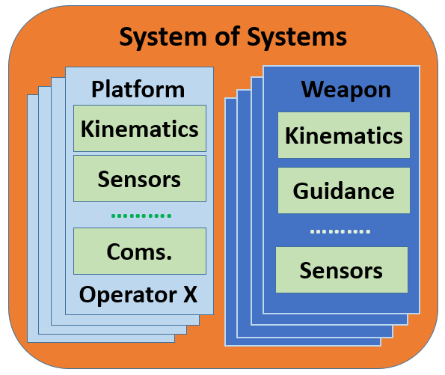
Routes to Verification and Validation
Sub-model development and testing
Automated system testing
Live Exploratory Testing
Post-flying Data Mining
Notes:
Talk about
1) How sub-models are developed based off inputs from domain experts in Aerodynamics, propulsion, radar system, mechanical and sensors.
2) How, in the case of concepts, there is often nothing to directly validate. However, for existing commercial products, reference models of the systems exist which we can validate against
3) We will talk about Four types of Software Testing
(i) Automated system testing. This uses highly structured script-based machine-driven response to specific areas of interest. This typically involves testing the specific behaviour of specific components/sub-systems of the model within the context of the whole software. E.g. (Kinematics, communications, sensors, weapons) often have relatively simple models which can be used to validate the system models in very simplistic scenarios. This VERIFIES the software.
(ii) Live Exploratory Testing. We will link here to the theme of Exploratory Testing: (see https://en.wikipedia.org/wiki/Exploratory_testing ), and
describe how Exploratory Testing is a well understood method from the non-defence world of Software Testing, which relies on only setting high-level objectives, and leaving the low-level objective to be determined by the informed responsible tester (e.g. the Operator Pilot). This looks at:
→ How Exploratory Testing combines learning about the System (Experimentation) with Software Test Design and Execution.
→ How a key objective of this approach is to catch un-expected behaviour, and that this approach can be more efficient than standardised testing, allowing spontaneous response.
(iii) LIVE exploratory testing. This describes a subset of Exploratory Testing, where in real-time, multiple intermediate variables describing the sub-system behaviour are available to the Experiment Overseer to un-unsual behaviour can be quickly identified.
(iv) Post-Flying Data Mining. A key feature of the OITL simulator is that all outcomes and intermediate variables are recorded This describes the after-the-fact analysis of these “recordings”, to identify repeated outcomes across multiple experiments. → Will Link to Josh saying more about this in his slides on “Analysis”. This tool is useful for investigating, addressing and identifying learning effects in the Operators; variability in individual operator behaviour; and groups behaviours, in addition to looking for confounding behaviours.
Question: What to say about assessing variability in operators ?

Slide 11
Fitness for Purpose
WHAT
Trial Plan
Test Specification
Models and Assumptions
Understanding of potential outcomes
WHO
Senior Stakeholders
Customer(s)
Trial Director
Chief Analyst
Technical Experts
WHY
Clear Objectives (Purpose)
Are the plan, facility, data and models appropriate?
Strategic Objectives
Risk Mitigations
Notes:
Explain the objective of the fitness for propose review is:
(i) What we are trying to achieve; outline the plan, assumptions and likely outcomes
(ii) Describe the roles of the people involved
(iii) Why: to contrast trial objectives with strategic objectives and (business & technical ) risk mitigations.

Slide 12
OITL Simulator Use
PLANNING
DELIVERY
ANALYSIS
Technical
Objective
Live Analysis
Technical
Outcome
Operator Training
Fit For Purpose ?
Operator In The Loop Simulator
Data
Extraction
Build &
Config
Operator Inputs
Data
Analysis
Validate & Verify
Notes:
Operator Simulator can be described in 3 distinct phases
Planning and preparation for the events, including both an event itself and the people, software, facilities, data that is required
Delivery of the event itself, including appropriate review and validation
Analysis post-event and the mechanisms to extract value from an event

Slide 13
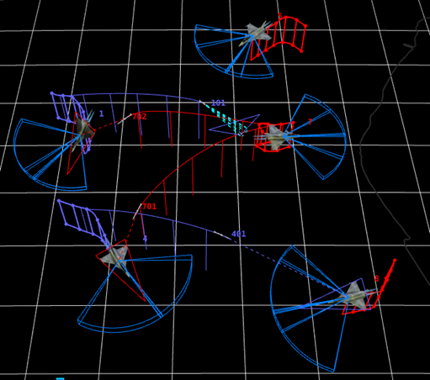
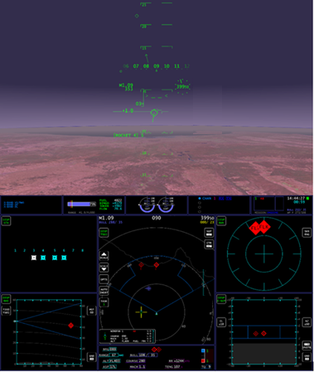
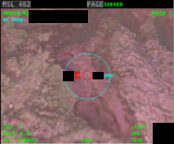
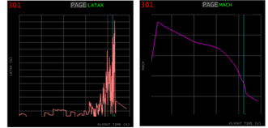
Delivery
Pilot Briefing & Planning
Mission Execution
Replay & De-brief & Observation capture
Debrief Reports
Debrief Reports
Debrief Reports
x
Notes:
Event delivery in the context of an Air Combat Trial encompasses:
Briefing and familiarisation of the data, assumptions and objectives to all participants
A chance for both Red and Blue operators to form plans and tactics
A number of ‘combats’ flown utilising the heads up/down displays and throttle and stick
Combat Debrief includes interaction between operators to capture insights and live interrogation of the events that have just happened
Capturing these insights / observations as they occur is the first major stream of value in terms of outputs
The debriefs typically take at least as long as the combat!
The power of OITL simulation is to understand why things happened the way they did, and how the human and system interactions affected outcomes
Missile X was really effective at Y
Whenever we do X, Red team do Y

Slide 14
OITL Simulator Use
PLANNING
DELIVERY
ANALYSIS
Technical
Objective
Live Analysis
Technical
Outcome
Operator Training
Fit For Purpose ?
Operator In The Loop Simulator
Data
Extraction
Build &
Config
Operator Behaviours
Data
Analysis
Validate & Verify
Notes:
Operator Simulator can be described in 3 distinct phases
Planning and preparation for the events, including both an event itself and the people, software, facilities, data that is required
Delivery of the event itself, including appropriate review and validation
Analysis post-event and the mechanisms to extract value from an event

Slide 15
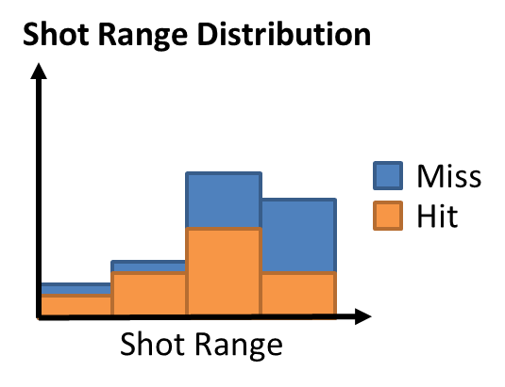
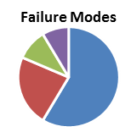
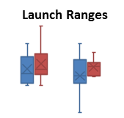
Post-Event Analysis
Combat 1
Measure of Effectiveness
Data Extraction & Collation
Outcomes
Combat 2
…
Data Analysis
Detailed Investigations
Combat N
Debrief Reports
Debrief Reports
Debrief Reports
Observations
Operator Behaviours
Notes:
Post-Event Analysis is about deriving value.
Combats are recorded and post-processed to extract raw data (e.g. entity positions and states at each time step)
The questions you want to answer and the methods of answering those questions should have been defined by your Experimental Design / Trial Planning process
This allows you to capture Measures of Effectiveness (e.g. Mission Success)
This provides a data set to undertake more detailed analysis (e.g. the distribution of missile engagements and how that related to kill %, or the manoeuvrability of a missile, or use of a particular sensor)
The Debrief reports and Observation notes from the trial can provide significant value
These observations must drive your data analysis – you need to know where to look in the data!

Slide 16
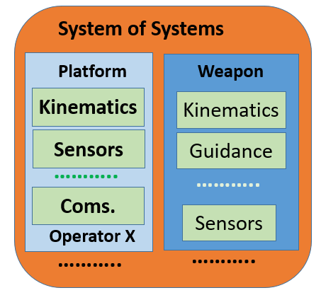
Summary / Conclusions
Know your Assumptions
Control for Confounders
Observations First
Live Exploratory Testing
How to capture value?
Debrief Reports
Debrief Reports
Debrief Reports
Notes:
Ensuring these communities are sharing information and knowledge is key
Gaining access to the right personnel to support OITL activities is always difficult
Know your Assumptions
Having a well defined and careful list of assumptions and capture of them is key
In a real time environment you cannot get to 100% representation
So understanding the limitations and impact of these is key
Along with having a good relationship with the input data generators to allow that transition from the detailed to the less detailed
Control for Confounders
E.g. Learning effects, gaming the system
Operator familiarity with the environment is a challenging factor
A lot of design decisions have been chosen to try to mitigate these
Both in the simulator design and experimental design
The human provides a key element into the environment which makes analysis significantly easier and more valid
But humans come with a host of confounders
Observations First
Where observations from the trial are supported by numerical evidence
This is due to the complex nature of this environment, it is difficult to draw direct conclusions from numbers alone
Did they launch at that range due to the capability of the weapon, or due to the tactics they employed?
Hence fox puts a lot of focus on capturing the human insights from the trial, both in the debrief and observations capture
In addition to allowing full replay-ability for post trial debrief
The numerical output is also very important, however we try to ensure it is always informed by the trial conditions and observations
Live Exploratory Testing
Ability for a controller to ‘see’ what’s happening in the models live
How to capture value?
Scribes to capture discussions and insights
Debrief sessions
Questionnaires
Paper notes
Post-trial analysis

