Slide 1
Algorithm development to identify Canadian Armed Forces service couples from imperfect data
Ingrid Lai, MSc
Director Research Workforce Analytics (DRWA)
Director General Military Personnel Research and Analysis (DGMPRA)
39th International Symposium on Military Operational Research (ISMOR)
20-21 July 2022

Slide 2
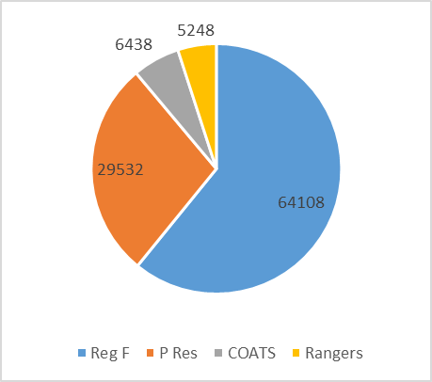
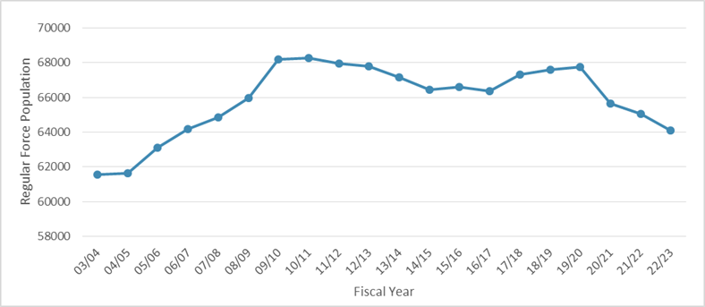
Introduction – DND/CAF
Department of National Defence and Canadian Armed Forces (DND/CAF) consists of*:
  Regular Force: 64,108
  Primary Reserve: 29,532
  Cadet Organizations Administration and Training Service: 6,438
  Canadian Rangers: 5,248
  Civilian employees: ~28,000
Director General Military Personnel Research and Analysis
  Research and analysis arm within Chief of Military Personnel
  Works closely with clients to provide evidence for policy/program development and to inform decision-making

Slide 3





Introduction – DRWA
Director Research Personnel Generation
  Research and analysis in areas of attraction, recruiting, training & education, career management, human resources planning, retention and attrition
Director Research Personnel and Family Support
  Research and analysis in the areas of conditions of service and quality of life of CAF members and their families, employment equity and diversity, and the physical and psychological health
Director Research Operational & Organizational Dynamics
  Research and analysis in the areas of leadership and culture, operational
  and organizational dynamics, workplace well-being and performance measurement
Director Research Workforce Analytics
  Develops workforce analysis tools, simulation models and forecasting tools, and reports various personnel metrics to inform policy, strategy and decision-making at various levels
Director Personnel Science-Policy Integration
  Enables science-policy integration through research synthesis, knowledge translation, network liaison, strategic outlook, and capability development
3

Slide 4
Problem definition
Canada’s defence policy, Strong, Secure, Engaged,¹ announced intent to improve support and services to families of military members, including help to stabilize family life for CAF members and their families who frequently have to relocate
A significant proportion of CAF members are part of service couples, and understanding them can lead to better support to military families overall
Data on marital status and service couples are available from Guardian, the Canadian Armed Forces HR system of record. However, the quality of the marital status data has been questioned in the past because:
  Unlike data pertaining to rank, positions, qualifications, etc., there is often no urgency in updating marital status or spouse information → potentially outdated and contradicting records for service couples
  All HR data had been moved to Guardian in 2018 and marital status options that indicated if members were part of service couples had been removed

Slide 5
Purpose & data sources
Purpose: To determine quality of marital status data and develop an algorithm to identify service couples from the data
Use current and historical data from DRWA Data Mart, an analytics engine, which processes data from Guardian
  “Current” data taken from 30 November 2021
Marital status related fields to investigate:
  Marital status – married, common-law, divorced, separated, single, etc.
  Marital status date – date of marital status change
  INTER_SN – should contain service number (SN) of spouse or common-law partner who is/was also in the CAF, if one exists
Other useful fields: last name, age, sex, city, province, postal code, etc.

Slide 6
Part 1: Data investigation

Slide 7
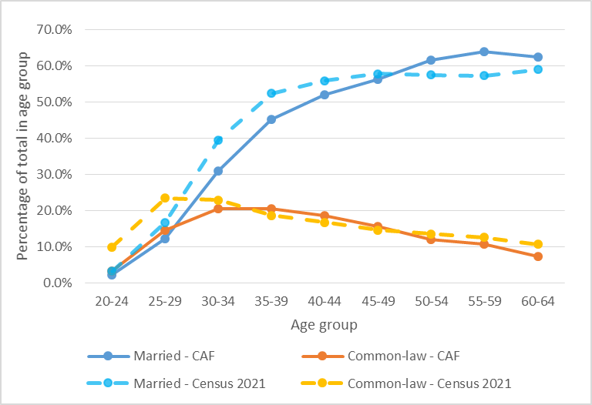
Data investigation – Marital status
Number of current CAF members with a common-law or married status compared with 2021 Canadian census data²
For this project:
CAF personnel data taken on 30 Nov 2021, “current” refers to this date
CAF population is Regular Force and Reserve Force (excluding Supplementary Reserve)
For younger age groups, CAF members are less likely to be common-law or married

Slide 8
Data investigation – Status date & INTER_SN
Based on historical data of the current CAF population
  When the marital status date changes, the marital status changes 98.5% of the time
  When the marital status changes, the marital status date changes 99.9% of the time
Data appear reasonably high-quality since status changes are plausible and number of clear errors (e.g. single/divorced/separated people with an SN in INTER_SN) is less than 3%
Marital status of members with INTER_SN filled in:
Top 5 historical status changes:
97.3% of members with a SN in the INTER_SN field have a common-law or married status

Slide 9
Data investigation – Types based on INTER_SN
Depending on whose SN was linked to through the INTER_SN field, members were assigned “types”:
99% of Type 3 members’ “partners” were found in past snapshots (only 14 were not found)
Will mainly look at current service couples so Type 3 are ignored for now
Types 4 and 5 are ignored since there are so few (9 of the Type 5 members had married or common-law statuses)

Slide 10
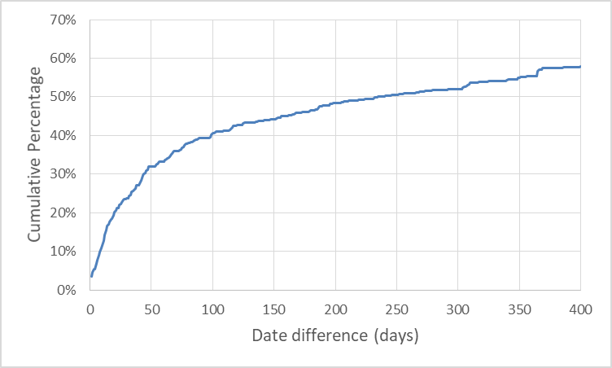
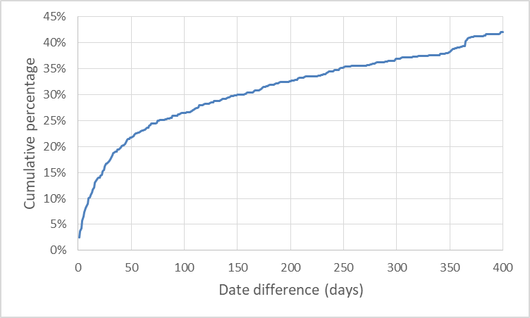
Data investigation – Type 1 couples
How often Type 1 couples have the same marital status and/or marital status dates:
434 common-law couples with different status dates
862 married couples with different status dates
40% of Type 1 common-law couples with different status dates have dates <100 days apart, compared to about 1 year apart for
Type 1 married couples with different dates
Couples in which both members had the married status were most likely to have the same date, compared to other statuses

Slide 11
Data investigation – Type 1 couples
Looking only at Type 1 couples in which both members have a common-law or married status (most likely to be actual current service couples):
For comparison, from Canadian censuses:
  2.8% of common-law partners were same sex and 0.4% of married couples were same sex³
  1.6% of married couples over age 20 were living separately⁴
It is expected that fewer married service couples would have the same address, compared to the rest of the Canadian population

Slide 12
Data investigation – Type 2 couples
Comparing Type 2 couples in which both members have a common-law or married status to Type 1:
Type 2
64% of Type 2 couples have the same common-law or married statuses, compared to 95% of Type 1 couples
Type 2 couples are slightly less likely to have the same address
Type 1
Type 2 couples are more likely to have different status dates
Data of Type 2 couples seem more likely to be outdated than Type 1, but not enough to exclude them entirely from final group of current service couples

Slide 13
Part 2: Algorithm development

Slide 14
Algorithm to identify current service couples
Must be Type 1 or 2
Use historical data to find previous status for each member. For couples with different statuses, if one member has a current status C/M that matches the previous status and date of the other member, the (likely out-dated) current status and date may be replaced with the other member’s status:
  C → E (i.e. C can be replaced with E),
  C → M
  C → S
  M → D
  M → E
For couples with different statuses, if one member has status C/M with a later status date than the other member, and if both members have the same postal code or last name, the non-C/M status may be replaced with C/M
C = Common-law
D = Divorced
E = Separated
M = Married
S = Single
U = Unknown

Slide 15
Algorithm to identify current service couples
Include only couples with combined statuses:
  CC, CM, MC, MM
  CD, CE, CS, MD, ME, MS, DC, EC, SC, DM, EM, SM
  if the C/M status is associated with a later status date than the other member’s status
  SS, SU, US, UU, CU, UC, MU, UM
  if both members in couple have same postal code or same last name
Details can be adjusted to balance accuracy versus having a large enough population to analyse
4,885 service couples were identified using this process
99% of Type 1 couples and 85% of Type 2 couples were included
The status updates (previous slide) increase the number of identified service couples by a negligible amount (0.2%)
C = Common-law
D = Divorced
E = Separated
M = Married
S = Single
U = Unknown

Slide 16
Part 3: Summary of key demographics and options for future work

Slide 17
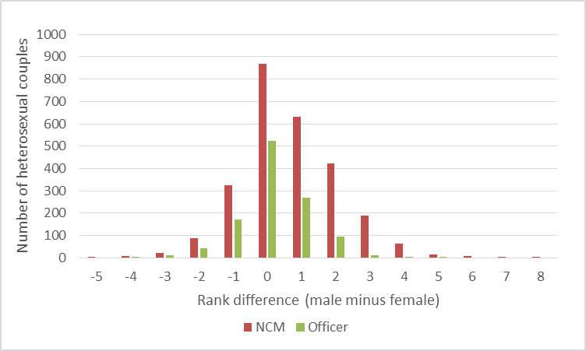
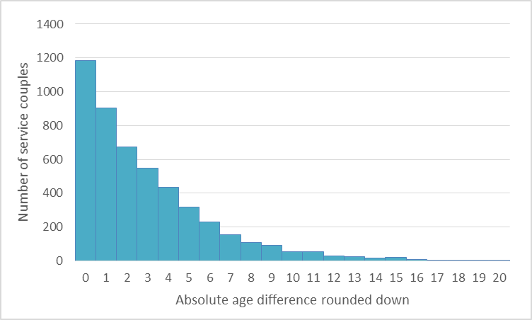
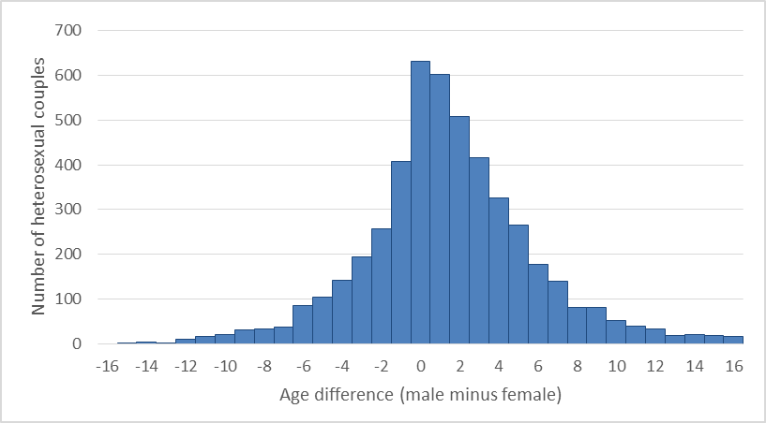
Demographics of current service couples
Of the 4,885 service couples determined using the algorithm:
Most common for couples to have same rank, although for heterosexual couples it is more common for the male member to have a higher rank
It is more common for couples to be closer in age, and for heterosexual couples it is more likely for the male member to be older

Slide 18
Options for Future work
Analyse data on past service couples (Type 3 and others)
Examine attrition patterns for members of service couples
  How do attrition rates vary for male and female members of service couples in comparison to those who are not members of service couples?
    Are there differences in the tendencies to leave at particular points in a career?
    How do the reasons for release differ?
  Among service couples, is there a relationship between the rank differential and attrition patterns?
Examine data on location of service couples
  If possible, find how often service couples were posted to the same area
Collaborate with researchers in other areas of military personnel research
  Help inform CAF surveys on family, relocation, and deployment
Expand analysis to include other aspects of military families (e.g. children)

Slide 19
Questions?
ingrid.lai@forces.gc.ca

