Slide 1
Natural Language Getting the Language Right
Dominic McCaskill
Innovative Thought | Critical Technology | Absolute Trust
June 2022
Notes:
Introduction to me,

Slide 2
About TPG Services
Secure UK sites
MoD Accredited IT
Able to work at high levels of classification
64 years of British Engineering heritage
tpgroup provide consulting, digital solutions and engineering services across the full lifecycle of mission and safety critical programmes in Aviation, Critical Infrastructure, Defence and Space sectors
Listed on London Stock Exchange
High calibre expertise in critical domains
2019 revenue £52.8m
Agile and responsive business model
Northallerton
International
customer base
Bristol
Lincoln
Melksham
Farnborough
Wincanton
Fareham
Portsmouth
Part of

Slide 3
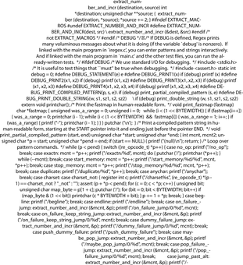
Overview
What is Natural Language Processing? How has it been developed? What are some current applications?

Slide 4
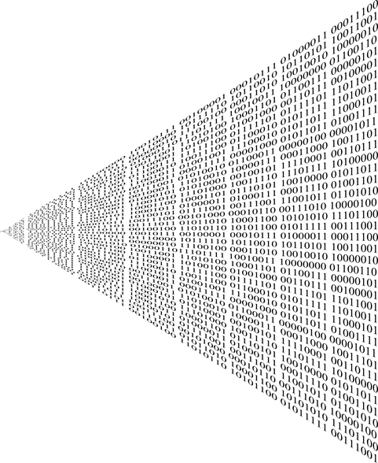
Agenda
Introduction to Natural Language Processing
Early Years
Eliza & First Chat Bots
Stochastic vs Symbolic
Neural Networks
Entity Extraction
Sentiment Analysis
The cutting edge

Slide 5
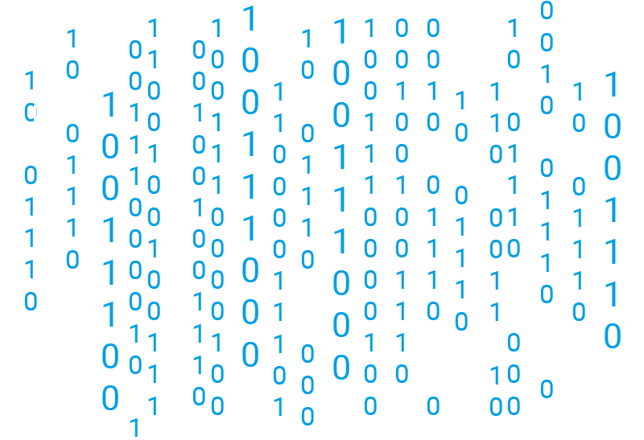
Introduction to NLP
Natural Language Processing (NLP) is the ability of a computer program to understand human language as it is spoken and written
Phonology
Pragmatics
Morphology
Syntax
Semantics
Notes:
Phonology This science helps to deal with patterns present in the sound and speeches related to the sound as a physical entity.
Pragmatics This science studies the different uses of language
Morphology This science deals with the structure of the words and the systematic relations between them.
Syntax This science deal with the structure of the sentences.
Semantics This science deals with the literal meaning of the words, phrases as well as sentences.
Machine translation (Google Translate)
Natural language generation
Web Search
Spam filters
Sentiment Analysis
Chatbots

Slide 6
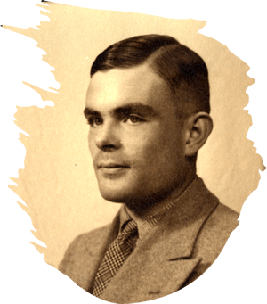
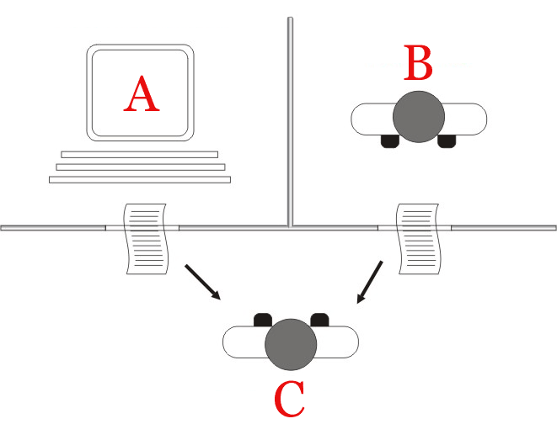
Turing Test
By Juan Alberto Sánchez Margallo - CC BY 2.5
Notes:
Initially focussed on Machine translation during the second world war
Turing Test
Published in 1950 – called the imitation game
C is interrogator, needs to decide which of A and B is a computer and which is a human
C must view the response to written questions
Question is, can a computer imitate a human

Slide 7
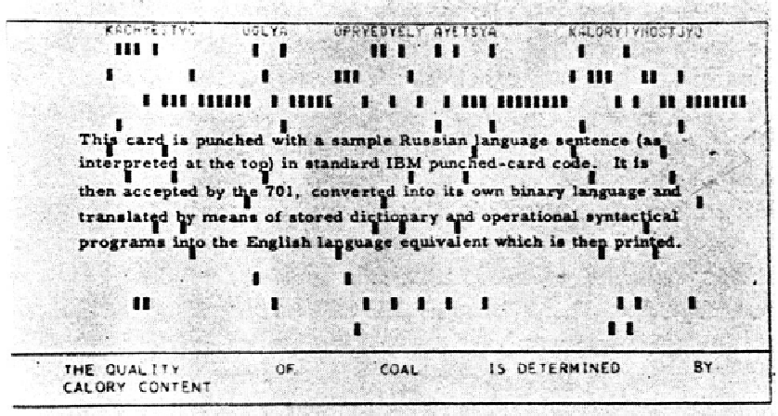
Georgetown Experiment
Notes:
1954
Romanisized russin on top, translated sentence on the bottom
First fully automatic machine translation
Only 6 grammar rules and 250 items in it’s vocabulary
Sentences were carefully selected but were proposed as a demonstration of machine translation.

Slide 8
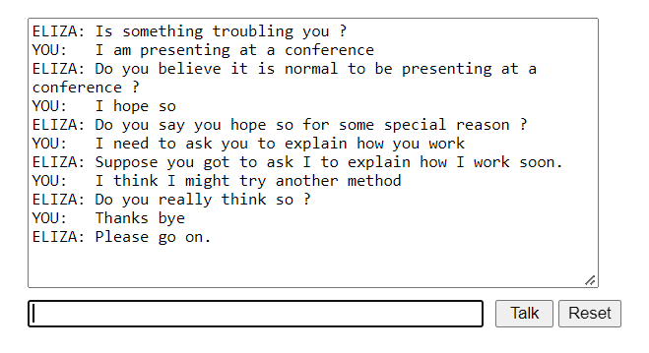
Eliza
Notes:
Described by Joseph Weizenbaum in January 1966
Keyword priority and rules make up script
“Rogerian Psychotherapy”
If a keyword is found, do a rule
If a keyword is not found, generic or repeat
Gave rise to the Eliza effect, Weizenbaum commeneted "I had not realized ... that extremely short exposures to a relatively simple computer program could induce powerful delusional thinking in quite normal people.”
Parry was developed in 1972 as a more advanced implementation and tried to simulate a person with paranoid schizophrenia.
Adaptation of Turning text
No better than guessing psychiatrists telling parry from patient
Eliza VS Parry over ARPNET

Slide 9
Machine Learning
Colourless green ideas sleep furiously.
Furiously sleep ideas green colourless.
Notes:
Starting in the 80s with increasing computer power
Large multi lingual corpora created by the Canadian parliament and European Union allowed development of translation algorithms.
Previous theoretical approach to NLP championed by Noam Chomsky gave way to the analysis of language as expressed in real world text.
Using statistical techniques such as Decision trees, to analyse large documents

Slide 10
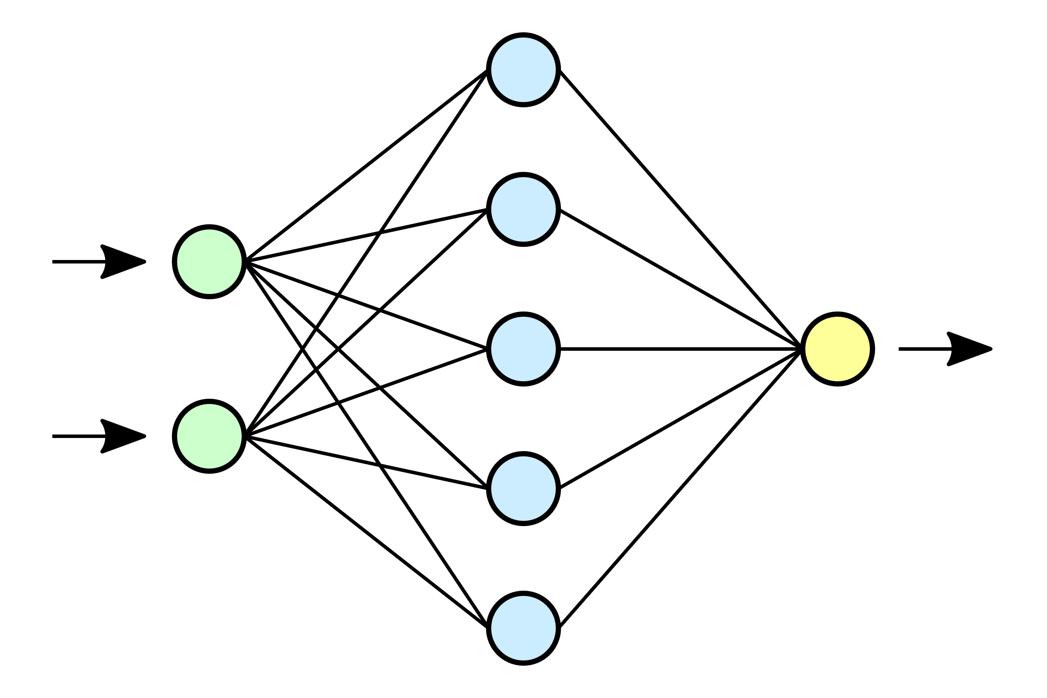
Neural Networks
Notes:
Based on how Neuron’s work in the human brain
Can adapt to changing input
perceptron = multi linear regression, minimise a loss function
Inputs are fed into the left and passed through the hidden layers to provide an output
Output layer can be a single yes/no output or multiple criteria

Slide 11
Current Generation Tools & Techniques
Entity Extraction Entity extraction is a text analysis technique that uses Natural Language Processing (NLP) to automatically pull out specific data from unstructured text, and classifies it according to predefined categories.
Sentiment Analysis Sentiment analysis is the use of natural language processing, text analysis, computational linguistics, and biometrics to systematically identify, extract, quantify and study affective states and subjective information.

Slide 12
Entity Extraction
Notes:
Trying to extract the entities from a document effectively nouns
Trying to categorise the identified entities
This output was generated automatically using the Spacy Library.
It is not perfect, it misses “greeks” and misclassifies “Principality of Arber”

Slide 13
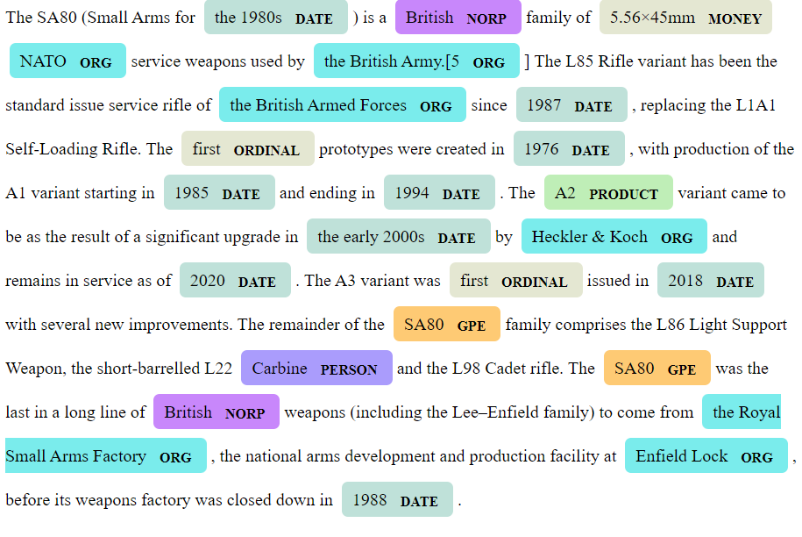
Entity Extraction
https://github.com/dstl/re3d
Notes:
The more specific and niche the language the poorer performance can be expected from the pre trained models.

Slide 14
Data labelling
https://ubiai.tools/Docs
Notes:
Inter-annotator agreement is a measure of how well two (or more) annotators can make the same annotation decision for a certain category

Slide 15
Defence Specific Data Sets – R3ed
Step 1
Step 2
Step 3
https://github.com/dstl/re3d
Notes:
Used publicly available datasets:
BBC Online
UK Government Website
US State department
Wikipedia, among others
Tagged defence specific entites such as weapons, vehicles and Milatry platforms

Slide 16
Uses
Notes:
Cribrum
Chat bot
Word cloud
Feed into sentiment analysis
Volume of mentions
Remove the noise from the data

Slide 17
Sentiment Analysis
☹️
😃
😐
This presentation is boring
I’m really enjoying this explanation of sentiment analysis
I suppose this is vaguely interesting
Notes:
Trying to understand the polarity or range of possible emotions or intentions expressed in a text.
Can be overall sentiment of a text
How sentiment changes over time
Sentiment related to a specific topic.

Slide 18
Out of the box

Slide 19
Custom Model
Notes:
If yo want specific use case for sentiment analysis then you can train your own model
The sentiment of the message is the value that the loss function wants to minimise

Slide 20
Problems
Sarcasm I’m so happy the plane is delayed
Negation I am not happy today and I’m not feeling well
Ambiguity We went to the theatre and went for dinner. It was awful.
Domain specific language OFSED reported that the school was inadequate.
Slang/Emojis
🤯

Slide 21
Uses
Notes:
Understanding large amounts of text
Marketing
Change in sentiment over time
Used as input for models
Looking into sentiment of Elon Musk over time. Further analysis of users possible
Used as variable in further machine learning.

Slide 22
Current Cutting Edge
Natural language generation
Bias detection and mitigation
Multi document summarisation
BERT
Notes:
BERT developed by google,
Current cutting edge
Trained on over 3.3B words from Wikiepdia and BooksCorpus
Currently not quite sure why its so good

Slide 23
Contact me……
Dominic.McCaskill@tpgroup.uk.com
07771 387 669
Notes:
Put in linkedin adresss

