Slide 1
ADA model
A holistic simulation model to explore the availability and costs of military assets in the exploitation stage

Slide 2
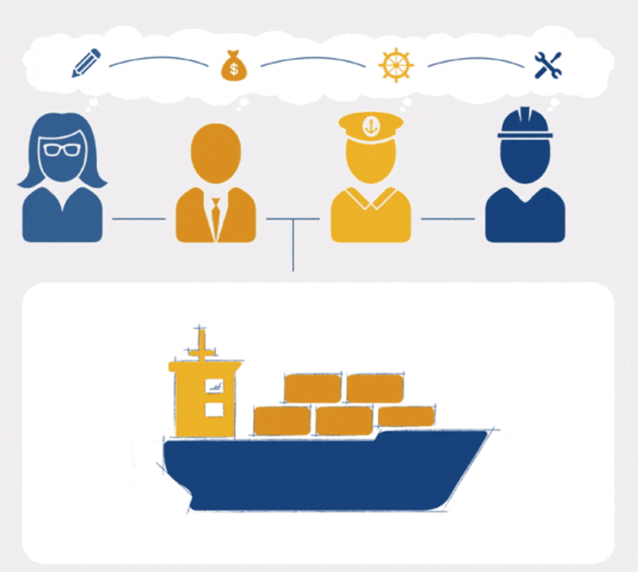




the Copernicos approach
map to connect
model to understand
analyse to improve

Slide 3
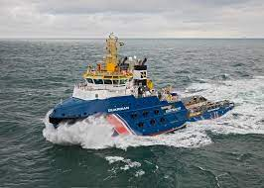

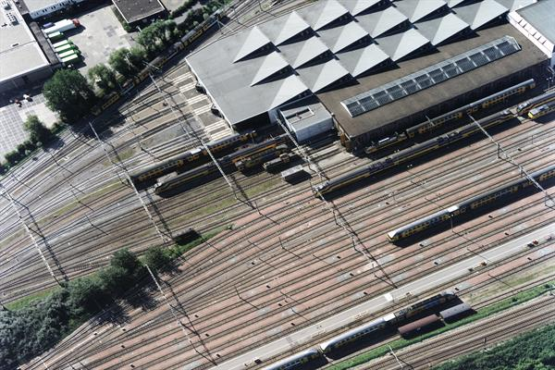

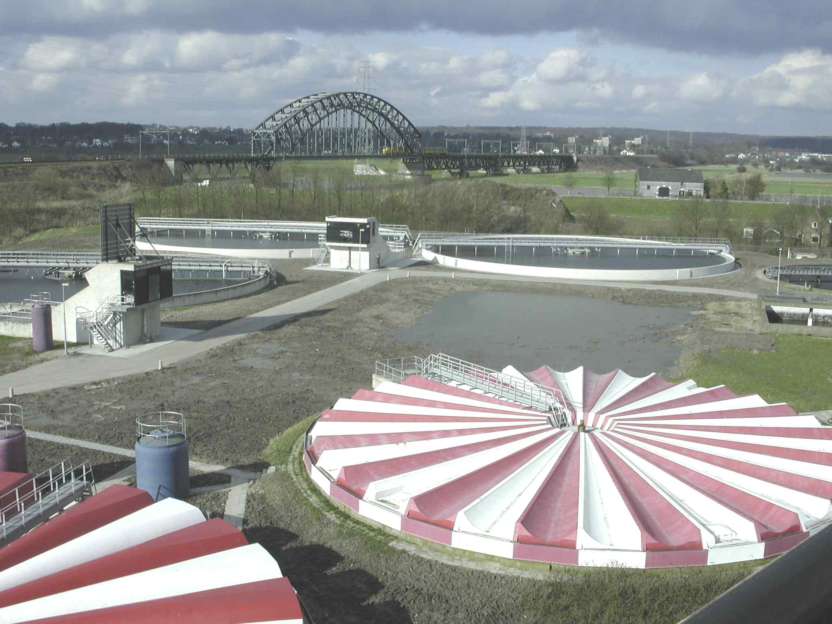

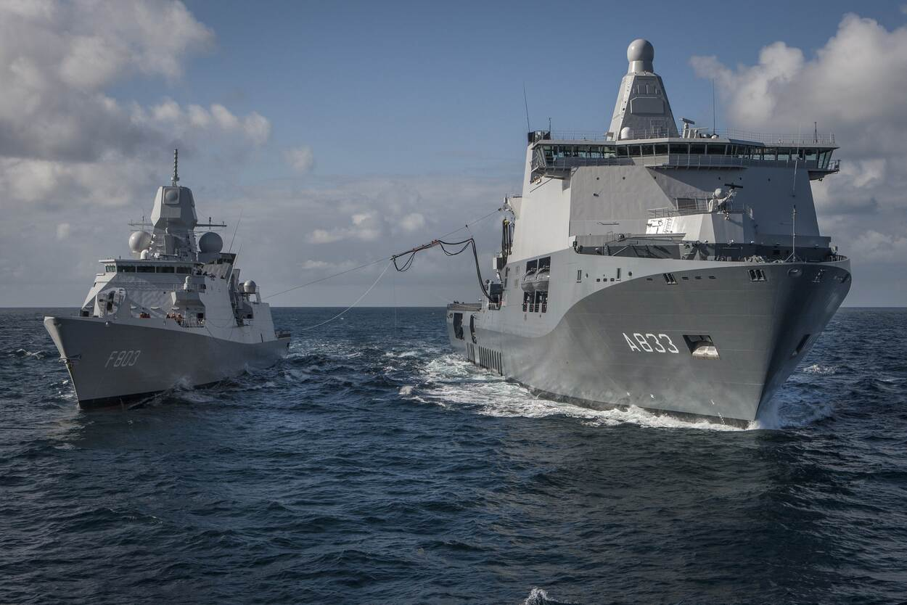
Physical assets (examples)

Slide 4
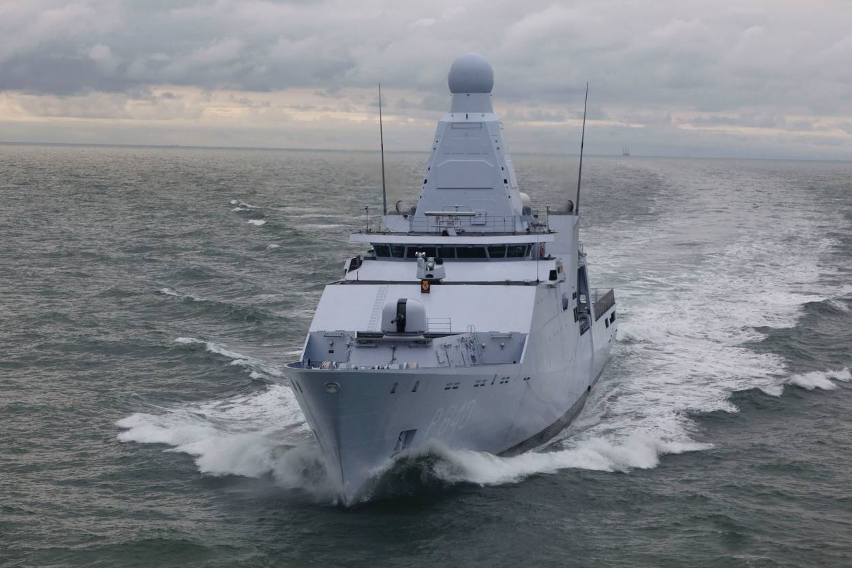
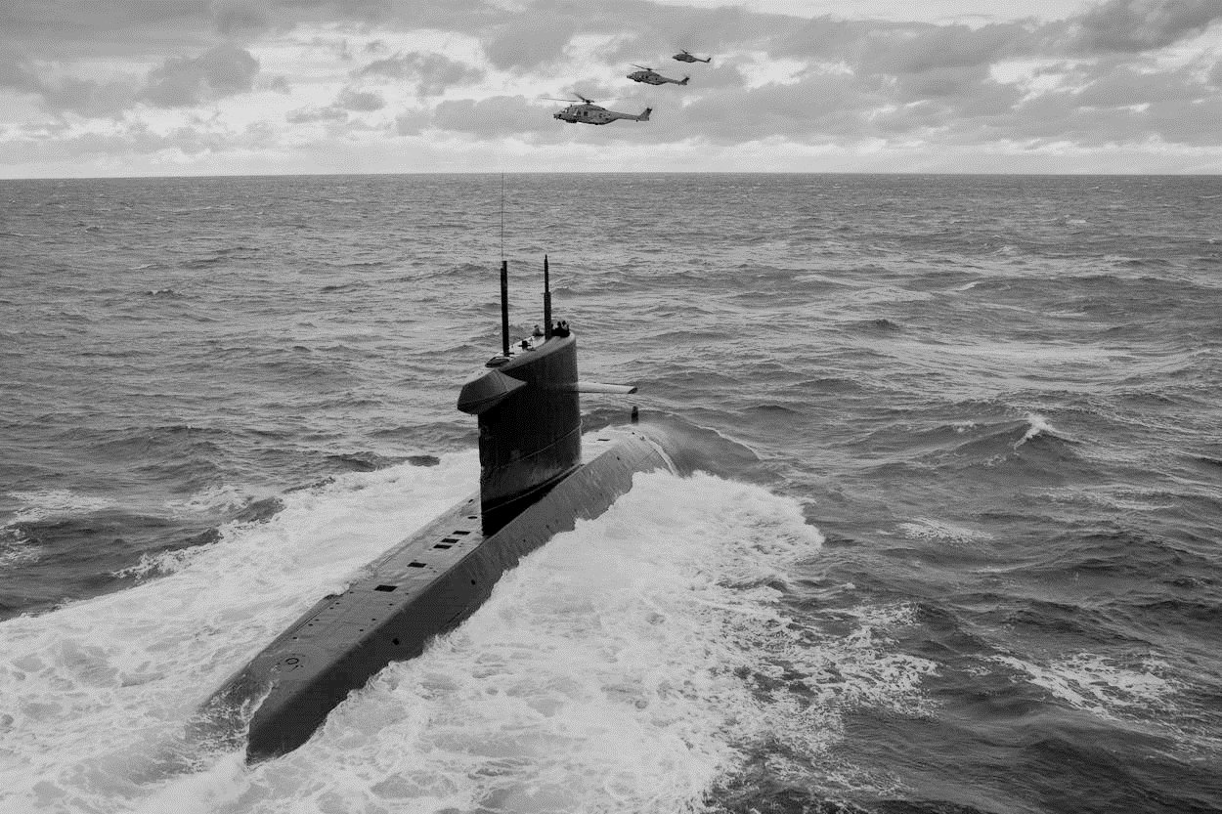
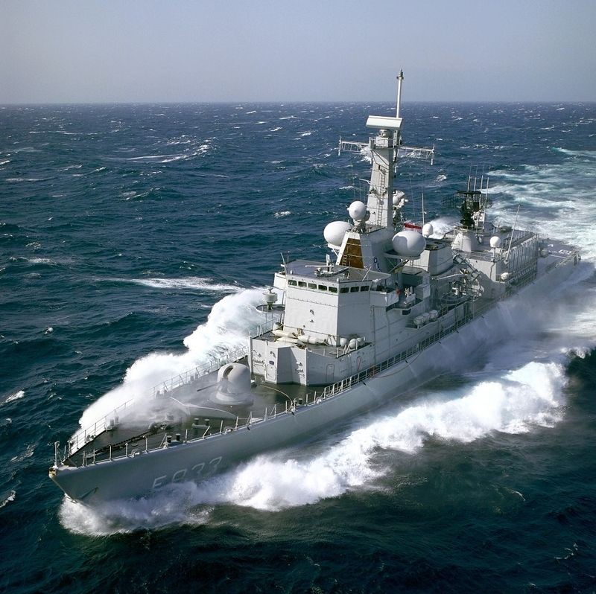
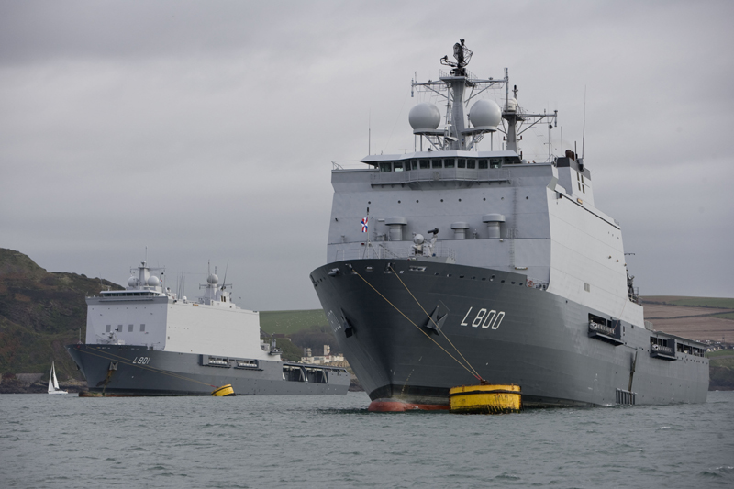
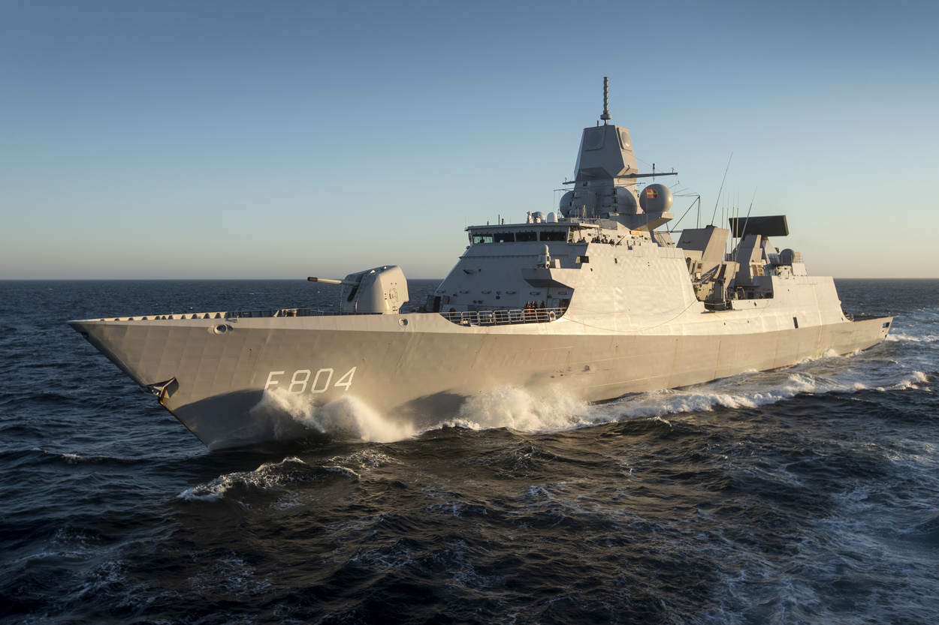
Asset dynamics
Asset Dynamics A-phase model
Asset Dynamics model
Feedback
Design
Engineer
Construct
Use & Maintain
Re-use
Concept
Phase
Project
Phase
Contract
Phase
Exploitation
Phase
Recirculation Phase
Effects on remaining life cycle

Slide 5
ADA model
A holistic simulation model to explore the availability and costs of military assets in the exploitation stage

Slide 6
What?
The Asset Dynamics A-phase (ADA) model evaluates ship design concepts on
  availability (= total availability % and operational downtime h)
  affordability (= exploitation costs € and maintenance hours h)
to timely adjust the
  ship design
  support system
  usage plan and requirements
to improve the cost-effectiveness of military ships in the exploitation phase

Slide 7
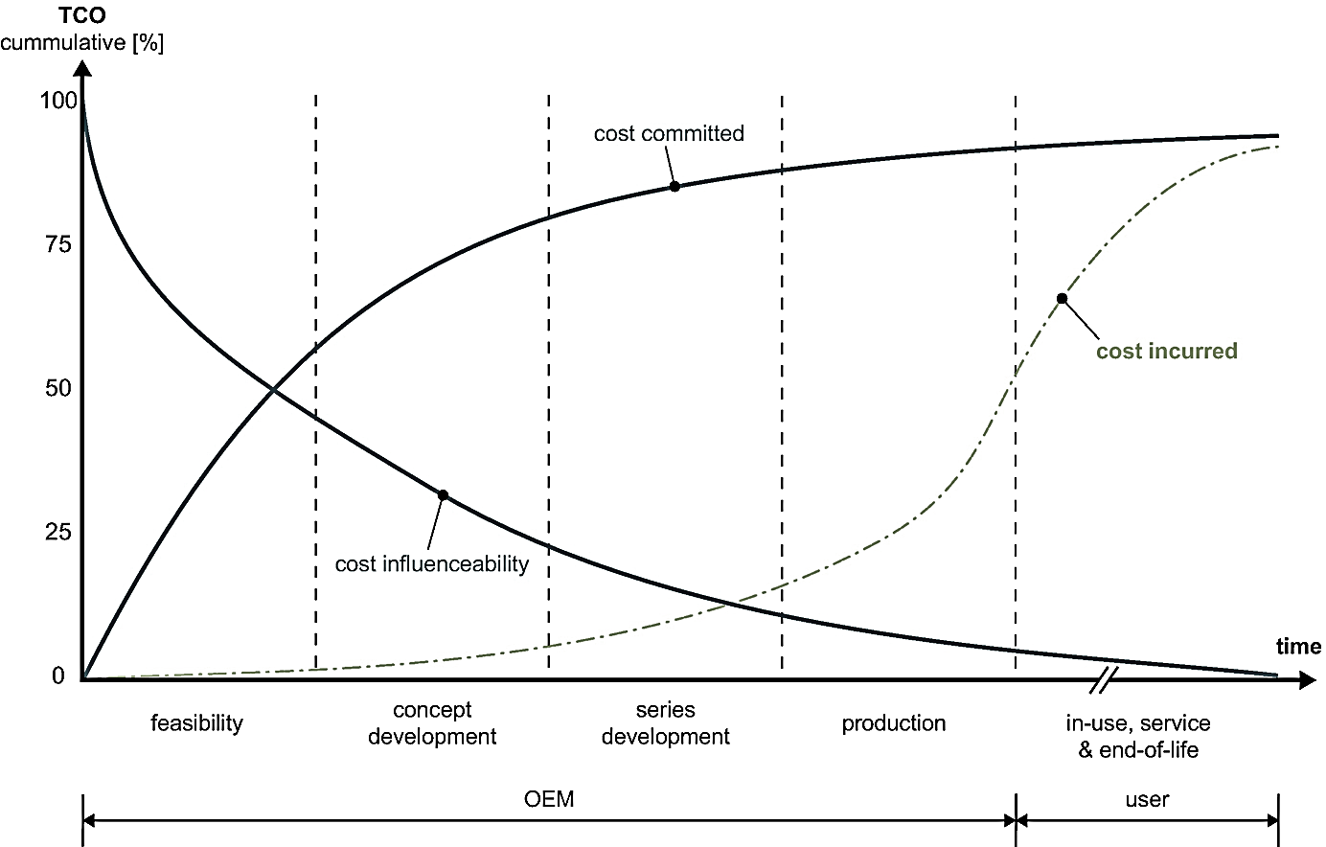
Why?

Slide 8
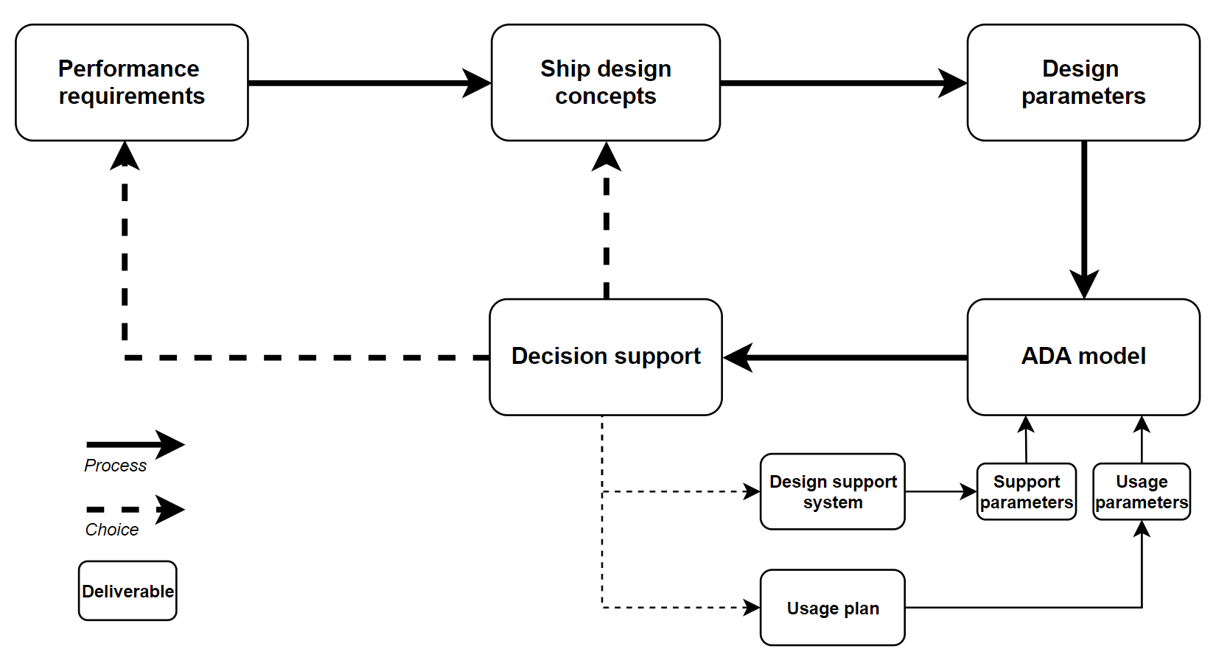
How?

Slide 9
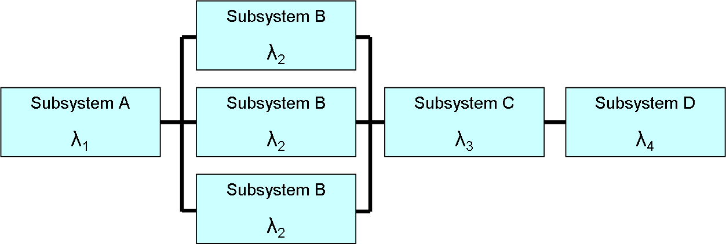
Performance requirements & Ship design concepts
A set of performance requirements for different usage modes, e.g.,
  Transit: 19 kn propulsion, 2 MW other systems
  Combat: 28 kn propulsion, 4 MW other systems
Ship design concept diagrams
  Single line diagram
  Reliability Block Diagrams

Slide 10
Support system & Usage plan
Support system: how is the ship maintained?
  Budget allocation
  Maintenance during operation?
  Spare parts stock?
  Interval large maintenance?
  Workforce characteristics (capacity, education level, etc.)
Usage plan: how will the ship be used?
  What type of area?
  What type of activities during operation?
  Expected lead time of operations?

Slide 11
Process diagram

Slide 12
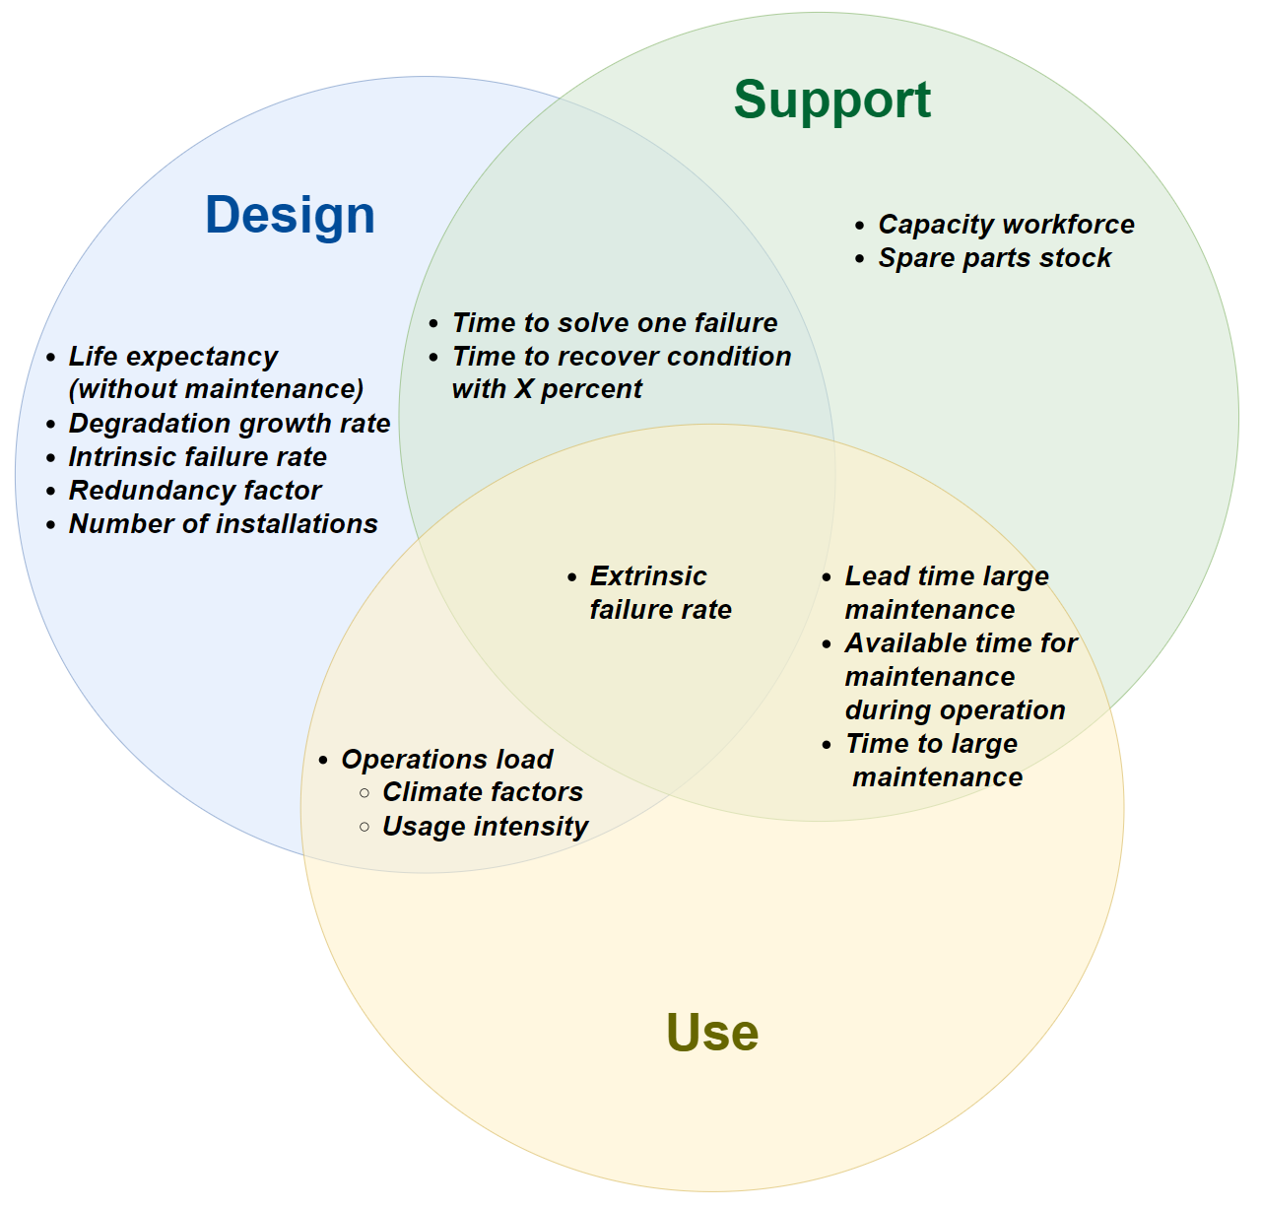
Parameters

Slide 13
Process diagram

Slide 14
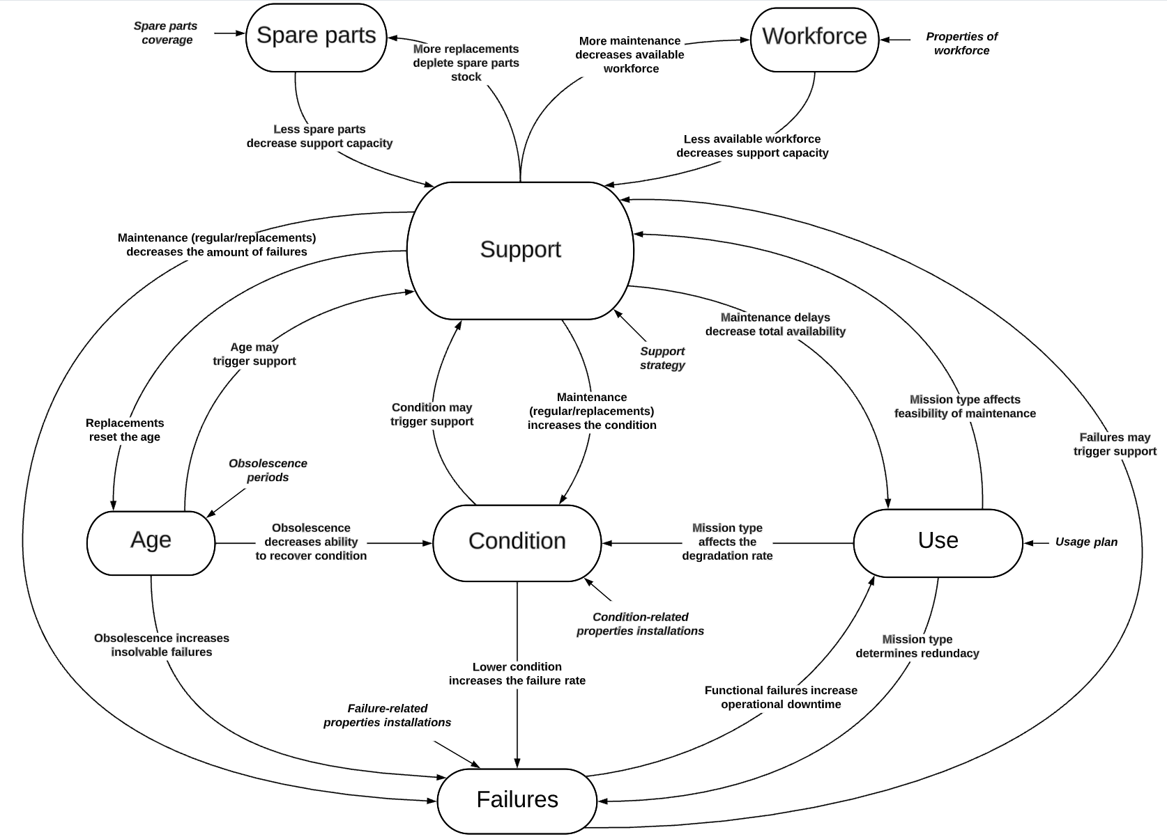
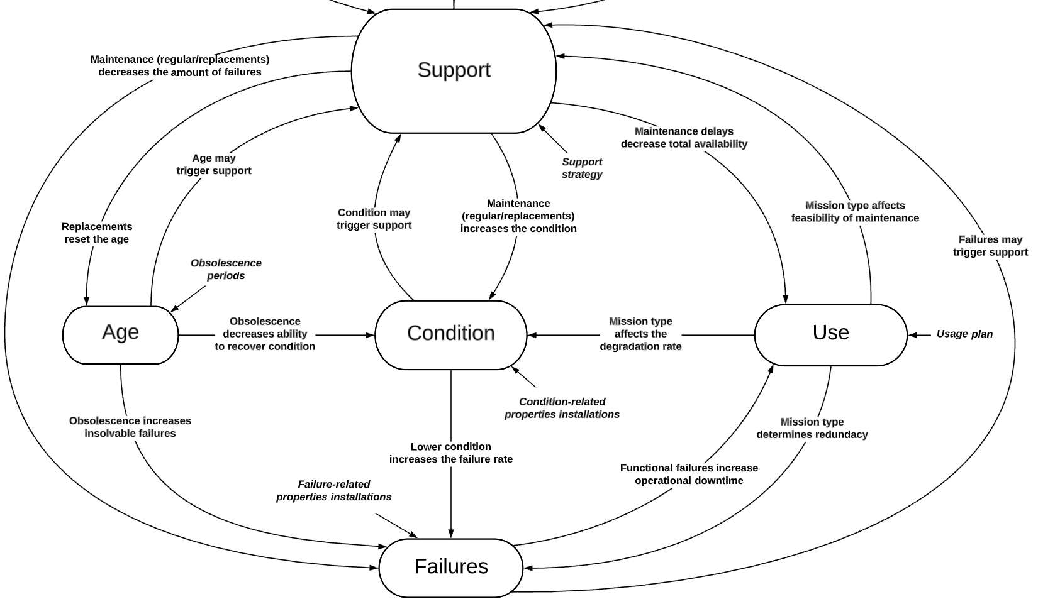
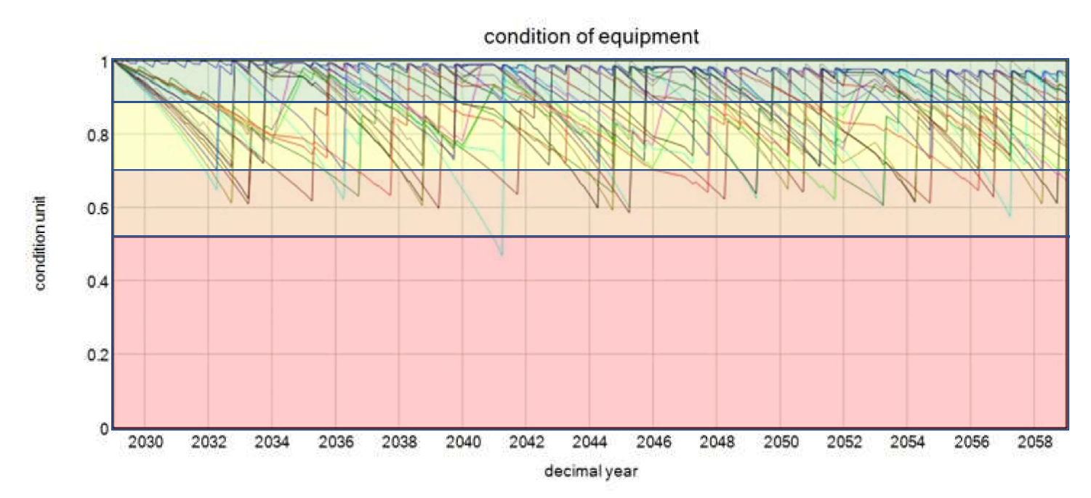
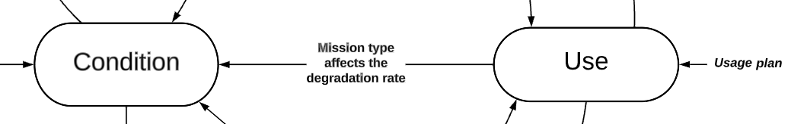
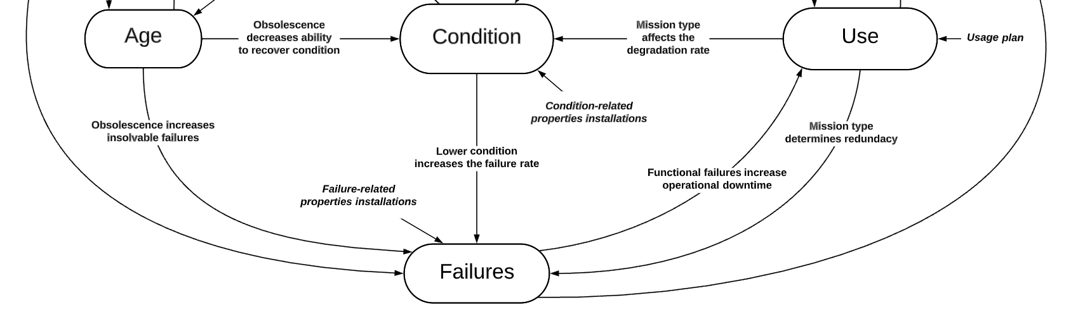
ADA model

Slide 15
Process diagram

Slide 16
Robust Decision-Making (Lempert et al., 2006)
Specify policy alternatives and uncertainty bandwidths of parameters
Large-scale computational experimentation
Worst-case scenario discovery
Determine the robustness of policy alternatives
If the robustness criterion is not satisfied, specify new alternatives and repeat the analysis

Slide 17
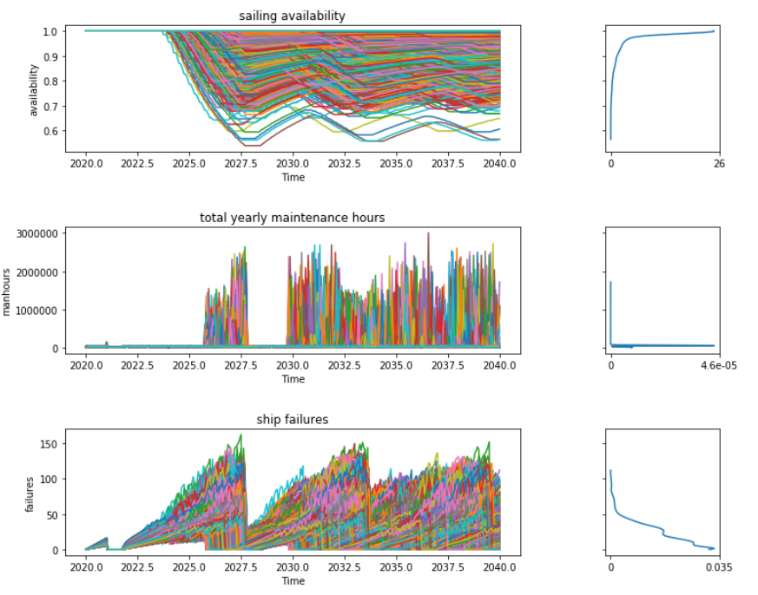
Computational experimentation

Slide 18
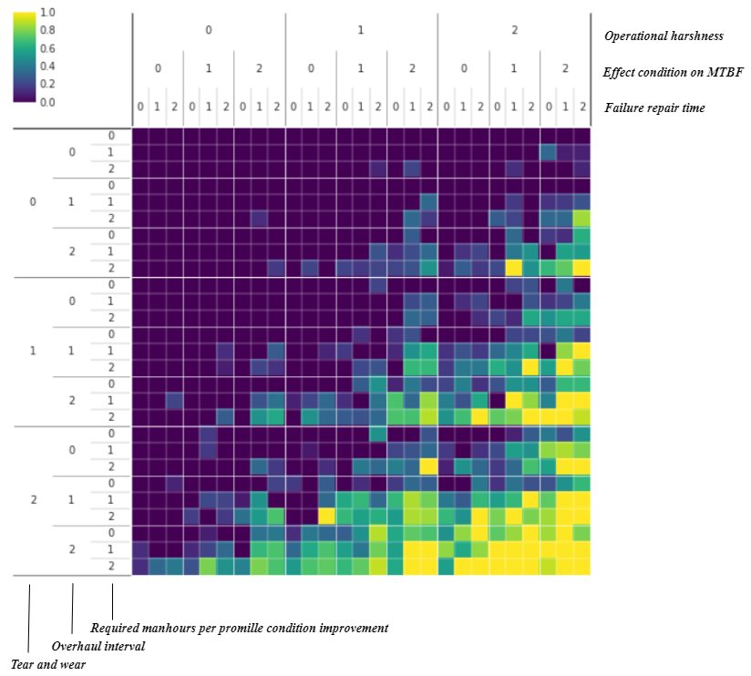
Worst-case scenario discovery

Slide 19
Process diagram

Slide 20
For a succesful cooperation
www.copernicos.com

