Slide 1
Insights from the main execution phase of a large-scale multi-domain wargame

Slide 2
Planned Force Testing IX (PFT IX)
A large-scale analysis exercise, aiming to
test and evaluate the ability of IF30 to conduct a multi-domain, medium scale intervention against a major state actor
generate evidence on the strengths and weaknesses of the force structure,
develop insights into current and planned capability.

Slide 3
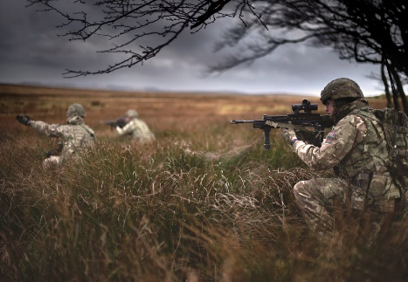
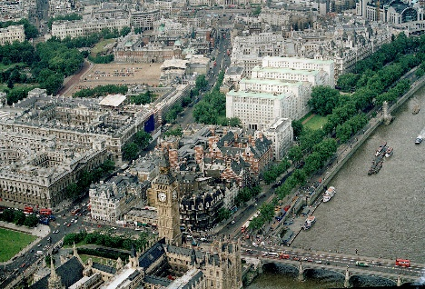
What is Planned Force Testing for?
One of the key analysis processes for Defence
Large stakeholder base:
X-MOD
X-Command
X-Whitehall
Develops scenarios for future analysis
Generally examines a single scenario in detail.
Develops insights into force structure, capability risks, and opportunities.
Provides a coherent, and common, scenario context for Defence, inc Dstl, for further exploitation.
Grown from a “background task” into work that reaches the highest levels of Defence and HMG
PFT7 briefed to No.10
PFT8 had direct involvement from the Vice Chief

Slide 4
Objectives
Investigate the strengths and weaknesses, and dependencies of Defence’s force elements and capabilities when operating across the 5 domains, including readiness levels and support requirements.
Analyse the capability and capacity risks and opportunities to UK forces.
Identify any difference between the planned force structure and that required to deliver medium scale operations.
Testing future concepts of multi-domain integration
Notes:
As well as assessing the force structure, we also looked at organisational concepts, testing a way the domains could work together.

Slide 5
Main execution phase
~130 staff
Over a hundred participants from across UK Defence and wider government institutions, representing the full five domains – Land, Air, Maritime, Space, and Cyber - as well as broader political interests.
Attendees from the USA.
Ten long days.
8 am briefing through to night time
Serge data capture tool.
~1300 kit-kats
Notes:
We had wargamers and military personnel attending from the States, bringing a wealth of experience with them. History of cooperation, including wargaming
Players were present from 8am for a fairly standard day, with adjudication starting ideally around 15:00 16:00. There was often a need for members of the adjudication team to be present during the players’ turn as well as during adjudication, which lengthened the days.

Slide 6
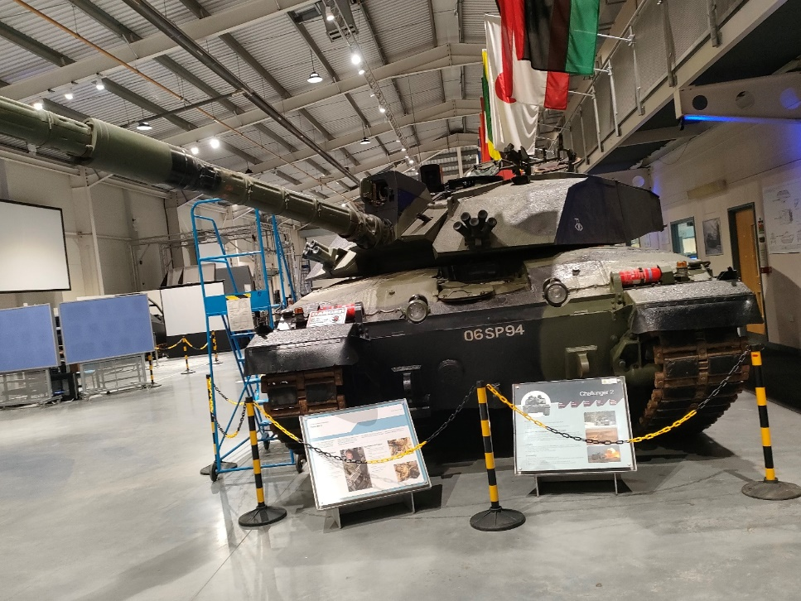
Where
Defence College for Military Capability Integration – Battle Lab at the Defence Academy, Shrivenham

Slide 7
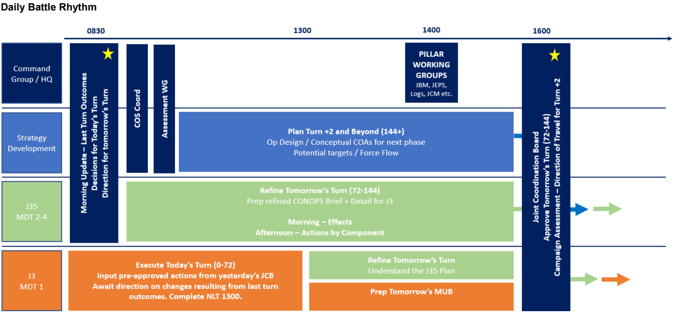
Daily Battle Rhythm
Notes:
Patrol boxes

Slide 8
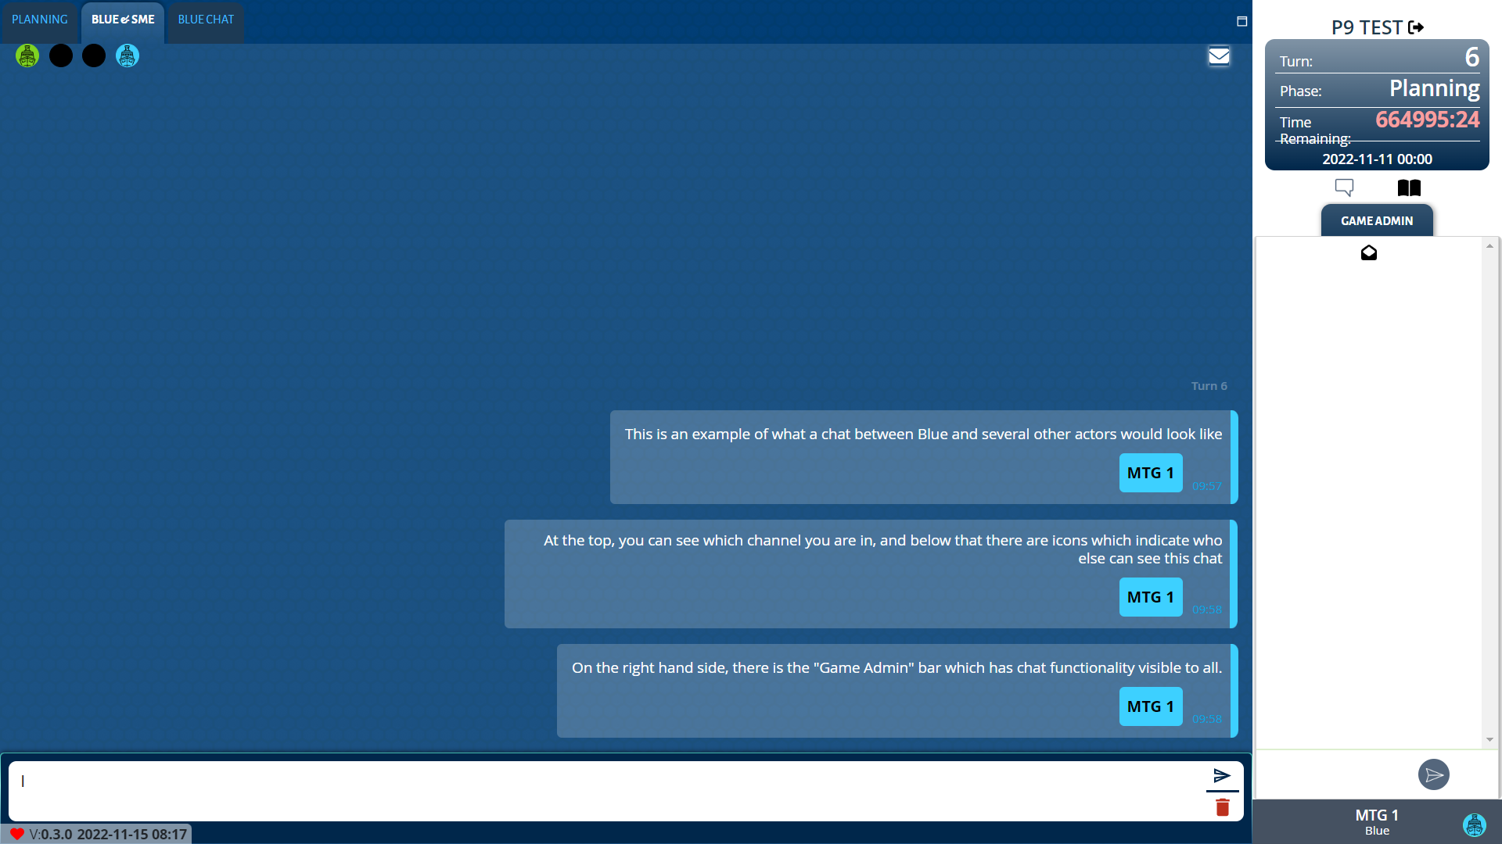
Serge
SERGE (Serious Gaming Evolved) – Data Capture & Communications
Data capture tool and player interface
Order generation
Communications between cells / roles
Anonymous insight capture function
Notes:
Patrol boxes

Slide 9
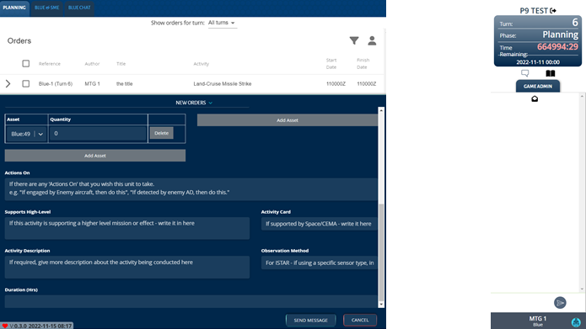
Serge Usage
For players
Relatively intuitive format
Able to get players up and using it with relatively little initial training
Some need to retrain players on specific issues as these were encountered
In adjudication
Generating interactions between orders
Hundreds of actions/ interactions
Notes:
Patrol boxes

Slide 10
Serge Usage
Notes:
Patrol boxes

Slide 11
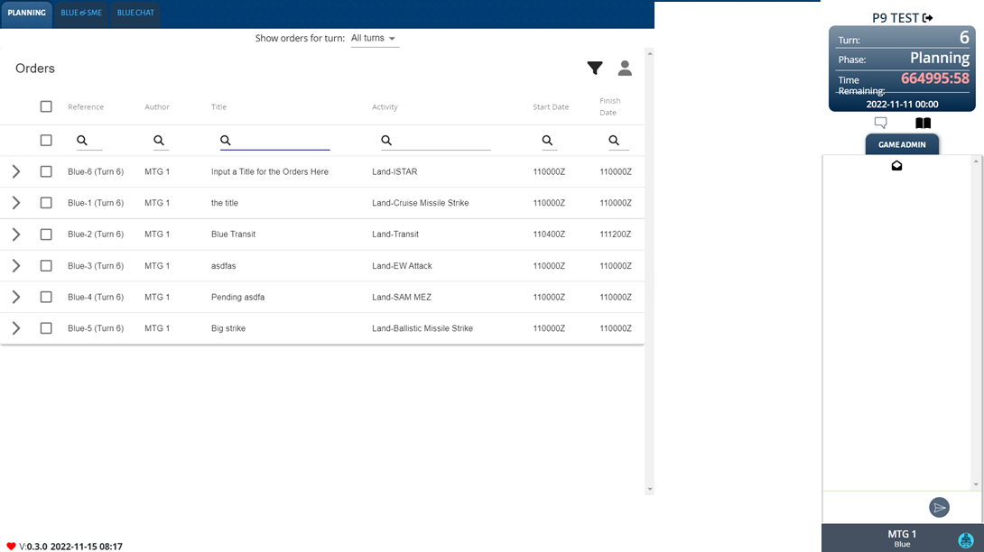
Serge Issues
Technical teething issues
Trimming the data bases
Night-time slow downs
Interactions which had to be manually skipped
Might benefit from an automated filtering process
Notes:
Technical teething issues at the code level – not in remit of this presentation.
Multiple users refreshing Some technical issues with developer working to streamline processes and issues with databases having to be trimmed throughout the adjudication process. A sthsi was causing slow downs and delays.
There were issues around interactions that the Serge system was identifying in that we had unfeasible interactions such as the satellite interacting with all land assets or submarine aircraft interactions that highlighted a need for a process for filtering these out. Also info ops having a physical location and therefore interacting with units on the map. We processed these out by assigning them relatively small areas. There were also tiny over laps with patrol boxes hundreds of square kilometres overlapping by meters.

Slide 12
CEMA and SOF
CEMA and SOF handled in a more bespoke manner
Handled at S-level, focussing on the effect
Cyber cards with results determined by SME judgement - Handled at S-level
SOF worked through with specialists using the four box-method
++ | + | - | - -
Notes:
Focussing on the what not the how
SOF collaborative
SOF worked through with specialists using the four box-method early in adjudication process

Slide 13
Collaboration
Clarity of post-adjudication briefings.
Briefing to the audience.
Being present
Sitting in planning sessions / talking to the inputters
Notes:
Ensuring everyone on same page.
Where there were issues with key events not in back brief resolving this as quickly as possible.
- Early heads up

Slide 14
Points of note
Individual player agendas
Single actions such as a unit travelling to fire a single missile
Information Ops area effects
Need for building in more munition equivalents
Notes:
Individual player agendas e.g. a player deliberating over using a resource rapidly to make a point
Rather than asking an SME live during adjudication what ‘s the closest option to this from this list.
‘x counts as y’ options for some of the munition options in the preparation phase

Slide 15
Learning points
Early heads up
Pre-adjudication (where possible)
Four box method
Gap between spreadsheet plan and usage
One evening largely manually adjudicating
Notes:
Getting a sense of their intentions for the turn
Preadjudication –rather than waiting fro Serge to tell us there was an adjudication getting a list of all shooting and putting it through the spread sheets to have an outcome ready

Slide 16
Looking ahead
Analysis is underway from the data and vignettes generated by PFT IX
Process has already started again for PFT X

Slide 17
Questions?

