Slide 1
Application of a Novel Technique to Help Determine Mission Success in Computational Multi-Mission Modelling
Lyds Smith
Joint Analysis and Decision Support Group
40 ISMOR, July 2023

Slide 2
Agenda
Introduction
Decision Maker
Effects Trees
Force Mix Score
Applications of Force Mix Score
Wrapping Up

Slide 3
Introduction
Dstl performs analysis to inform MOD decision makers.
One of the analysis tools is Force Mix Score.
It was initially designed for campaign level analysis.
Evolved to be used in single and multi-mission models.
Decision Maker is the software that runs the simulations and generates a Force Mix Score.

Slide 4
Decision Maker
‘Decision Maker’ (DM); is a Python toolset for a complex physics-based simulation software, used to plan and run multi-mission models.
It takes in a variety of data through spreadsheets and prompts through a command line interface.
BLUE
Platforms
RED
Targets
Effects Tree Solutions
Over Target Requirement (OTR) and Platform Loadouts
Project configuration

Slide 5
Decision Maker
BLUE
Platforms
RED
Targets
Effects Tree Solutions
Over Target Requirement (OTR) and Platform Loadouts
User Commands
Decision Maker
Data + Force Mix Score

Slide 6
Effects Trees
Effects Trees are a way of exploring full spectrum targeting options
They allow for multiple options of enabling the same military effect to occur
Disrupt facility for 24 hours
Physical actions
Cognitive actions
Information actions
Structure
People
Data

Slide 7
Effects Trees
Effects Trees are a way of exploring full spectrum targeting options
They allow for multiple options of enabling the same military effect to occur
Disrupt facility for 24 hours
Physical actions
Cognitive actions
Information actions
OR
People
Data
E1
E2
AND
E2.1
E1.1
E1.2

Slide 8
Effects Trees
Disrupt Storage Depot for 24 hours
OR
DESTROY FACILITY
DEGRADE POWER
AND
DESTROY Warehouse
DESTROY
Power Generator
DEGRADE
Power Generator

Slide 9
Targets
Compound
Target
Storage Depot
Target Element
Warehouse
Target Element
Power Generator

Slide 10
Simple Scenario
Storage Depot A
Storage Depot B
Blue Fighter
Warehouse A
Warehouse B
Weapon 1
1
1
1
Power Generator A
Power Generator B
Weapon 2
1
1
1
4 weapons required in total to engage both targets fully
Only 2 weapons available

Slide 11
Decision Maker & Effects Trees
Storage Depot A
Storage Depot B
Storage Depot A
Storage Depot B
Warehouse A
Warehouse B
Warehouse A
Warehouse B
S 1
S 2
Power Generator A
Power Generator B
Power Generator A
Power Generator B
NONE
NONE
DESTROY FACILITY
NONE
4 Solution Options
Storage Depot A
Storage Depot B
Storage Depot A
Storage Depot B
Not engaged
Warehouse A
Warehouse B
Warehouse A
Warehouse B
S 3
S 4
Engaged
Power Generator A
Power Generator B
Power Generator A
Power Generator B
NONE
DESTROY FACILITY
DEGRADE POWER
DEGRADE POWER

Slide 12
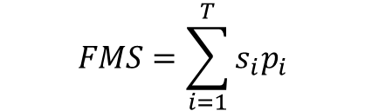

Force Mix Score
Force Mix Score is a way of summarizing how effective a mission has been at engaging compound targets, compared to the total number of compound targets in the mission.
$$FMS=\sum_{i=1}^{T}{s_{i}p_{i}}$$
$$\sum_{i=1}^{T}{p_{i}}$$
T = number of compound targets in the mission
s_{i} = service value [0, 1/5, 1]
p_{i} = target priority value [1, 2, 3, 4]
i = target number

Slide 13
Force Mix Score
T = number of compound targets in the mission
s_{i} = service value [0, 1/5, 1]
p_{i} = target priority value [1, 2, 3, 4]
i = target number

Slide 14
Force Mix Score
T = number of compound targets in the mission
s_{i} = service value [0, 1/5, 1]
p_{i} = target priority value [1, 2, 3, 4]
i = target number
Storage Depot A
Storage Depot B
Warehouse A
Warehouse B
Our scenario has 2 compound targets
Power Generator A
Power Generator B

Slide 15
Force Mix Score
T = number of compound targets in the mission
s_{i} = service value [0, 1/5, 1]
p_{i} = target priority value [1, 2, 3, 4]
i = target number
FULLY SERVICED
PARTIALLY SERVICED
NOT ENGAGED
Engagement level
Service value
1
1/5
0

Slide 16
Force Mix Score
T = number of compound targets in the mission
s_{i} = service value [0, 1/5, 1]
p_{i} = target priority value [1, 2, 3, 4]
i = target number
FULLY SERVICED
Engagement level
Not engaged
Engaged
Storage Depot
Storage Depot
Warehouse
Warehouse
Service value
1
1
Power Generator
Power Generator
DESTROY
DEGRADE

Slide 17
Force Mix Score
T = number of compound targets in the mission
s_{i} = service value [0, 1/5, 1]
p_{i} = target priority value [1, 2, 3, 4]
i = target number
PARTIALLY SERVICED
Engagement level
Not engaged
Engaged
Storage Depot
Warehouse
Service value
1/5
Power Generator

Slide 18
Force Mix Score
T = number of compound targets in the mission
s_{i} = service value [0, 1/5, 1]
p_{i} = target priority value [1, 2, 3, 4]
i = target number
Highest priority
4
Storage Depot A
Storage Depot B
3
Warehouse A
Warehouse B
2
Power Generator A
Power Generator B
1
Priority
3
4
Lowest priority

Slide 19
Force Mix Score
T = number of compound targets in the mission
s_{i} = service value [0, 1/5, 1]
p_{i} = target priority value [1, 2, 3, 4]
i = target number
Highest priority
4
Priority
4
1
3
Engagement level
2
P
F
Service value
1/5
1
1
Lowest priority
0.8
1

Slide 20
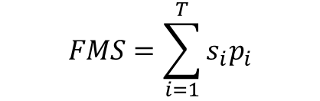

Force Mix Score
$$FMS=\sum_{i=1}^{T}{s_{i}p_{i}}$$
$$\sum_{i=1}^{T}{p_{i}}$$
T = number of compound targets in the mission
s_{i} = service value [0, 1/5, 1]
p_{i} = target priority value [1, 2, 3, 4]
i = target number
Mission Calculated Target Engagement Score
Force Mix Score =
Mission Maximum Target Engagement Score

Slide 21
Force Mix Score
Storage Depot A
Storage Depot B
Mission Maximum Target Engagement Score
Warehouse A
Warehouse B
Power Generator A
Power Generator B
FULLY SERVICED
Priority 3
Priority 4
*
+
*
=
Service value
3
1
4
1
7
Priority

Slide 22
Force Mix Score
Storage Depot A
Storage Depot B
Storage Depot A
Storage Depot B
Warehouse A
Warehouse B
Warehouse A
Warehouse B
S 1
S 2
Power Generator A
Power Generator B
Power Generator A
Power Generator B
Not engaged
NONE
NONE
DESTROY FACILITY
NONE
Engaged
Storage Depot A
Storage Depot B
Storage Depot A
Storage Depot B
Warehouse A
Warehouse B
Warehouse A
Warehouse B
S 3
S 4
Power Generator A
Power Generator B
Power Generator A
Power Generator B
NONE
DESTROY FACILITY
DEGRADE POWER
DEGRADE POWER

Slide 23
Force Mix Score
Storage Depot A
Storage Depot B
0
Warehouse A
Warehouse B
S 1
Power Generator A
Power Generator B
NONE
NONE
*
+
*
=
3
0
4
0
0

Slide 24
Force Mix Score
Storage Depot A
Storage Depot B
Warehouse A
Warehouse B
3
S 2
Power Generator A
Power Generator B
DESTROY FACILITY
NONE
*
+
*
=
3
1
4
0
3

Slide 25
Force Mix Score
*
+
*
=
3
0
4
1
4
Storage Depot A
Storage Depot B
4
Warehouse A
Warehouse B
S 3
Power Generator A
Power Generator B
NONE
DESTROY FACILITY

Slide 26
Force Mix Score
*
+
*
=
3
1
4
1
7
Storage Depot A
Storage Depot B
Warehouse A
Warehouse B
7
S 4
Power Generator A
Power Generator B
DEGRADE POWER
DEGRADE POWER

Slide 27
Force Mix Score
Storage Depot A
Storage Depot B
Storage Depot A
Storage Depot B
0
Warehouse A
Warehouse B
Warehouse A
Warehouse B
3
S 1
S 2
Power Generator A
Power Generator B
Power Generator A
Power Generator B
NONE
NONE
DESTROY FACILITY
NONE
Storage Depot A
Storage Depot B
Storage Depot A
Storage Depot B
4
Warehouse A
Warehouse B
Warehouse A
Warehouse B
7
S 3
S 4
Power Generator A
Power Generator B
Power Generator A
Power Generator B
NONE
DESTROY FACILITY
DEGRADE POWER
DEGRADE POWER
Notes:
Mission Calculated Target Engagement Score for each mission plan

Slide 28
Force Mix Score
Mission Calculated Target Engagement Score
Force Mix Score =
Mission Maximum Target Engagement Score
*
+
*
=
3
1
4
1
7
Notes:
A reminder of the maximum target engagement score

Slide 29
Force Mix Score
Storage Depot A
Storage Depot B
Storage Depot A
Storage Depot B
0/7
Warehouse A
Warehouse B
Warehouse A
Warehouse B
3/7
S 1
S 2
Power Generator A
Power Generator B
Power Generator A
Power Generator B
NONE
NONE
DESTROY FACILITY
NONE
Storage Depot A
Storage Depot B
Storage Depot A
Storage Depot B
4/7
Warehouse A
Warehouse B
Warehouse A
Warehouse B
7/7
S 3
S 4
Power Generator A
Power Generator B
Power Generator A
Power Generator B
NONE
DESTROY FACILITY
DEGRADE POWER
DEGRADE POWER
Notes:
This is the calculation

Slide 30
Force Mix Score
Storage Depot A
Storage Depot B
Storage Depot A
Storage Depot B
0
Warehouse A
Warehouse B
Warehouse A
Warehouse B
0.42
S 1
S 2
Power Generator A
Power Generator B
Power Generator A
Power Generator B
NONE
NONE
DESTROY FACILITY
NONE
Storage Depot A
Storage Depot B
Storage Depot A
Storage Depot B
0.57
Warehouse A
Warehouse B
Warehouse A
Warehouse B
1
S 3
S 4
Power Generator A
Power Generator B
Power Generator A
Power Generator B
NONE
DESTROY FACILITY
DEGRADE POWER
DEGRADE POWER

Slide 31
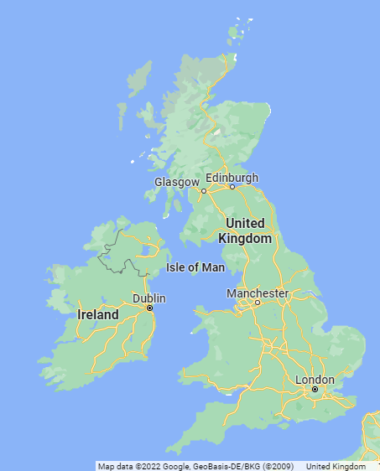
Applications of Force Mix Score
4
We can use it to assess mission clustering configurations
2
A
B
Image source: maps.google.com

Slide 32
Applications of Force Mix Score
Comparing situations where multiple platforms are available
Platform A
FMS: 0.7
Platform A & B
FMS: 0.8
Image source: maps.google.com

Slide 33
Applications of Force Mix Score
We can also apply Force Mix Score to the outcome of simulation engagements.
Scenario | FMS | Weapons launched | Platforms lost
A | 0.8 | 20 | 3
B | 0.76 | 25 | 1
C | 0 | 0 | 10
D | 0.24 | 4 | 0
Image source: maps.google.com

Slide 34
Applications of Force Mix Score
Now imagine we need to assess a scenario like this:
Consider…
  The number of clusters
  Platforms available
  Priority of targets
  Weapons required
  Cost
  Risk to blue
  Collateral considerations
Image source: maps.google.com

Slide 35
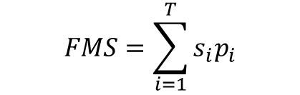

Wrapping up
Force Mix Score is a useful tool that can be used for mission planning and analysis of simulation results.
It relies on Effects Trees and breakdown of compound targets into their key target elements.
It helps planners utilise resources in order to achieve high levels of mission effectiveness.
It is used to support MOD decision makers quickly make sense of complex military scenarios.
$$FMS=\sum_{i=1}^{T}{s_{i}p_{i}}$$
$$\sum_{i=1}^{T}{p_{i}}$$

