Slide 1
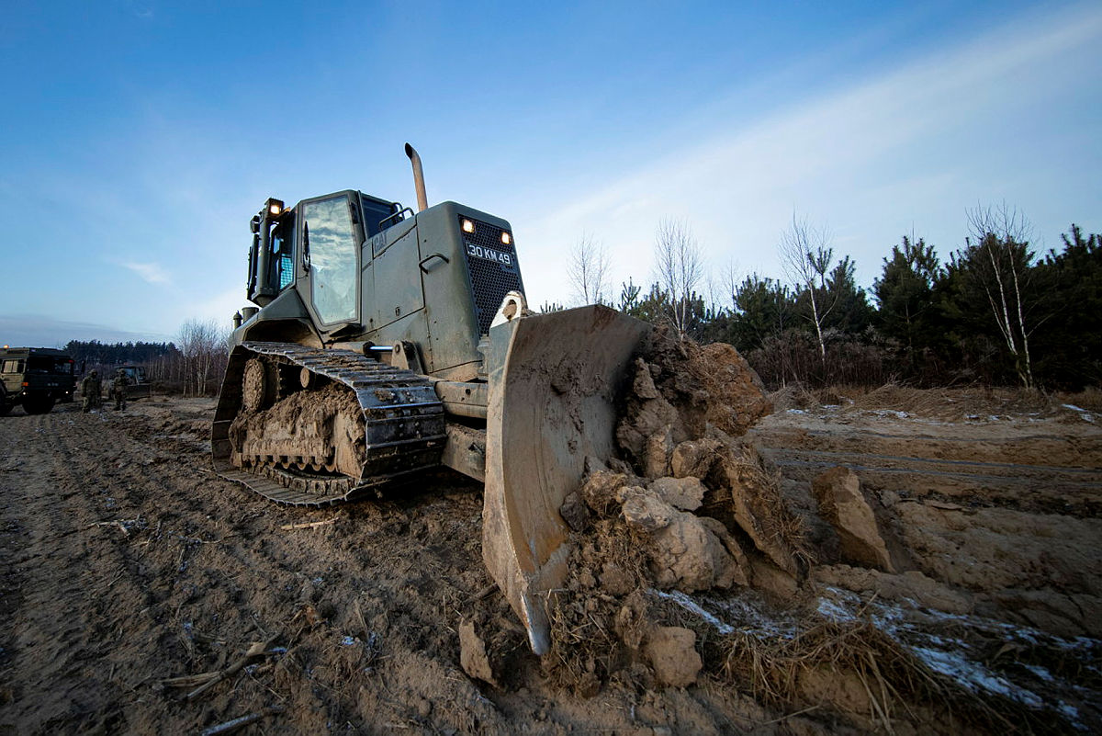
Autonomy in Military Engineering Phase 2
18th July 2023
C Warfield, R Smith, Dr. L Whittingham, T Potts
1. https://www.defenceimagery.mod.uk/Home/Search?Query=45169800.jpg&Type=Filename

Slide 2
Agenda
Requirement
Background
TRIZ Approach
Wargame Approach
Results

Slide 3
Requirement

Slide 4
Overview of Requirement
Arke were tasked with identifying and recommending areas for investment by MOD for exploitation of Autonomy and Automation technologies within Force Support Engineer Regiments.
Concepts should be generated against specific engineering tasks and assessed through a TTX or wargame

Slide 5
Background

Slide 6
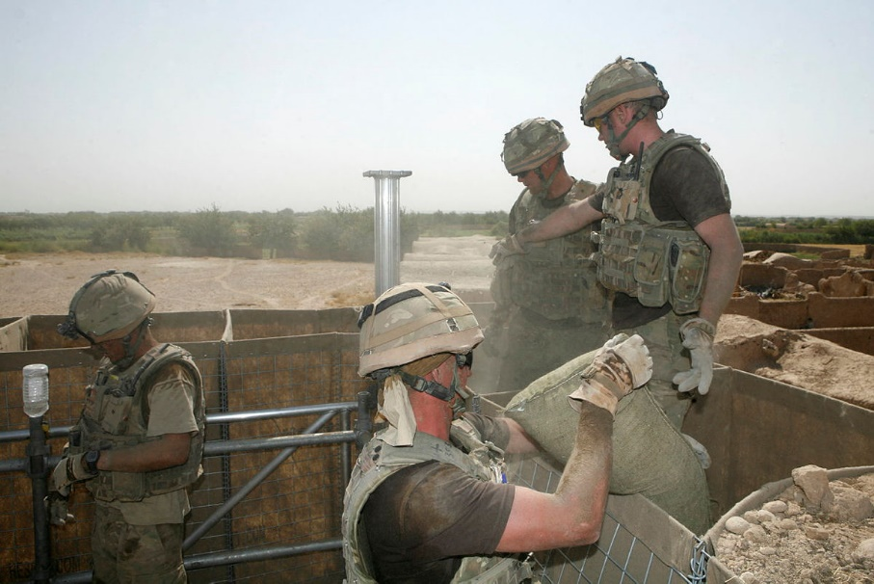
Force Support Engineers
Study was to target FS Engineer Regiments
They conduct a wide array of civil and traditional military engineering tasks
A down selected sub-set of tasks chosen for greatest applicability to the problem and reduce duplication of effort from other studies
2. https://www.defenceimagery.mod.uk/Home/Search?Query=440630.jpg&Type=Filename

Slide 7
Utility of A&A in FS
A&A is being explored across a range of defence roles currently
Some relevant and appropriate, others not so
FS Engineer tasks are typically:
  Well defined
  Prescriptive
  Repetitive
  Conducted in comparatively benign environments (compared to Armoured Engineers)

Slide 8
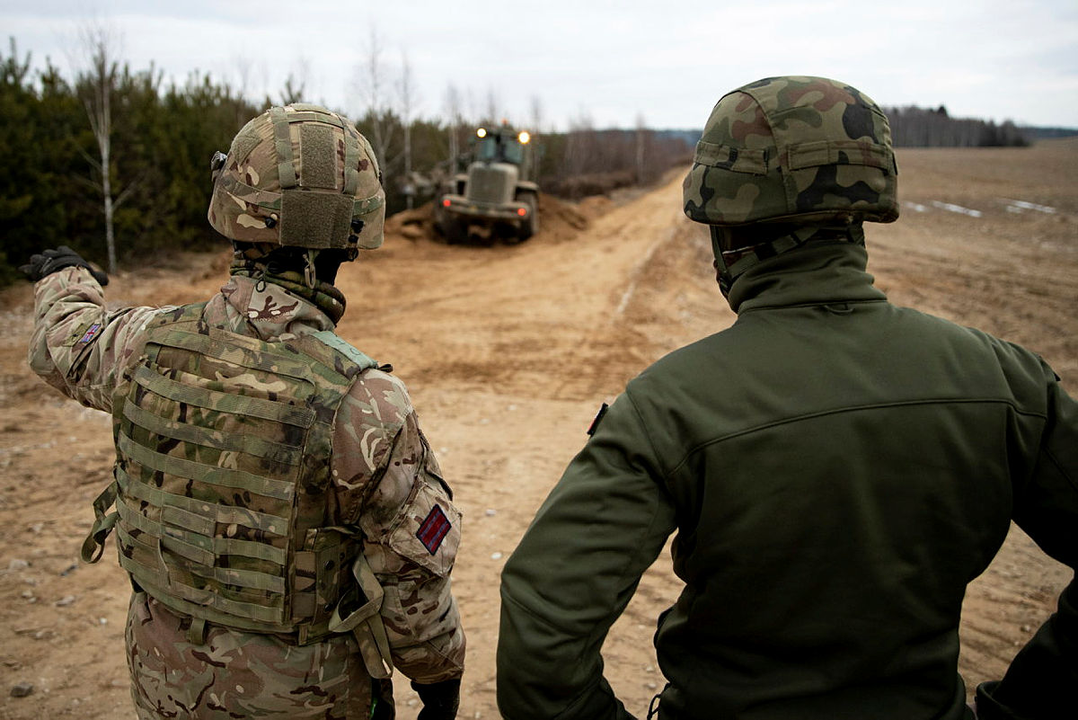
Task Refinement & Data Capture
Prioritised Tasks
  Securing Ground Lines of Communication
  General Support Bridging
  Rail Recce & Maintenance
  SPOD Entry
  Engineer Logistics
  Air & Aviation
Review of previous OA
Review of RE Training Publications
Engagement with RE Officers and Soldiers, covering both training and operations
3. https://www.defenceimagery.mod.uk/Home/Search?Query=JIAG-OFFICIAL-20220110-OPROC-32ENG-108%20-003.jpg&Type=Filename

Slide 9
TRIZ Approach

Slide 10
TRIZ
Soviet method of creativity developed from 1940s through to the 80s
Acronym in Russian for “Theory of Inventive Problem Solving”
Only 100 known solutions to fundamental problems
Many variations on the original method – either simplify or tailor to specific needs
4. Wiki
Notes:
4. https://en.wikipedia.org/wiki/TRIZ
According to TRIZ, universal principles of creativity form the basis of innovation. TRIZ identifies and codifies these principles, and uses them to make the creative process more predictable.
In other words, whatever problem you're facing, somebody, somewhere, has already solved it (or one very like it). Creative problem solving involves finding that solution and adapting it to your problem.
Research into patents found only 100 solutions for fundamental problems

Slide 11
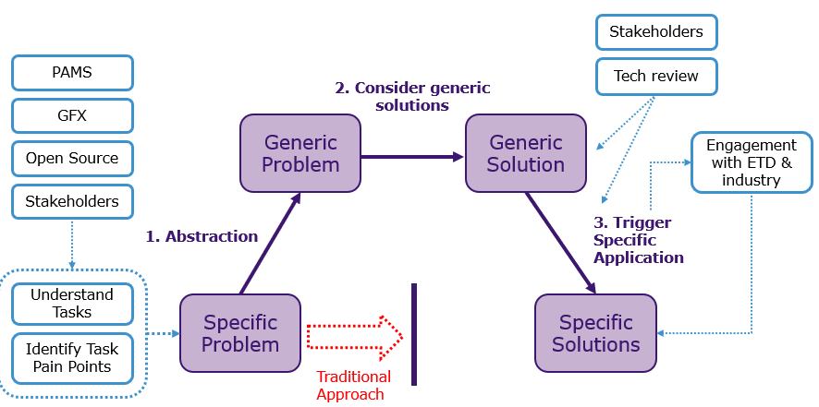
Approach
3 key step to avoid duplicating traditional solutions
Took task pain points identified from stakeholders
Compared against data set of A&A research projects from academia and industry

Slide 12
Solution Example
Example of previous use of approach
Generified for Presentation
Towing vehicle causing damage to trailer
Don’t have trailer being pulled by vehicle
Trailer keeps failing due to stress from movement
Self-propelled trailer that follows vehicle
Design new trailer able to handle stress

Slide 13

Concept Generation
Engagement with Engineering Liaison Officer in US and ERDC
Down select conducted with 12 FS Eng GP & AHQ

Slide 14
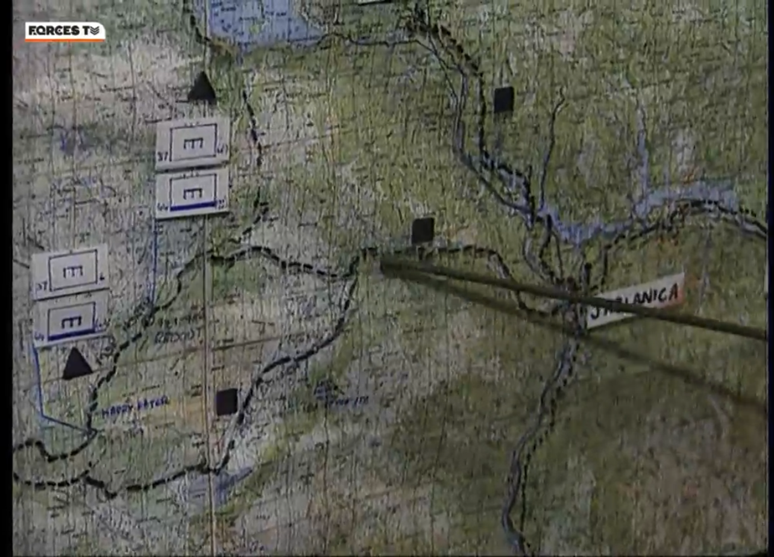
War Game - Design & Develop
Notes:
3 tasks chosen due to length of time available and support from RE

Slide 15
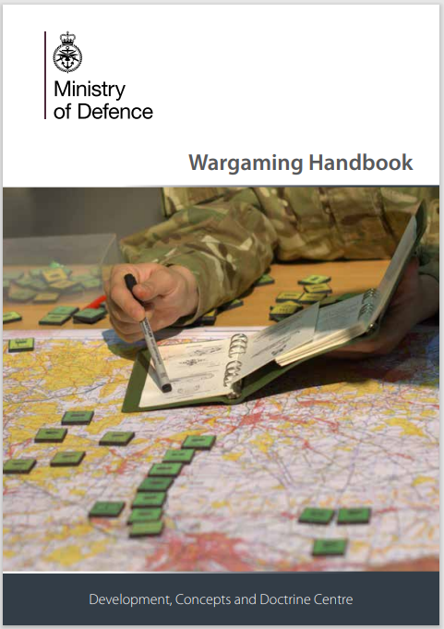
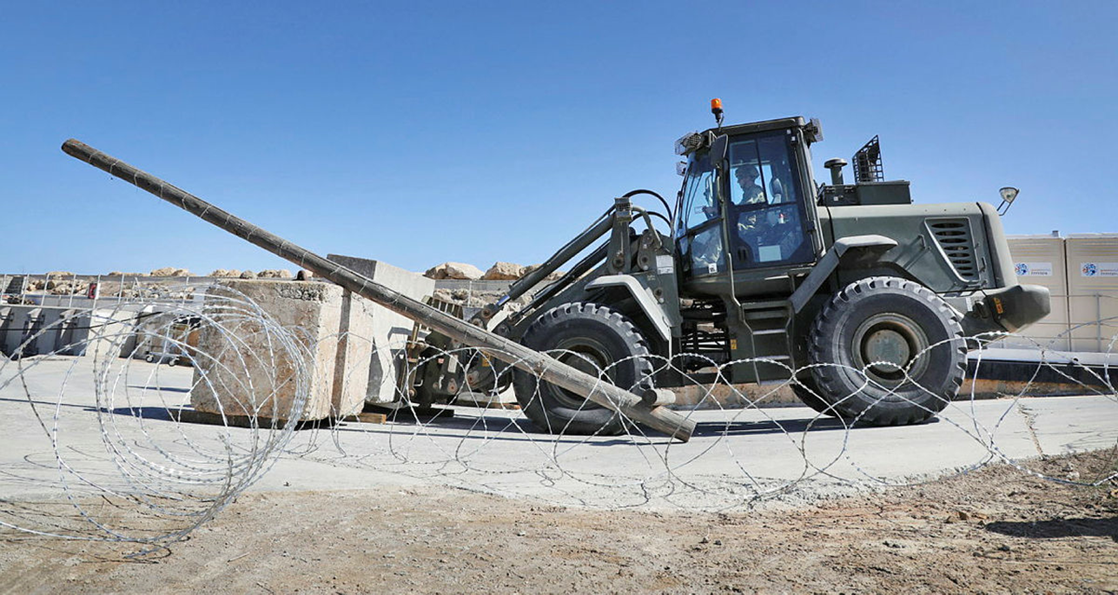
War Game - Design & Develop
Design
Design steps – based on MOD guidance
Settled on historical Royal Engineers Force Support (FS) tasks
3 tasks chosen
Bosnia (Op. Grapple) Historical scenario chosen with relevance to:
  Route Recce
  Road Route construction and maintenance
  Base building
5. https://www.gov.uk/government/publications/defence-wargaming-handbook
6. Defence Imagery (mod.uk) AKR-20221003-342-Ex Austere Wolf-0161.jpg
Notes:
3 tasks chosen due to length of time available and support from RE

Slide 16

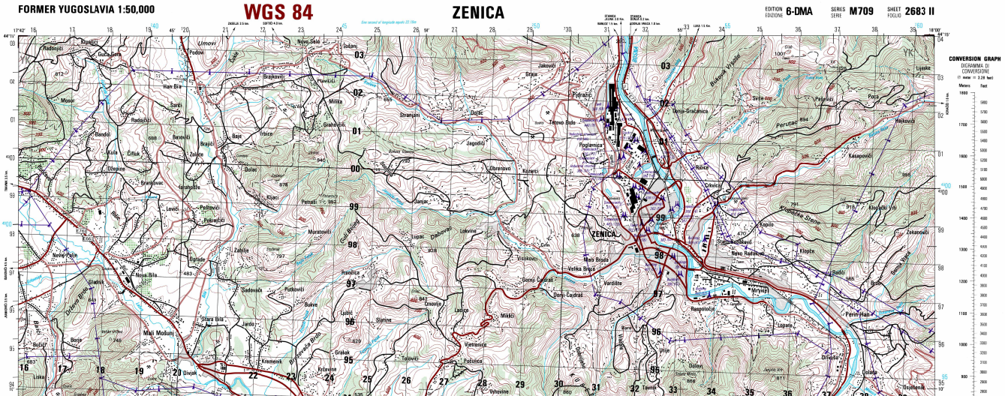
Sources
Sources
Primarily open source
  Books: “The Muslim-Croat Civil War in Bosnia, A Military History, 1992-1994” , Charles R. Schrader.
  Contemporary video: Forces.net documentary (30 min from 1992/1993)
  Contemporary maps: Perry-Castañeda Library, University of Texas at Austin (US Def. Map. Agency.)
  MOD internal: Sketch from deployed personnel alongside historic accounts
7. Former Yugoslavia Topographic Maps - Perry-Castañeda Map Collection - UT Library Online (utexas.edu)
https://maps.lib.utexas.edu/maps/topo/former_yugoslavia/zenica-bosnia_and_herzegovina-50k-2683ii-1996.pdf
8. https://www.iwm.org.uk/history/25-photos-from-the-bosnian-war-of-1992-1995
Notes:
3 tasks chosen due to length of time available and support from RE

Slide 17
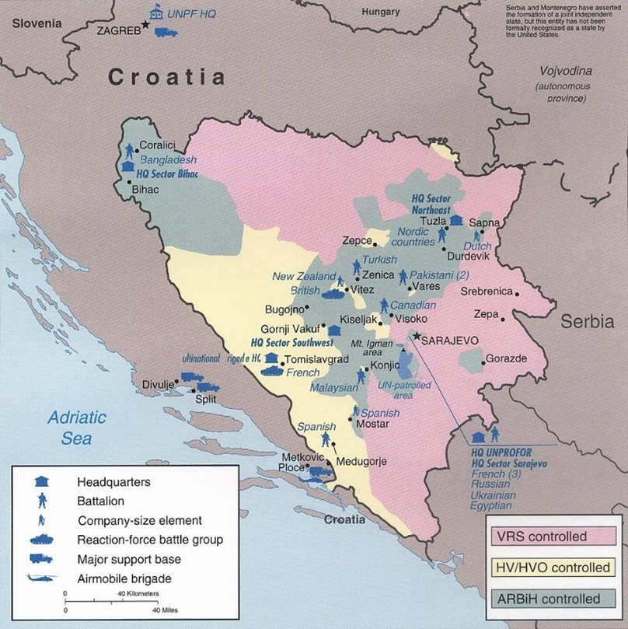
War Game – snapshot
Scenario. UNPROFOR in Bosnia
Security corridor established by UNPROFOR
Route selection: minimise ‘switching’ through zones of different control.
Relief cargo to be distributed
9. https://upload.wikimedia.org/wikipedia/commons/d/d8/UNPROFOR_1995.jpg
Notes:
Security corridor established by UNPROFOR, bypassing held main routes and enabling supply to Sarajevo from the north.
Brigade level multinational deployment
Sea POD @Split.
Ground Line of Communication required to enable:
UNPROFOR relief cargo to be distributed to population via UNPROFOR units/points of control
Bde(+) from SPODs
Across Central and NE
Armoured BG (UK) to be sustained at Vitez
Supply to Medium multinational BGs beyond

Slide 18
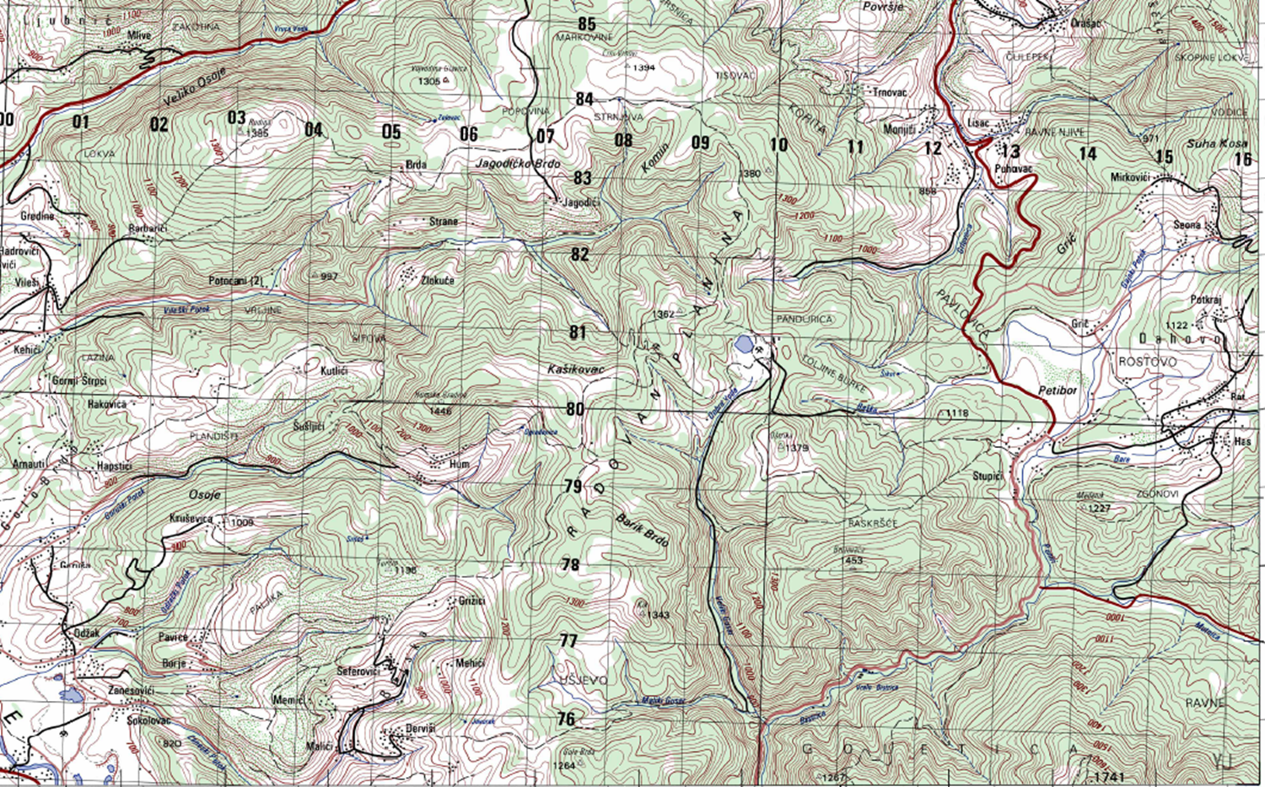
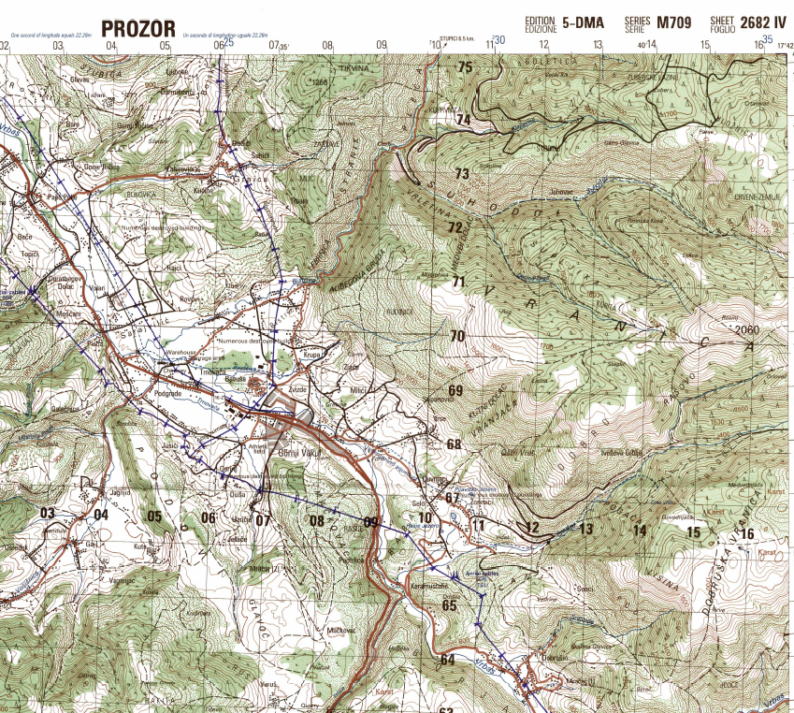
War Game – snapshot
Scenario. UNPROFOR in Bosnia
Security corridor established by UNPROFOR
Route selection: minimise ‘switching’ through zones of different control.
Relief cargo to be distributed
Task Example: Route Construction, Route Diamond
Several road routes.
Route Diamond ~35km
More widely ~60km+ Recce, construction, widening*
9. https://upload.wikimedia.org/wikipedia/commons/d/d8/UNPROFOR_1995.jpg
7. Former Yugoslavia Topographic Maps - Perry-Castañeda Map Collection - UT Library Online (utexas.edu)
https://maps.lib.utexas.edu/maps/topo/former_yugoslavia/zenica-bosnia_and_herzegovina-50k-2683ii-1996.pdf
Notes:
Security corridor established by UNPROFOR, bypassing held main routes and enabling supply to Sarajevo from the north.
Brigade level multinational deployment
Sea POD @Split.
Ground Line of Communication required to enable:
UNPROFOR relief cargo to be distributed to population via UNPROFOR units/points of control
Bde(+) from SPODs
Across Central and NE
Armoured BG (UK) to be sustained at Vitez
Supply to Medium multinational BGs beyond

Slide 19
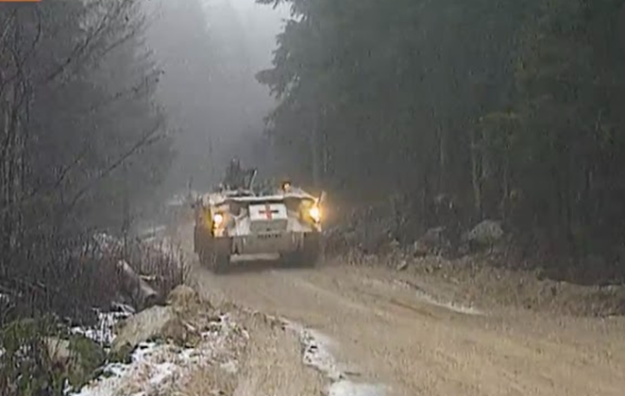
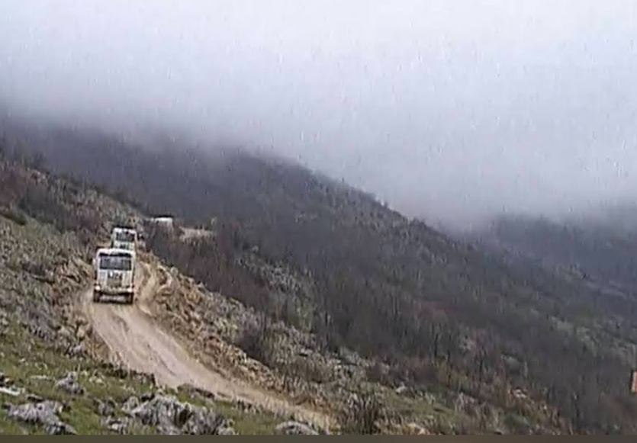
War Game – snapshot
Task Example: Route Construction, Route Diamond
Several road routes.
Route Diamond ~35km
More widely ~60km+ Recce, construction, widening
11. Bosnian War: The Road To Vitez (forces.net) (30 min documentary from 1992/1993)
7. Former Yugoslavia Topographic Maps - Perry-Castañeda Map Collection - UT Library Online (utexas.edu)
https://maps.lib.utexas.edu/maps/topo/former_yugoslavia/zenica-bosnia_and_herzegovina-50k-2683ii-1996.pdf
Notes:
IWM collection. “Route Diamond ran from Prozor to Vitez via Gornji Vakuf. The main route into central Bosnia was little more than a goat track before the British Army's Sappers (Royal Engineers) improved it to accommodate humanitarian aid trucks and military traffic. From the Croatian port of Split to the town of Lipa it was called Route Circle; between the towns of Lipa and Prozor it was called Route Triangle. The Croat–Bosniak War was a conflict between the Republic of Bosnia and Herzegovina and the self-proclaimed Croatian Republic of Herzeg-Bosnia, supported by Croatia, that lasted from 18 October 1992 to 23 February 1994.”
https://www.iwm.org.uk/history/25-photos-from-the-bosnian-war-of-1992-1995

Slide 20
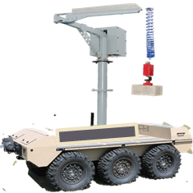
Seminar Exercise
Assessment factors.
Merits per concept: effect, time, resource, risk
Issues ID: achievability (logistics, data and comms)
X8 Concepts
Assessed in
Capture/review
War Game
In each Task Phase
Recce
Build
Maintain
Task 1. Sea Port hub
Task 2. Road Route
Task 3. Base Build

Slide 21
Outcome
Notes:
3 tasks chosen due to length of time available and support from RE

Slide 22

Post-Analysis & Outcome
Analysis and Reporting
Priority ranking based on the metrics and exercise outcome (top 4 concepts)
Outcome: Recommendations to Army HQ
  given wider context of industry investment
  pointing to where MOD should act, spend money
  proposed actions for the top concepts

Slide 23
Post-Analysis & Outcome
Observations
TRIZ: useful ideas, mindset, for concept development
Historical tasks and scenario: excellent resources available including
  Map libraries hosted by University of Texas in Austin
  Books
  Forces.net, Imperial War Museum and other media
  Contemporary Dstl experiences – support to Ops
  And facial hair in the British Army in early 90s…: impressive, highly competitive environment.

Slide 24
Questions
11. Bosnian War: The Road To Vitez (forces.net) (30 min documentary from 1992/1993)

Slide 25
References
Title image, C fleet vehicle https://www.defenceimagery.mod.uk/Home/Search?Query=45169800.jpg&Type=Filename
Force Support Engineering task - simple illustration of sand bag filling and fortification construction https://www.defenceimagery.mod.uk/Home/Search?Query=440630.jpg&Type=Filename
Force Support task - simple illustration of route construction or maintenance https://www.defenceimagery.mod.uk/Home/Search?Query=JIAG-OFFICIAL-20220110-OPROC-32ENG-108%20-003.jpg&Type=Filename
Wikipedia TRIZ overview https://en.wikipedia.org/wiki/TRIZ
Defence Wargaming Handbook https://www.gov.uk/government/publications/defence-wargaming-handbook
Force Support task - Defence Imagery (mod.uk) AKR-20221003-342-Ex Austere Wolf-0161.jpg
Former Yugoslavia Topographic Maps - Perry-Castañeda Map Collection - UT Library Online (utexas.edu) https://maps.lib.utexas.edu/maps/topo/former_yugoslavia/zenica-bosnia_and_herzegovina-50k-2683ii-1996.pdf
Imperial War Museum photograph collection https://www.iwm.org.uk/history/25-photos-from-the-bosnian-war-of-1992-1995
Overview map of UNPROFOR deployment https://upload.wikimedia.org/wikipedia/commons/d/d8/UNPROFOR_1995.jpg
Books: “The Muslim-Croat Civil War in Bosnia, A Military History, 1992-1994” , Charles R. Schrader.
Contemporary video: Forces.net documentary (30 min from 1992/1993) https://www.forces.net/services/tri-service/bosnian-war-road-vitez
Dstl: deployable analyst contemporary sketches (not shareable)

