Slide 1
Multi-Domain Integrated Swarms (MDIS) Matthew Hodge Operational Analysis TPG Services
Official
Official
Notes:
Good Morning Everyone.
Today I am going to tell you about the Multi-Domain Integrated Swarms project (also known as MDIS).
My name is Matt and I work for a company called TP Group.

Slide 2
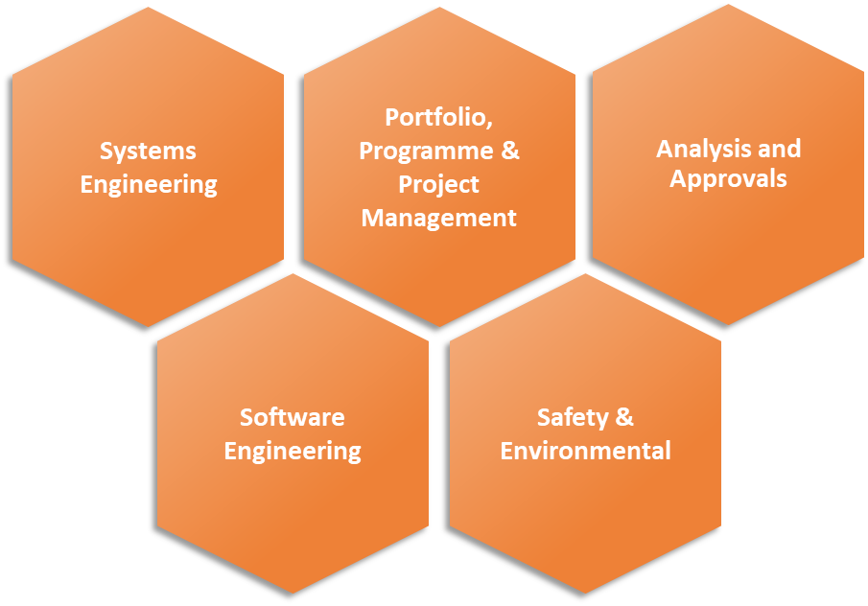
tpgroup
Evidence Based Decision Analysis
COEIA for procurements
Modelling of ‘what ifs’
Expert analysis and assessment
Consulting & Solutions
Workshops to generate consensus
Stakeholder Engagement to secure buy in
Requirements elicitation to shape projects
Customer Friend
Independent, impartial and solution agnostic advice
Aid procurement and support gate review
Full Business Case Approvals Process
Holistic End to End Programme Delivery
Full programme life cycle
Partnering with SMEs and Primes where needed
Delivery of projects, management of operations
tpgroup provide consulting, digital solutions and engineering services across the full lifecycle of mission and safety critical programmes in Aviation, Critical Infrastructure, Defence and Space sectors
Approx. 160 Core staff, matrixed Account and Capability structure with significant Associate/SME partner base
Broad client tasking portfolio including in Army HQ, Air Command, DE&S, Defence Digital and Dstl inc. wider S&T.
Notes:
We are a medium sized consultancy providing professional expertise in a number of areas such as systems engineering, project management, software engineering and operational analysis. We work a lot with the military, with customers including Army HQ, Air Command, DE&S and Dstl.

Slide 3
Capabilities – Operational Analysis
Case-Studies:
Future Beyond Line-of-Sight Communications – analysis of use case scenarios to agree MOD needs for FBLOS in the 2040 timeframe.
CBR Modelling – helping Dstl and DEFRA simulate different PPE supply strategies and hazard reduction efforts.
Human Augmentation – identifying areas of future science and technology that could augment human capability in the military domain.
Business Case & Approvals Support
Modelling and Simulation
Concept Definition & Analysis
Decision Support
Notes:
I work with some great people in the Operational Analysis sector. We cover the full spectrum of OA, including developing the requirement, running workshops, concept development.

Slide 4
What is MDIS?
What is RAS?
Operational Analysis on MDIS
MDIS Use Cases & RAS Concepts
Measures of Merit
Testing & Modelling
What’s Next?
Contents
Notes:
This is a brief overview of what I am going to cover today. I am going to explain the terms “MDIS” and “RAS”. I am then going to talk about the analysis we have done, which involves creation of Use cases, defining Measures of Merit, running Tabletop Exercises and modelling.

Slide 5
What is MDIS?
Notes:
So first of all, what exactly is MDIS?

Slide 6
MDIS aims: Change the Game
What is MDIS?
A 4-year capability investigation
Demonstrate potential value to Defence of MDI RAS to inform investment decision at IR25.
Designed to produce high-quality decision-making evidence.
A ‘Game Changer’ programme with a mandate to:
CHANGE FIGHT:
Change the way Defence fights, or
Render a current way of fighting, threat or process obsolete.
CHANGE PROCURE:
Deliver capability faster.
Use bespoke procurement and commercial models and a streamlined approach to approvals.
Notes:
It’s an MOD 4-year capability investigation, looking to demonstrate the potential value to Defence of MDI RAS. This will inform an investment decision at the Integrated Review 2025.
It is also known as a ‘Game Changer’ programme with a mandate to change how we fight (because we will be using new technology). It will also change procurement, giving us the ability to deliver capability faster. (if anyone asks about this, say rapid development trials outside traditional routes).

Slide 7
MDIS Overview
What is MDIS?
With FoAM as its key challenge MDIS will:
Assess whether MDI RAS, enabled by a common Reference Architecture, will have a noticeable and economical effect on Operational Advantage.
Identify and address security, regulatory and policy challenges and produce roadmaps to operationalisation of MDI RAS.
Seek, where possible, to exploit early capability delivery opportunities.
MDIS has 4 primary desired outcomes:
Develop a prototype, multi-domain digital architecture for MDI RAS.
Accelerate RAS capabilities in all domains.
Develop pan-Defence mechanisms for accreditation of RAS for operational use.
Identify operational use cases for MDI RAS, including cost effectiveness analysis.
Notes:
MDIS is driven by a requirement for UK forces to obtain Operational Advantage, specifically in terms of FOAM. This means Freedom of Access and Manoeuvre . I am going to go into this more later.
We want to know whether Robotic Autonomous Systems will help us obtain that advantage. I am also going into more detail on RAS shortly.
There are a number of challenges involved in terms of security and regulatory policies.
What are the MDIS aims? There are several and the project itself is broken down into various work streams which look at these.
First is the creation of an architecture by which all RAS can communicate with other systems. There is an Architecture work stream looking at this. Next is the acceleration of RAS capabilities in all domains. The Experimentation workstream works closely with the Armed Forces and is extensively involved in testing new RAS technology. Developing mechanisms for accreditation of RAS is the work of the Regulatory workstream. Identifying use cases for RAS and cost effectiveness analysis. That is us, the Operational Analysis workstream

Slide 8
MDIS Outputs and Defence Outcomes
MDIS WORKSTREAM OUTPUTS
MDIS PROGRAMME OUTPUTS
DEFENCE
OUTCOMES
Reference Architecture
Investment choice for MDI RAS at IR25, supported by evidence,
standards and delivery pathways
Coherence & acceleration across MDI RAS
Ability to achieve FOAM
Operational Concept Demonstrator
Operational Analysis
Regulatory & Policy Roadmaps
Operational Commercial Framework
Accelerated FLC Experiments
Early capability exploitation, where possible
Security
Notes:
This slide gives an overview of the programme as a whole.
On the left we have all the various activities. These relate to the project workstreams. All of them are very important to make the project a success. I have highlighted the OA workstream as that is the specific focus of this talk.
The output of the programme is to provide evidence to the MOD to support their choice of investment at IR25. We also look for early capability exploitation.
For Defence, the outcome is coherence across MDI RAS programmes and of course, the ability to achieve FOAM.

Slide 9
Freedom of Access and Manoeuvre (FOAM)
Notes:
Freedom of Access and Manoeuvre is one of UK Defence’s current key Defence Tasks.
The MOD’s Science and Technology portfolio has laid out the requirement to “Generate affordable, survivable capability responsive to rapidly evolving threats operated within a denied electromagnetic environment and be interoperable with our allies and partners”
Basically, it means the ability to enter a theatre of operations and have the ability to do what we want to do without the enemy stopping us. This slide, which was created by my colleague, shows a conception of the future battlespace. As well as the current systems, there are UAVs, UGVs and USVs, all integrated into a coherent fighting force. FOAM means that RAS give us new opportunities or alternative options to get into the enemy’s “space”.

Slide 10
What is RAS?
RAS? UAS? UXVs? UFOs?
Notes:
I am going to briefly touch on terminology.

Slide 11
MDIS
Multi Domain Integrated
Swarms
Notes:
For the phrase MDIS, there are a couple aspects. “Multi Domain” – this means we want these systems to operate across domains – land, sea, sky. Perhaps even space. One example might be a Royal Navy commander of the RAS assets tasking them all in one go instead of separately, thus achieving the integration of assets across multiple domains. “Integrated” – this refers to data sharing and the communication. You need a shared Architecture to make this happen.

Slide 12
MDIS
Multi Domain Integrated
Swarms
Notes:
Swarms – this phrase refers to Robotic Autonomous Systems (RAS).
Note on swarms – these days we tend to use the term “collaborative squad” Why? Because people assume a swarm has to include many vehicles. In fact, even a couple of vehicles can constitute a swarm, in MDIS terms.

Slide 13
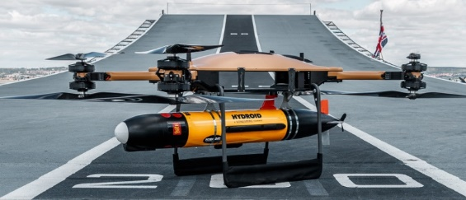
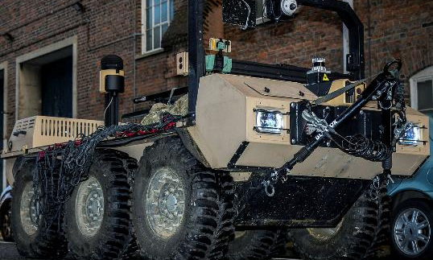
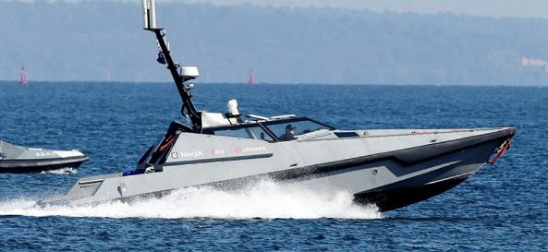
What are Robotic Autonomous System & Uncrewed Vehicles?
UAV (Air, Fixed Wing)
UAV (Air, Rotary Wing)
Above: Proj. VERMEER platform: https://www.gov.uk/government/news/rafs-first-synthetic-fuel-drone-flight
UUV (Underwater)
(Add in UUV)
Above: Malloy t150 with a payload sensor [https://mezha.media/en/2022/05/04/malloy-aeronautics-t150-uav-for-delivery-of-urgent-cargo-to-or-from-the-front-line]
UGV (Ground)
USV (Surface)
Image Attribution Statement: Contains public sector information licensed under the Open Government Licence v3.0.
Image Attribution Statement: Contains public sector information licensed under the Open Government Licence v3.0.
Notes:
Here are some examples of RAS. A UAV is a type of RAS. Future RAS may have a higher degree of autonomy. For example, while today, UAVs need an operator to fly them, in the future there is an aspiration for them to be able to fly themselves. The autonomous programming would also allow them to fly in complicated formations, such as a swarm.

Slide 14
Definitions: RCO’s (Current) Autonomy Framework
Notes:
We acknowledge there are different definitions of autonomy. This is one was used during a recent TTX, as recommended by the RAF Rapid Capabilities Office.
The definition was specifically given to us by Air Capstrat and Capdev. We always envision a human in the loop when it comes to certain activities such as engaging an enemy, so full level 5 is unlikely.

Slide 15
Operational Analysis on MDIS
Notes:
I am now going to talk about Operational Analysis and cover the various approaches we have used to look at whether MDIS provides Operational Advantage.
So how could MDIS help give us operational advantage? You might imagine all sorts of situations. We already know how current uncrewed systems (mostly UAVs) are used to gather intelligence or even strike enemy targets. But imagine having more of such systems and giving them some autonomy. Instead of each having to be piloted individually, a single controller could tell a swarm to go over a hill and conduct surveillance.
You could have collaborative squads of underwater vehicles searching for enemy submarines.
Or maybe you could use uncrewed surface vehicles to sail up a river and conduct an engineering recce.

Slide 16
MDIS OA Master Question List (MQL)
What are the representative scenarios for MDIS to be applied against?
What operational advantages could an MDIS-enabled force provide in 2025+?
What system elements and enablers does an effective MDIS capability require?
What are the cost implications of implementing MDIS?
What future (2030+) developments to elements in an MDIS system would create the greatest benefit?
Notes:
These are the questions which MDIS would like the Operational Analysts to answer. Taken together, they form the steps of the analytical approach to determining the value of MDIS.
The first question is there because we need to take a variety of scenarios and see whether MDIS helps in each one. These are our Use Cases.
The second question relates to mapping out the capabilities of MDIS and determining whether they give Operational Advantage.
The third question is down to the requirements needed to make MDIS actually work.
Question 4 - Cost implications is an important question because there would be no point in having MDIS if it's extremely expensive but delivers little extra capability. So, a cost benefit analysis is necessary.
The last question looks to the future. Based on the results of our analysis for the 2030 epoch, we should have a good idea of areas where technology could make it even more impactful going forwards.

Slide 17
Where we are
IR25
Cost Modelling
Measures of Merit
Tabletop Exercises
Scenario Modelling
Horizon Scanning
Threat Environment
Use Cases
Evidence Based Decision Making
Recommendation
Analysis
Underlying
Evidence
Notes:
So how have we tackled this task? This is an overview of the techniques we have used, which fall into the traditional “soft” and “hard” OA. I am going to go into these in more detail in each of these. The qualitative side includes our scenario development – use cases and workshops with SMEs. We developed ideas about how you would use RAS. We then developed metrics to determine effectiveness of MDIS – our MoMs. Finally, we conducted Tabletop exercises with the military. This gave us a great number of insights into how MDIS could be effective. On the quantitative side, we are starting a series of modelling tasks.

Slide 18
What OA Methods have we applied
Qualitative
Produced Use Cases
Produced RAS Concept Cards
Workshops with military SMEs
Measures of Merit
Tabletop Exercises
Quantitative
Modelling
SEAD
Theatre Entry
ASW
Other
Platform Investigations
Notes:
So how have we tackled this task? This is an overview of the techniques we have used, which fall into the traditional “soft” and “hard” OA. I am going to go into these in more detail in each of these. The qualitative side includes our scenario development – use cases and workshops with SMEs. We developed ideas about how you would use RAS. We then developed metrics to determine effectiveness of MDIS – our MoMs. Finally, we conducted Tabletop exercises with the military. This gave us a great number of insights into how MDIS could be effective. On the quantitative side, we are starting a series of modelling tasks.

Slide 19
Hypotheses for MDIS Enabled Operations
Accuracy, Precision & Timeliness
MDIS-enabled platforms perform FIND, IDENTIFY and STRIKE missions more effectively than the current 2030 baseline, by connecting multiple sources that enable the dynamic and timely collection of ISR data. This provides in-depth and multi-layered ISR pictures, to deliver greater accuracy and precision.
Lower Cost, Same Effect
MDIS nodes can be equipped with less expensive effectors than traditional platforms, and which require less technologically sophisticated systems to deliver precision effect.
Greater Redundancy
High volume of MDIS platforms in operation enables greater redundancy and coverage to improve mission survivability.
Lower Risk To Life (Blue)
The risk incumbent in having multiple MDIS platforms destroyed is still lower in cost (both financially and in human life) than losing manned platforms.
Greater Endurance
The endurance of MDIS platforms is great enough to support the duration of an operation without impacting allocation of resources away from other taskings.
Quality of Information Exchanges / Decision Making
The speed at which better information is exchanged between platforms is increased, enabling better decision making.
Notes:
So how could MDIS help give us operational advantage? You might imagine all sorts of situations. We already know how current uncrewed systems (mostly UAVs) are used to gather intelligence or even strike enemy targets. But imagine having more of such systems and giving them some autonomy. Instead of each having to be piloted individually, a single controller could tell a swarm to go over a hill and conduct surveillance.
You could have collaborative squads of underwater vehicles searching for enemy submarines.
Or maybe you could use uncrewed surface vehicles to sail up a river and conduct an engineering recce.
to answer.
Most of the ideas can be broken down into the categories here.
Accuracy, Precision and timeliness – Compared to the 2030 baseline, MDIS is more effective at ISR and STRIKE missions due t connectivity of multiple sources through an architecture.
Lower cost compared to traditional platforms.
The redundancy and lower risk to live come from the fact the RAS are uncrewed.
The greater endurance means you can use MDIS for your campaign and you won’t have to substitute traditional assets.
Finally, we think that MDIS would allow enhanced speed of information sharing, leading to better decision making.

Slide 20
Possible MDIS Options
Baseline (No MDIS) | Current RAS Programme Without Common Architecture No SWARM capability (Except through remote pilot / HITL)
MDIS + | Current RAS Programme With Common Architecture No SWARM capability
MDIS + + | Current RAS Programme + Additional RAS platforms Common Architecture AI/Autonomy (Optimised SWARM using extra RAS platforms)
* This is not meant to be a complete set and other alternative solutions may need to be considered
Notes:
The way we have broken the problem down from an OA perspective is by way of comparison.
We look at the situation in 2030 if we do not have MDIS, then we compare to the situation when we do.
We looked at 2 alternatives.
In the first, we had the same RAS as in the current programme.
But we gave them a common architecture so that they could communicate with other assets.
In the second, we also added additional RAS platforms and assumed they have a level of autonomy and can swarm.

Slide 21
MDIS Use Cases & RAS Concepts

Slide 22
MDIS Use Cases Developed (to date)
Use Case 1 - SEAD
Use Case 2(a) – ASW Barrier, North Atlantic
Use Case 2(b) – ASW Barrier, Carrier Strike Group
Use Case 3(a) – ISR, Deep Recce FIND
Use Case 3(b) – Engineering Gap Recce
Use Case 4 – Littoral STRIKE
Use Case 5 – Operating in a Denied Environment
Use Case 6(a) – Theatre Entry, NEO
Use Case 6(b) – Theatre Entry, Opening A New Flank
Notes:
Then we needed a test bed.
The OA team ran a number of workshop with the Front-Line Commands, the OA community and industry to develop a number of scenarios – MDIS USE CASES.
We prioritised 4, by direction from the SRO.
I am going to show you an example of one those 4 cases and talk about suggested ways in which RAS can help.
DON’T DISCUSS, JUST SHOW WHILST YOU EXPLAIN UC WORK

Slide 23
MDIS Use Cases Developed (to date)
Use Case 1 - SEAD
Use Case 2(a) – ASW Barrier, North Atlantic
Use Case 2(b) – ASW Barrier, Carrier Strike Group
Use Case 3(a) – ISR, Deep Recce FIND
Use Case 3(b) – Engineering Gap Recce
Use Case 4 – Littoral STRIKE
Use Case 5 – Operating in a Denied Environment
Use Case 6(a) – Theatre Entry, NEO
Use Case 6(b) – Theatre Entry, Opening A New Flank
Notes:
Then we needed a test bed.
The OA team ran a number of workshop with the Front-Line Commands, the OA community and industry to develop a number of scenarios – MDIS USE CASES.
We prioritised 4, by direction from the SRO.
I am going to show you an example of one those 4 cases and talk about suggested ways in which RAS can help.
DON’T DISCUSS, JUST SHOW WHILST YOU EXPLAIN UC WORK

Slide 24
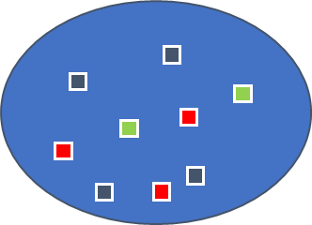
Use Case 6(b)
Theatre Entry: Opening a New Flank
Situation: Conduct a deliberate operation for theatre access and entry, enabling a Divisional size force to enter the battle space and open up a new flank. Then provide support to Green military forces to DEFEAT Red Forces from Green Territory, under NATO Article V agreement.
Intent: Through the use of MDIS-enabled Forces, a theatre access and entry operation will be conducted to provide re-enforcements through a new flank in order to defeat Red forces operating in the area of operations (AO), whilst maintaining FOAM in the vector of ingress and preventing a Red counter-flanking manoeuvre .
Main Effort (ME): Opening up a new flank to provide a secure theatre entry point for s divisional size force re-enforcing the AO.
Blue country
HQ
Green country
Notes:
First we have the title, this is the brave (second) iteration of Use Case 6
That is: Theatre Entry, a divisional movement to open a new flank (here, from the north) on an ongoing operation
Then we have the situation: this is the scenario brief, providing minimal context for this phase.
In this particular scenario, we have a deliberate movement across a northern border, where BLUE will enter GREEN country to DEFEAT RED forces.
We then move on to the Intent: Here we always note the end goals of the phase. In this scenario, the goals of each phase change from a secure crossing of the border, to force protection and ISR of RED assets and locations, to the BATTLE and DEFEAT of RED, to securing the area and confirming FOAM.
Lastly, at the bottom left, we have the Main Effort: put simply [read the last point]
This is actually the subject of one of our team’s modelling exercises, which I will discuss shortly

Slide 25
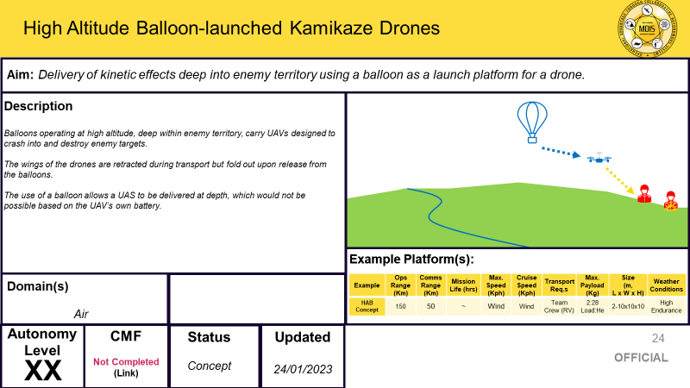
Notes:
To look at all the possibilities, we worked with subject matter experts at Dstl and produced a series of concept cards.
These showed the current thinking and the types of things RAS might be able to do in different scenarios.
On the left we have an example of a collaborative squad of RAS attempting to overload an enemy air defence network.
To the right, is an example of an engineering recce being undertaken using RAS platforms.
Some are UAVs and some are USVs, illustrating the multi domain nature of MDIS.
Below is an example of a deployment method for a UAV.
One of the issues with certain UAV types is their battery life and endurance.
A number of novel techniques have been proposed to enhance their range.

Slide 26
Notes:
Here is an up close example of one of the concepts. This one was developed for our SEAD use case.

Slide 27
Measures of Merit
Examples:
Probability of Mission Success
Number of Blue System Losses
% Red targets engaged
Endurance time on task for an MDIS – enabled system
Proportion of tasks executed without conflicts in resource allocation
System failure / breakdown rate
Notes:
We need metrics by which to determine whether MDIS has a positive effect over the baseline.
TPG worked with Dstl to create a set of Measures of Merit. These covered all sorts of areas. Some were based on Blue casualties lost during an operation and whether these were fewer with MDIS. Others looked at combat metrics such as how quickly Red forces were identified or neutralised. Others were based on logistics, such as how many operators you need to control MDI RAS.
A set of examples is below.

Slide 28
Testing & Modelling

Slide 29
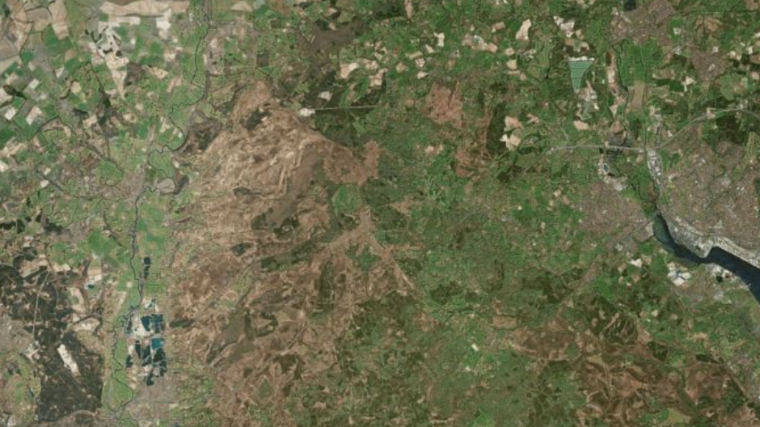
Tabletop Exercises (TTX)
Notes:
Earlier this year, we ran a series of tabletop exercises with the military. These are a bit like mini war games. You have a scenario with a map and you ask the experts what they would do in the baseline. Then you ask what they would do if they had MDIS. (this is just a map of Salisbury area but obviously the real maps are at higher classification).
The aim is to learn what advantages you get from MDI RAS.
From an OA perspective we gain an evidence base to answer the MQLs.

Slide 30
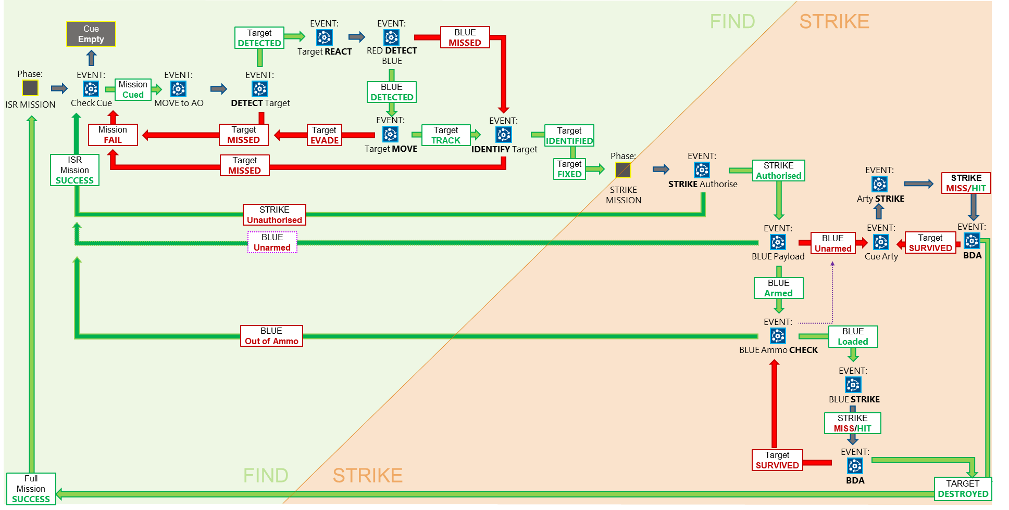
Modelling Example: Use Case 6(b)
Notes:
The current phase of work involves modelling. We have been making a SEAD model in Python and a Theatre Entry Model in SIMUL8.

Slide 31
What Next?
Gap Analysis
Cost Analysis
MOD RAS programme and platform investigations
Attending RAS experimentation events
Modelling
Theatre Entry Use Case modelled in SIMUL8.
SEAD Use Case modelled in Python.
ASW Use Case to be modelled soon.
Full OA report for the MDIS programme (March 2024)
Notes:
Gap Analysis
This will enable us to identify both what we know, and what we don’t know, and will (we hope!) steer us in the right direction
This work will highlight which MQL entries we haven’t figured out yet, and also which MQLs we may have got carried away with!
Cost Analysis
Further programme and platform investigations and deep dives
etc

Slide 32
Questions

