Slide 1

Red’s Shoes
An application of novel wargaming AI to operational planning
Dr Darrell Jaya-Ratnam (DIEM Analytics Ltd), Capt (RN) Matt Boulind (ACOS Ops SJFHQ)
ISMOR 40
Royal Holloway
18th July 2023

Slide 2
Outline
‘What Would Napoleon Do’ and ‘Red Shoes’ ideas (funded by Dstl IMMT project) first presented at ISMOR 38.
Detail of subsequent practical application presented here.
Theory
  Learning cycles
  Algorithm
  Output
Proof of concept
  Process
  4 historic commanders
  2 contemporary commanders
Practice
  Context
  Insights presented into current commanders
  Skill vs Will matrix
Conclusions

Slide 3
Theory | Learning cycles
People do what they know
How they do depends on what they learn
Learning depends on how they did previously
You must not fight too often with one enemy, or you will teach him all your art of war
Hubris cycle
Hubris cycle
Humility cycle
Humility cycle

Slide 4
Theory | Learning cycles
Positive assumption bias about the past
We assume consistency when things go well…
Hubris cycle
Hubris cycle
Humility cycle
Humility cycle
…and variability when things go badly

Slide 5
Theory | Algorithm
Cyclical-regression of categorical outputs from mixed inputs (not mean-regression)
Determines
  Which inputs are drivers (some categorical, some quantitative e.g. assets and losses)
  The time-window of input relevance
  Characteristic frequency of relevant inputs
Predicts next output for planned inputs i.e. skill and will vs different effect/situation combination

Slide 6
Theory | Output
Captures Lines of Operations, Decisive Conditions (DCs), Supporting Effects (SEs), Campaign Objectives, Red Centre of Gravity (COG) and desired end state
Indicates overall ‘risks to effect’ for each DC and SE, overall ‘risk to outcome’ and the ‘plan value’, when facing a specific Red commander

Slide 7
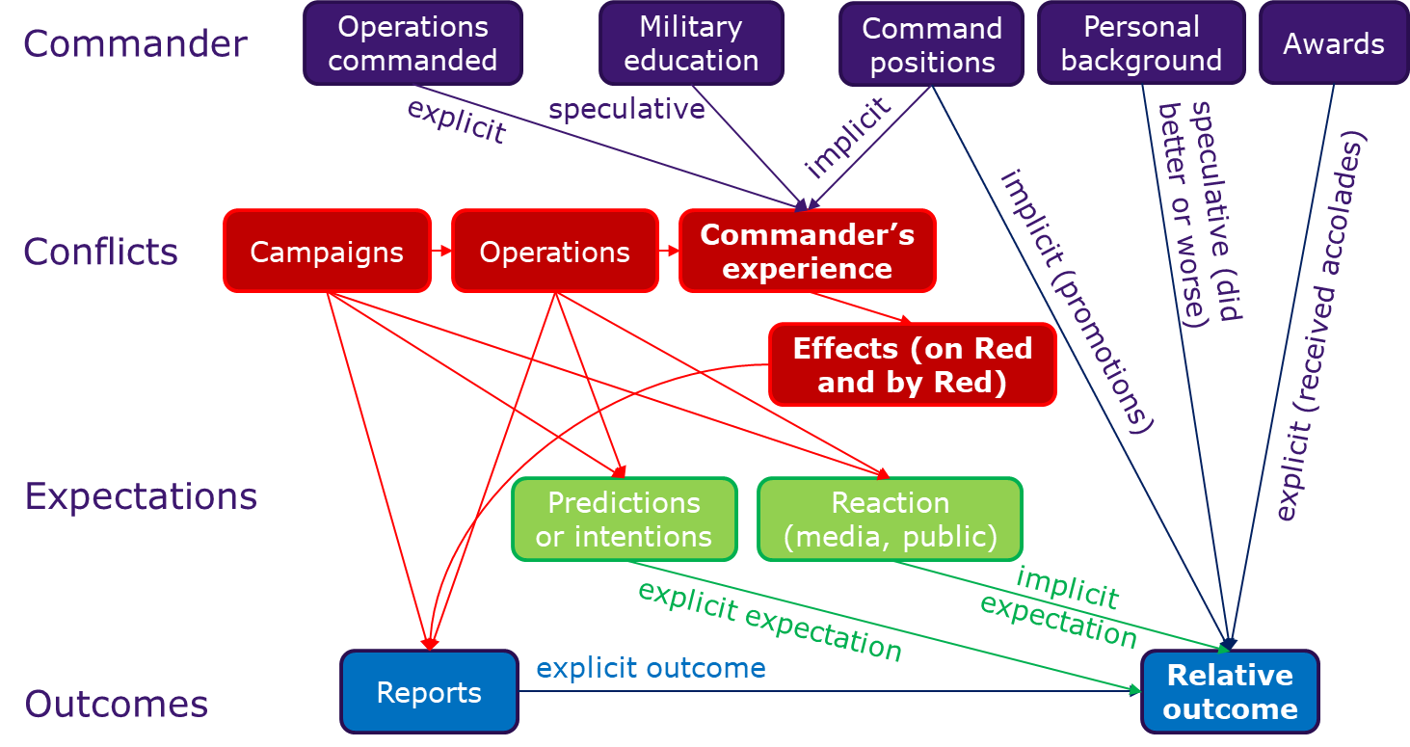
Proof of concept | Process

Slide 8
Proof of concept | 4 historic commanders
3 Chechen commanders from the Russian-Chechen wars
1 Russian commander from WWII

Slide 9
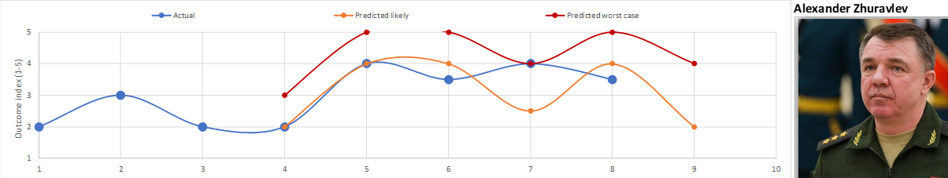
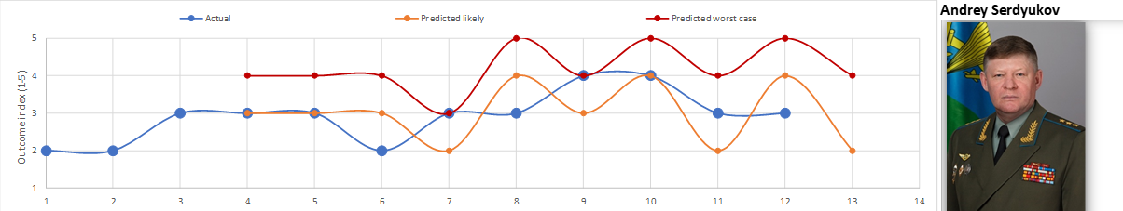
Proof of concept | 2 contemporary commanders
Limited time span, available data on forces and losses
Mixture of combat, influence, and development experiences
Outcomes versus expectation assessed on reported outcomes
Extensive time span, but little data re forces and losses
Mixture of combat, influence and political experiences
Outcomes versus expectation much harder to assess as politically sensitive so reports less reliable

Slide 10
Proof of concept | 2 contemporary commanders
1.Decisive Conditions and Supporting Effects in Blue’s plan
2.Risk due to Red commander’s ‘will’ and ‘skill’ to resist (driven by combination of experience and outcome e.g. confidence or revenge)
3.Red commander’s past experience that drives skill and will. Experience can be ‘equivalent’ to planned supporting effect (based on ‘lack of optionality in resisting’), it does not have to be identical

Slide 11

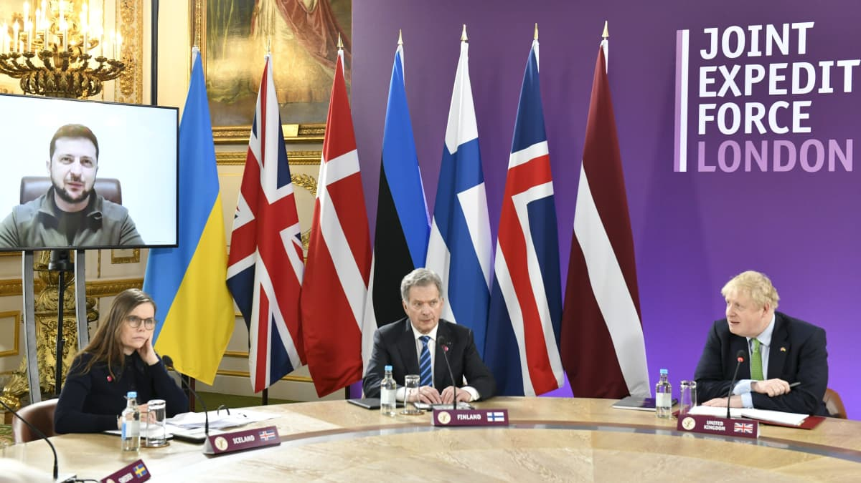


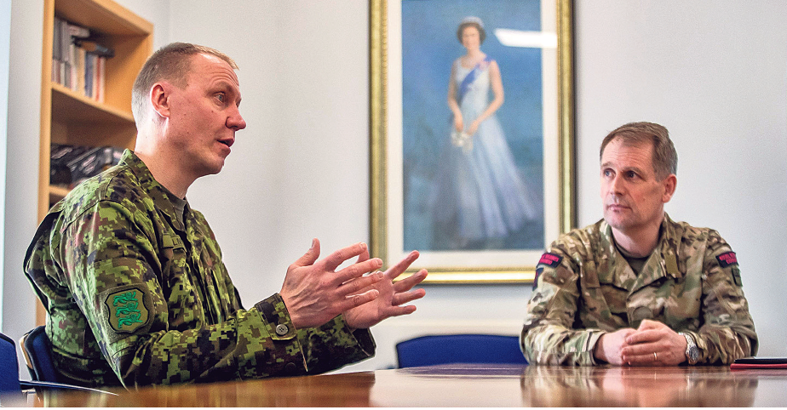
Practice | Context
The JEF: From Force Development to Operational Delivery
FORCE DEVELOPMENT (2014-2020)
NATO Framework Nation Concept
Directed to focus regionally and below the threshold of conflict
INITIAL ‘OPERATIONALISATION’ (2021)
JP21: 1st operational level exercise in the ‘sub threshold’
Lessons identified: JEF HQ as a ‘Platform for integration’
RESPONSE TO CURRENT CRISIS (24 Feb 22-Present Day)
Political progress
HQ Deployment to Latvia and Lithuania: Response to PN ‘push’
JEF Integration Options (JIOs)
HQ Activated: Operational Co-ordination Cell
JP22 – 3 Key Themes
Developing the role of the JEF below the threshold of conflict. ​
Plotting a path to closer integration with NATO.
Developing the Combined Joint Interagency Task Force concept.
In order to facilitate JEF Response Options (JROs).

Slide 12

Practice | Context
JEF Operating Framework
JROs
JIOs
Follow-on activity
Initial phase activity
Enhanced Vigilance
BACO – Peacetime Vigilance
COMPETITION
CRISIS
Transition to CONFLICT

Slide 13
Practice | Context
JEF Operating Framework
Follow-on activity
Initial phase activity
Enhanced Vigilance
BACO – Peacetime Vigilance
COMPETITION
CRISIS
Transition to CONFLICT

Slide 14
Practice | Context
JEF Operating Framework
Follow-on activity
Initial phase activity
Enhanced Vigilance
BACO – Peacetime Vigilance
COMPETITION
CRISIS
Transition to CONFLICT

Slide 15

Practice | Context
JEF Operating Framework
Persistent
Proactive
NATO/JEF Integration and Mutual Advantage
Responsive
NATO/JEF Integration and Mutual Advantage
NATO
Collective Defence
JIOs
JROs

Slide 16
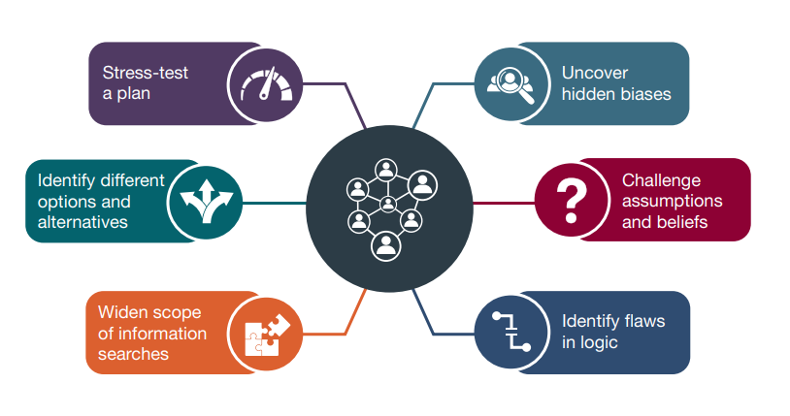
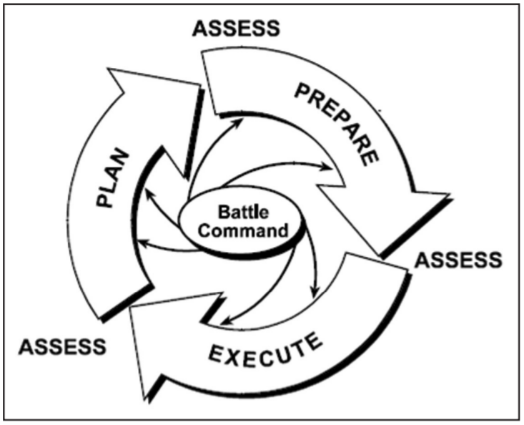
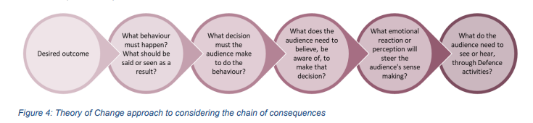
Practice | Context
Red Shoes = Red teaming

Slide 17
Practice | Insights presented into current commanders
What he knows
Infantry officer made a general of the air force
Working with…
  Chechen units (‘Zapad’ and ‘Vostok’ battalions)
  PMCs (Wagner)
  Syrian Army and IRGC
Focussed on ‘preparation’ of enemy capability
  Degraded ISIS oil facilities
Close coordination of ground and air forces
Media view
‘General Armageddon’
‘Goal is to inflict chaos and panic’
Lessons being exploited?
Making use of Iranian drones
Attacking energy infrastructure in the approach to winter
Uses up AD missiles
Allows greater freedom for air force to support ground forces

Slide 18
Practice | Insights presented into current commanders
What he knows
Non-military background, technical education
Mainly submarine command and operations
Many tests and ‘firsts’
  Commercial space launch from submarine
  Reserve control systems
  Ballistic missile launches from submarines
Kerch Strait incident
Development of naval and marine capability
Lessons being exploited?
??Gas pipelines??
??Communications cables??

Slide 19
Practice | Skill vs Will matrix
Catalogue what they know
Detect a decision maker’s learning cycle in terms of their
  Skill
  Will
Inform which parts of your plan (or courses of action) provide risk or opportunity…
Potential for unexpected opportunities that could be exploited
Plan at risk due to unexpected ability to ‘cope’ with intended effects
High skill
Risk of escalation to compensate for lack of capability
Low skill
Low will
High will

Slide 20
Conclusions
In theory there is no difference between theory and practice. In practice there is
The scientifically interesting/challenging things are different to the most useful things
  Few data points are ok as long as they are rich, adjacent, and any bias is consistent
  Qualitative data (even if open source) can be used so long as it meets certain criteria
  The most useful insight concerned the narrative of the Red commander’s interpretation of Blue’s intent
  The numbers helped judge the extent to which the insight is trustworthy
Users can see the best ways to fit it into the current process
  Commander’s Approval and Guidance Board (CAGB): Inform course of action and messaging
  J5 process: Which target MOEs should either be avoided or strongly managed
  J3 process: Incorporate choice of options and their messaging as part of the core planning

