Slide 1

Eating the Elephant
Analysis and Planning of NATO’s Acquisition Portfolio
Nick Rose
HQ SACT CAPDEV / OA Branch

Slide 2
Summary
Who am I?
Portfolio management
What is the NATO portfolio?
The problem
Portfolio management analysis maturity model

Slide 3









Who am I?
Business cases & approvals management
Studies: modelling & simulation, soft OR
Military / political concept development
P3M
Notes:
OR / OA consultant for 10 years
BAE Systems
Dstl
NATO Communications & Information Agency
DE&S
NATO ACT

Slide 4

NATO
Defensive political-military alliance of 31 (soon 32) Nations
Formed in 1949
Organization(s) to facilitate & deliver political & military direction
Deterrence & defence
Crisis prevention & management
Collective defence & security
Notes:
What is NATO
Collection of 31 nations (two Nations yet to ratify Sweden’s accession – votes expected in the next few months)
The organizations that facilitates & delivers the shared political / military direction
Political
Military / Operational
Military / Futures
Strategic concept: deterrence & defence, crisis prevention & management, collective defence & security

Slide 5
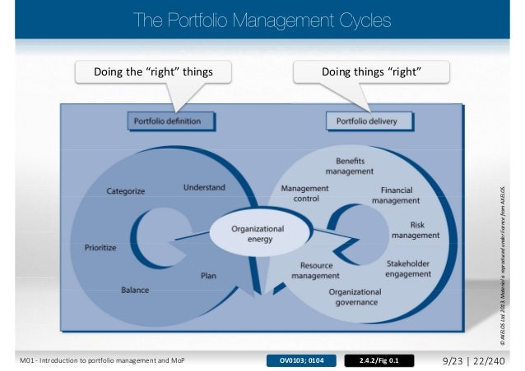
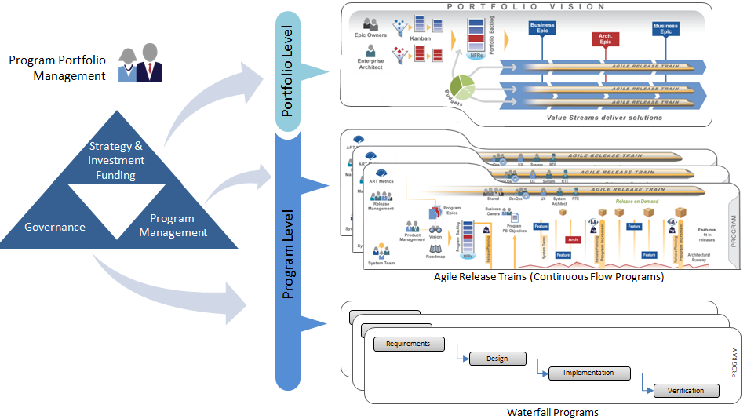
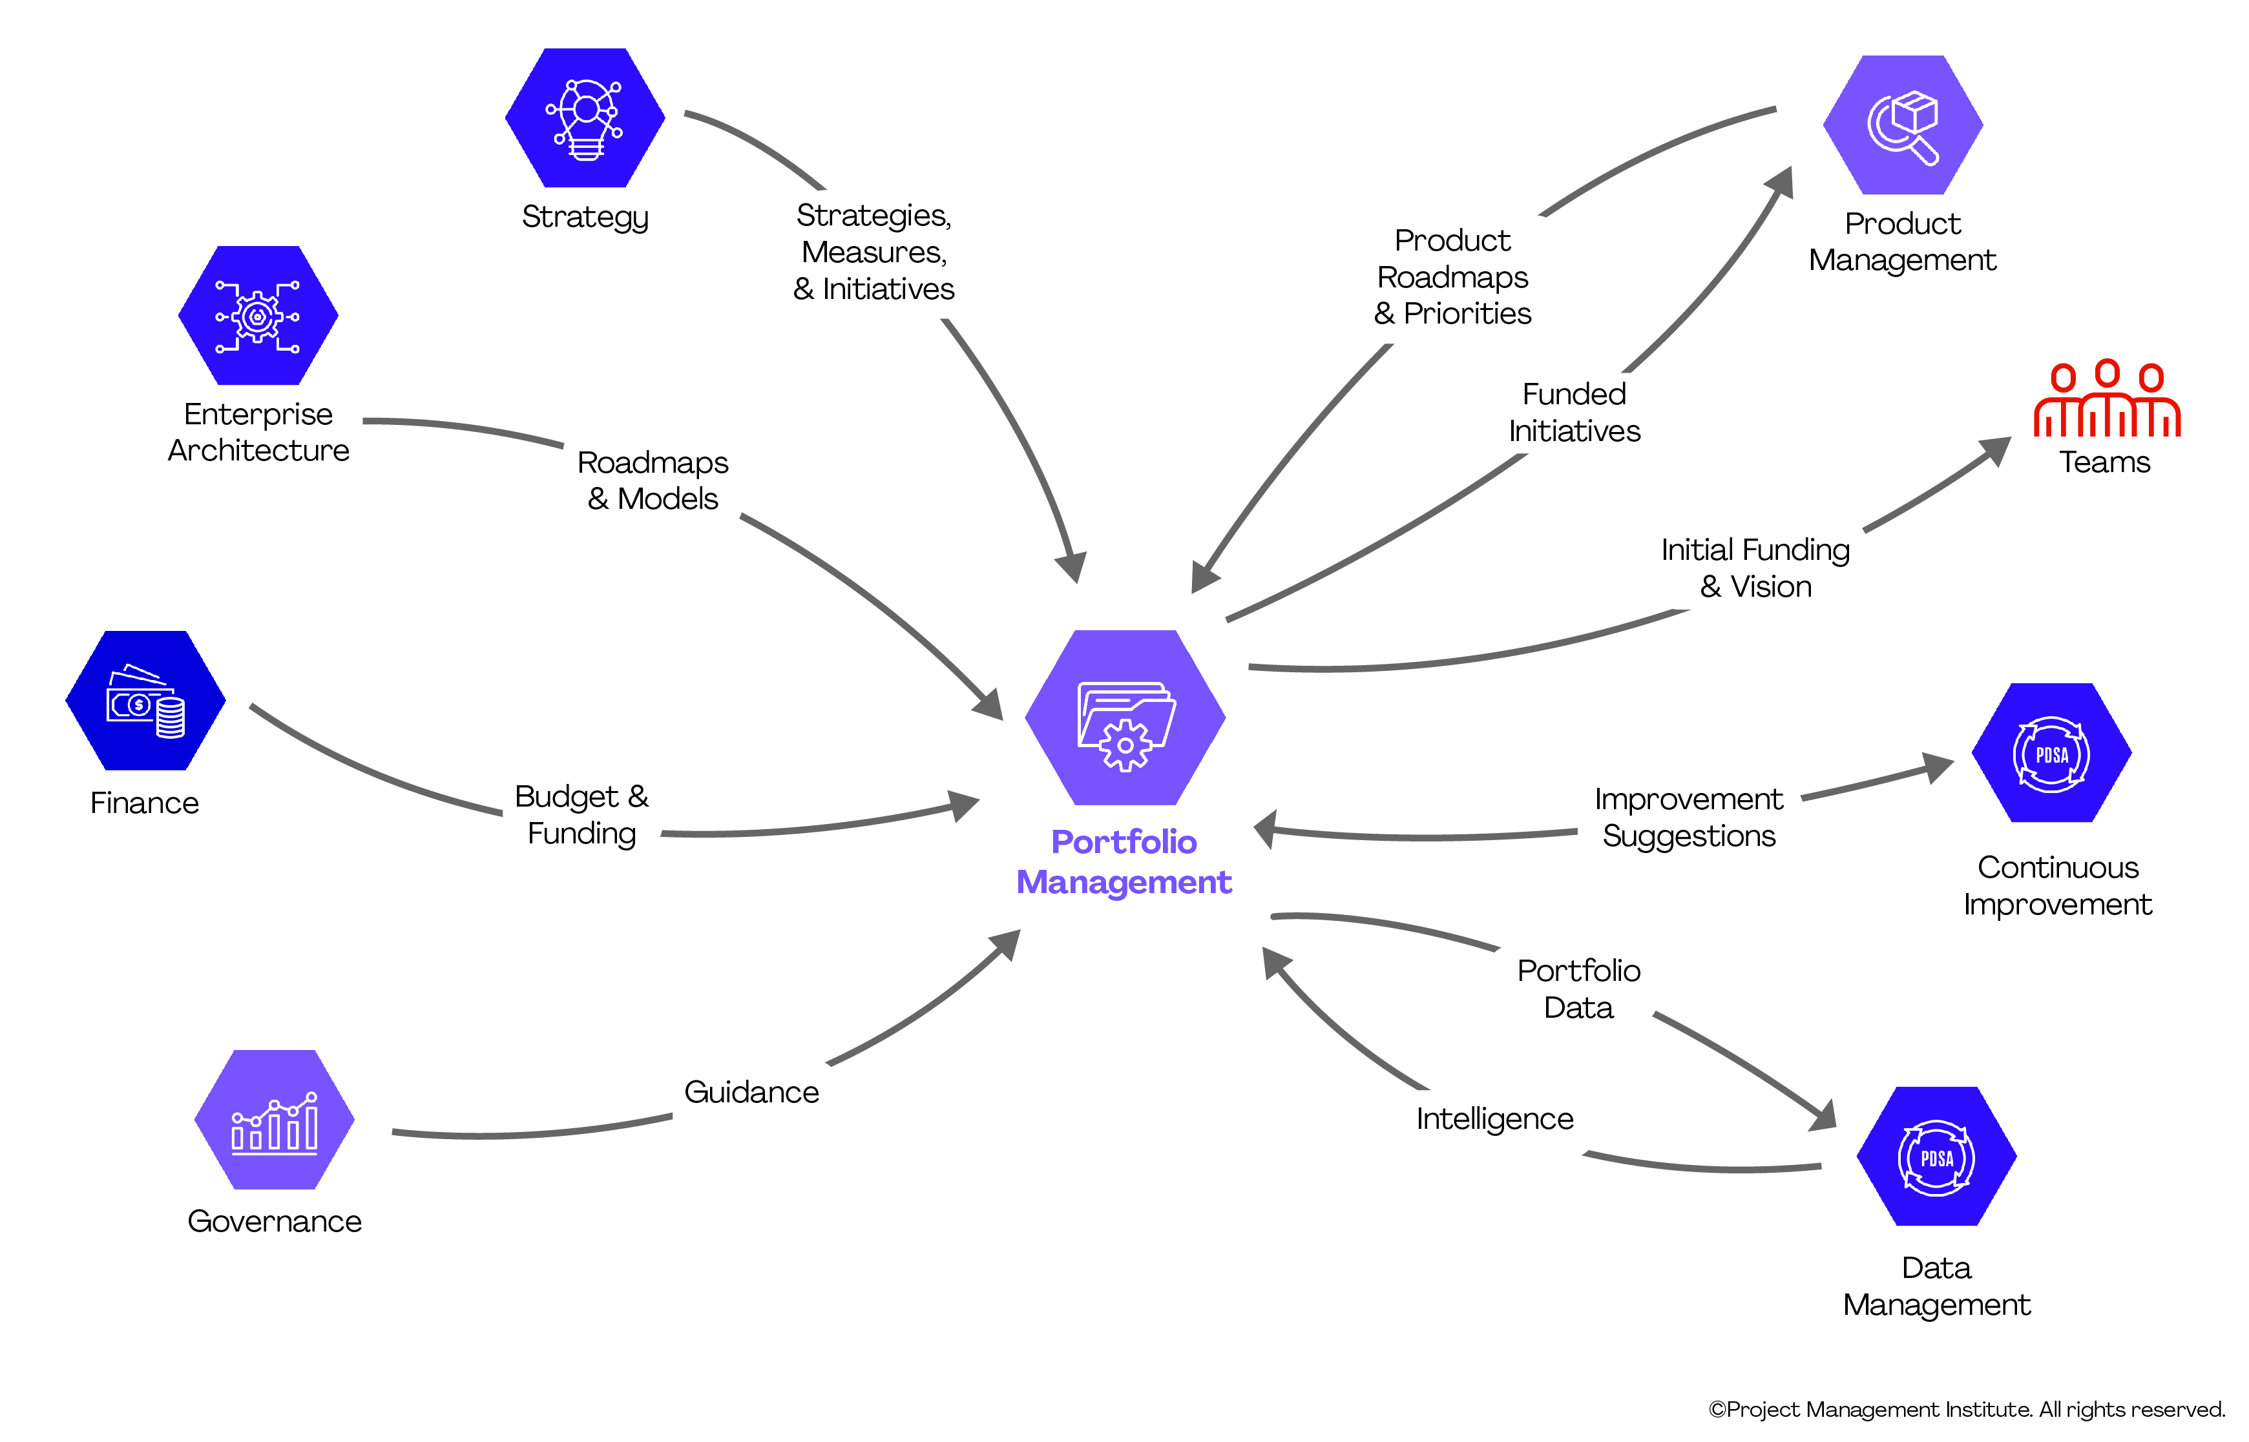
Portfolio Management
AXELOS Management of Portfolios
Scaled Agile Framework (SAFe): Portfolio Management
Disciplined Agile Framework: Portfolio Management
Coordination of all activities to optimize the achievement of strategy within organizational constraints

Slide 6
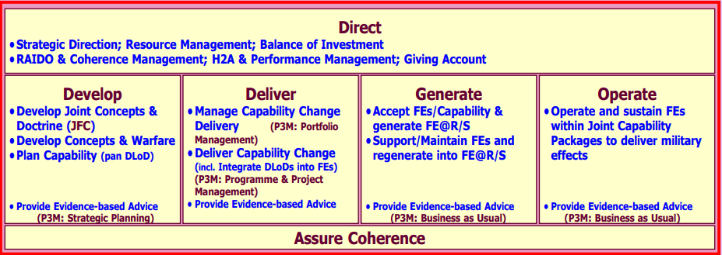
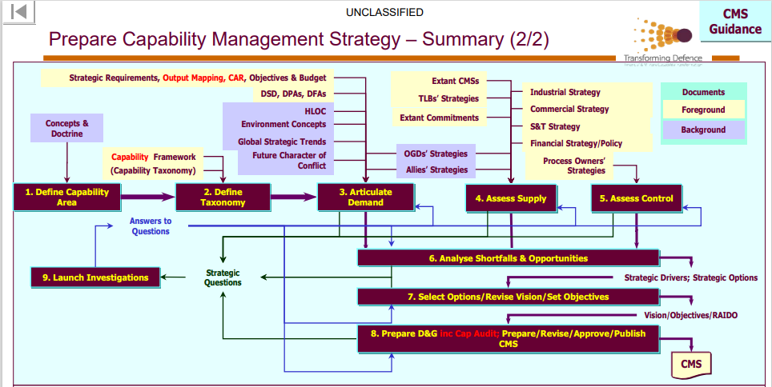
Portfolio Management
UK MOD Generic Capability Management Model (GCM)
Coordination of all activities to optimize the achievement of strategy within organizational constraints

Slide 7
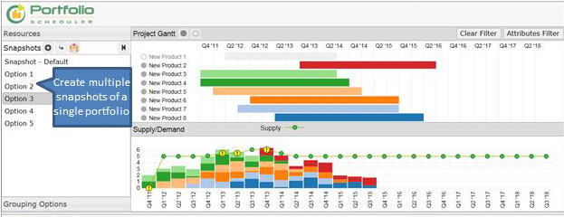
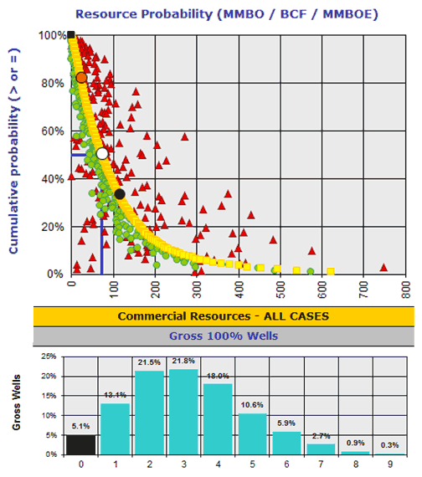
Portfolio Analysis
Portfolio Optimization
Assessment method & process
Strategic alignment
Project pipeline management
Resource Management
Identification & capacity assessment for scarce resources
Estimation & planning
Supply / demand assessments
Performance Management
Risk analysis
Cost & schedule performance analysis (e.g. EVM)
Portfolio Management
Data status & reviews
Portfolio visualization & communication
ProModel Blog: https://promodel.files.wordpress.com/2014/01/ms-conf-2014-blog-post-ellen-pic1.jpg
Rose & associates: https://www.roseassoc.com/software-oil-gas-prospect-play-portfolio/portfolio-risk-analysis/
Based mostly on Acuity PPM

Slide 8
NATO Portfolios
Identifying and agreeing National forces (“Defence Planning”)
Connecting and cohering National forces (NATO Common Funded acquisition)
USA Forces
FRA Forces
ITA Forces
POL Forces
CZE Forces
DEU Forces
GBR Forces
TUR Forces
Etc.

Slide 9
Cohering the Common Funded Portfolio
The Problem
How can we tell if activities are aligned to strategy?
How can we tell if strategy is fully being implemented?
If we add up all the costs, are we getting good value? Are ‘priorities’ aligned to objectives?
How do we address structural issues?
If we only have organic visibility on a small part of the portfolio, how can we plan?

Slide 10
Cohering the Common Funded Portfolio
Allied Command Operations
Hundreds of urgent requirements
The Analytical Problem
We can’t even see all the activities!
“Strategy” is loosely defined
Collected data is variable quality and not always trustworthy
NATO HQ
>50 capability acquisition programmes
Other Orgs
Tens of special urgent requirements
Allied Command Transformation
>50 capability acquisition programmes
Individual Nations
Hundreds of infrastructure “minor works”
NATO Delivery Agencies
31 Individual Nations

Slide 11
Typical PfM Maturity Model
5 - Continuous Improvement
Optimization of R&D and delivery to strategy
R&D / innovation initiatives clearly feed project delivery in line with strategy
Increased coherence across the business
Whole enterprise ‘DevOps’
4 - Proactively Managed
Portfolio driven by strategy; strategy driven by portfolio
Strategy is clearly traceable to action
Strategy is informed by delivery capacity and shape of current business
Outcome: P3M clearly adds value to delivery and to business planning.
3 - Fit-for-Purpose Processes
Integrated project delivery & portfolio coordination
Scarce resource supply-demand management
Increasing focus on skills, experience, data fusion
Roles & responsibilities are clear and valued
2 - Developing
Full portfolio coordination processes being defined
Focus on process adherence over tailoring suitability to types of portfolio
PfMO created
1 - Ad Hoc
Sub-portfolios (sometimes) coordinated
No real resources
Inconsistent processes and data
Mostly focused on firefighting
Treating symptoms, not causes
Based mostly on the CMMI, Project Management Institute, Gartner, and PPM Express

Slide 12
PfM Analysis Maturity Model
5 - Continuous Improvement
Optimization of R&D and delivery to strategy
4 - Proactively Managed
Portfolio driven by strategy; strategy driven by portfolio
3 - Fit-for-Purpose Processes
Integrated project delivery & portfolio coordination
2 - Developing
Full portfolio coordination processes being defined
1 - Ad Hoc
Sub-portfolios (sometimes) coordinated
0 - None
Projects are managed as completely standalone activities

Slide 13
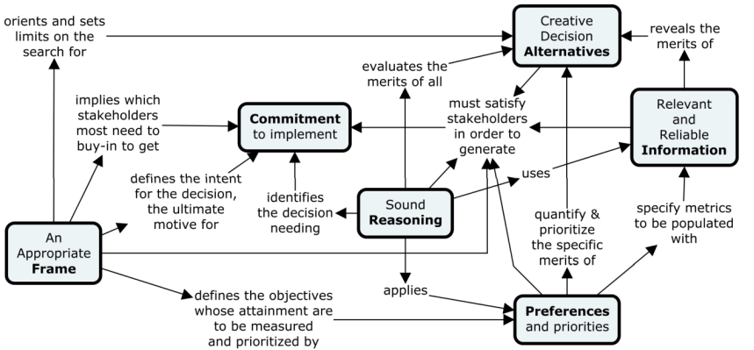
Column Headings
Appropriate Frame
Commitment to Implement
Creative Decision Alternatives
Sound Reasoning
Preferences and Priorities
Relevant & Reliable Information
… So what?
From NATO STO SAS-134 Improving Defence Investment Portfolio Decisions: Insights from the Literature and National Practice
What should analysts be trying to do?

Slide 14
PfM Analysis Maturity Model
5 - Continuous Improvement
Optimization of R&D and delivery to strategy
Appropriate Frame
Commitment to Implement
Reliable & Relevant Information
Creative Decision Alternatives
Preferences and Priorities
Sound Reasoning
Example Analyses
Analytical Team Should Work On
4 - Proactively Managed
Portfolio driven by strategy; strategy driven by portfolio
3 - Fit-for-Purpose Processes
Integrated project delivery & portfolio coordination
2 - Developing
Full portfolio coordination processes being defined
Where am I?
What should I be doing?
1 - Ad Hoc
Sub-portfolios (sometimes) coordinated
0 - None
Projects are managed as completely standalone activities

Slide 15
PfM Analysis Maturity Model
5 - Continuous Improvement
Optimization of R&D and delivery to strategy
Appropriate Frame
Commitment to Implement
Reliable & Relevant Information
Creative Decision Alternatives
Preferences and Priorities
Sound Reasoning
Example Analyses
Analytical Team Should Work On
There is clear, enterprise-wide, understanding of decision variables and both soft and hard constraints | Portfolio analysis results are expected to support C-suite decision making, with full business and enterprise support | Portfolio data is linked with, and managed coherently with, all other enterprise business data | Both soft and hard constraints are regularly ‘stress-tested’, including outside of the mandate of imminent decisions | The enterprise hierarchy of priorities are transparently reflected in actual decision-making | The value of high-quality portfolio analysis is evangelized by the enterprise. Analytical skills are widespread | Managed, data-driven common operational picture of the current enterprise and potential futures | Maintaining business engagement and value proposition Maintaining data, skills, tools in line with business direction
Clearly sets out the conceptual and temporal boundaries, as well as the Ends, Ways, and Means of portfolio decisions | Portfolio analysis is held at the center of management processes, and are shared across the enterprise | Planning information and strategy tokenization; automated generation of documents Data quality is always reflected in analysis confidence | Analytical processes for collecting and integrating enterprise perspectives when identifying options are valued and used | Strong feedback loop between stated and revealed preferences and priorities. Assessment methods vary to fit contexts | Analytical skills are valued in non-analysts. Analytical rigour is applied on a risk-based approach. Confidence in findings, and limits / voiding conditions are understood by decision-makers. Complex analyses are automated; data collection is a project priority | Balancing efficiency and business resilience under constraints thresholds Analysis to support strategy – forecasting the competition landscape; strategic risks & opportunity assessment Analysis of the strategy – decomposition into themes & tasks | Business data-centricity driven by visible analysis benefits Aligning analytical resources (cost, including people) to business value provided
Lays out the strategic landscape and highlights external legal and policy constraints on decision-making. Dependencies are identified at many levels | There are clear delegated authorities and pathways for accessing greater authority based on analytical findings | Portfolio data is seamlessly linked across the business. Data captures quantitative and qualitative aspects of projects and programmes, and is formally managed | Creativity is valued in the creation of options Options must reflect more than just three choices: 1) ineffective, 2) too expensive, and 3) the preferred approach | Priorities, and assessment methods, are known and agreed across all stakeholder groups |  | Resource supply and demand mapping Maximizing delivery value under a budgetary threshold Future portfolio options assessments & scenario analyses | Integrating qualitative strategic assessment with quantitative analysis Broadening analyst business / strategic understanding Developing bespoke problem formulations and tools
Sub-portfolio analysis boundary agreed in line with organizational responsibilities. Project dependencies are identified and managed | There are mechanisms for escalation of portfolio decision-making with analytically-driven business cases | Portfolio data is linked across the business through manual or infrequent automatic means. Quantified data captures many aspects of projects, and is regularly checked | Business cases are required to demonstrate options | Priorities integrate the perspectives of many business stakeholders. Analytical assessments match options to priorities | Analytical skills are managed as a portfolio management resource. Processes for analytical rigour are being defined. Simple analyses are automated | Integrated portfolio cost, schedule, and risk management Root cause analyses Enterprise opportunity optimization | Delivering benefits from portfolio-level analysis to create supporters Engagement across scarce resource owners Developing predictive relationships and models
Frame is poorly bounded and thought-through, with no agreement of analytical scope | Results must be ‘sold’ to senior executives, and may be opposed or stopped by other executives | Programme and sub-portfolio data is aggregated locally in organizational stovepipes. Data quality is irregularly and / or inconsistently managed | No analytical support to identifying and assessing decision alternatives | Priorities are defined. Analytical support to priority-setting and assessment is inconsistent | Analytical skills are valued as a source of rigour, and used when available | Simple sub-portfolio cost, schedule, and risk management Simple dependencies mapping & root-cause analysis Investment opportunity identification and quantification | Integrating data stovepipes Ensuring data is trustworthy Ensuring data supports high-value analyses Acquiring analytical tools Developing descriptive and diagnostic analyses
No coordinated decision-making | No mechanism for portfolio analysis to drive change | Activity data held at project-level | Decision-making is not coordinated, and is constantly reactive. Staff constantly feel like they are “fire fighting” | Priorities are entirely implicit, or may be explicitly stated in ways that do not match business behaviour, or do not aid decisions | Analytical rigour is poorly understood. Decisions are supported by whomever is available | Project-level cost, schedule, and risk management Workshops: collecting and aggregating SME judgement-based assessments | Collecting and aggregating data. Identifying high-visibility incoherence / missed opportunities Getting analytical resources
4 - Proactively Managed
Portfolio driven by strategy; strategy driven by portfolio
3 - Fit-for-Purpose Processes
Integrated project delivery & portfolio coordination
2 - Developing
Full portfolio coordination processes being defined
1 - Ad Hoc
Sub-portfolios (sometimes) coordinated
0 - None
Projects are managed as completely standalone activities

Slide 16
PfM Analysis Maturity Model
5 - Continuous Improvement
Optimization of R&D and delivery to strategy
Appropriate Frame
Commitment to Implement
Reliable & Relevant Information
Creative Decision Alternatives
Preferences and Priorities
Sound Reasoning
Example Analyses
Analytical Team Should Work On
There is clear, enterprise-wide, understanding of decision variables and both soft and hard constraints | Portfolio analysis results are expected to support C-suite decision making, with full business and enterprise support | Portfolio data is linked with, and managed coherently with, all other enterprise business data | Both soft and hard constraints are regularly ‘stress-tested’, including outside of the mandate of imminent decisions | The enterprise hierarchy of priorities are transparently reflected in actual decision-making | The value of high-quality portfolio analysis is evangelized by the enterprise. Analytical skills are widespread | Managed, data-driven common operational picture of the current enterprise and potential futures | Maintaining business engagement and value proposition Maintaining data, skills, tools in line with business direction
Clearly sets out the conceptual and temporal boundaries, as well as the Ends, Ways, and Means of portfolio decisions | Portfolio analysis is held at the center of management processes, and are shared across the enterprise | Planning information and strategy tokenization; automated generation of documents Data quality is always reflected in analysis confidence | Analytical processes for collecting and integrating enterprise perspectives when identifying options are valued and used | Strong feedback loop between stated and revealed preferences and priorities. Assessment methods vary to fit contexts | Analytical skills are valued in non-analysts. Analytical rigour is applied on a risk-based approach. Confidence in findings, and limits / voiding conditions are understood by decision-makers. Complex analyses are automated; data collection is a project priority | Balancing efficiency and business resilience under constraints thresholds Analysis to support strategy – forecasting the competition landscape; strategic risks & opportunity assessment Analysis of the strategy – decomposition into themes & tasks | Business data-centricity driven by visible analysis benefits Aligning analytical resources (cost, including people) to business value provided
Lays out the strategic landscape and highlights external legal and policy constraints on decision-making. Dependencies are identified at many levels | There are clear delegated authorities and pathways for accessing greater authority based on analytical findings | Portfolio data is seamlessly linked across the business. Data captures quantitative and qualitative aspects of projects and programmes, and is formally managed | Creativity is valued in the creation of options Options must reflect more than just three choices: 1) ineffective, 2) too expensive, and 3) the preferred approach | Priorities, and assessment methods, are known and agreed across all stakeholder groups |  | Resource supply and demand mapping Maximizing delivery value under a budgetary threshold Future portfolio options assessments & scenario analyses | Integrating qualitative strategic assessment with quantitative analysis Broadening analyst business / strategic understanding Developing bespoke problem formulations and tools
Sub-portfolio analysis boundary agreed in line with organizational responsibilities. Project dependencies are identified and managed | There are mechanisms for escalation of portfolio decision-making with analytically-driven business cases | Portfolio data is linked across the business through manual or infrequent automatic means. Quantified data captures many aspects of projects, and is regularly checked | Business cases are required to demonstrate options | Priorities integrate the perspectives of many business stakeholders. Analytical assessments match options to priorities | Analytical skills are managed as a portfolio management resource. Processes for analytical rigour are being defined. Simple analyses are automated | Integrated portfolio cost, schedule, and risk management Root cause analyses Enterprise opportunity optimization | Delivering benefits from portfolio-level analysis to create supporters Engagement across scarce resource owners Developing predictive relationships and models
Frame is poorly bounded and thought-through, with no agreement of analytical scope | Results must be ‘sold’ to senior executives, and may be opposed or stopped by other executives | Programme and sub-portfolio data is aggregated locally in organizational stovepipes. Data quality is irregularly and / or inconsistently managed | No analytical support to identifying and assessing decision alternatives | Priorities are defined. Analytical support to priority-setting and assessment is inconsistent | Analytical skills are valued as a source of rigour, and used when available | Simple sub-portfolio cost, schedule, and risk management Simple dependencies mapping & root-cause analysis Investment opportunity identification and quantification | Integrating data stovepipes Ensuring data is trustworthy Ensuring data supports high-value analyses Acquiring analytical tools Developing descriptive and diagnostic analyses
No coordinated decision-making | No mechanism for portfolio analysis to drive change | Activity data held at project-level | Decision-making is not coordinated, and is constantly reactive. Staff constantly feel like they are “fire fighting” | Priorities are entirely implicit, or may be explicitly stated in ways that do not match business behaviour, or do not aid decisions | Analytical rigour is poorly understood. Decisions are supported by whomever is available | Project-level cost, schedule, and risk management Workshops: collecting and aggregating SME judgement-based assessments | Collecting and aggregating data. Identifying high-visibility incoherence / missed opportunities Getting analytical resources
4 - Proactively Managed
Portfolio driven by strategy; strategy driven by portfolio
Prescriptive
3 - Fit-for-Purpose Processes
Integrated project delivery & portfolio coordination
Predictive
2 - Developing
Full portfolio coordination processes being defined
1 - Ad Hoc
Sub-portfolios (sometimes) coordinated
Diagnostic
0 - None
Projects are managed as completely standalone activities
Descriptive
07/16/2023 | PAGE 16

Slide 17
What do I want from you?
Feedback please!
If you’re interested:
Come collect a copy of the detail
Tell me what you think

Slide 18
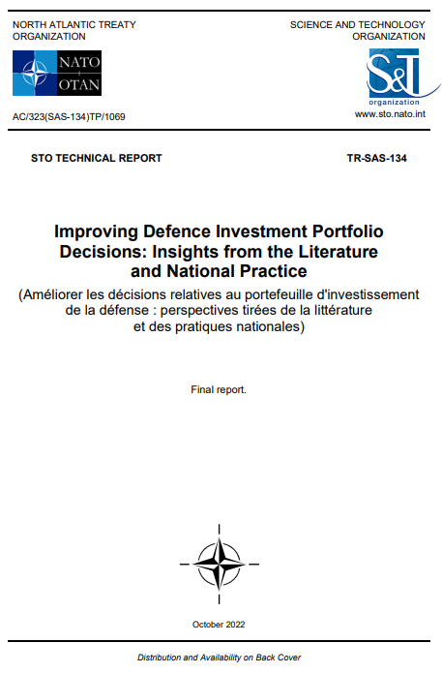
Resources
If you’re interested in portfolio management and analysis:
Management of Portfolios (Axelos)
Scaled Agile Framework
Disciplined Agile Framework
NATO SAS-134 Report
NATO STO SAS-178 Defence Investment Portfolio Decision-Making and Analysis Support: workshop in Germany 12-14 Sept
  for COL to 1* MIL & “senior portfolio analyst” CIVs

Slide 19
Questions?
Email
Nicholas.Rose@act.nato.int
Phone
+1 757-747-3387

