Slide 1
Finding Space to Play in Wargames
Elizabeth Burn
Joint Analysis and Decision Support Group, Dstl
40 ISMOR, July 2023
DSTL/PUB150918

Slide 2
Introduction
The Space Domain
Why does Space OA matter to decision makers?
2015- 2023
Wargaming as an OA tool
Notes:
Pre 2015 – 2023 onwards

Slide 3
Introduction
The Space Domain
Why does Space OA matter to decision makers?
2015- 2023
Wargaming as an OA tool
Notes:
Pre 2015 – 2023 onwards

Slide 4
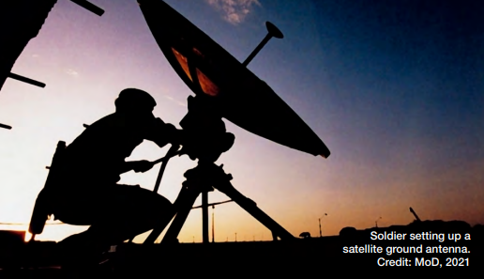

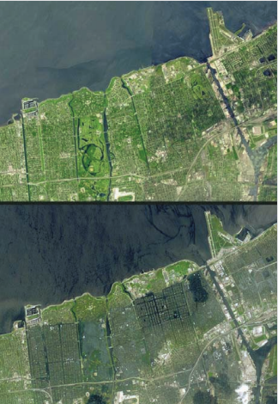
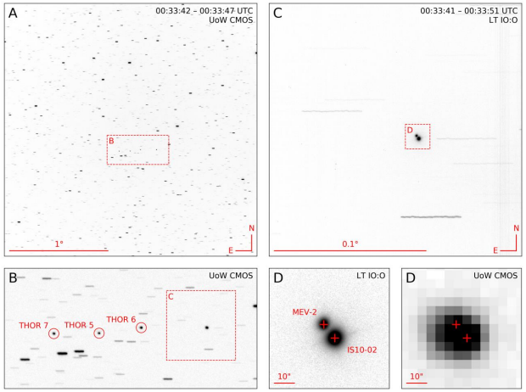
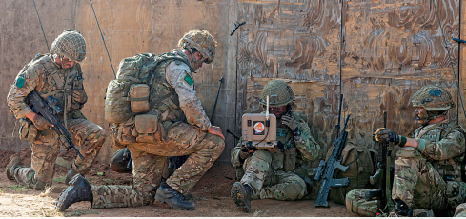
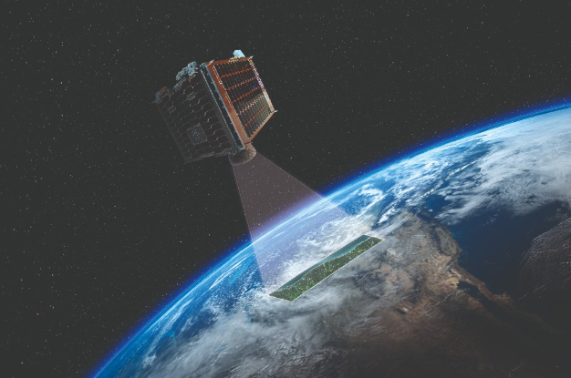
The Space Domain
National Space Strategy, September 2021
UK Space Power (JDP 0-40), September 2022
UK Military Space Primer, June 2010
PHANTOM ECHOES 2: A Five-Eyes SDA Experiment on GEO Proximity Operations, September 2021
Guidance: UK Space Command, April 2021
UK Space Power (JDP 0-40), September 2022
Notes:
Is it just this? (i.e. satellites)
How do we ensure our reliance [will edit English on this phrase] on space (ie. soldiers using satcom and GEOINT)?
Therefore we need to understand the Space Domain

Slide 5
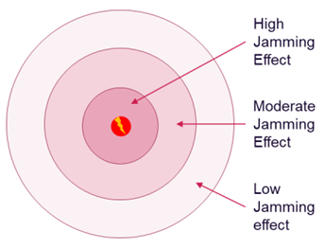
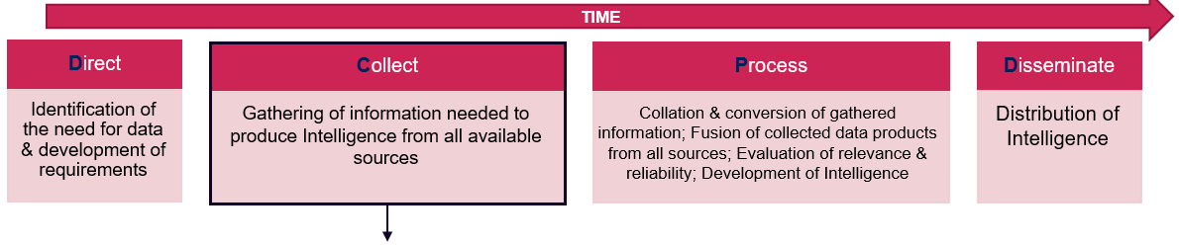
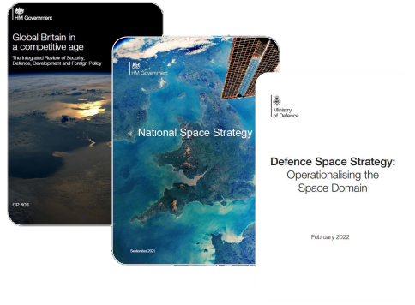
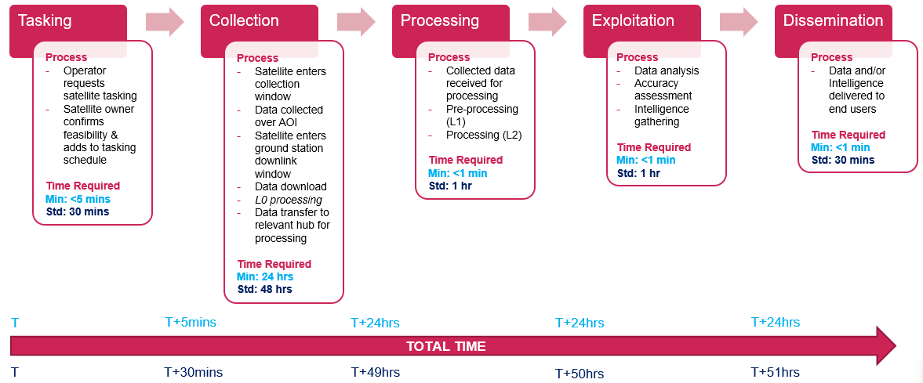
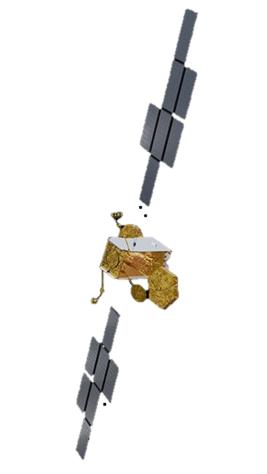
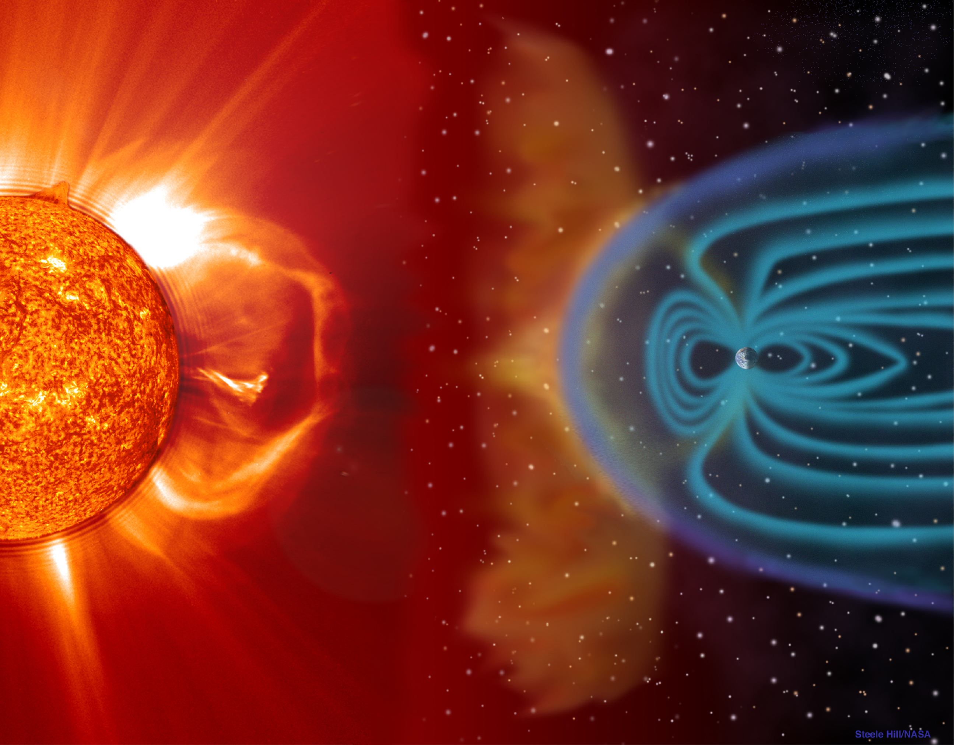
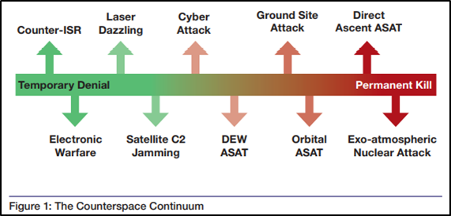
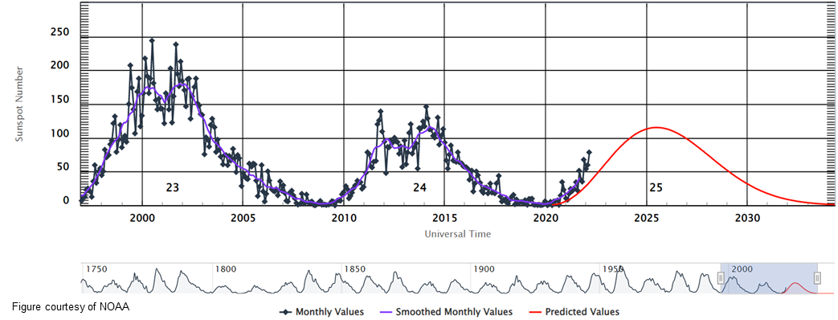
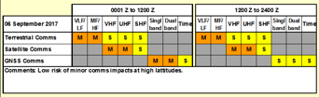
Military Need Why is space important to decision makers? | Space Domain Awareness (SDA) | Space Control s | Space support to Operations .
 | Hazards Space Weather | The Roles of Space Power for Command and Control | Threats
Position, Navigation, Timing (PNT)
GNSS
UK Defence Strategy/ policy/ reviews
Reliance link
Detect, track and identify
Segments
Intelligence Surveillance Reconnaissance (ISR)
Defence Scenario’s Book
Reliance link
Ground
Campaign Planning
Adversary response
Threat warning
User
Link
Military Requirement
Space
Data integration
Orbits
LEO
MEO
HEO
GEO
Missile Warning
Characterisation
Requirement set
The OA Approach
Satellite Communications (SATCOM)
.
Threat analysis
Simulation
Operational vignettes
NASA, (accessed July 2923)
Allied
Sovereign
Skynet
Commercial
e.g. Lance
Metrics
Campaign Analysis
Defence benefits
Defence Shortfalls
Defence Space Strategy, February 2022
(solar cycle 25)
Decision Making
The ‘so what’?
Met Office Space Weather Operations Centre (MOSWOC)
UK OFFICIAL
Notes:
If we were to put The Space Domain on a page, it might look like this
Then brief in brief on the sections, stepping through

Slide 6
Military Need Why is space important to decision makers? | Space Domain Awareness (SDA) | Space Control s | Space support to Operations .
 | Hazards Space Weather | The Roles of Space Power for Command and Control | Threats
Position, Navigation, Timing (PNT)
UK Defence Strategy/ policy/ reviews
Reliance link
Detect, track and identify
Segments
Intelligence Surveillance Reconnaissance (ISR)
Defence Scenario’s Book
Reliance link
Ground
Campaign Planning
Adversary response
Threat warning
User
Link
Military Requirement
Space
Data integration
Orbits
LEO
MEO
HEO
GEO
Missile Warning
Characterisation
Requirement set
The OA Approach
Satellite Communications (SATCOM)
.
Threat analysis
Simulation
Operational vignettes
NASA, (accessed July 2923)
Allied
Sovereign
Skynet
Commercial
e.g. Lance
Metrics
Campaign Analysis
Defence benefits
Defence Shortfalls
Defence Space Strategy, February 2022
(solar cycle 25)
Decision Making
The ‘so what’?
Met Office Space Weather Operations Centre (MOSWOC)
UK OFFICIAL
Notes:
If we were to put The Space Domain on a page, it might look like this
Then brief in brief on the sections, stepping through

Slide 7
Military Need Why is space important to decision makers? | Space Domain Awareness (SDA) | Space Control s | Space support to Operations .
 | Hazards Space Weather | The Roles of Space Power for Command and Control | Threats
Position, Navigation, Timing (PNT)
GNSS
UK Defence Strategy/ policy/ reviews
Reliance link
Detect, track and identify
Segments
Intelligence Surveillance Reconnaissance (ISR)
Defence Scenario’s Book
Reliance link
Ground
Campaign Planning
Adversary response
Threat warning
User
Link
Military Requirement
Space
Data integration
Orbits
LEO
MEO
HEO
GEO
Missile Warning
Characterisation
Requirement set
The OA Approach
Satellite Communications (SATCOM)
.
Threat analysis
Simulation
Operational vignettes
NASA, (accessed July 2923)
Allied
Sovereign
Skynet
Commercial
e.g. Lance
Metrics
Campaign Analysis
Defence benefits
Defence Shortfalls
Defence Space Strategy, February 2022
(solar cycle 25)
Decision Making
The ‘so what’?
Met Office Space Weather Operations Centre (MOSWOC)
UK OFFICIAL
Notes:
If we were to put The Space Domain on a page, it might look like this
Then brief in brief on the sections, stepping through
One point to make re PNT is that Space is one form of PNT (I personally think they should not call it PNT in doctrine but rather GNSS) and the challenge here is how to add resilience to Space via PNT sources from other domains

Slide 8
Military Need Why is space important to decision makers? | Space Domain Awareness (SDA) | Space Control s | Space support to Operations .
 | Hazards Space Weather | The Roles of Space Power for Command and Control | Threats
Position, Navigation, Timing (PNT)
UK Defence Strategy/ policy/ reviews
Reliance link
Detect, track and identify
Segments
Intelligence Surveillance Reconnaissance (ISR)
Defence Scenario’s Book
Reliance link
Ground
Campaign Planning
Adversary response
Threat warning
User
Link
Military Requirement
Space
Data integration
Orbits
LEO
MEO
HEO
GEO
Missile Warning
Characterisation
Requirement set
The OA Approach
Satellite Communications (SATCOM)
.
Threat analysis
Simulation
Operational vignettes
NASA, (accessed July 2923)
Allied
Sovereign
Skynet
Commercial
e.g. Lance
Metrics
Campaign Analysis
Defence benefits
Defence Shortfalls
Defence Space Strategy, February 2022
(solar cycle 25)
Decision Making
The ‘so what’?
Met Office Space Weather Operations Centre (MOSWOC)
UK OFFICIAL
Notes:
If we were to put The Space Domain on a page, it might look like this
Then brief in brief on the sections, stepping through

Slide 9
Military Need Why is space important to decision makers? | Space Domain Awareness (SDA) | Space Control s | Space support to Operations .
 | Hazards Space Weather | The Roles of Space Power for Command and Control | Threats
Position, Navigation, Timing (PNT)
GNSS
UK Defence Strategy/ policy/ reviews
Reliance link
Detect, track and identify
Segments
Intelligence Surveillance Reconnaissance (ISR)
Defence Scenario’s Book
Reliance link
Ground
Campaign Planning
Adversary response
Threat warning
User
Link
Military Requirement
Space
Data integration
Orbits
LEO
MEO
HEO
GEO
Missile Warning
Characterisation
Requirement set
The OA Approach
Satellite Communications (SATCOM)
.
Threat analysis
Simulation
Operational vignettes
NASA, (accessed July 2923)
Allied
Sovereign
Skynet
Commercial
e.g. Lance
Metrics
Campaign Analysis
Defence benefits
Defence Shortfalls
Defence Space Strategy, February 2022
(solar cycle 25)
Decision Making
The ‘so what’?
Met Office Space Weather Operations Centre (MOSWOC)
UK OFFICIAL
Notes:
If we were to put The Space Domain on a page, it might look like this
Then brief in brief on the sections, stepping through

Slide 10
Introduction
The Space Domain
Why does Space OA matter to decision makers?
2015- 2023
Wargaming as an OA tool
Notes:
Pre 2015 – 2023 onwards

Slide 11
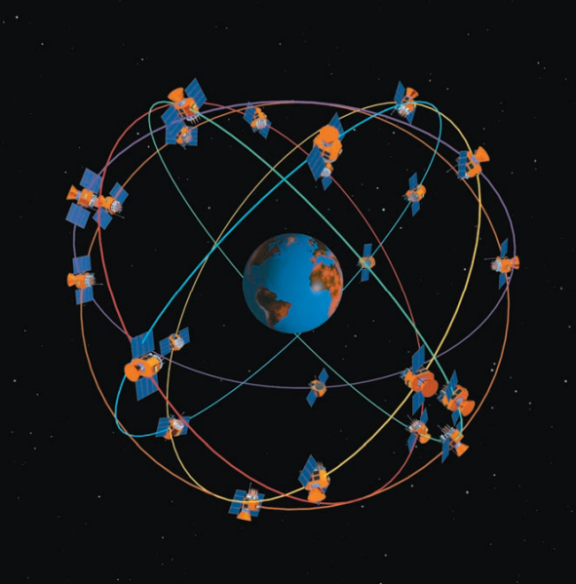



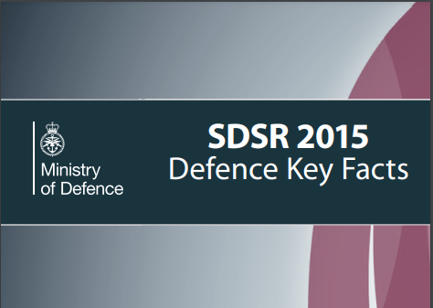
Space OR Timeline - Origin
2015
UK Military Space Primer, June 2010
The Strategic Defence and Security Review 2015: defence facts and figures, November 2015
DST identified need to complement continuing Space S&T dev activity with OR to provide that evidence
Notes:
Up to 2015, access to Space domain for UK Defence had been…
via allied and industrial partners (e.g. US, SKYNET PFI)
critical to ops, and assumed to be relatively uncontested
considered unaffordable for sovereign investment
BUT…. Over several years
Commercial interests=increasing options, reducing costs
Increasing number of govs investing in capabilities
Increasing threats, and willingness to use them
Space changing into a more accessible, but contested, domain
Several SDSR15 Space options put forward, mostly from S&T area - all ultimately rejected
Lack of broader understanding of opportunities and risks
Lack of organisational ownership of Space domain consideration
Lack of evidence or operational experience

Slide 12
Space OR Timeline - Approach
2015
2017-2020
Strategic advice e.g. Integrated Review
Strategic Force Development
Space Cap Dev/Del
Other Cap Dev
  StratCom
  Navy programmes
  Air Programmes
Anticipate demands
Develop and utilise OA approaches
Exploit

Slide 13
Space OR Timeline - Impact
2015
2017-2020
2020/21
Space Cap Strategy (draft) – para 3
“The invaluable work that Dstl has carried out to provide us with evidence-based decision support into Defence’s Space enterprise highlights…”
MOD IR submission to CO – para 1
“Since then, we have undertaken science-led operational analysis and specific capability investigations into the types of space systems Defence needs.”
MOD BOI– para 3
“We have undertaken 5 years of focused, science- led operational analysis (OA)…”

Slide 14
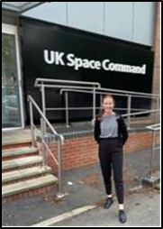
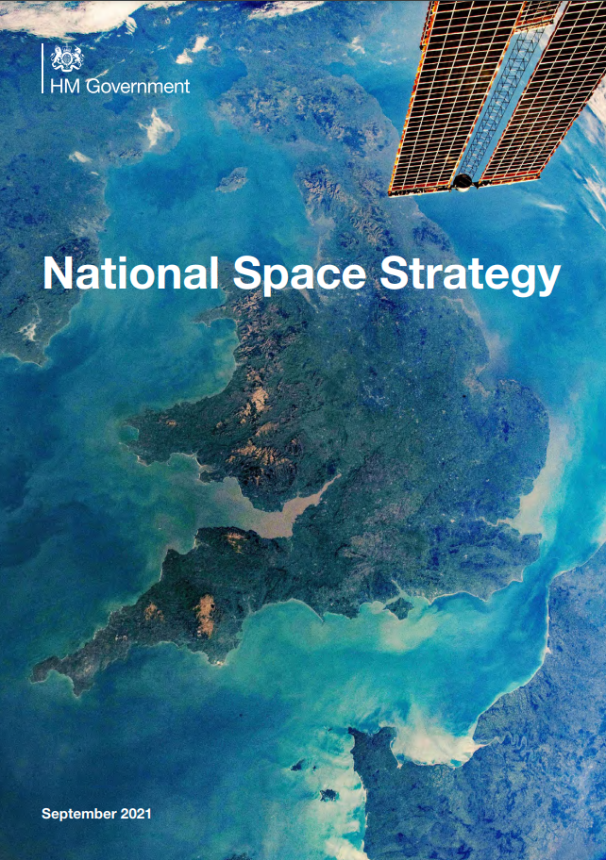
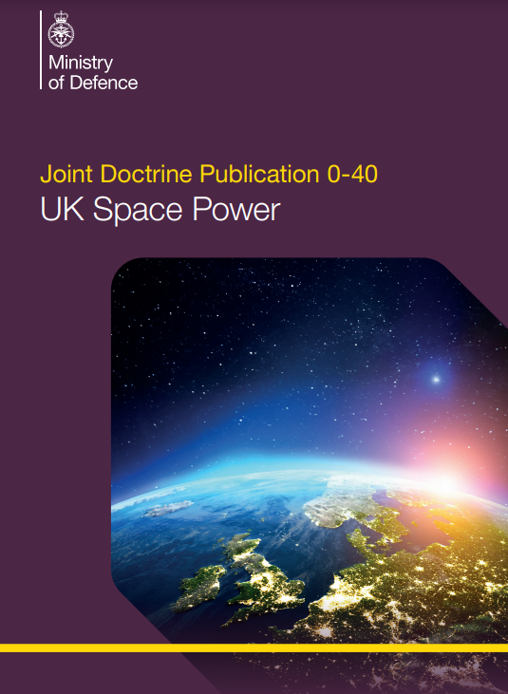
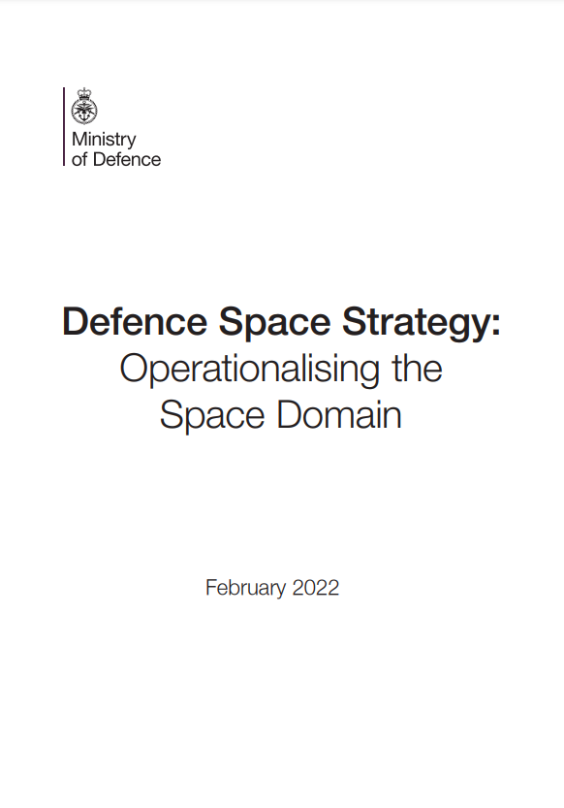
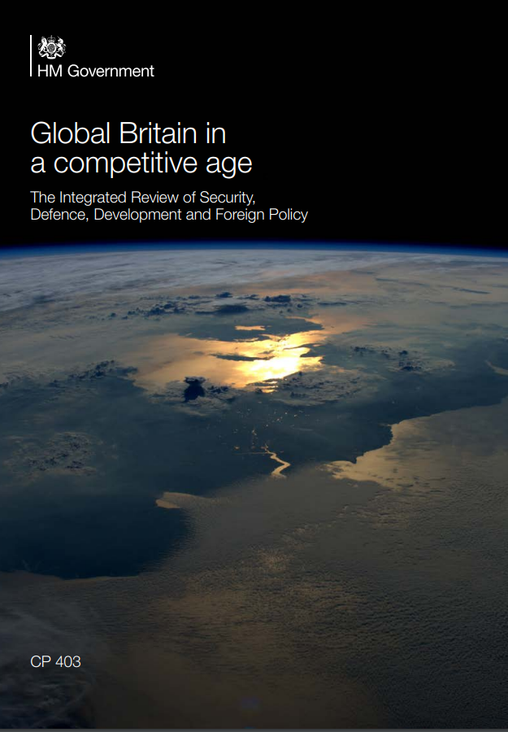
Why should space matter to decision makers?
IR21 led to significant increase in MOD Space allocation
£1.4B over 10 years
ISTARI programme, along with investments in Space Ops and SDA, to complement SKYNET
Formation of UK Space Cmd
“Space is a key enabler for Defence operations and is now an operational domain in its own right. It is also fundamental to our aspiration to integrate across those five domains.” - UK National Defence Space Strategy February 22
UK OFFICIAL
Notes:
Published doctrine updated to provide the military need for the UK and allies.

Slide 15
Space OR Timeline
2015
2017-2020
2020/21
2022+
Now and the future:
Working with SpaceCmd to normalise OR demand/utility
Continuing to support S&T concept development
Sustaining and develop OR capabilities
Continue to be responsive to short-term demands and requests
Notes:
Now going into an example…wargaming as an OA tool for the UK Space Domain

Slide 16
Introduction
The Space Domain
Why does Space OA matter to decision makers?
2015- 2023
Wargaming as an OA tool
Notes:
Not going to describe wargaming, but how space has been involved and analysis benefited from wargaming. How can we find space to play space in wargaming (given it’s a novel/ new domain with less experience as talked about before/ above)?

Slide 17
The Wargame Process
Notes:
How the process of wargaming is not just the execute (play) stage. But the build up (AFS, playtests) which informs how the game will be undertaken as well as the analysis after the execute phases

Slide 18
Wargaming: What are we trying to achieve?
 | Creating knowledge | Conveying Knowledge | Experiential/ Engagement
Unstructured problem | Discovery Games | Educational Game | Role-playing games
Structured problem | Analytical Games | Training Games | Commercial games
Notes:
Examplain that WG design spans continuum
Two examples talk through which span discovery to analytical

Slide 19
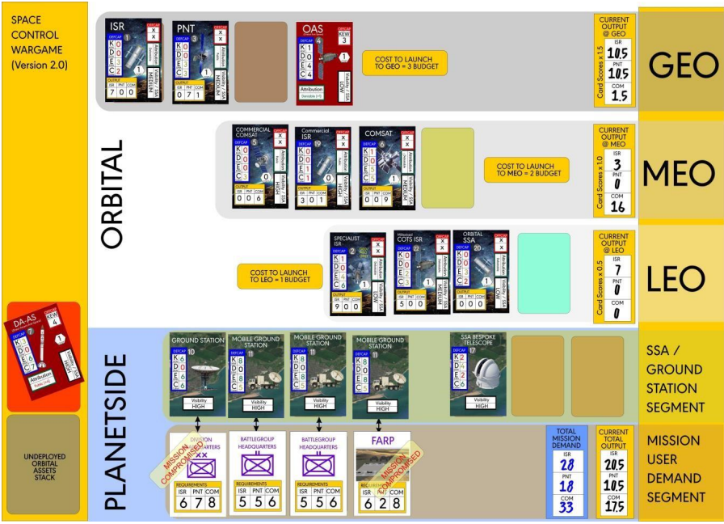
Small wargames
Strengths:
Flexible, scalable, deployable, focused
Challenges:
Tactical limitations, complexity ‘for the sake of it’
Wallman, JG, Marston, CA: SPEEDS: Exploring Space Control through wargaming- Game Designer notes (March 2021)

Slide 20
Evolution of consideration of Space in UK large games
Primary large military UK wargame is PFT9
  PFT: MOD Centre (FMC CapStrat) led activity (with extensive Dstl support) to explore ability of anticipated/planned force structure against specific policy requirements
Up to 2018, Space has not had strong representation within such activities
Since 2018, Space OA has endeavoured to provide support to
  PFT7: + generation of assumptions; provision of SMEs into adjudication
  PFT8: + direct support to associated variation analysis; Rainbow Cell; COA review
  PFT9: …..
Notes:
The largest being Planned Force Testing
MOD Centre (FMC CapStrat) led activity (with extensive Dstl support) to explore ability of anticipated/planned force structure against specific policy requirements

Slide 21

Large wargames- the differences
Planned Force Testing 9:
Medium scale intervention
Investigate Defence’s force elements across the 5 domains (Land, Air, Maritime, Cyber and Space)
Generate evidence on the strengths and weaknesses of the force structure
Operate turns after the Execute phase through a simulated model to give analytical outputs
Notes:
Test and evaluate the ability of IF30 to conduct a multi-domain, medium scale intervention against a major state actor
Investigate Defence’s force elements and capabilities when operating across the 5 domains (Land, Air, Maritime, Cyber and Space)
Generate evidence on the strengths and weaknesses of the force structure, that required to deliver medium scale operations
Operate turns after the Execute phase through a simulated model to give analytical outputs

Slide 22
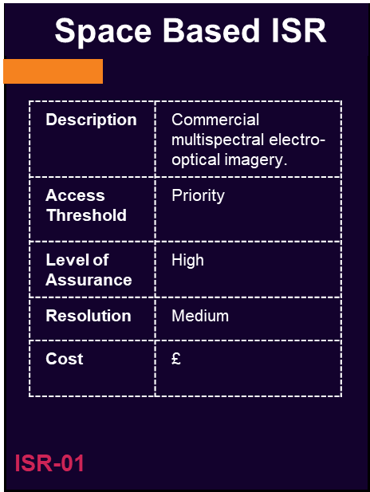
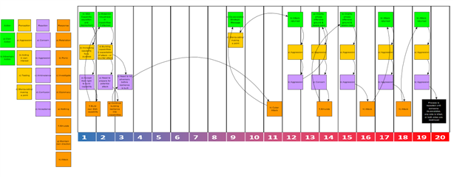
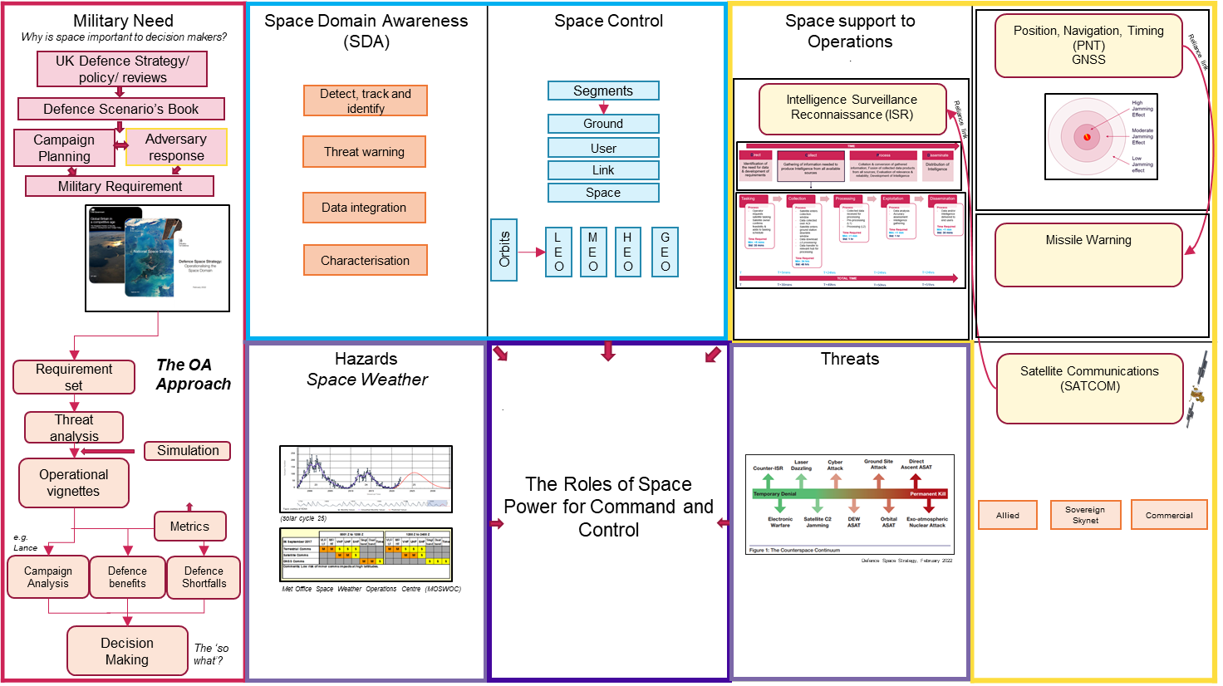
Mechanisms for Space- PFT9
NB: Illustrative examples
Notes:
Play and communicate mechanisms
So what? Allowed space to be an active player. First educating on the domain and then providing tools in which to act with
Outputs of game above this classification but through model simulation we hope to analyse how, what’s happening in space, has an effect on wider war
Secondly, strategic messaging and perceptions identified as critical, particularly for space that is less well known (Deterrence, escalation, misperceptions etc)

Slide 23

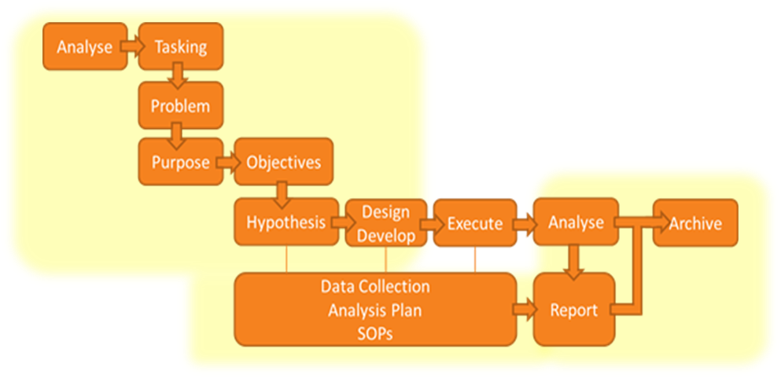
Observations from PFT9
Co-operation
Doctrine
Understanding
Priorities of the game overall
Classification debate
Involved in whole process
Wargaming as a means to an end
Notes:
Importance of cooperation to enable MDI
Requirement of Doctrine to facilitate decision making
Understand of the Space domain
Not the time to test small scale Space interactions, as usually outweighed by the priorities of the game overall
Debate of classification; enough to have accurate representation without compromising on accessibility
Being involved in the whole process was a great benefit
Wargaming as a means to an end

Slide 24
Summary
The Space Domain
Provides critical information services for all operations. Underpinned by Space Domain Awareness and Operations
Why does Space OA matter to decision makers?
OA has proven to be a key source of evidence and understanding of Space as a military domain
Wargaming as an OA tool
There have been developments of Space representation through small to large wargames, including PFT iterations, but still got a way to go
Notes:
The progression of space in small and large wargames has improved the representation of Space for MOD Decision Making, so going in the right direction but still not treated the same as the traditional domains (Land, Mar, Air)

Slide 25
Why should space matter to decision makers?
Aaron Tinney (July, 2023) Daily Star: China’s cosmic moon nukes
  “New arms race mining space rocks to make super weapons”
(July 2023), The Daily Star

Slide 27
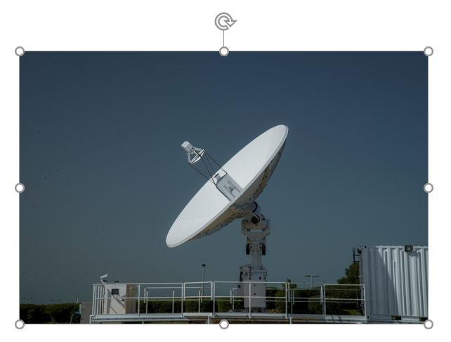
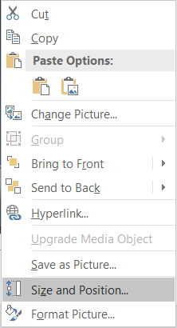
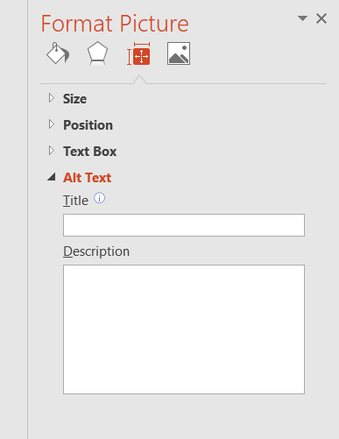
Instructions - Adding Alt Text to Images
Click on the picture
Right click to show the options menu
Choose Size and Position…
The Format Picture panel will appear to the right
Select the Size & Properties
In the Alt Text section, add an appropriate description
2
4
5
1
6
3
(Delete this page from your presentation)

Slide 28
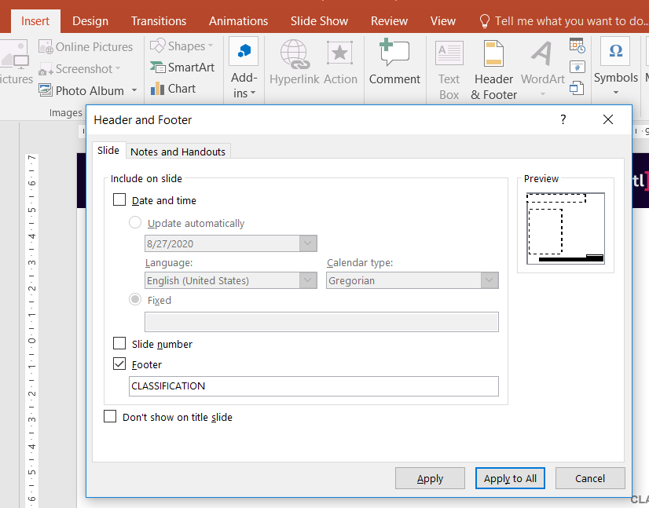
Instructions - Changing the classification of slides
1
Select the Insert tab from the Ribbon
Click Header & Footer
In the Footer, change CLASSIFICATION to the appropriate classification
Click Apply to change the classification of the current slide or Apply to All to change the classification of all slides
2
3
4
(Delete this page from your presentation)

Slide 29
Instructions - Adding slide numbers
1
Select the Insert tab from the Ribbon
Click Header & Footer
Tick the box next to Slide number
Click Apply to add the slide number to the current slide or Apply to All to add the slide number to all slides
2
3
4
(Delete this page from your presentation)

