Slide 1
FUTURE-MATERIEL DISTRIBUTION LAND (FMDL) STRATEGY​
ISMOR 40
Royal Holloway
18th July 2023

Slide 2
Outline
SCALE
  Introduction
  Position and purpose
  Structure
  Outputs
FMDL
  Aims and objectives
  Approach
  Findings
  Strategy
Lessons
  Technical
  Military

Slide 3
SCALE | Introduction
Dstl commissioned the SCALE model, as part of the Policy and Capability Enterprise Support (PCES) programme to
  Initially, contribute to the Logistics Technology Investigations (LTI) project
  Enable Dstl and MOD to
    Identify points across the DSN where investment in research and innovation (in policy, structure, as well as technology) may drive step changes in capability or cost
    Generate evidence of the potential impact on DSN capability and/or cost of specific ‘interventions’ e.g. strategies, concepts or technologies
The driving principles of the model were to
  Be highly aggregated in nature, order to model the ‘end-to-end’ DSN
  Model the baseline to measure the benefit and impact of a change
  Be able to consider radically different approaches (without having to build a new model)
  Represent military operations of different scale, duration and physical location
  Conduct rapid sensitivity analysis
    To address emerging requirements from reviews or as new ideas come up
    As more up to date data is sourced

Slide 4
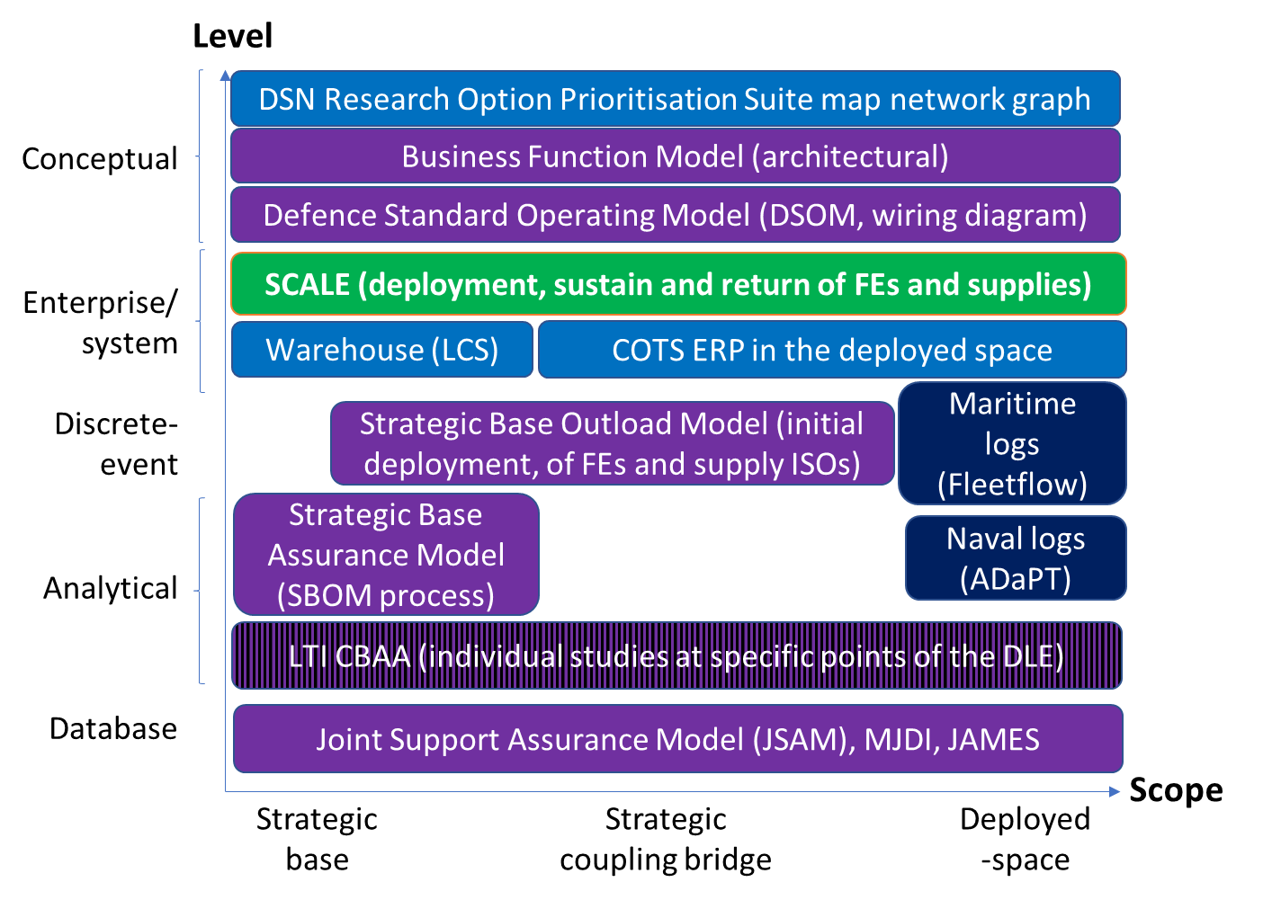
SCALE | Position and purpose
Benefits
Flexible
  Look at overall DLE at high level or
  Look at small part of the DLE in detail
Fast running of different scenarios and ‘what ifs’
Model business as usual + simultaneous operations

Slide 5
SCALE | Position and purpose
2. Points of opportunity or risk
Where are there bottlenecks in the system…
Where would XYZ be best applied…
3. Option ID
What tech would solve…
What could address problem XYZ…
1. Problem definition
Why are things failing…
How effective are we at…
Can we do XYZ
How good are we compared to…
4. Option assessment
How much difference would XYZ make when applied to…
What are the pros and cons of XYZ…
3 levels
Technology e.g. AM
Functionality (due to technology or not) e.g. RAS for ground lift
Structural/ policy e.g.
  Source at point of use
  Stock spares forward
8. Solutions
What should we do…
How should we do XYZ…
5. Implications and trade-offs
What knock-on effects would there be…
What trade-offs would we have to make…
Would it simply move the problem to….
7. Change management
How should we transition to get the benefits of……
6. Methods of employment
How would we use XYZ to…
Can we…

Slide 6
SCALE | Position and purpose
Enterprise
“…identify potential areas that could reduce the cost of logistics whilst maintaining or enhancing supply at point of use…”
“…generate an assessment of where there are ‘pinch points’ or areas within the logistics system that are not optimised and that changes in these areas would improve efficiency…”
Themes e.g.
Cost of ownership
Value of veracity
Reliance on host nation support and contractors
Deploying ‘forward’
Cases e.g.
Trident Juncture 18 deployment
Where should Additive Manufacture be placed to reduce
  Resupply
  Lead times
  Footprint
  Impact of obsolescence
Autonomous leader follower for rear area logistics
Last mile resupply
Platform availability vs loading/ unloading material handling equipment vs transport to site

Slide 7
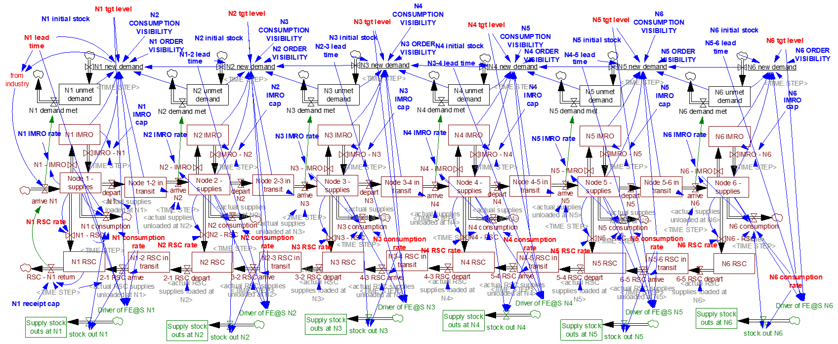
SCALE | Structure
Demand and fulfilment based on information flow
Forward and reverse stocks and flows based of logistics assets
User defines ‘nodes’

Slide 8
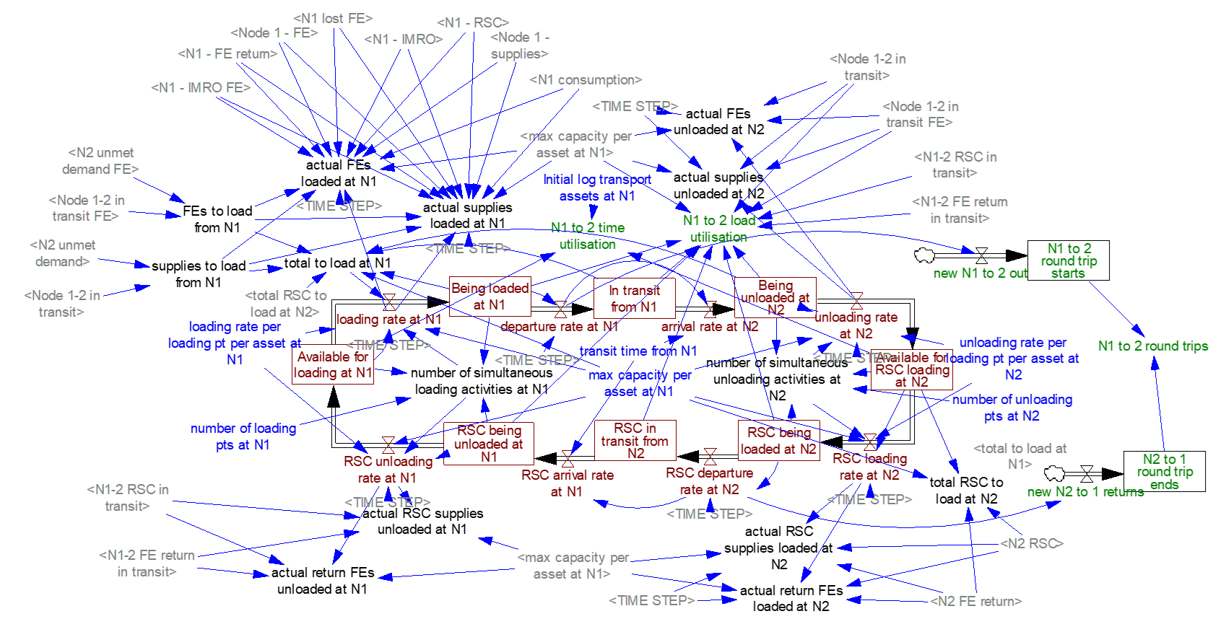
SCALE | Structure
Logistics assets stock and flow between node pairs
Allocates assets to different supplies, FEs or routes

Slide 9
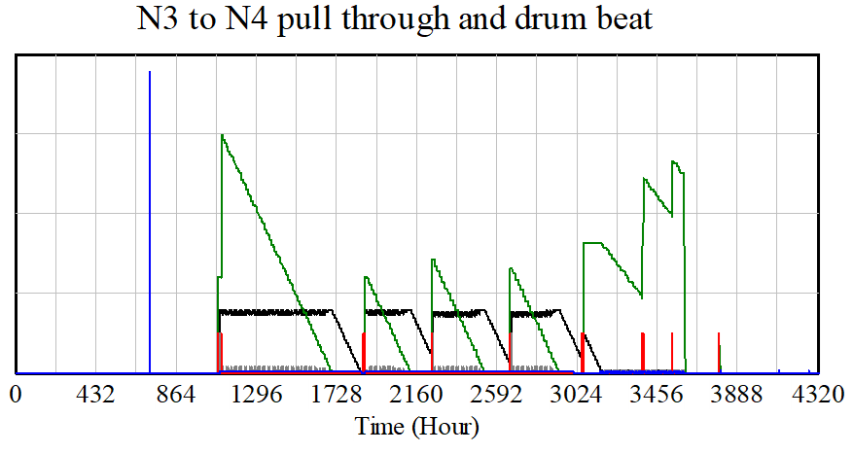
SCALE | Outputs
Pull-through and drum-beat dynamics
Inventory levels at Node 3
Initial demand outload (Nodes 3 and 4)
Arrival of stocks at Node 3
Inventory levels at Node 4
Onward deliveries to Node 4

Slide 10
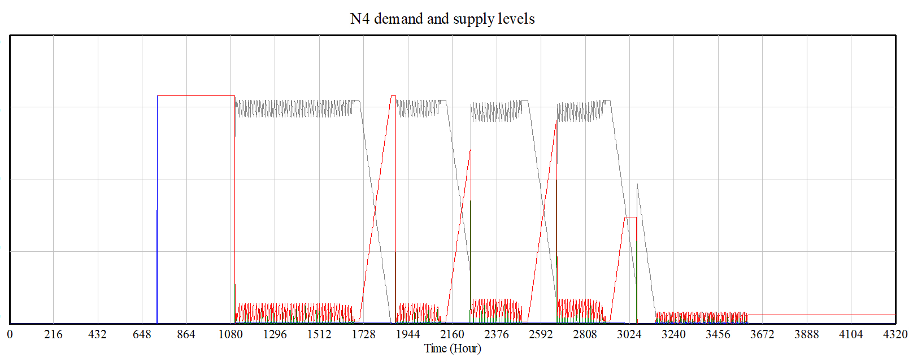
SCALE | Outputs
Demand and supply profiles
Initial outload to node 4
Arrival of stock at node 4 from node3
Stock levels at node 4 topped up from node 3
Node 3 stock outs lead to fall in node 4 stocks and increase in unmet demand

Slide 11
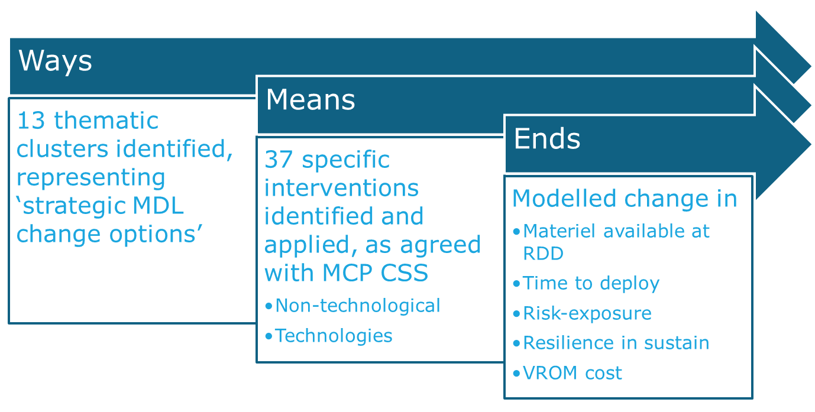
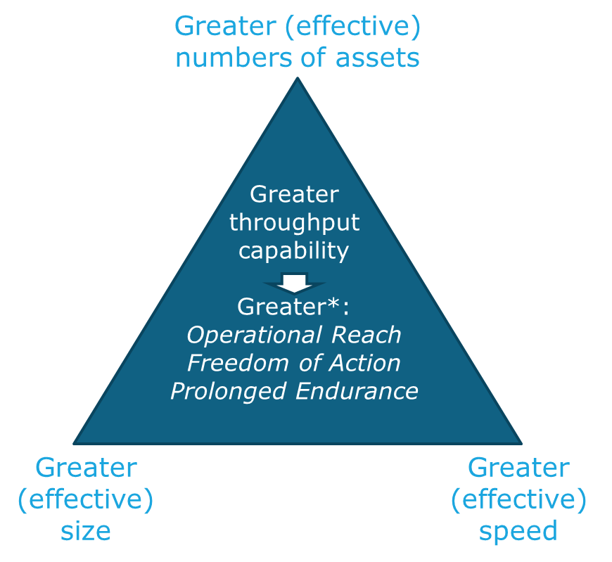
FMDL | Aims and objectives
AHQ need
What makes a difference
For specific types of Op
In specific LSC legs
With different ways and means
In the face of threats and risks
‘Strategy is…
…When…
…Where…
…How…
…to Compete’*
FMDL ‘strategy’
Benefits & costs (Tr2),
FOC (Tr3), Concurrency (Tr4)
DSTL’s ASTRID Task 66 analysis
* McKinsey training circa 2000

Slide 12
FMDL | Approach
1
FMB
Aggregated for rapid sensitivity analysis of ‘end-to-end’ logs system
‘Chains Of Communication’ (ChOCs) of platforms and supplies (‘materiel) using common logs assets
Simulates levels of material at, and rate of flow between ‘nodes’
‘Nodes’ represent conceptual ‘sources, stocks and sinks’ of materiel
5
9
13
1
2
J/DSA
3
BSA
4
BG + A2
SPOD
FE capability 1
5
6
7
8
20
21
22
FE capability 2
A1
F
9
10
11
12
Supply type A
13
14
15
16
Supply type B
17
18
19
Supply type C
Contractors

Slide 13
FMDL | Approach
Deployment
% of demand level available at RDD
Time deployment achieved
Logistics activity level (LAL), as drives cost and operational risk
level required for op to start
Deployment achieved earlier
Supplies or FEs at node
Percentage of demand available at RDD (e.g. 30 days or 720hrs)

Slide 14
FMDL | Approach
Sustainment
% of demand unmet over time
Logistics activity level (LAL)
Resilience to availability
front-line demand is fully-met
front-line demand is not fully-met
Percentage of demand unmet over this time
NATO pallets-worth of volume of supply consumed per hour
Cumulative NATO pallets-worth of volume of supply demand not met
cumulative ‘stock-out’

Slide 15
FMDL | Approach
Supply sourcing
Supply manufacturing
Availability
Error management
Demand level
Delivery distance
System structure
Financing of assets
Demand volumetrics
Process speed
Delivery throughput
Resilience
SPOD/FMB
J/DSA
BSA
BG
A2
F,G,H
FE capability 1
F,G,H
FE capability 2
BG
A1
Front
A,C,F,H
F,H,K
A,D,J,K,L
A,C,H,K
Supply type A
F,H,J,K
A,C,F,H
A,J,K,L
D,K,L
Supply type B
A,C,F,H
A,C,F,H
Supply type C
Contractors

Slide 16
FMDL | Findings
Shortfalls are estimated in the ability of the LSC to meet Supported Force demand, in the following contexts
Assumes 100% availability of the CSS Supporting Force capabilities (platforms)
 | Scenario 1 |  | Scenario 2
ChoC | Deployment | Sustainment | Deployment | Sustainment
FE capability 1
FE capability 2
Supply type A
Supply type B |  | 0% |  | 0%
Supply type C |  | 0% |  | 0%
Metrics reported:
  Deployment Phase: % shortfall in required materiel available at RDD
  Sustainment Phase: % shortfall in planned demand met on time

Slide 17
FMDL | Findings
Pinchpoints - are estimated in the reduction in the ability of the LSC to meet Supported Force demand with 20% reduction in CSS capability
Assumes an (arbitrary) 80% availability of the CSS Supporting Force capabilities (platforms)
 | Scenario 1 |  | Scenario 2
ChoC | Deployment | Sustainment | Deployment | Sustainment
FE capability 1
FE capability 2
Supply type A
Supply type B |  | 12% |  | 20%
Supply type C |  | 12% |  | 20%
Metrics reported:
  Deployment Phase: change in % shortfall in required materiel available at RDD
  Sustainment Phase: change in % of planned demand not met on time

Slide 18
FMDL | Findings
 | Deploy time/ level | Deploy LAL | Sustain LAL | Attrition resilience | Avg
A. Supply sourcing
C. Availability
D. Error management
F. Delivery distance
G. System structure
H. Financing of assets
J. Process speed
K. Delivery throughput
L. Resilience
M. Asset management
LAL = Logs Activity Level

Slide 19
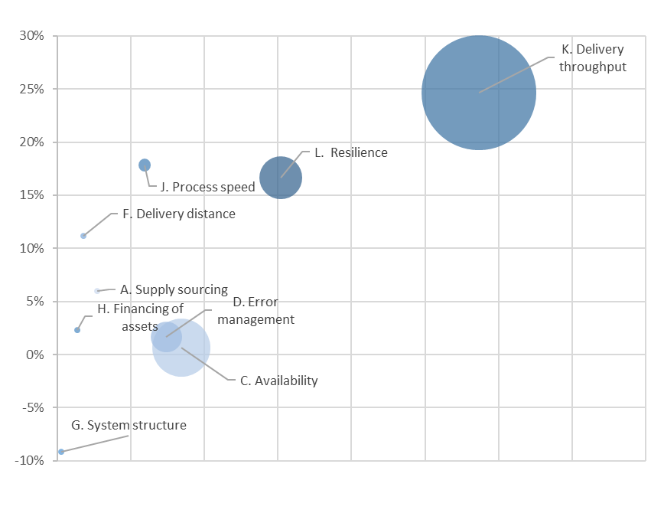
FMDL | Strategy
Centre of bubble: Average cost and logs benefit across of all interventions in cluster
Bubble size: Proportional to standard deviation of costs of interventions in cluster
The axes are not linear but scaled to show a clear distinction between approval categories
efficient frontier
Average improvement
Whole Life Costs (dependent on assumptions re DLODs and Ops over time)

Slide 20
FMDL | Lessons
Technical
  Pipe-cleaning the analysis was useful, but be careful which case you use
  Model speed allowed us to compensate for input data uncertainty
  A close working relationship, and hands-on approach (three ways i.e. DIEM/TPG/TechModal, Dstl, ASTRID) was built-in, and a life-saver
    Data gathering and verification separated-out and fully-funded
    The best verification is repetition
    Testing and translation from ‘OA nerd’ to ‘military’
    Software versions, GUI options and file-naming conventions are risks
    Diversions and deep-dives were supported, but a menu/MoSCoW approach might have helped
  Previous research did not have us in mind!
  Need more ‘elapsed time’ (person-hours enough though)
Military
  Grouping technologies into ‘intervention clusters’ allowed greater option coverage and made the strategy more robust to the future
  A wargaming approach might have helped focus early on
  Use more input-data workshopping/ MJP

Slide 21
Thank you

