Slide 1
Electric UAVs: Lessons from collaborative multi-supplier utility studies
Clarice Chung, BAE Systems CORDA
July 2023

Slide 2
What we’ll cover today
Project scope and context
Customer, stakeholders and SMEs
Our approach
Lessons that could benefit you

Slide 3
Our work helped
Drive
strategic direction
Create better market understanding
Create Analysis framework for future products
Define technical requirements
Notes:
Work assessed the utility of drones for military and parapublic purposes.
At a super high level, Created a number of use cases, looked at how the drones

Slide 4
Potential use cases
Battlefield Support
Logistics on Land
SAR on Land
Sub-Surface Defence
High rise fire control
Logistics Shore to Sea
Notes:
Infantry close support APKWS
Anti armour Self-guiding
Movement of supplies from shore to boat
High rise fire control

Slide 5
The process
Scope
Customer engagement
Prep
Workshop plan
Vignette creation
Test and refine process
Operational Assessment
Create Pilot vignette
Repeat
Product Assessment
Establish CONOPS, key requirements and scoring
metrics and assessment criteria
Notes:
Intent was to develop a good pilot vignette then roll that template and methodology out to the other use cases then assess and document
Customer engagement
Wider requirements
Create Pilot vignette

Slide 6
The multi-disciplinary ‘team’
The manufacturers
The analysts (CORDA)
Subject Matter Experts
Our internal customer
Notes:
Customer – holds the purse strings for us and the manufacturers!
Manufacturers – 2 of them, one for a heavy lift quadcopter (stuff dangles below), one for an optionally manned ‘helicopter’ like UAV (has a cabin)
Subject matter experts – the people who’ve been there, done it and got the T-shirt. Army and Navy Captains, Logistic experts and firefighters
As my Venn diagram alludes to… finding the ‘sweet spot’ that works for all is very difficult!

Slide 7
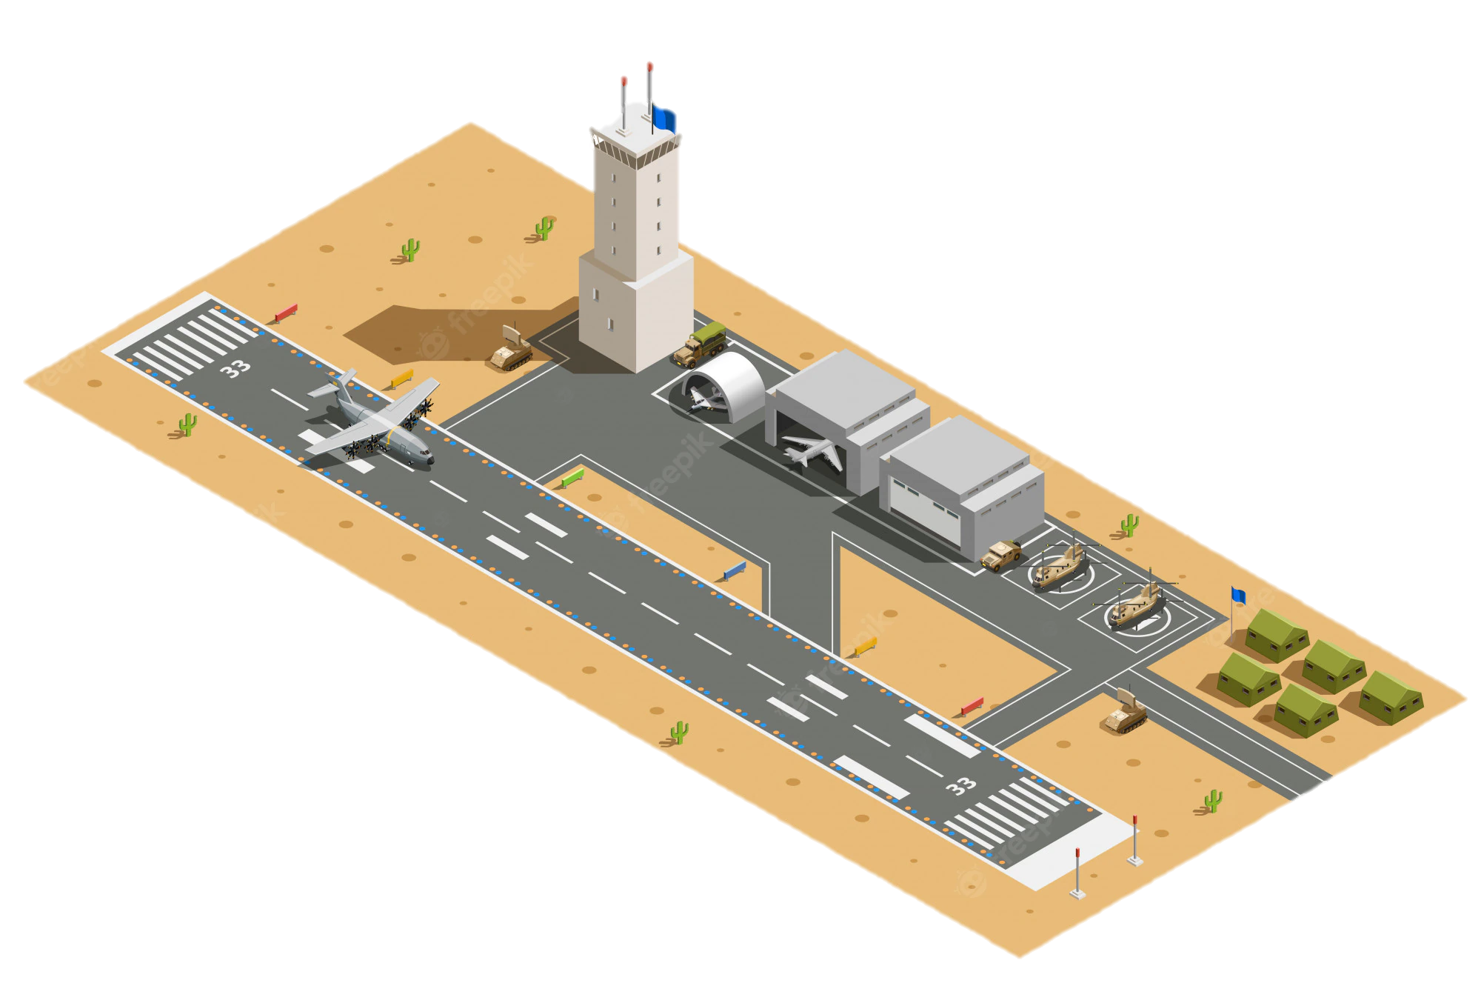
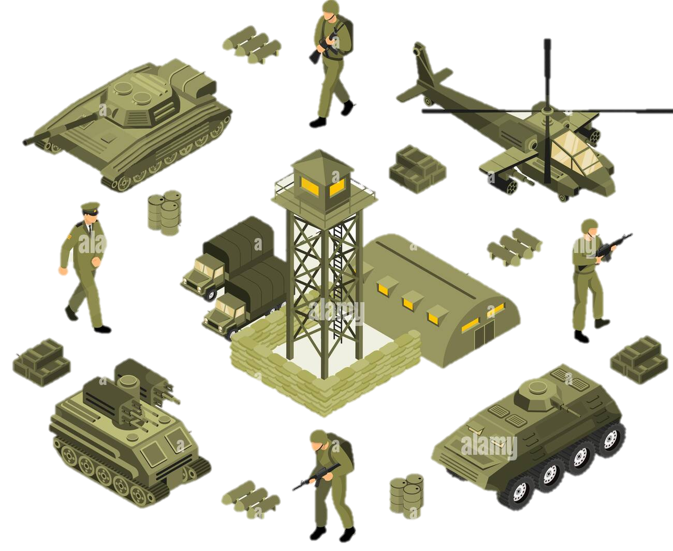
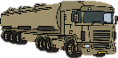
Vignette B – Logistics at Land In Theatre logistics
Task
Move key supplies e.g fuel, rations, water and ammunition
Key task Assumptions and Constraints:
Close Support Squadron (CSSqn) supports ~3000pax Total CSups (fuel, ammo, water, rations, batteries and other equipment) c. 50kg per person based on daily rations c 4kg per person. Common vehicle spare parts e.g. starter motors, wheels, engines, seats
Typical Key Task Activities: | As is activities | Proposed UAV solution
Routine logistics daily delivery
 | PLS Truck Company (of 7 trucks) is prepped with CSups PLS Truck Company completes the 100km journey from DSG to the CSSqn | UAV completes multiple trips between DSG and CSSqn
PLS Truck Company
70-150+ km
Divisional Support Group
Close Support Squadron
Notes:
Ammo rations fuel are heavy
1 pallet is a metric tonne and you move more than one…. So really the eVTOL must be able to carry at least one pallet

Slide 8
Vignette B – Logistics at Land In Theatre logistics
Solution Discussion
Threat level? Opportunistic attacks? Assets, cargo and people are safe Assumed advantages of the eVTOL
Task
Move key supplies e.g fuel, rations, water and ammunition
Information exchange requirements
Inputs and from where | Outputs and to where
Key Task Performance Requirements:
 |  | MVP
Range required when fully loaded |  | xx
Payload |  | xx
The platform needs to cope sufficiently on very soft ground
Other options to consider
UAV could be used to deliver adhoc/emergency supplies
MOEs/MOPs |  | Current | eVTOL | Justification
deliver mission objective | Payload |  |  | UAV multiple trips per day
 | Manoeuvrability |  |  | UAV not affected by terrain
 | Range |  |  | Truck range >> UAV
Time to complete task | Prep time
 | Transit time |  |  | Speed is terrain dependant for trucks.
Survivability | Detectability |  |  | Trucks noisier, slower and bigger targets
 | Susceptibility |  |  | UAV is in the air and moves faster, low threat in use case
 | vulnerability |  |  | Trucks are armoured
Recommended Improvements
Payload to be increased Multiple UAVs complicates air space management Range to be improved
Notes:
Tools I used and how I found using it.
Sorts of analysis that we were doing only needs a template
Lots of other considerations to be made that havne’t been captured here.
Would pallets fit in Adam? Or would non-standard packaging be required?
these require a faster response time (typically would not wait for the routine deliveries). Expect that such P1 supplies are much lighter weight but are delivered direct to where they are needed so range would need to be increased.

Slide 9
Lessons Learnt
Make sure your customer knows what they want
Notes:
Consistent terminology should also be there
Customer picked a set of use cases or ways they thought the beastie could be used which showed that they had no understanding of how things work in

Slide 10
Vignette B – Logistics at Land In Theatre logistics
Solution Discussion
Threat level? Opportunistic attacks? Assets, cargo and people are safe Assumed advantages of the eVTOL
Task
Move key supplies e.g fuel, rations, water and ammunition
Information exchange requirements
Inputs and from where | Outputs and to where
Key Task Performance Requirements:
 |  | MVP
Range required when fully loaded |  | xx
Payload |  | xx
The platform needs to cope sufficiently on very soft ground
Other options to consider
UAV could be used to deliver adhoc/emergency supplies
MOEs/MOPs |  | Current | eVTOL | Justification
deliver mission objective | Payload |  |  | UAV multiple trips per day
 | Manoeuvrability |  |  | UAV not affected by terrain
 | Range |  |  | Truck range >> UAV
Time to complete task | Prep time
 | Transit time |  |  | Speed is terrain dependant for trucks.
Survivability | Detectability |  |  | Trucks noisier, slower and bigger targets
 | Susceptibility |  |  | UAV is in the air and moves faster, low threat in use case
 | vulnerability |  |  | Trucks are armoured
Recommended Improvements
Payload to be increased Multiple UAVs complicates air space management Range to be improved
Notes:
Tools I used and how I found using it.
Sorts of analysis that we were doing only needs a template
Lots of other considerations to be made that havne’t been captured here.
Would pallets fit in Adam? Or would non-standard packaging be required?
these require a faster response time (typically would not wait for the routine deliveries). Expect that such P1 supplies are much lighter weight but are delivered direct to where they are needed so range would need to be increased.

Slide 11
Lessons Learnt
Make sure your customer knows what they want
Engage SMEs early
Notes:
Consistent terminology should also be there
Customer picked a set of use cases or ways they thought the beastie could be used which showed that they had no understanding of how things work in

Slide 12
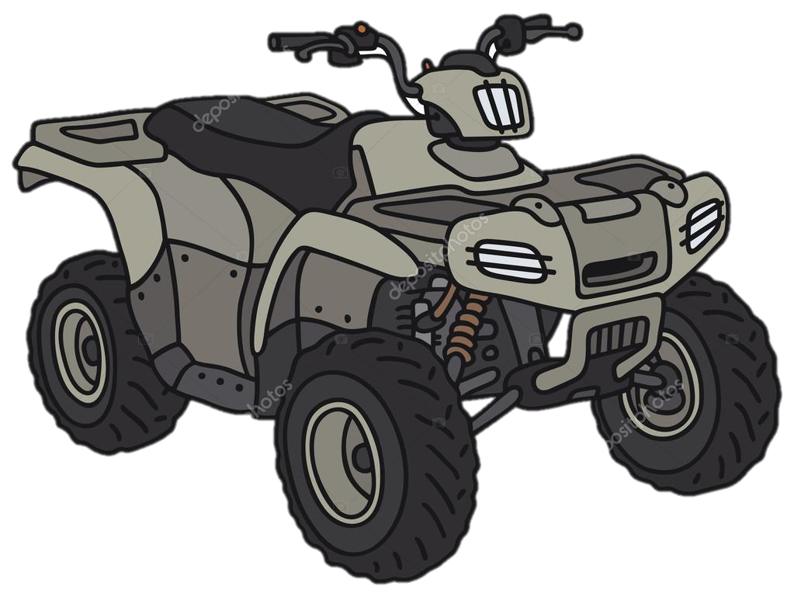
Overview Vignette B – Logistics at Land
Front Line
150km
PLS Truck Company
PLS Truck Company
Brigade HQ
Main Operating Base
25km
5km
Battalion HQ
Company Group
25km
Range
Enemy Regiment
5km
Notes:
Based on the customer use cases we built this
Spot the difference

Slide 13
Overview: Vignette B – Logistics at Land
Rear
Close
Deep Ops
FLOT
Airhead
Bde Tac HQ
Fd Hosp
BG
Eng Regt
A1 ech
Coy Gp
Enemy Regiment
Port
BSG
Sqn Gp
B ech
A2 ech
C Sups
RAP
BG
Coy Gp
DSG
Close Sp Sqn
A1 ech
A2 ech
Eng Regt
DP
Recce Sqn
Artillery HQ
Coy Gp
A2 ech
RAP
A2 echelon
A1 ech
LSD
Sqn Gp
BSG HQ
BG
A1 echelon
DP
ACP
Arty
gun line
LAD
Coy Gp
100+ km REAR
20-30km
3km
CLOSE 0.5-2km
DEEP 20-60 km
Notes:
Difference in terminology!
Echelons not linear distribution
Logistics is not just food and water, Ammo, medical supplies and spare parts
You don’t just deliver stuff to the front line! DP is a Distribution Point, pre arranged drop off point, ‘open’ for a set period of time then departs.
Regimental aid posts for dealing with cuasulaties
LAD – engineers to fit parts and repairs. All of this needs to be managed
Our simplistic model works…. For routine stuff. And we can make it work based on the use case we chose. We’ve stuck with the use cases the customer asked for (from MOB to HQ etc) we can categorically say that the distance and payload for in theatre logistics is way too much for our beastie to cope with ( 100s of return flights even if it could manage the 100k)
but know that there are more interesting uses for the non –routine adhoc stuff where the eVTOL could be useful in.
In the instance that a non standard part fails at the Company Group. They would send a jeep all the way back to the DSG and wait for it to arrive. Wouldn’t it be nice if a beastie could be sent instead (no personnel impact) and fly back? Met by the LAD and part fitted. The payload is more suited to spare parts. But… distance could be up to 150km
Whilst the input from Mark didn’t materially change the use cases we were looking at (they were very specific), it highlighted that the customer doesn’t really understand the end users that well and the huge range of tasks/uncertainty that they face.

Slide 14
Lessons Learnt
Make sure your customer knows what they want
Engage SMEs early
End User focus
Notes:
Consistent terminology should also be there
Customer picked a set of use cases or ways they thought the beastie could be used which showed that they had no understanding of how things work in

Slide 15
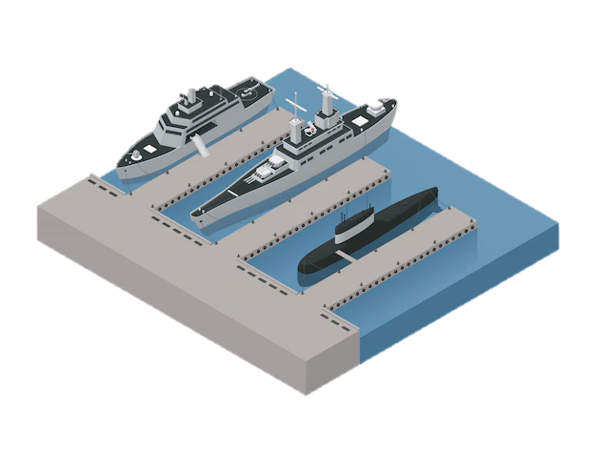
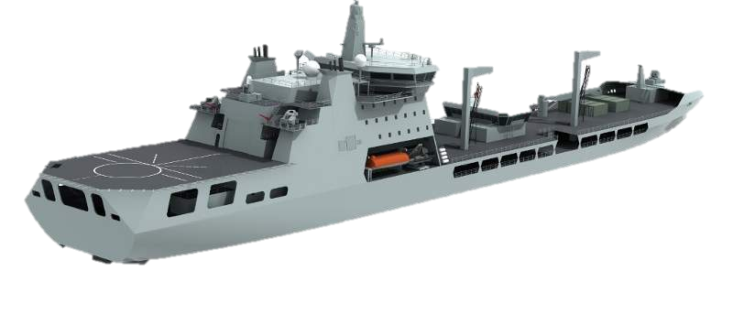
Not considering the limitations/restrictions on the end user
Do I want a random drone to land in my port?
Do I have the SQEP to land this?
Do I have space for this?
What do I turn off to make sure I have the bandwidth I need for this?
Local Friendly Port
Wildcat Carrying Part
Wildcat Carrying Part
5nm / 9km
RFA Stores Ship
RAS Corridor
Carrier Strike Group
RFA Stores Ship
20nm/37km
*e.g. a starter motor c. 10kg
** Based on SME experience –
Notes:
Talk to the realities
Captain needs to think about what he turns off to fly this thing?
Frigate skipper…
Cheaper quicker less resource Intensive than helicopter but…
Control of the eVTOL can be handed over between at-shore team and the ship. Flight could be automated but take off and terminal approach may be controlled by different operators. (Control sits with ship captain in the Terminal Control Zone c. 2Nm around ship)
It is an organic CSG/RFA asset - Frigates and destroyers are very space constrained** so may not be able to accommodate these additional assets.
There is sufficient bandwidth!! Note that ships are short on bandwidth especially SHF. It is not uncommon to turn off one network to turn another on.

Slide 16
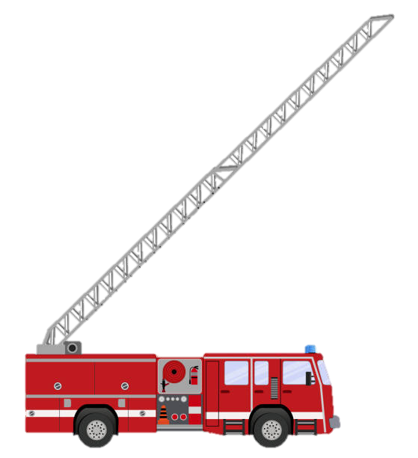
Vignette I –Emergency Services at Land High rise fire control
Task
To extinguish the fire with minimal damage and risk
Key task Assumptions and Constraints:
Wet riser system and mains riser in good working condition UAV is tethered and therefore not limited by capacity of battery
Typical Key Task Activities: | As is activities | Proposed eVTOL solution
Fire has broken out and emergency services deployed
 | Firefighters with breathing apparatus connect hose to the landing valve of the wet riser system to tackle fire from inside High reach appliances used for external firefighting. 2 men on each hose to control. | Assumes that hose has been redesigned and certified for use with UAV UAV flies to height with hose attached Hose attached to rising main for external firefighting only
Fire extinguished Fire damage assessment Return to station
Notes:
My final example. (such a fab picture from Tash)
Hose would need to be adapted and re qualified for use with a drone
eVTOL stable in the microclimates and eddy currents associated with high rise buildings
eVTOL stable and can control the pressurised hose
Never in 20 years of firefighting have I heard someone say ‘ you know what? I wish we had a drone’

Slide 17
Scenario 1:
Vignette A
FEBA
Deml Guard
Coy Gp
Sqn Gp
10-20km
1-3km
20km
Recce
CF
BG Tac HQ
Lead Elements of Enemy Regiment
50-150km
Coy Gp
FLOT
2km
5-20km
Division Support Group
Brigade Support Group
10-20km
1-3 km
Enemy Brigade
BG Tac HQ
Company Group
Vignette B & C
Notes:
They envisaged the drone to be collocated with the Company Group
We had to push back HARD. Theres no charging infrastructure to operate this
We can have spare batteries
Jerry: they’ll be dug in. They don’t want a great big flying thing giving away their location.
We can camouflage it
Jerry: then the soldiers will have to leave their posts to uncover the beast which puts them at danger
Ooooh.
Maybe I’m labouring the point and my 2 lessons learnt are basically the same – end user focus or certainly operational readiness/ease of deployment not just operational utility needs to be considered

Slide 18
Lessons Learnt
Make sure your customer knows what they want
Engage SMEs early
End User focus
Notes:
As I said at the start, nothing ground breaking here but I think are key considerations that we should always have at the front of our minds when doing any analysis. And I hope that the examples that I shared help explain the impact or importance of this.

Slide 19
Any questions?
Notes:
Questions for them?
Who’s had a similar experience?
Anyone want to share their lessons learnt?

