Slide 1

Collaboration across Boundaries
Richard Brown, BAE SYSTEMS CORDA

Slide 2

Aim and Purpose
Engagement and Collaboration in OR
Context – ASTRID framework study on power and energy developments
Explore through:
  Workshops
  1:1 Interviews
  Survey
What worked, challenges and lessons learned
Planning a successful collaborative engagement – key conclusions

Slide 3

Context - Power and Energy Study
ASTRID framework Power and Energy collaborative study
  The brief: An horizon scan
  Power and Energy developments with potential to improve MoD capability
Engagement with Industry, Academia and MoD representatives
  What developments they were working on?
  Why?
  Timelines, implementation and execution challenges
  MoD needs

Slide 4

Engagement – planning phase
Objective setting
  Designing the (exam) questions: What, Why, How structure
A blend of engagement formats
  Workshops
  Survey
  1:1 interviews (Semi structured)
Identifying / sourcing the right attendees
  Network of study team
  Open source / cold call enquiry

Slide 5
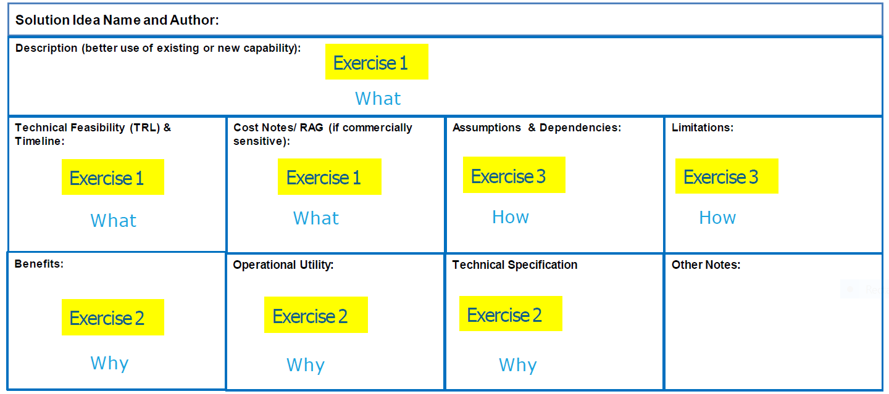

Workshops - format
 | Format | Purpose | Output
What? | Plenary | Identify P/E developments / timelines / cost | Word cloud, List, TRL plot, Cost RAG | Solution sheets
Why? | Break out | Reasoning / Benefits / Utility | Discussion / plenary debrief
Dstl/MoD | Plenary | MoD needs / engagement routes | Presentation / contact for follow up
How? | Break out | Implementation / challenges | Discussion / plenary debrief

Slide 6
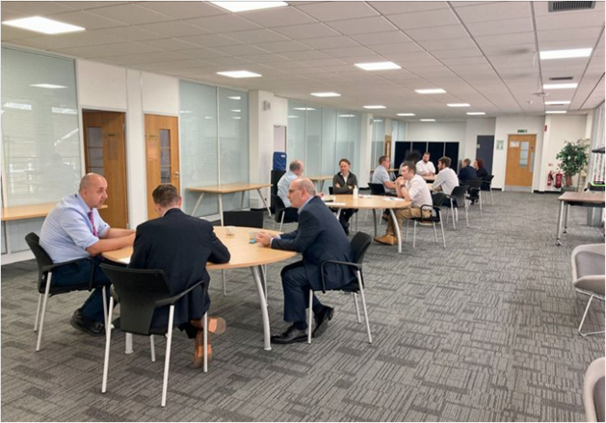
Workshops - evaluation
What worked
  Direct interactions (not hybrid) facilitated much output
  Use of technology eg word cloud to summarise results in real time
  Solution sheets to consolidate all workshop questions by development
  Use of the breaks for follow up / 1:1 conversations
Challenges
  Vocal vs reserved participants
  Confidentiality issues
  Differing motivations (Industry/Academia/MoD)

Slide 7
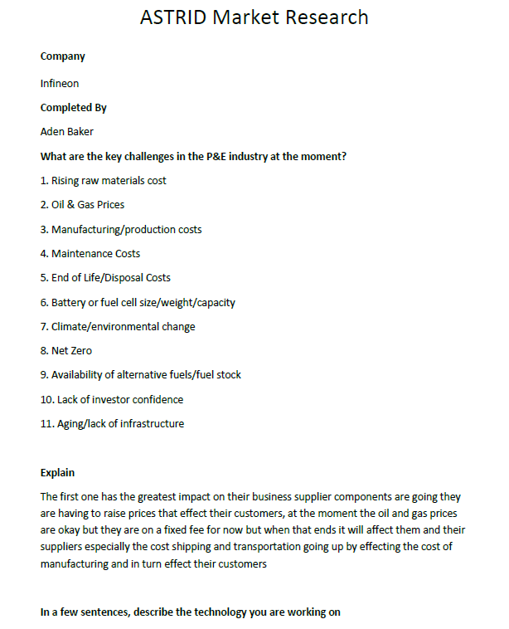
Surveys - format
Questionnaire format similar to the what, why, how questions of workshops
Blend of multiple choice questions and open text
Simplistic format to facilitate quick response
Telephone follow up attempted

Slide 8

Surveys - evaluation
What Worked
  Broader reach – 113 organisations approached
Challenges
  Low Response rate 14%
  Time and effort to administer (32.5 hours)
  Little motivation to feedback
  Questionnaire not interactive
    Telephone follow up attempted
  Quality issues with feedback
  Hours on campaign: 32.5
  Total organisations approached: 113
  Total completed research: 16

Slide 9

1:1 Interviews
Format: Semi structured with questionnaire but also open discussion
What worked
Very targeted
Detailed discussions
Less confidentiality concerns / more open
Good to do after workshops to tackle gaps / unresolved issues
Challenges
It is only one view – no challenge from other stakeholders
Difficult to set up (motivation)

Slide 10
Planning a successful collaborative engagement – key conclusions
Strive for win/win
  Understanding what participants want to get out of it
  Study team and participants both need to come away with something of value
Balance information sharing with confidentiality concerns (give/take)
Choose an appropriate blend of formats.
  Workshops/1:1 interviews worked best for us.
  Surveys less so – but they may still offer benefit where large scale input required.
Effective tools – eg Solution sheets accelerated input consolidation and analysis
Industry
Academia
MoD

Slide 11

Thank you
Questions and Answer

