Slide 1
Collaboration across boundaries – AN astrid perspective
Ed Aubrey – ASTRID Technical Manager

Slide 2
Contents
Context
  My experience
  What is ASTRID
Collaboration
  Theory
  Ingredients of good collaboration
  Barriers to collaboration
Case Studies
Summary

Slide 3
Context – My experience
~ 30 years in Defence OA/OR
Worked for both MOD and Industry
Competed, collaborated and delivered analysis in these roles
Although my current role focuses on ASTRID my comments and views are more general

Slide 4


Context - ASTRID
Framework agreement giving Defence and Security customers access to OA/OR decision support services
Delivers a broad scope of analysis to support decision-making in Defence, Security and Resilience across MOD and UK Government
Awarded in April 2020 – a five-year contract worth £250m plus two-year option (£350m)
BAE Systems Digital Intelligence CORDA is prime, bringing in expertise from supporting organisations
Provides access to analysis and decision support expertise:
  Open supply chain; 180+ core suppliers including primes, SMEs, consultancies and academia
  Provides access to wider skill and expertise base via academic network and Knowledge Transfer Network

Slide 5
Collaboration – the theory
Collaboration
People
Common objective
Knowledge
Common language
Shared space
Interaction
Time
Teams comprising people with diverse backgrounds, cultures, strengths and skills work together to deliver outcomes with high productivity, efficiency and speed
Lots of material in literature
Soliman, Borne, Simoff proposed 7/8 ingredients
Soliman, R. & Braun, Robin & Simoff, Simeon. (2005). The essential ingredients of collaboration. 366- 373. 10.1109/ISCST.2005.1553336.
Notes:
illustrations

Slide 6



Ingredients for Successful Collaboration (1)
3
3
People
Knowledge
Different background, cultures, perspectives, pre-conceptions
Behaviour
Lessen the transactional relationship
Each party having different knowledge and skills
Optimal Utilisation
Notes:
Different backgrounds and cultures can be both +ve and -ve

Slide 7


Ingredients for Successful Collaboration (1)
3
3
Common Objective
Common Language
Know where you are going (but not necessarily the route)
Roles
Are we all talking (and understanding?!) the same thing?
Need to be alive to nuances and ‘falling between cracks’
Notes:
Different backgrounds and cultures can be both +ve and -ve

Slide 8



Ingredients for Successful Collaboration (2)
3
3
3
Shared Space
Interaction
Time
Environments within which to collaborate – physical/virtual + information environment (e.g. Kahootz)
The touch points that enable collaboration
F2F, embedded floor plate, workshops, sprints etc.
Choosing when, and for how long to interact.

Slide 9
Barriers to Successful Collaboration
Attitude & trust
  Start with the right attitude
Mis-alignment of goal or disagreement on the journey
  Be open to different approaches
Breakdown in communication particularly when there are ‘bumps’ in the road
Don’t be too quick to ‘press the emergency button’ (commercial and contractual)
Notes:
Understanding ethos
Yes there are organisational and business model differences but both parties are striving for the same end goal

Slide 10
How ASTRID helps
Ethos
  Encourages direct customer – supplier interaction. ASTRID PMO is here to facilitate not ‘control’
Sourcing channel
  Collaborative allows individual organisations to submit bids
    We then use evidence to select the best team
  Comprehensive
    On large tasks we offer a ‘matching service’
Kahootz
  Collaborative working environment, accredited to OS
Notes:
ASTRID there to facilitate relationships, support and add value.

Slide 11


Some examples of good collaboration (1)
Task 094 – Maritime Surveillance Study
  Close involvement with supplier and customer. Customer actively suggesting solutions and helping with stakeholder access etc. Team building even involved a trip aboard an FPV and attendance at an exercise
Task 048 – AFSIM
  Joint working and fully embedded team on Dstl floorplate
Task 152 – Concept Development Support
  Many collaborative sessions between Dstl and Supplier

Slide 12


Some examples of good collaboration (2)
Task 040 – Force Optimisation and Experimentation
  One team approach – many exercise deployments
Task 209 – Reserve Forces Review
  Over 70 interviews required – real partnership between customer and supplier to organise and administer. Critical component to the work with some risk – collaboration made it a smooth process
Task 197 – Cost to deliver (mil. Logs)
  Stakeholder engagement a key challenge including data extraction/input
  Regular communication and a ‘one team’ approach ensured success

Slide 13
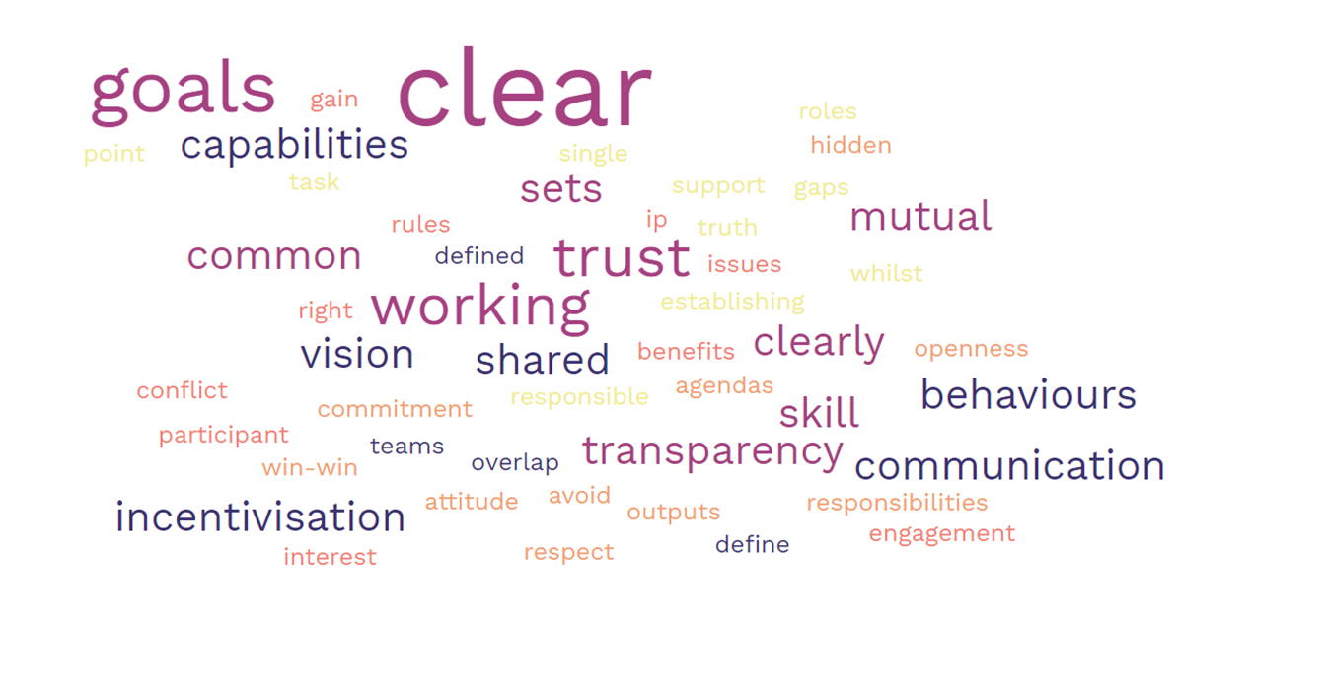
Summary
Need to have the right attitude and behaviours
  Be open, expect openness
Need to ensure goal is common; all parties on the same page
Build relationships
Needs to be give and take from both sides when ‘bumps’ occur
Don’t stop the communication
What are the ingredients of good collaboration?

Slide 14

For more details on ASTRID, please email ASTRID@baesystems.com

