Slide 1
Operations Research in
Israel MOH
Covid-19 Task Force
Mizrahi Ami
Head of the OR group
Takeaways from setting up a new OR group

Slide 2
Covid-19 in Israel
1st Lockdown
Task Force
Setup
2nd
3rd
Vaccination
Booster
OR Group
Setup
We Won (again)
We Won
OR Group
Personnel

Slide 3
MOH and Partners Dealing with Covid Pandemic
MOH
Home Front Command
)ALON HC(
Labs & Hospitals
HMOs
COVID-Task Force
(MAGEN ISRAEL)
NSC,
Government Offices
Local Authorities

Slide 4
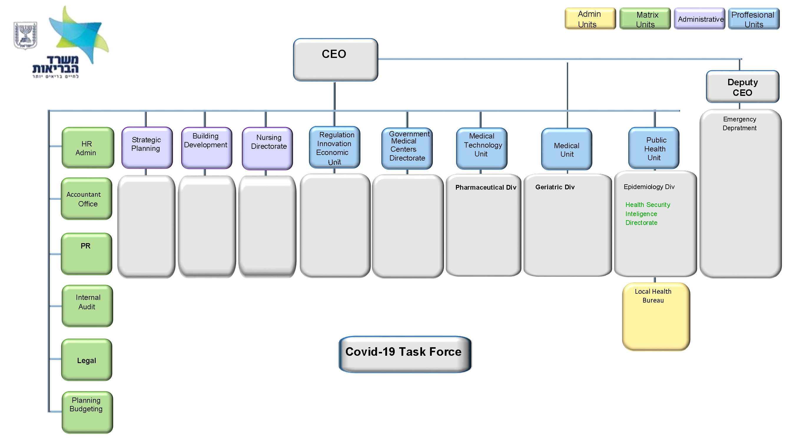
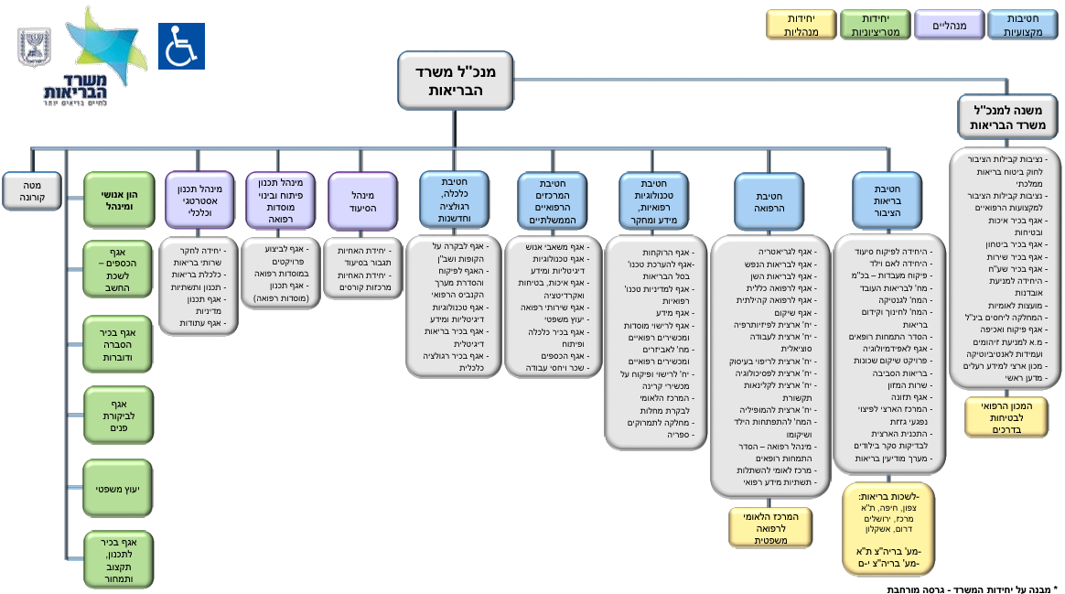
The OR Group and the Israeli MOH
Intel experts
Data Scientists
Subject Matter experts
OR Experts
Knowledge & Information Center
Data
World
Sci. Reviews
OR

Slide 5
Professional and Environment
Professional:
  Build the team
  Utilize available research capacity
  Earn trust
  Create partnerships & Dissolve differences and tensions
Environment / Decision Process
  Head of public health (2)
  Health ministers (4) ; CEO’s (3) ; Deputy CEO (1.5)
  Advisory Committee for Epidemics (1)
Corona Task Force – starting Aug. 2020

Slide 6
Examples to go along and tell the story
Domestic Policy
Vaccines
Border Control

Slide 7
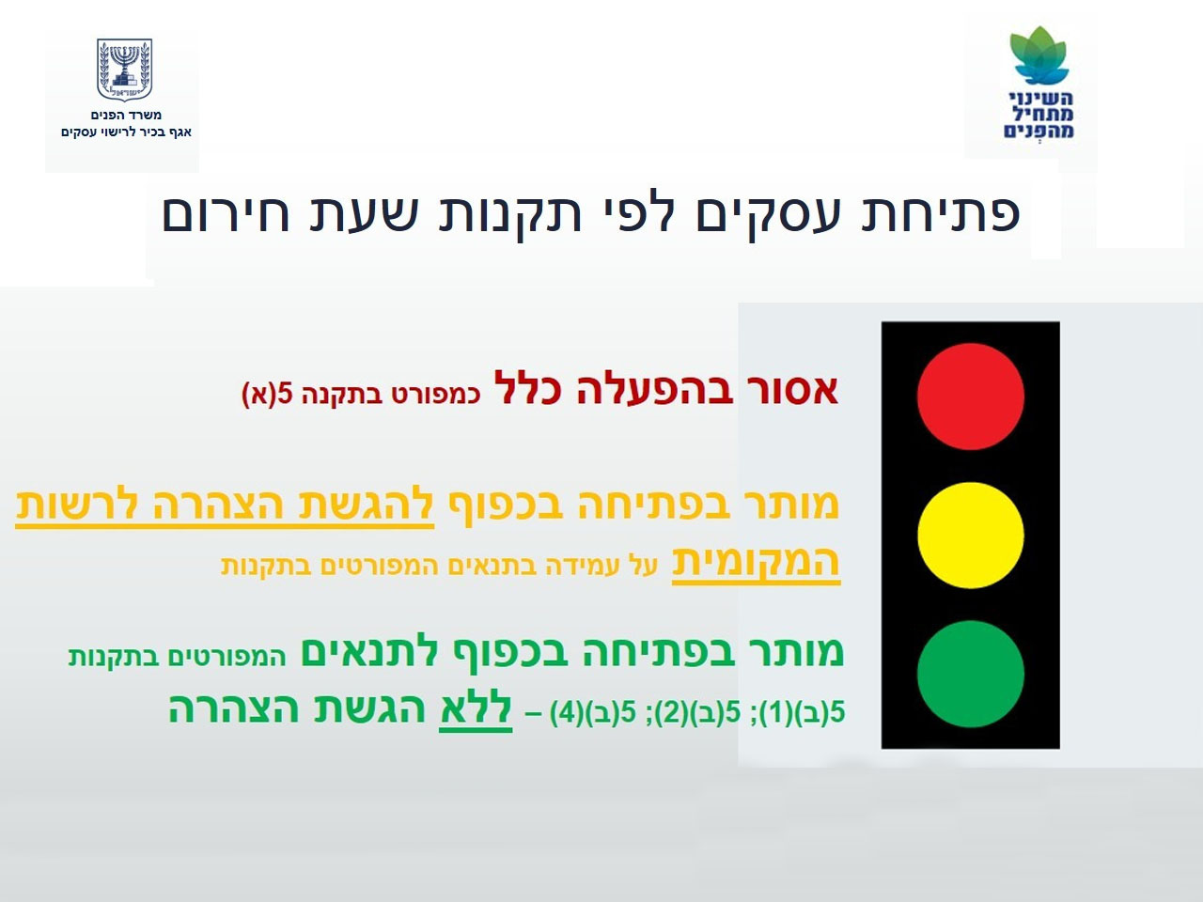
Domestic Policy
Stoplight policy
Effectiveness of Local Policy Measures

Slide 8
Local Closures (are not) Effective to reduce infections IN the municipality
9.2020
Outsourced to HUJI
Municipality with closure
Similar (synthetic) area without closure
1 Researcher
+ 4 Students

Slide 9
Local Closures (are not) Effective to reduce infections OUTSIDE the municipality
Infections per 1,000 infected in original municipality |  | Origin Municipality
 |  | RED | ORANGE | YELLOW | GREEN
Destination municipality | RED | 52 | 42 | 28 | 20
 | ORANGE | 79 | 49 | 82 | 78
 | YELLOW | 45 | 57 | 134 | 144
 | GREEN | 30 | 50 | 104 | 170
total infections in other municipalities |  | 0.20 | 0.20 | 0.35 | 0.41
Total infections per infector |  | 1.02 | 0.99 | 1.01 | 0.98
9.2020
Done by students
during summer-break
People from highly infectious municipalities – infect more, but mostly in the original municipality
Local closures in RED municipalities are NOT EFFECTIVE
1 Researcher
+ 4 Students

Slide 10










What are the other policy tools?
Done in collaboration
Intelligence Group
Crowds, time limit,
Ventilation, PPE/Masks
9.20
Closure Ends
Infections
Reduce Infections
Culture/Shows
PPEs/Masks
Schools
Events
Limit Capacity & time
18+
25-50
Ventilation
Outdoor events
Bars
Gyms
50+
Restaurants
Recent Test
Shopping Centers
Reduce Severe Sickness
Age Limit
18+
Open only to vaccinated
1 Researcher
+ 4 Students
Personal Services
Non-Personal Services
Age/Vaccination
Severe Sickness

Slide 11
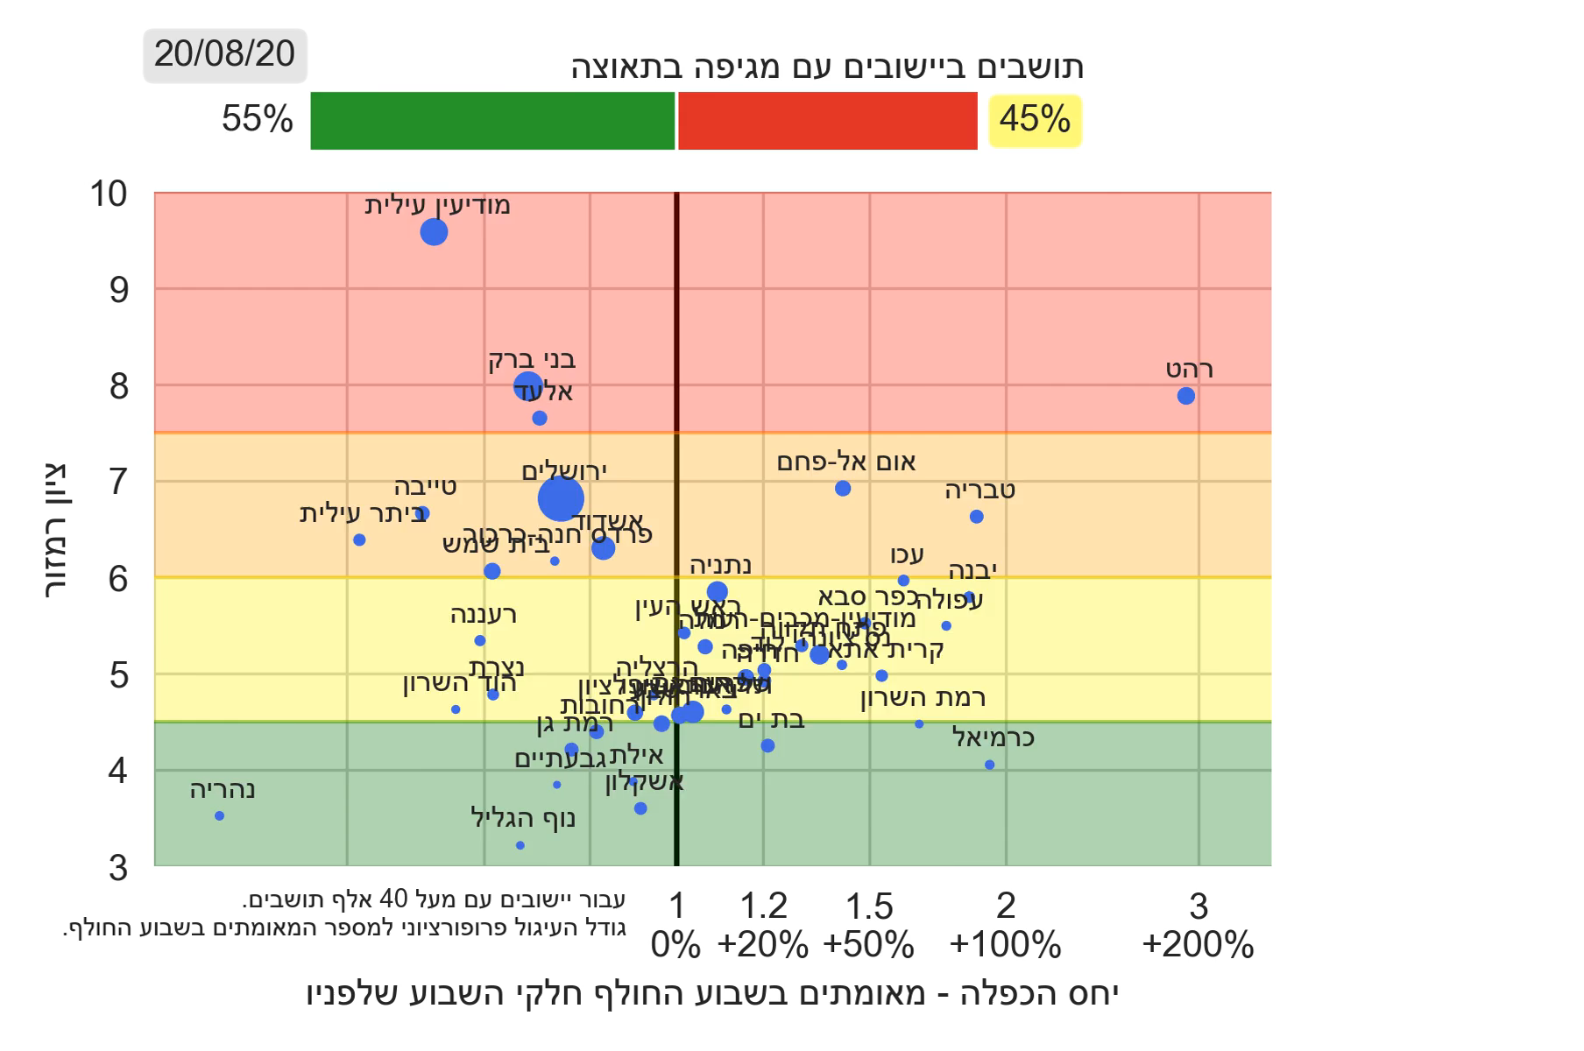
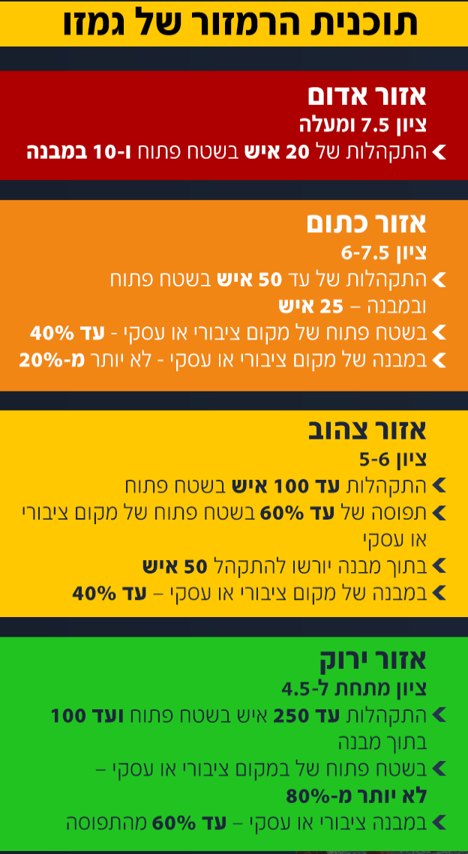
The original rational of STOPLIGHT KPI proved not effective but it was adopted with limited tools
8.2020
STOPLIGHT = F( new infections in locality , % positive )
The original rational of closures on “red” municipalities proved not effective
The Stoplight policy was adopted to compel local politicians to join
  Our work helped direct the policy towards more relevant policy tools (education, gathering restrictions)
  It became a national KPI
Our Data Group produced
daily STOPLIGHT KPI nationally
1 Researcher
+ 4 Students

Slide 12
Border Control
Tools for assessing KPI’s based on partial data
Change of KPI’s over time

Slide 13

Border Control
What is the KPI?
  Infections
    significant level of infections compared to local levels
  Variants
    dangerous variants compared to local variants
Reliability of data
  Available data - Our World In Data
  Check Covid mortality and excess mortality data to estimate cases (IFR)
  Use incoming flights tests and sequencing to estimate risk

Slide 14
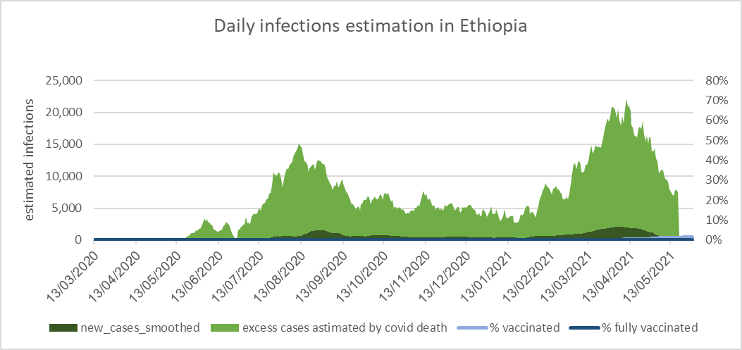
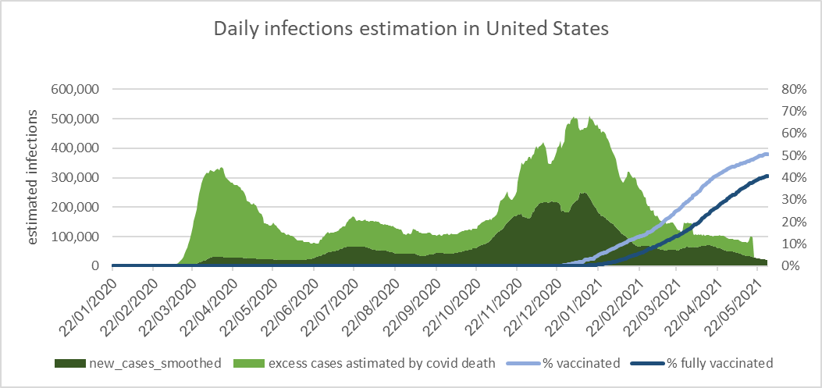
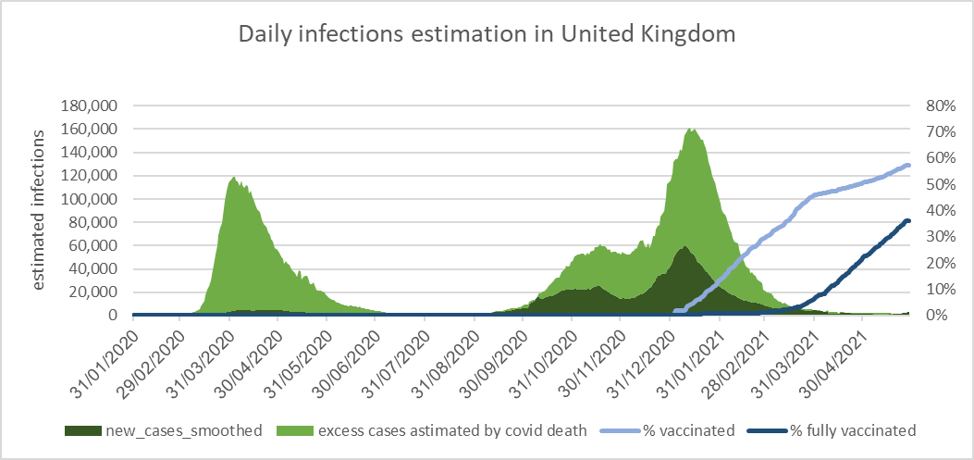
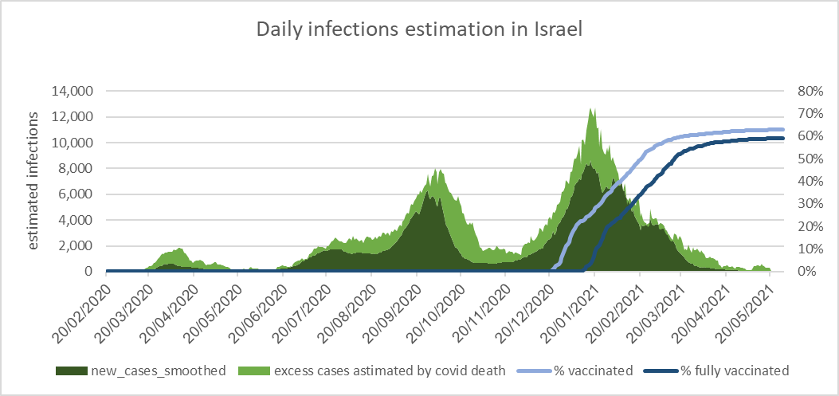
Data is incomplete ➔ Assess what you can’t measure
Thanks to OWID
5.2021
Ethiopia
USA
New cases based on Excess Death
New cases based on Excess Death
Reported New Cases
Reported New Cases
UK
Israel
3 Researchers

Slide 15
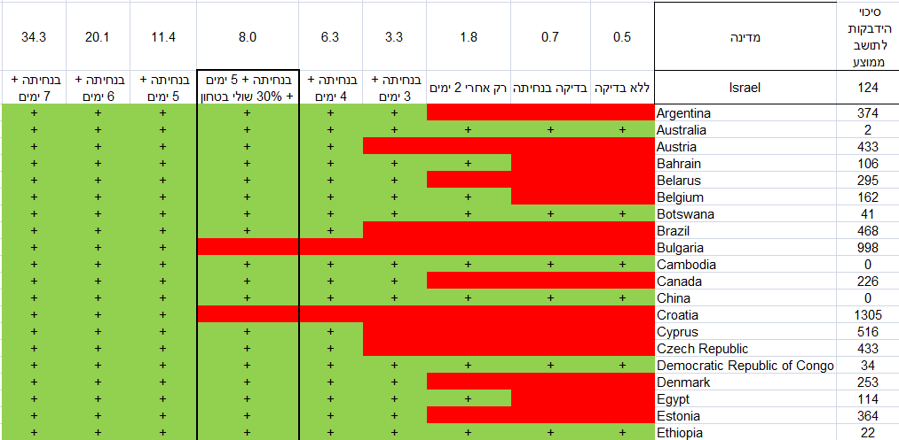
We suggested that tests could substitute isolation
4-11.2020
Test Strategies
Landing +
7 Days After
Landing +
6 Days After
Landing +
5 Days After
Landing +
4 Days After
Landing +
3 Days After
2 Days after
At Landing
No test
Research Volunteer
The suggestion was not accepted then
Only a year later, the policy was accepted
3-4 Researchers

Slide 16
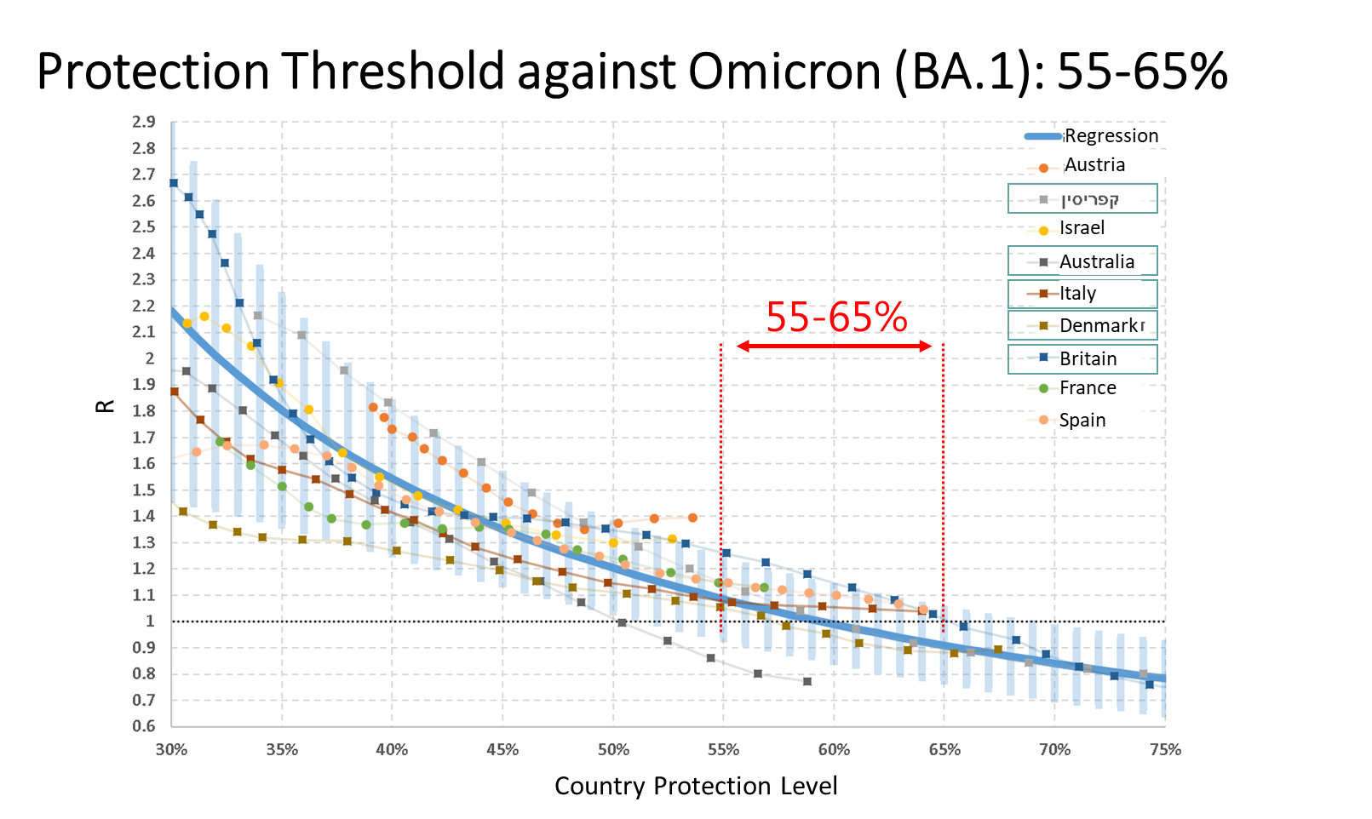
Assessing is harder – Multitude of Vaccinations, Variants and decay times
We assessed the empirical protection threshold
Israel total immunity VS. daily cases
11.2021
Waning again. Below 55%
New Infections
Immunity Level
This work promoted the 2nd booster
6 Researchers

Slide 17
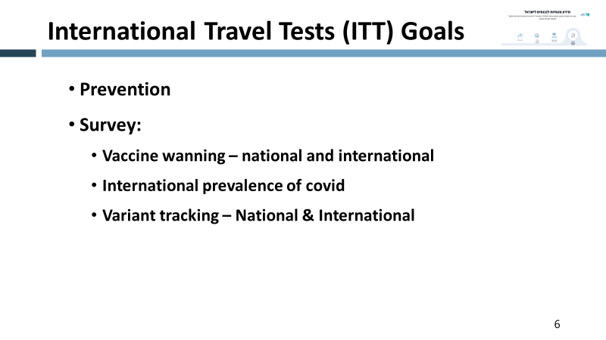
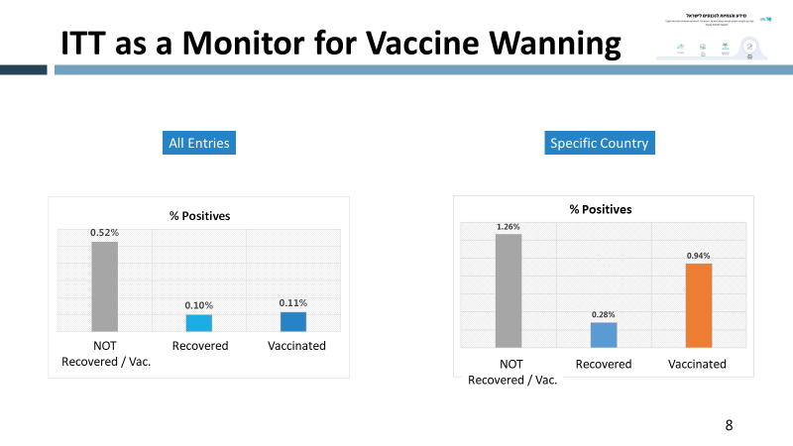
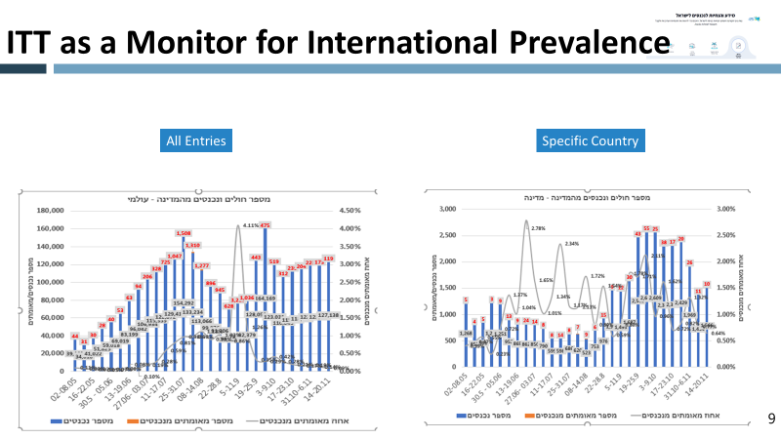
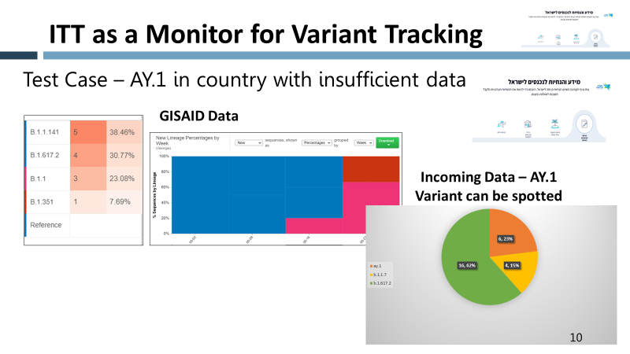
And when we can’t rely on others – We Do it ourselves
International Travel Tests
11.2021
6 Researchers
Notes:
Anecdote about alerting UK of Omicron variant in a conference

Slide 18
Vaccines
We were “leading the fleet”
Effectiveness against a-symptomatic infections
Vaccine Waning
3rd Dose Effectiveness

Slide 19
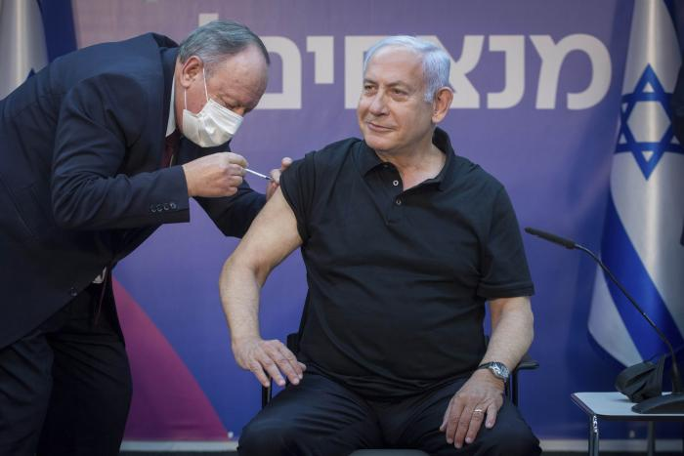
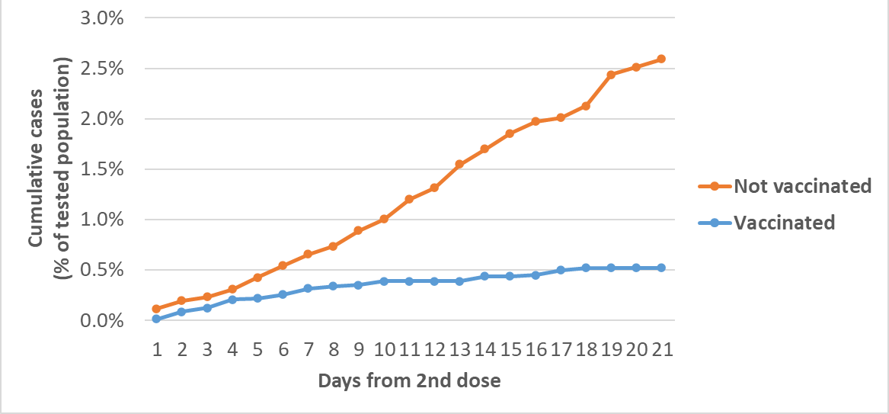
Vaccines (1) –
Effectiveness Against Infections (not only symptomatic)
2.2021
2nd Vaccination dose in Israel
  LTC facilities ~ Jan 30th
Episodes from 2nd dose
Jan 9th, 2021 – Former PM
getting his 2nd vaccination dose
Jan 9th, 2021 – PM
getting his 2nd vaccination dose
Cases After 2nd Dose Only
Sparsity of Data
PFE* (CI 95%) | Days from 2nd dose
88% (76%, 94%) | 7-14 days
90% (83%, 94%) | 7+ days
* PFE – Prevented Fraction in Exposed
Day of 2nd Dose
Administration
* Data extracted on Feb 14th; Vaccination operation of 2nd dose amassed in LTC facilities on end of Jan 2021
3 Researchers
Collaboration with Geriatric Unit & Senior Shield

Slide 20
Fast and crude analysis → feedback & verification
2 Weeks
5 Weeks
2.2021
2nd Vaccination dose in Israel
  LTC facilities ~ Jan 23rd
Presentation to Israel Policy Makers - Feb. 3rd
Presentation to ECDC - March 5th
This work eased the decision to end the national closure
3 Researchers

Slide 21
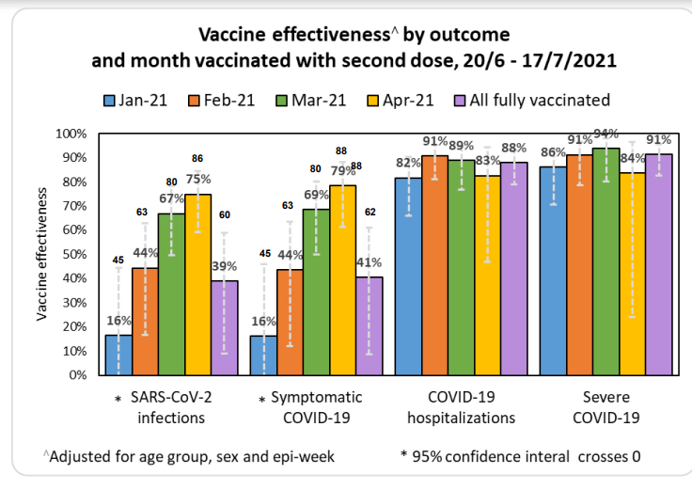
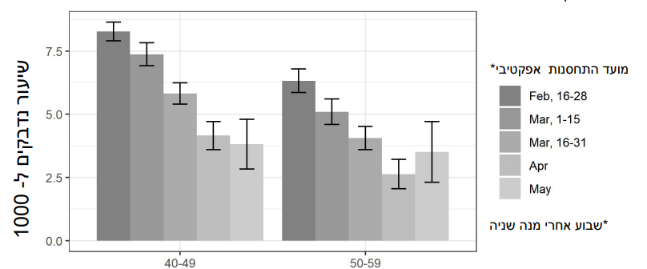
Vaccine (2) - Waning uncoordinated results can be harmful
6.2021
Detected Infections vs. Date of Vaccination
Effective Vaccination Month *
Infections per 1,000
* 7 Days after booster
1st Presentation to Israeli Advisory Committee for Epidemics - July 15th
3 meetings later, 28th Jul. – booster approved for ages 60+
2 different groups
Different analyses, same conclusions, similar but not identical results, delayed decision for weeks
5 Researchers

Slide 22
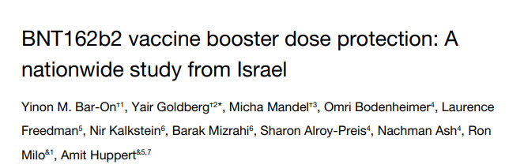
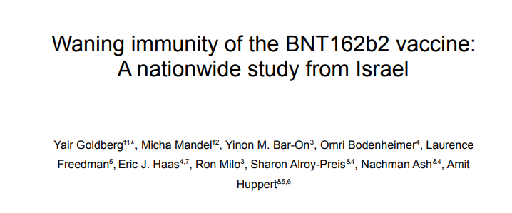
Vaccine (3) - Booster
Coordinate all research groups proved effective when the need for a booster came
8.2021
https://www.gov.il/BlobFolder/reports/vaccine-efficacy-safety-follow-up-committee/he/files_publications_corona_booster-27082021.pdf
https://www.gov.il/BlobFolder/reports/vaccine-efficacy-safety-follow-up-committee/he/files_publications_corona_immunity-waning-082021.pdf
NEJM Publication - World Class Research
6 Researchers
coordinated groups

Slide 23
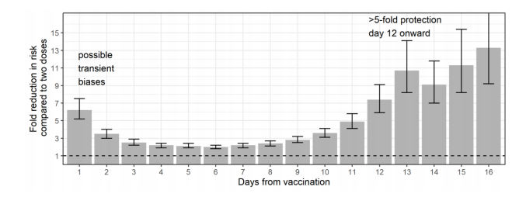
Booster Efficacy
8.2021
As of 27th Aug.
Aug. 12th - booster approved for ages 50+
Aug. 19th - booster approved for all eligible ages
Empirical data proved booster efficacy; growing infection rates ➔ prompted expanding the booster to other age groups
6 Researchers
coordinated groups

Slide 24
Takeaways

Slide 25
Takeaways
Setting up a OR group is challenging
  Learn fast and deep
  Earn trust
  Coordinate –
    know the other groups, have peer reviews, create partnerships, dissolve differences
  Create Personal relations with decision makers
  Get “screen time” – official and unofficial, direct and indirect
  Get results in time to impact decisions
What helped (besides the general sense of emergency):
  Access to people
    Enjoy what My Unit has to offer - world, data, scientific reviews
    Connect to Other Units – provide them with deep and data-based insights
    Increase research capacity - universities, ad-hoc researchers (not a simple task)
  Access to data
    Understand and double-check it, Talk to the users
    Use outside sources of data (but carefully)
    Always try to find the missing data and potential biases

