Slide 1

Juxtaposing Numbers and Narrative: Combining Methodologies in Historical Analysis
Rebecca Brown, Arnie Delstanche, Colin Irwin, Ahmad I. Villasenor, Elliot Cook, and Paul R. Syms, Dstl Platform Systems Division
40th International Symposium on Military Operational Research
Notes:
Abstract
Military theorists have long grappled with offence versus defence, and the virtues of each posture. Media coverage of the war in Ukraine, with scenes from Bakhmut reminiscent of the grinding attrition of the First World War, has generated a renewed appetite to look to history to identify what factors, if any, have featured in successful defensive operations. Combining qualitative analysis of the historical literature with quantitative analysis of 470 battles and campaigns from the updated Helmbold Land Battles Database revealed some surprising results. Both methodological approaches identified consistent themes around training, morale, and leadership as being at least equally as important as logistics, the air situation, and ISTAR superiority. As revealing as these results were, so too was the implication that utilising blended methodological approaches to historical analysis increases analytical efficacy and confidence in the results. Routinely, military historians seek ways to engage a wider audience in the historical conversation, and juxtaposing narrative with numbers may offer a better approach to achieving this.

Slide 2
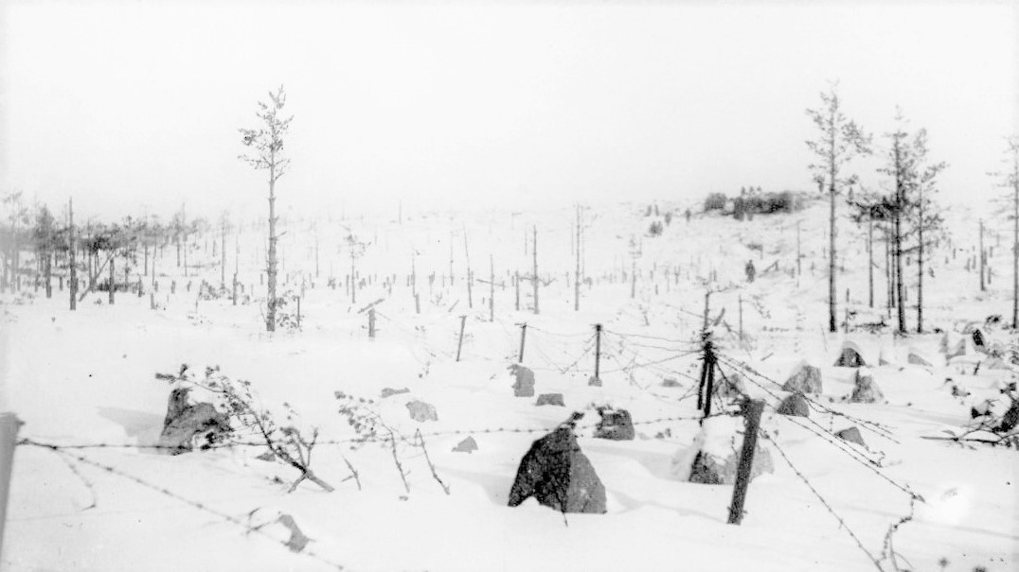
Topics
Introduction and background
Qualitative analysis of defensive operations
Regression analysis of numerical data
Conclusions
Questions?
UK OFFICIAL
Notes:
The Finnish Mannerheim Line, 1939 (Wiki Commons)

Slide 3

The Idea
UK OFFICIAL

Slide 4
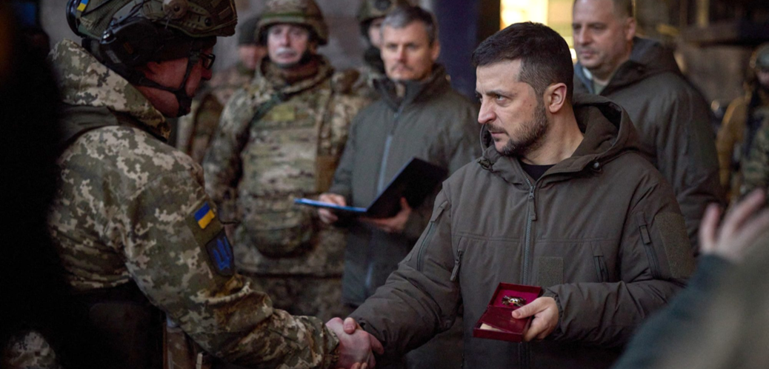
Renewed Interest in Defensive Operations
https://www.atlanticcouncil.org/blogs/ukrainealert/ukraine-is-the-front-line-of-the-free-world/

Slide 5
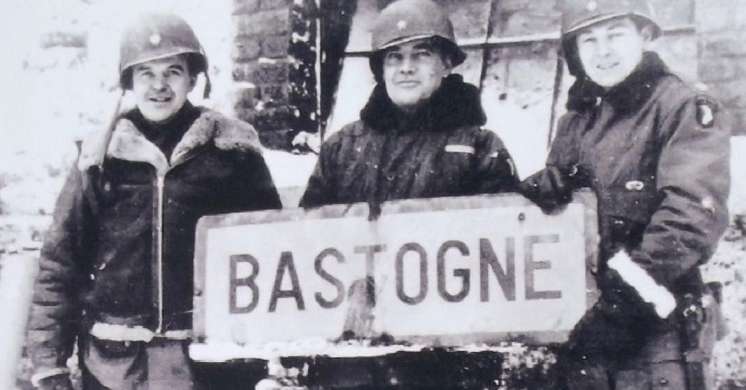
Qualitative Analysis: Capturing the Nuances

Slide 6
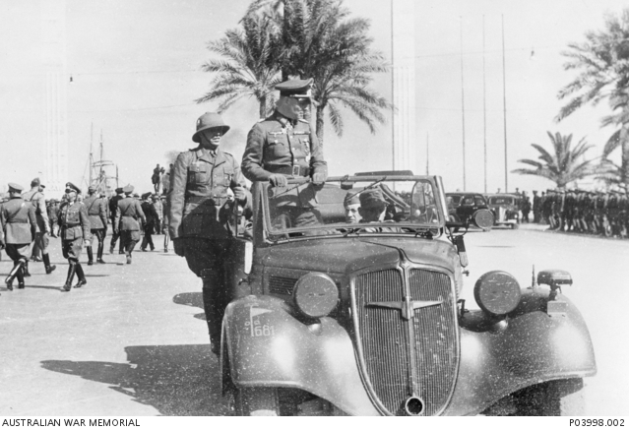
Factors Influencing Successful Defensive Operations

Slide 7
Qualitative Analysis Key Findings
Leadership, morale, and will to fight are the ‘holy trinity’
Fortifications and outposts slow the attacker
Counter-attack is key
‘Citadelization’ useful in urban defence
Assimilating terrain obstacles
Air superiority is important
Maintain ISTAR superiority
Artillery, armour, logistics and C3 are all important

Slide 8
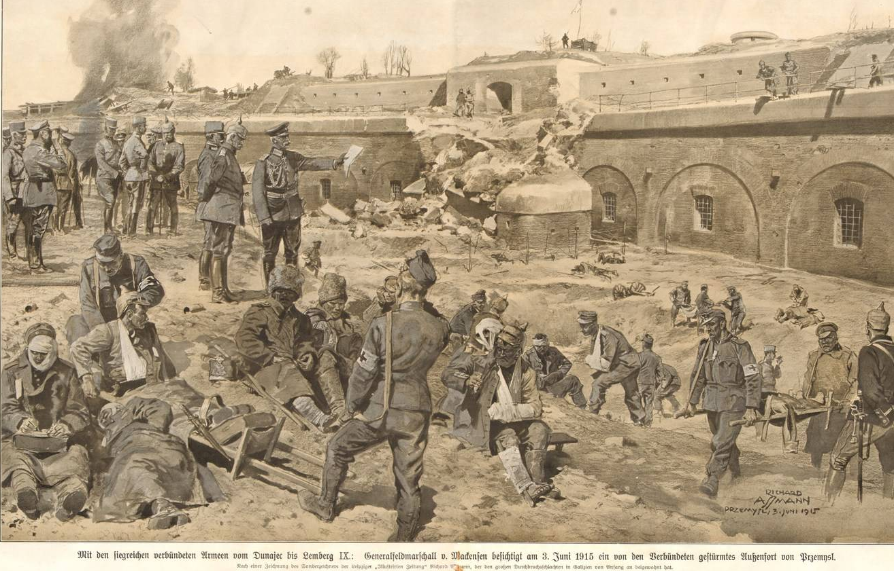
The Value of Qualitative Analysis: The Case of Przemysl

Slide 9
The Utility of Numbers in Historical Analysis:
Regression Analysis of Defensive Operations

Slide 10
Regression Analysis Method
Selected 470 historical battles from the revised Helmbold database
  from 1914 to 1999
  including examples of five different defensive postures
Agreed a list of 14 factors to analyse with our customers
  covering physical, moral, conceptual, and environmental factors
Ran full-factor regression analyses using R
What are the key contributors to defender victory in each posture?
Notes:
Assembling and cleaning the data was described by Syms (2022) at 39 ISMOR.

Slide 11
Defence Postures
DELAY (DL): Prevent the enemy from arriving at a specified location, either for a specified length of time, or until a force has withdrawn
  may or may not use the natural defensive strength of the terrain, e.g. shell scrapes, and improvised obstacles.
HASTY DEFENCE (HD): Normally organised while in contact with the enemy or when contact is imminent
  characterised by improvement of natural defensive features, e.g. shell scrapes, foxholes, and improvised obstacles.
PREPARED DEFENCE (PD): Bulk of the defending force is disposed in pre-selected positions
  non-permanent structures such as trenches and emplacements, and controlling the terrain between them using mines, wire, ditches, and other engineered obstacles.
FORTIFIED DEFENCE (FD): Built when out of contact with the enemy, and when contact is not imminent
  permanent fortified zones incorporating pillboxes, forts, mines, wire, ditches, and protected communication systems.
MOBILE DEFENCE (MD): Non-fixed tactical defence that concentrates on blocking and dislocating the enemy, as a prelude to counter-attacking.

Slide 12
Regression Analysis Method
Defence postures
Factors to analyse
Delay (DL)
Fortified Defence (FD)
Hasty Defence (HD)
Mobile Defence (MD)
Prepared Defence (PD)
Force Ratio
Artillery Ratio
Artillery Guns per 1K Defenders
Tank Ratio
Air Superiority
ISTAR
Logistics
Relative Technology
Morale
Leadership
Surprise
Training
Cover
Relief
Regression Analysis: Statistical technique used to establish relationships between variables, and to calculate the contribution of each to the probability of outcome

Slide 13
Findings: Physical, Moral, and Conceptual Factors
Key observations
Morale makes the largest contribution to defender victory across all defence postures
ISTAR makes the second largest contribution to defender victory in 3 of 5 defence postures
Greater variation in those factors that make smaller contributions to defender victory
Notes:
First explain the range.
The range of percentages indicate the probability of Defender Victory when it has a significant disadvantage to when it has a significant advantage in a given factor.
Other observations:
Across all DPs, the Probability of Defender Victory actually decreases if the Tank Ratio is in favour of the Defender.
Perhaps this reaffirms the notion that tanks are an offensive weapon used to seize ground, rather than to hold it.
The factors which make the smallest contribution to Defender Victory more or less make sense within the context of that Defence Posture.
ISTAR contributes little to Defender Victory in a Fortified Defence, given that the Defender has forfeited the initiative by being fixed in place, and as such, is not in a position to affect the situation even with intelligence of the enemy’s strengths and dispositions.

Slide 14
Findings: Terrain
Key observations
Mountainous terrain makes the largest contribution to defender victory in 4 of 5 postures
Urban makes the smallest contribution to defender victory across all postures
Notes:
The fact that defending in urban areas makes the smallest contribution to victory aligns with the finding that FIBUA does not favour the Defender.
Greater overall surface area in urban terrain means there’s more ground for the Defender to cover.
Urban terrain hinders LoS and compartmentalises the Defender in certain strongholds, leaving them vulnerable to isolation and envelopment.

Slide 15
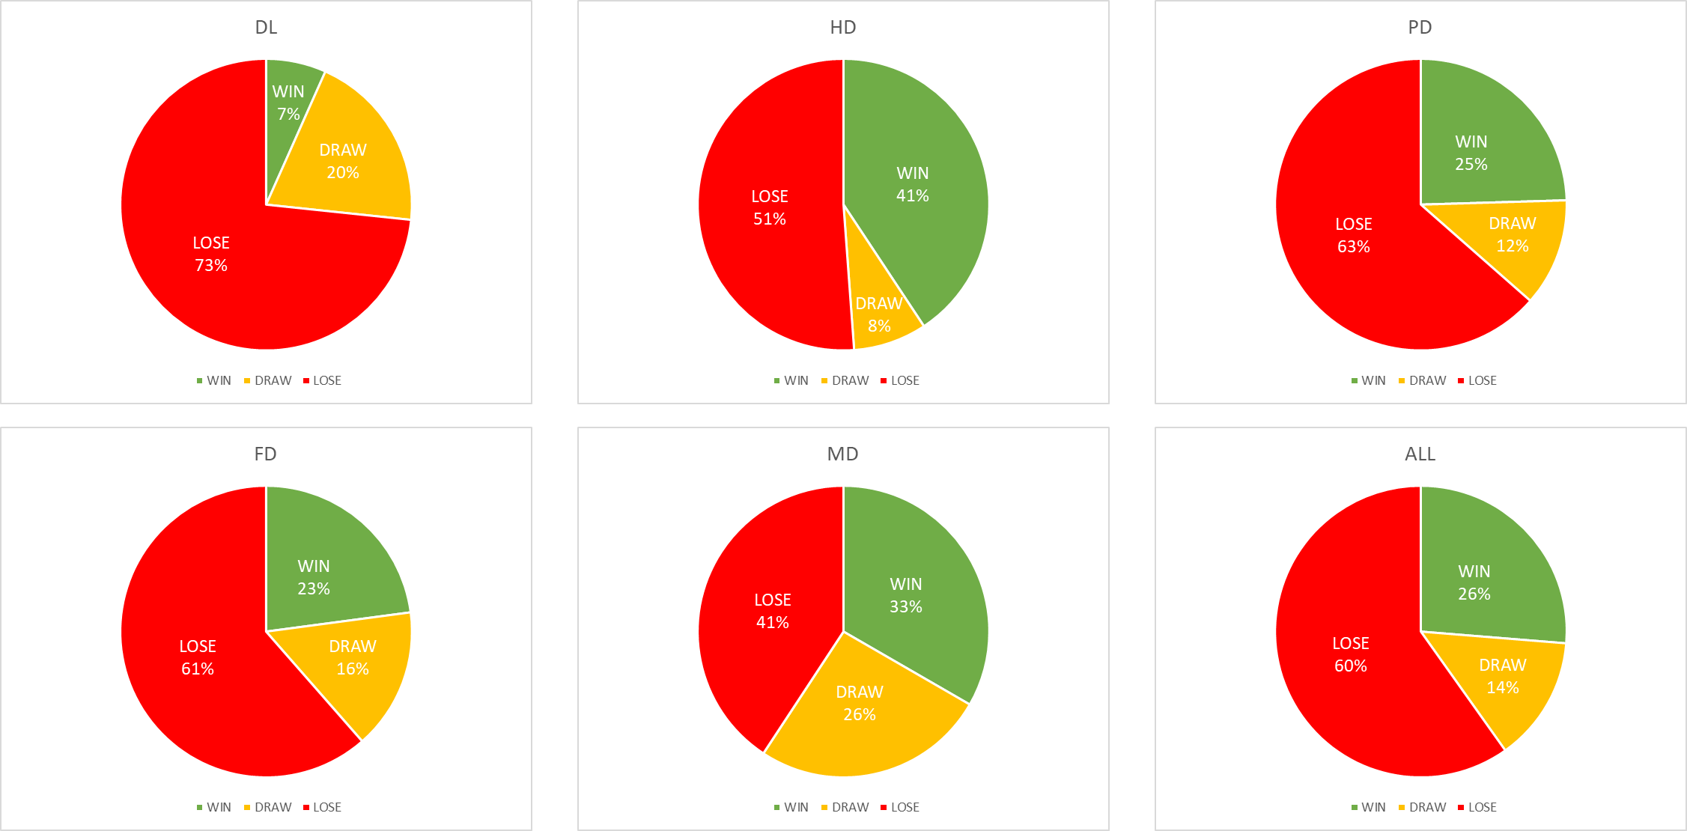
Different Defence Postures
Key observations
Hasty Defence has the most wins (41%), but fewest draws; it is ‘brittle’
Mobile Defence has the fewest losses (41%), but the most draws
Prepared and Fortified Defences have higher probabilities of loss (63% and 61% respectively)
Delay has the worst outcomes of all … known to be the hardest mission

Slide 16
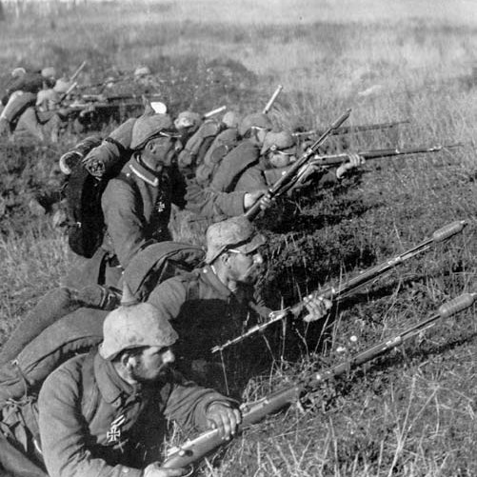
The Curious Case of Hasty Defence
Hasty Defence is not the posture of choice …
  but a defender must expect it, and thus prepare for it the most
    in leadership and flexibility …
  the attacker is having a hard time as well!
Must address ‘operational porosity’ challenge
  there will be local setbacks and penetrations
  counterattacking can manage them
Hasty Defence destroys attacker momentum
  reducing their ‘first-mover advantage’

Slide 17
How Should a Force Prepare for Defence?
Be diverse in strengths and skills
  don’t focus all energy on improving just one or two areas
Don’t let the attackers dominate in these key areas:
  air superiority, morale, ground force technology, logistics
Defenders benefit from advantage in these key areas:
  leadership, ISTAR, training, and logistics
Don’t need to be the best at everything to win!
Notes:
Explanation in commentary: since there is also the ‘draw’ result, the factors that correlate with attacker advantage don’t exactly mirror those that correlate with defender disadvantage. Air superiority, for example, appears to be more important for attackers than for defenders.

Slide 18

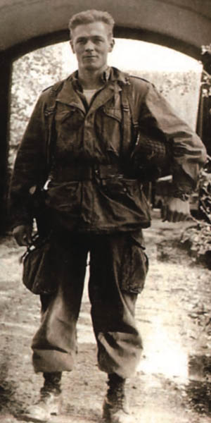
Closing Thoughts: Can Numbers Enhance the Narrative?

Slide 19
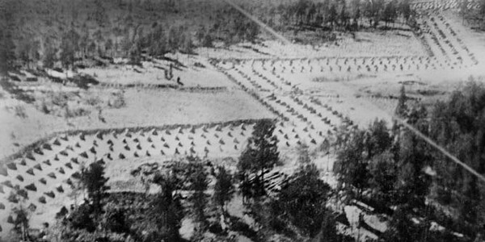
Questions?
Notes:
The Finnish Mannerheim Line, 1939 (Wiki Commons)

