Slide 1
World War 2 Operational Research revisited
Exploring the work of RAF Coastal Command
OR Section in the Battle of the Atlantic
John Magill
ISMOR 2023
Session: Leveraging Historical Analysis

Slide 2
World War 2 Operational Research revisited
(and updating)
Exploring the work of RAF Coastal Command
OR Section in the Battle of the Atlantic
John Magill
^
Part 2: Attacking the U-boats

Slide 3

Leveraging Historical Analysis
“It is better to be wise after the event than not wise at all, and wisdom after one event may lead to wisdom before another.” -- John C. Slessor (Air Power and Armies, xiii)
Real scenarios – “it’ll never happen” (again)
Constants: Decisions, judgements under uncertainty:
where statistics meets psychology

Slide 4


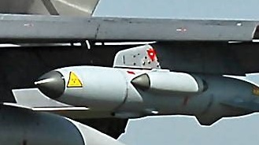
Who am I
john.magill@cantab.net
long … career in Aerospace and Defence
worked in Systems Engineering and OR/OA for 40 years
hold half a degree in OR
started out as a real engineer, can drop things on your toes
Notes:
4

Slide 5



Why am I so interested
70’s revelations on TV and print
  met Prof RV Jones at College
Started my career on defence systems at Marconi Stanmore
Distinguished relative was in RAF Coastal Command
  flew Harry Hopkins to meet Stalin July 1941
      via North Cape to Archangel
  Round-the-world and Arctic flights
  AOC Malta
  Air Vice Marshal David McKinley
Notes:
5
He started in coastal comm – may have moved out.
Harry hopkins – roosevelts rep - already dying of cancer
Had been in London during blitz and now wanted to size up stalin, after barbarossa – eg lend lease
Flew Invergordon to Archangel, (slow) Catalina 125 mph – at mercy of LR fighters Ju 88, but resolved to dive to sea level if attacked (maybe to avoid being attacked from below)
Also Xmas island tests
Left aged 54, reported spat re TSR2, he was against.
Harry

Slide 6
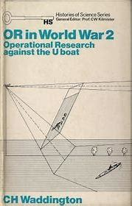
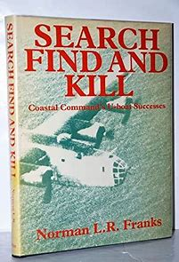
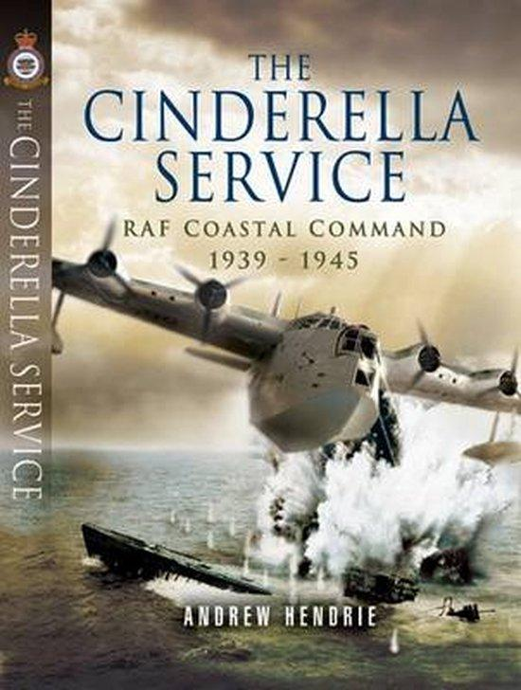

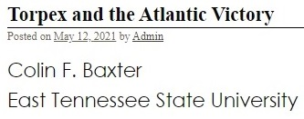
Source material
Notes:
6
Zoologist/ geologist – polymath, understand variation
Books difficult to get hold of, but I managed it
Other book impossible – not been written printed yet
OR Soc project, maybe re-energise?
Also a pt3 proposed – OR in the post cold war, COIN etc.

Slide 7
Contents
Introduction
Scenario
The U-boat Sighting Problem
Attacking U-boats:
  depth charge problems
  bombs
Conclusions
Notes:
7
Model based approach - “theory driven” sounds like “of no practical use”
Data-driven sounds great – even if you proceed “blind”

Slide 8
Famous person quote
“…the submarine has been mastered”
Winston S Churchill
March 1939

Slide 9
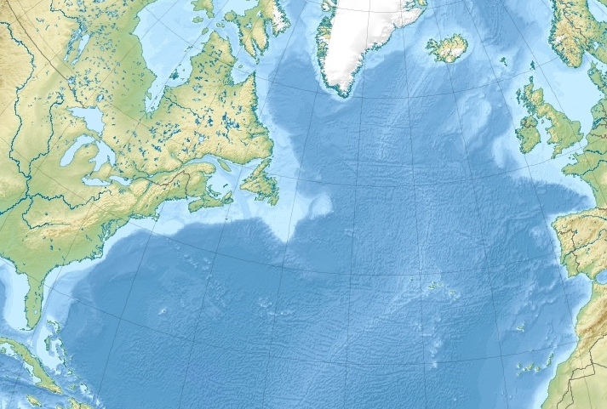
Scenario: Battle of the Atlantic
Notes:
9
This audience wont need to be told…
But, epoch – early days, Blackettonly just at CoaCom
U bt as submersibles – good tactic is to make em dive repeatedly

Slide 10

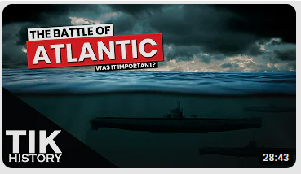
Battle of the Atlantic: 80 years on
Notes:
10
This audience wont need to be told…
But, epoch – early days, Blackettonly just at CoaCom
U bt as submersibles – good tactic is to make em dive repeatedly

Slide 11
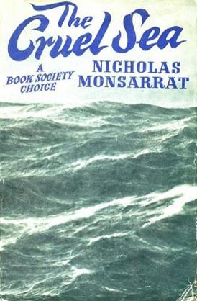
Scenario: Battle of the Atlantic
Need to secure routes across Atlantic
Convoys of merchantmen and escorts, vs
U boats:
  Submarines/submersibles – limited speed and endurance under water
Epoch May 1941:
  before Barbarossa, Pearl Harbor, Schnorkel
  U boats would dive as soon as they see aircraft
RAF aircraft flying around not seeing very much
Tasks:
  Find U boats: Visual sighting; ASV Radar; HF DF; Intel
  Destroy/ Deter U-boats: Force to dive; attack
Notes:
11
This audience wont need to be told…
But, epoch – early days, Blackettonly just at CoaCom
U bt as submersibles – good tactic is to make em dive repeatedly

Slide 12
U-boat diving status when spotted
wake
Sighted by aircraft
Surfaced 40%
-------------------------------------------------------------------------------------------------------------
swirl
Diving 40%
Periscope 20%
Periscope 20%
Saw aircraft early, dived and got away unseen
Alert sub lookouts
Dozy sub lookouts
Notes:
Assuming U boat dives when sees aircraft: 25-45s

Slide 13
The U-boat sighting problem: “Search and Find”
Why are we not seeing as many U boats as we expect?
We know roughly how many there are out there:
  Intel, Enigma, HF DF (shore and ship-based)
are they running submerged?
or diving when they detect aircraft approaching
  Visually or other means?
  (Germany did experiment with Radar and Radar Warning Receivers later)
In many cases, the U-boat was already diving when seen… so maybe they saw the aircraft first…
Notes:
13

Slide 14
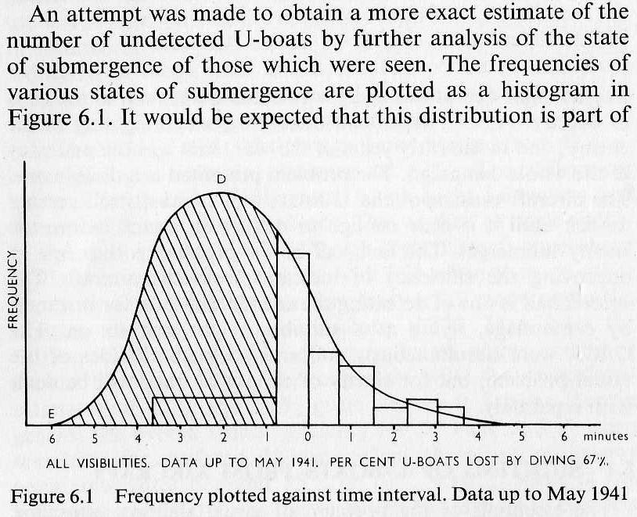
Waddington’s account
U-boat sees aircraft first
U-boat sees aircraft first and is diving when seen
U-boat sees aircraft first and dives before being seen
Aircraft sees U-boat first
Notes:
14

Slide 15

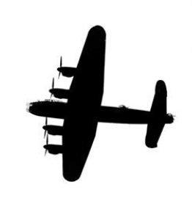
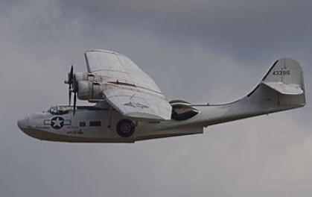
So...what to do?
Blackett recounts…
  A Wing Commander asked, what colour are our aircraft?
  mostly (night) bomber types, painted black to reduce visibility to searchlights...
  ...but stand out against a daylight sky
So, painting the undersides white:
  Reduced detection range (of the aircraft by the U-boat) by ~20%, and
  Increased attack rate by ~30%
Notes:
15
No presn to OR soc complete without mention of Blackett. Tho I’d also mention Plackett, of stats fame, Plackett & Burman, AAA

Slide 16
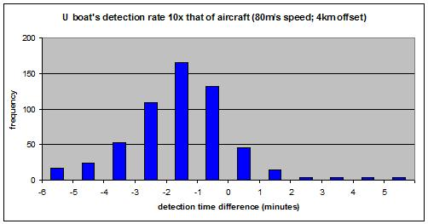
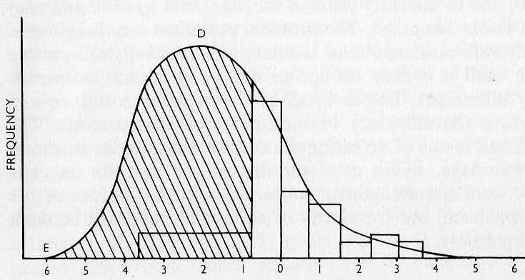
Matching the outputs
U-boat takes <1 minute to dive
U-boat “missed” if it sees first by >45s (yellow line)
Need to increase U-boat’s detection rate significantly before comparable results are obtained
Notes:
16
16
Lets see how far we have to go to reproduce the values based on experience/ best fit model. - about factor 10.
After all, have several indep ests of how many there are, the data fit is only 1
And the sub adv side tails off rather slower, as expected
Should be good deterrent effect to be seen, as long as you’re still regarded as a threat

Slide 17
“Kill”
Notes:
17

Slide 18
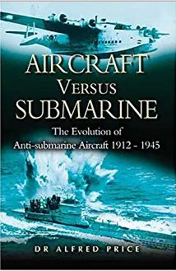
Attack U boat from the air
Bombs
  Initially more dangerous to the aircraft than U boat
Depth charges
  only ones immediately available were ship-launched types, set for 100ft
  Escorts would attack a surfaced U boat with gunfire or ramming
  450lb, size of (old) dustbin, few Coastal Command aircraft could carry them, need low altitude and low speed release
  250lb variant cleared for air drop May 41
  Lethal radius thought to be about 20ft
Notes:
18
Naval DCs – 100ft cos need to get ship clear (takes time to sink), get the pressured pistols to work. well tamped, doesn’t vent into atmosphere (as in the movies)

Slide 19
“Stick” of DCs
Plan view

Slide 20
Beam attack
Plan view

Slide 21
Track attack
Plan view

Slide 22
“Straddle”
Plan view

Slide 23
Ship-launched pattern
-----------------------------------------------------------------------------------------------------------------------------

Slide 24
OR Section looked at
Depth settings of charges
Number and size of charges dropped
  Subject to overall weight constraints
Length of stick; stick spacing
Accuracies
Attack bearing: beam/track
“Depth Bombs” vs “Depth Charges”
  Differences in release height, safety of aircraft
  Aerodynamics, hydrodynamics, fuzing
  Direct hits – DCs liable to break up
Notes:
24
Also the pistol fuses, no venting into atmosphere
How many feet can a uboat dive in 60 seconds?
Wiki User
∙ 14y ago
Study nowSee answer (1)
Best Answer
Copy
Most U-boats of WWII were physically capable of diving to maximum depths of around 150-160 feet, although they seldom ventured that deep unless in an emergency. They could attain this depth in approximately 60-65 seconds. Advanced designs in hull reinforcement, mainly pioneered by Germany made this possible. The modern military submarines of today have hull-crush depths of closer to 1,500 feet and that number is growing with advances in technology all the time. These kinds of depths take much longer to reach, depending on dive rate, but can take in the region of 20-45 minutes. (Exa

Slide 25
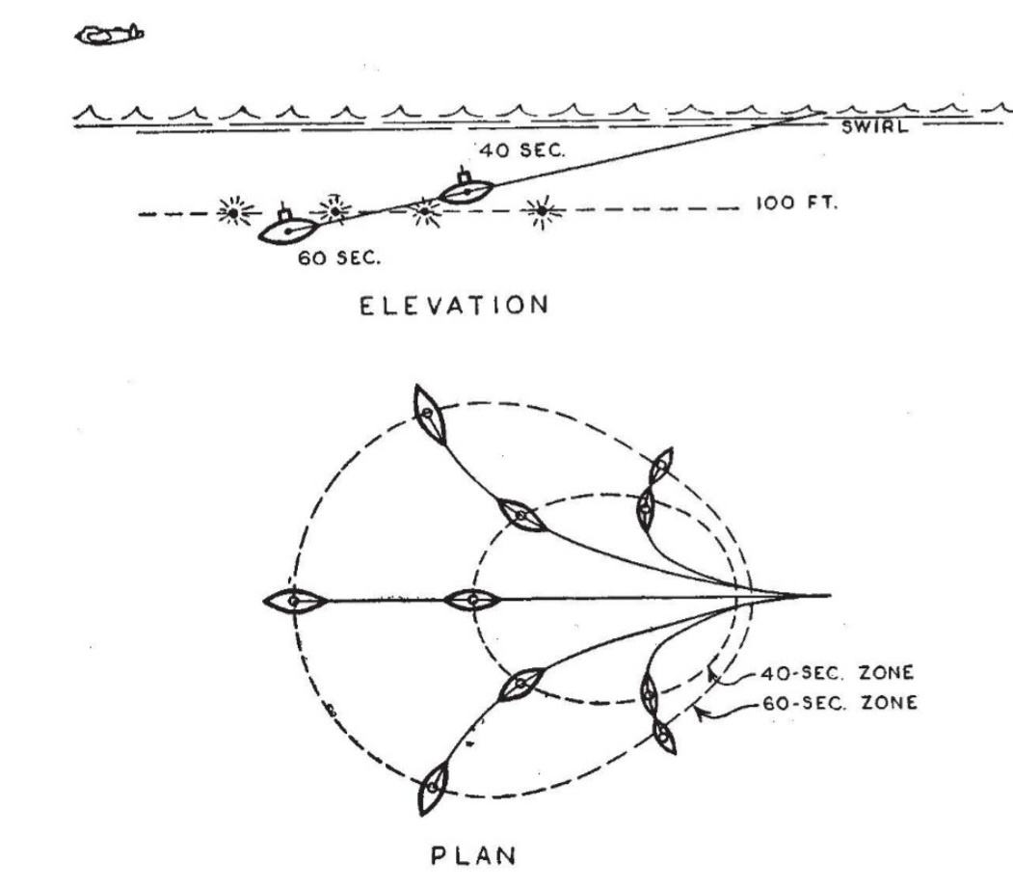
The Depth Charge depth-setting problem
Coastal Command initially assumed that (on average) a U boat would see aircraft a few km away, ~2 mins before the attack came in
  would immediately dive (<1 min)
  dive (at 2 ft/sec) to ~100 ft
  So 100ft was an appropriate setting
  Good “tamping”: depth charges more effective at depth, and underneath the target, other things being equal…, like, that’s where the U-boat was...
Notes:
25
Also the pistol fuses, no venting into atmosphere
How many feet can a uboat dive in 60 seconds?
Wiki User
∙ 14y ago
Study nowSee answer (1)
Best Answer
Copy
Most U-boats of WWII were physically capable of diving to maximum depths of around 150-160 feet, although they seldom ventured that deep unless in an emergency. They could attain this depth in approximately 60-65 seconds. Advanced designs in hull reinforcement, mainly pioneered by Germany made this possible. The modern military submarines of today have hull-crush depths of closer to 1,500 feet and that number is growing with advances in technology all the time. These kinds of depths take much longer to reach, depending on dive rate, but can take in the region of 20-45 minutes. (Exa

Slide 26
The depth-setting problem (2)
Ineffective tactic:
  If U boat had dived to 100ft, aircraft has little idea of plan position, so drops charges to explode at right depth but in wrong place
  If near surface, drops in right place but explode at wrong depth
  Pk about 1/1000 for a lethal radius of 20ft
  Even 15s out of sight after diving often enough to protect sub
ORS suggested more effective to concentrate on the “better” targets caught near the surface and attack with shallow-set charges
  Expected to improve lethality by factor of 10
  Also good idea to use the most energetic explosive
Recommendations accepted, mid 1941
Took a while to be implemented
Notes:
26
Was EJ Williams, not Goodeve

Slide 27
Lethality of attacks
BDA/Lethality hard to assess
Still disappointing (~15%) by mid 1942 even with 25ft depth setting and Torpex filling
ORS:
Accuracy is paramount:
keep practising.
Or maybe drop more, but smaller bombs, to fill in the “gaps” in the stick?
Pilots/ Air Staff:
We’re scoring “straddles”.
Maybe 250lb charge not big enough
How about 600lb depth bomb?

Slide 28
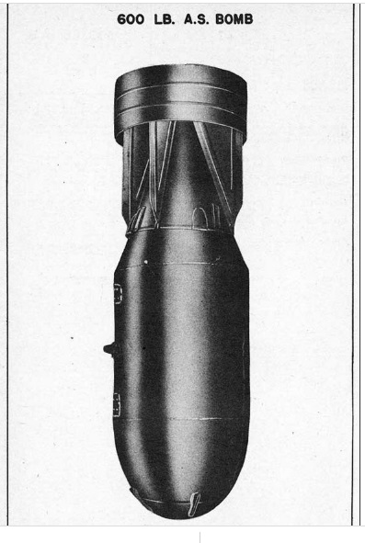
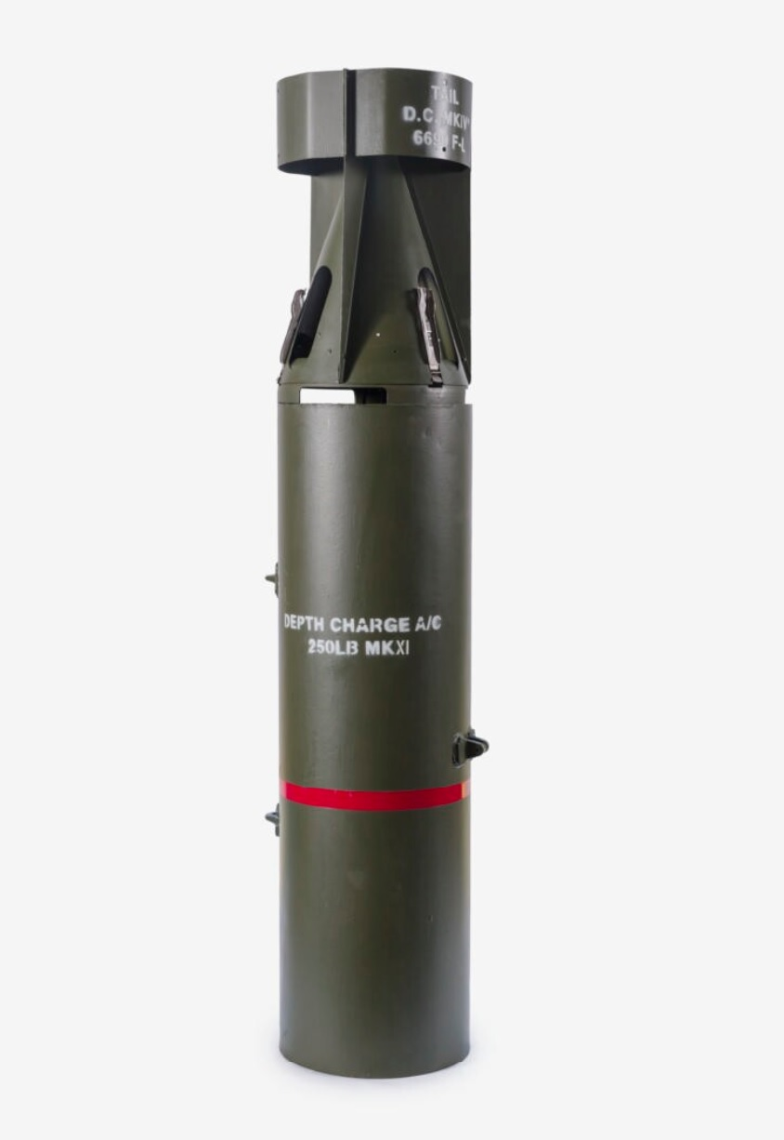
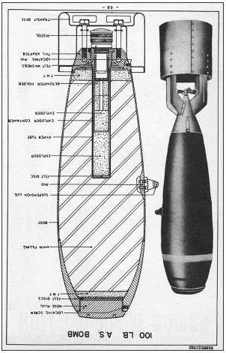
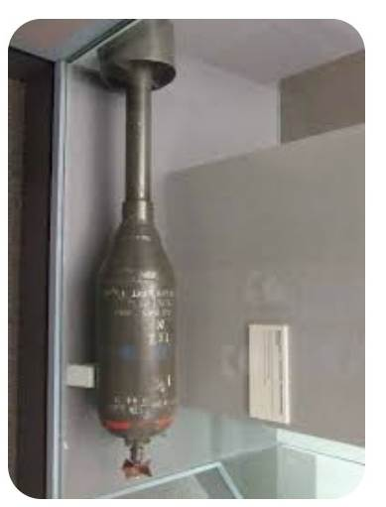
Contenders
600lb
250lb
100lb
35lb

Slide 29

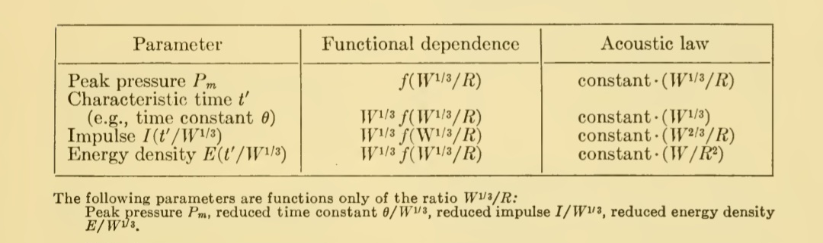
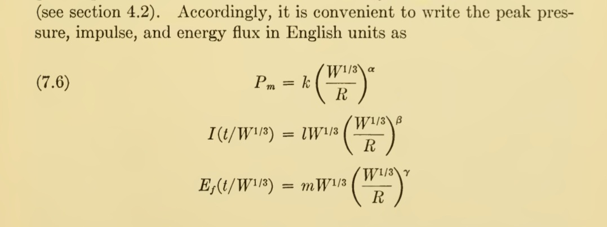
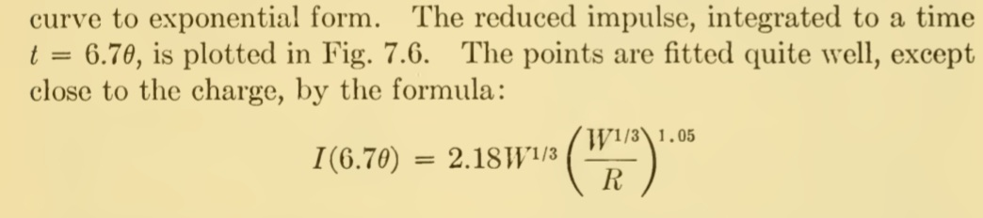
So, what do we know…

Slide 30
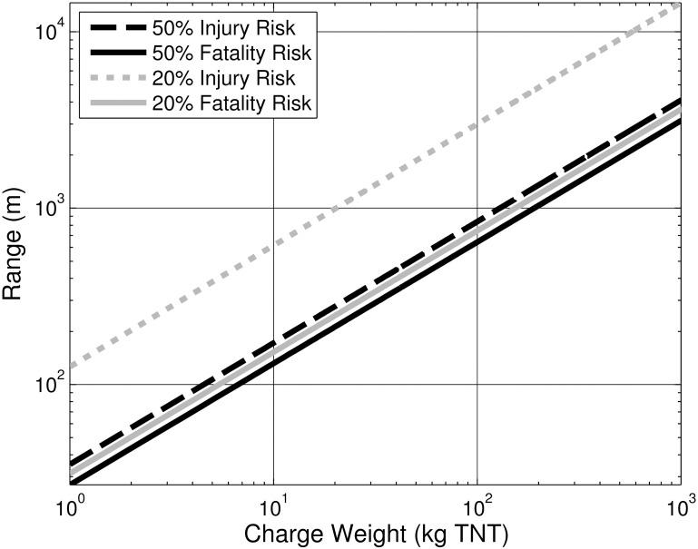
Charge size vs effective range
Choose Integrated Impulse as damage mechanism
“constant damage distance” goes as charge size W ^0.7
Human vulnerability…

Slide 31
So, a few big or many small?
Radius of constant effect
W
W/2
W/2
R
0.62 R
0.62 R

Slide 32
Reconciling the views
US naval board study 1936: “600lb charge better than 2x 300lb charges”
March 42: Admiralty Standing Committee on ASW claimed “stick of 250lb DCs more effective than equivalent weight of 500lb”
May be naval/aerial charge differences:
  Dimensionality of the respective problems
  Accumulated damage vs lucky hits
Decision was made to keep the 250lb depth charge while developing other, both heavier and lighter, options
Rockets and acoustic torpedoes - another day

Slide 33
Conclusions
Choice of weapons took a number of turns
Bombs
  Initially tended to be more dangerous to aircraft than U boat
  600lb Depth Bomb showed some utility towards end, but only credited with sinking 1 U-boat (U-462)
Depth charges
  250lb turned out to be a good, robust solution: just needed to be dropped accurately
  Rivals to the standard 250lb DC were developed, but entered service too late to be decisive; some lack of robustness to attack direction
=> Make best use of existing equipment before rushing to replace!
Notes:
33

Slide 34
End
Notes:
34
34

