Slide 1
Historical analysis of urban combat casualties and loss rates
Paul R. Syms, Dstl Platform Systems Division
40th International Symposium on Military Operational Research
DSTL/CP150990/1.0
Notes:
Abstract
The UK’s Land Warfare Centre (LWC) tasked Dstl with researching expected casualty rates in high-intensity warfighting, particularly in urban operations (otherwise known as fighting in built-up areas, or FIBUA), to inform casualty evacuation (Casevac) and medical treatment planning for Headquarters, Allied Rapid Reaction Corps (HQ ARRC). Legacy data from existing UK and US studies were reviewed, most of which rested on Second World War (WW2) battle data. A new dataset of 43 WW2 and post-WW2 urban battles was assembled, together with a similar dataset of 102 rural battles for comparison, starting with the updated Helmbold Database, and researching additional battles where necessary. Comparing these statistically confirmed that FIBUA favoured the attacker, and that this conclusion held for more modern combat as well as for WW2. The loss rates for forces engaged in urban and rural combat under different circumstances and for different organisational levels are calculated, as are the expected splits between losses that are killed in action (KiA), wounded in action (WiA), prisoners of war (PoWs). The implications for medical planning and for FIBUA doctrine, tactics, and training are discussed. (O)

Slide 2
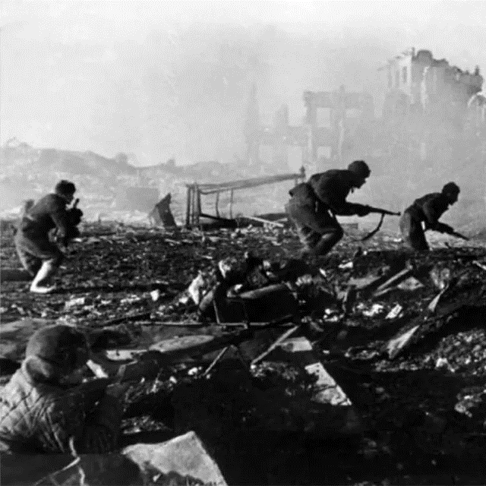
Topics
Introduction and background
Review of urban casualty and loss studies
Building new urban and rural data sets
Comparing urban and rural battles
The results in context
Conclusions
Questions?
UK OFFICIAL
Notes:
(Not much fun in Stalingrad.)

Slide 3
Background to project
Dstl supports the OR Branch of HQ ARRC
including planning data, wargames, and staff exercises
Recent exercises have a significant urban (FIBUA/MOUT) component
routinely include medical logistic planning
recognised that expected casualty rate data are old
FIBUA data in particular were derived from WW2 analysis
All quantitative FIBUA casualty analysis dates from 1980s–2000s
DOAC (UK) and TDI (US) exclusively using WW2 data …
is the analysis still valid?
Robustness: can counter-intuitive conclusions be repeated?
Value in confirming previous analysis independently
Notes:
FIBUA: fighting in built-up areas, = mounting operations in urban terrain (MOUT, US); I was brought up in the Cold War!

Slide 4
Review of previous studies
UK WW2 HA from the 1980s showed attacking was easier in FIBUA
attack took fewer losses, defence took more
difference approximately a factor of two in LER
but urban battles took longer: rubble, and shorter tactical bounds
Urban defenders took more losses as PoWs
US (TDI) HA in 2002 confirmed UK result
again using WW2 data – attacking is easier into urban terrain
UK studies appeared to show differences in W:K ratios …
but confounded by P(win) effects; needs further investigation
Historical DoW statistics collected, showing gradual improvements
Notes:
LER: Loss exchange ratio, being attacker losses divided by defender losses.
DoW(s): Died of wounds, i.e. after entering the medical logistic system.

Slide 5
Building new urban and rural data sets … 1
Customer focus at brigade level (US regiment in WW2) and below
also, ‘pure’ urban battles only tend to happen at lower levels
Started with Helmbold database (1991) and Goodman & Young (1996)
insufficient urban battles post-WW2 particularly
and needed a comparable sample of rural battles
for forces in attack and defence
matched for combat echelons
Researched 213 military forces fighting in 145 unique battles
43 urban battles, 102 rural
from 1943 to 2008
Notes:
As always, much of the effort in HA went into collecting and cleaning the data. Care was also needed with nomenclature: in the US and German Armies of WW2, a regiment was a multi-battalion formation, equivalent to a British and Commonwealth brigade. (In the US Army, a regiment was commanded by a full colonel, in the German Army by a full colonel or often a Generalmajor, and in the British Army by a brigadier-general, later shortened to brigadier.)

Slide 6
Building new urban and rural data sets … 2
Assembled data on 47 unique WW2 battles
22 urban, 25 rural
Assembled data on 98 unique post-WW2 battles
21 urban, 77 rural
Mostly from NW Europe and Middle-East
avoided WW2 Far East and Pacific theatres
Canadian battle of Ortona (in Italy, 1943) yielded four good data points
one at brigade, two at battalion, one at company
Data quality and cleaning were key to analysis
reliable casualty and loss data often available for one side only
previous HA studies did not document their data fully
Notes:
As noted in several HA studies, the determined nature of Japanese defences produced historically unique results, and these were excluded to reduce unwanted variability. There were also few well-documented FIBUA battles in the Far East and Pacific.
Because the study was addressing force-level statistics, rather than the characteristics of battles, for some purposes it was possible to use battles where high-quality loss statistics were available for one side only.

Slide 7
Casualty and loss types
Losses split into killed, wounded, and prisoners of war (PoWs)
a simplification driven by data availability (or lack of …)
Died of wounds
Wounded
PoW
WiA
WiA, PoW
Declared PoW
Killed
Known KiA
MiA
Deserters
Undeclared PoW
Unknown KiA
Notes:
This diagram illustrates the discussion on overlaps in casualty and loss statistics by Underwood (2006).

Slide 8
Durations of urban and rural battles
Urban battles take longer than their rural equivalents
but great variability, reflecting different forces and circumstances
durations in whole days
Very similar to previous DOAE (UK) and TDI (US) findings
using different data sets
Notes:
Some battle duration data were available as hours, but because the principal sources (Helmbold, and CORDA) used whole days, this was used for the present study. In reality it is often hard to know when a battle finished, particularly at brigade level, whereas many company-level battles were over in a few hours.

Slide 9
Winning and losing in town and country
Probability of attacker winning in urban and rural terrains
with a draw counting as 0.5
Findings highly statistically significant (0.1% level, Chi-squared test)
Confirms previous UK and US conclusions
again, using different data sets
Statistically significant for WW2 and post-WW2 data taken separately
a new result
Notes:
The WW2 result confirms previous HA, but makes it more robust, as it used a different method, and different data set (although there were significant overlaps); the post-WW2 result is new to science – you heard it here first!

Slide 10
Daily loss rates
Expected daily loss rates drive medical planning assumptions
greatly affected by P(win) and command level or echelon
as command level increases, proportion of forces engaged decreases
Brigade example:
Losses (unsurprisingly) much higher for losers
rates do not appear to have changed much since WW2
Notes:
This is an example of many such tables that were generated for each echelon, for winners and losers, in urban and rural terrains, for WW2 battles and post-WW2. In the event, the driving factors were the echelon, the posture (attack or defence), and whether the force won or lost, which was itself heavily influenced by the terrain.

Slide 11
Proportions of casualties killed and wounded
Wounded-to-killed (W:K) ratios for urban and rural battles
Reflects fact that P(win) differs between terrains
W:K ratios are always better for the winning force
W:K ratios are usually better for the attacker, as they own the ground
W:K ratios for attackers have improved since WW2
Notes:
The study review also presented data that have been accumulated over the years on died of wounds (DoW) statistics, which charted the gradual improvement from 10–20% DoWs in the nineteenth century to 1–4% today. This is from two factors: an improvement in casualty evacuation, especially from WW1 onwards, and improvements in combat medicine, such as surgery, blood transfusion, and antibiotics. However, it also depends greatly on what is counted as a wound.

Slide 12
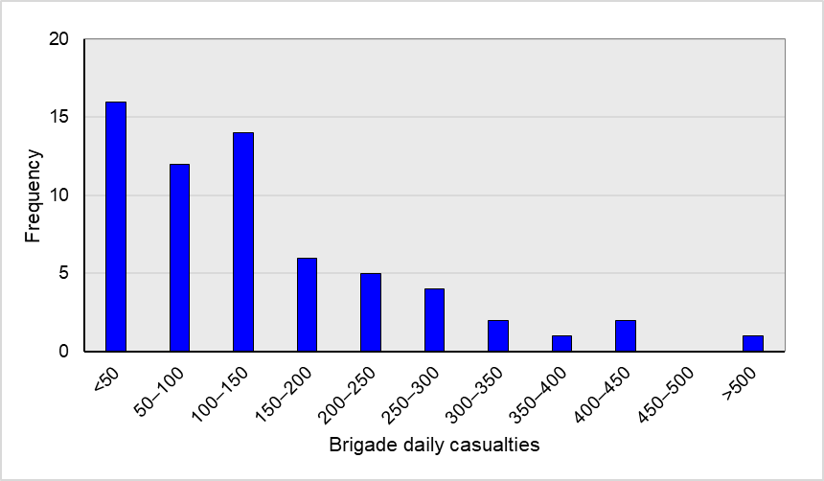
Brigade casualty rate spectrum
Daily combat losses at brigade command level
across all scenarios, because medical logs must cope with all cases
Highly skewed distribution
≈ log-normal
No ‘optimum’ capacity
A military choice
n = 63 rural and urban battles
Mean = 134
Median = 102
75%-ile = 195
90%-ile = 294

Slide 13
Proportions of casualties as prisoners
For urban defenders a median of 32% of losses were PoWs
compared with 8% for rural defenders
Largely due to defenders losing more often in urban
also probably affected by terrain
harder to withdraw
easier to become isolated in urban
Winners are usually responsible for wounded PoWs …
but as winners, are likely to have fewer friendly WiAs to treat
thus unlikely to raise average demand for medical service capacity

Slide 14
Results in context
Controlling for command level is important in HA
particularly in predicting casualty rate trends
split results by winning and losing … not done by previous UK and US HA
FIBUA characteristics have not changed greatly since WW2
and may not change radically in the future
Casualty treatment capacity is a military choice … no OR ‘optimum’
scaled for Blue force size; Red and White casualties unlikely to affect this
Implications for UK FIBUA doctrine and training
UK FIBUA training infrastructure needs review
more wargaming needed for training … as long as rules are realistic!

Slide 15
Conclusions
Urban battles last longer, on average, than their rural equivalents
Urban terrain favours the attacker
modern attackers typically sustain W:K ratios of 3.0–5.0
modern defenders typically sustain W:K ratios of 2.0–3.0
Attackers unlikely to sustain PoW losses, defenders 20–50% as PoWs
Casualty rate distributions are highly skewed, ≈ log-normal curve
Casualty and loss patterns have not changed greatly since WW2
validating and extending previous OR
UK forces should not seek to avoid attacking into urban areas
Notes:
Note that it is very hard to quote meaningful ‘expected’ results without quoting ranges; all the statistics in this study demonstrated great variability. While some of this will be due to data errors and approximations, much is down to uncontrolled variables and inherent real-world variability.

Slide 16
Some sources
GOODMAN R.C. & YOUNG M.J. (1996) ‘Predicting Success in Land Warfare at Operational Level’ Presentation to 13 ISMOR, Shrivenham, 3–6 September 1996; CORDA Ref. T1066
HELMBOLD R.L. (ed., 1991) Combat database version CDB91G
LAWRENCE C.A. & ANDERSON R.C. (2000) ‘Capture Rate Study, Phases I and II’ The Dupuy Institute (TDI), McLean, VA, report for CAA
LAWRENCE C.A. & ANDERSON R.C. (2002) ‘Measuring the Effects of Combat in Cities Phase I’ TDI report for CAA, contract ref. DASW01-98-D-0058
NICHOLSON G.W.L. (1957) ‘The Canadians in Italy, 1934–1945’ Volume 2, Official History of the Canadian Army in WW2, Queen’s Printer, Ottawa: 807 pp.
ROWLAND D. (1989) ‘Historical Analysis as Part of an Interdisciplinary Study’ Proceedings of the SCOHDA, US Army CAA, 19–21 July 1989
ROWLAND D. (1991) ‘The Effect of Combat Degradation on the Urban Battle’ J. Operational Research Society 42(7): 543–553
SYMS P.R. (2022) ‘Updating the Helmbold Land Battle Database’ Presentation to 39 ISMOR, Royal Holloway College, Egham, Surrey, 19–21 July 2022; DSTL/CP142393
UNDERWOOD R. (2006) ‘Estimating Casualty Numbers’ Presentation to 23 ISMOR, Southampton, 29 August–1 September 2006; DSTL/CP20991

Slide 17
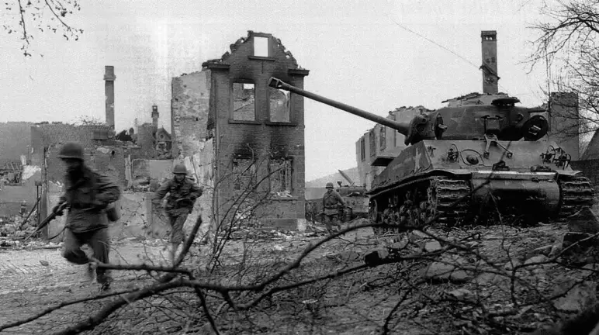
Questions?
Notes:
The US battle for Aachen, Germany, 1944

